Slide 1
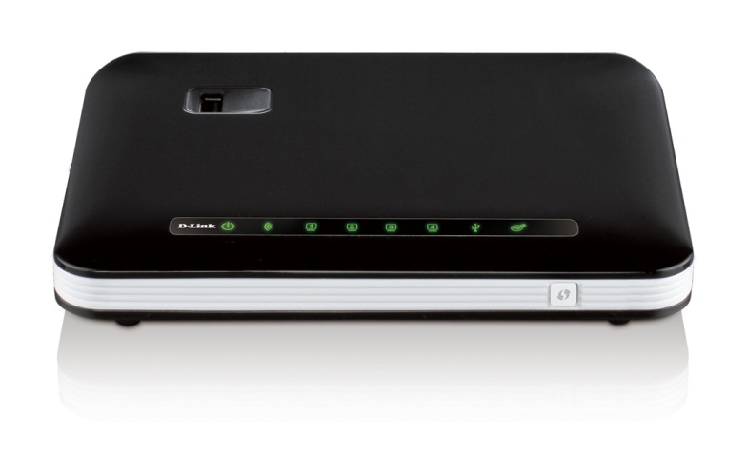
Sales guide for
Wireless 300N
3G Wi-Fi Router
DWR-112
MPD, kenny Hsieh 23th March, 2011
D-Link Confidential

Slide 2
DWR-112 Business Analysis
Model Description：
The DWR-112 is a WiFi 2x2 router, it supports 2USB ports, one for 3G adapter up to HSPA+ another one for Share Port that supports USB Flash or printer. The router features includes NAT, routing, firewall, VPN pass-through, WPS,auto-3G-dial-up backup connection, DHCP server..and so on. It is managed easily by web UI and UPnP. SPI firewall is embedded in the product, and packet filtering and access control were also implemented inside. It supports various connection approaches to ISP such as static IP, dynamic IP (DHCP client), PPTP, L2TP, PPPoE and 3G. It is also compliant to IEEE 802.11n/b/g standard for WLAN Features..
.
Target Market：
  Especially aims in the areas that lacks last –mile connectivity as well as the customers in other regions market who searches for Share Port and low priced 3G router.
Product Position：
  3G router to share mobile broadband network and ADSL/Cable/FTTH broadband service via high-speed WiFi access
  Most 3G card compliance to meet different 3G networks compatibility , EVDO, WCDMA, HSDPA , HSUPA, TDS-CDMA.
Notes:
2

Slide 3
Selling Points
Share Network with your friends via high-speed Wi-Fi 300N (11n 2x2) connection
NAT, routing, firewall, VPN pass-through, WPS,auto-3G-dial-up backup connection, DHCP server
Secure and Private network access via PPTP, L2TP and connection and VPN pass through as well
WPS Support
WMM Support
2 USB port :3G adapter and Share Port
4 x LAN or 1 WAN/ 3LAN
IPv6 Support

Slide 4



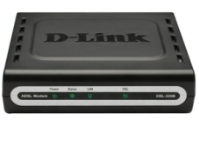

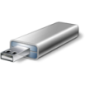
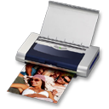

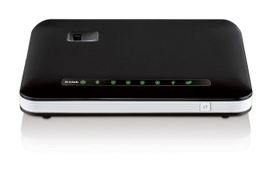




DWR-112 Application Diagram
Cable/ADSL/FTTH
modem
  Internet
  xDSL Modem
3G/2G
1. Ethernet port connect to Cable/ADSL/FTTH modem(1Wan /3 Lan)
2. Use 3.5G USB adapter connect to mobile station(4 Lan )
3. Share Port supports USB Flash or printer

Slide 5
DWR-112 Specification
  IEEE 802.11b/g compliant and 11N 2x2 (2Tx2R)
    Backward compatible to IEEE 802.11b standards
    Max physical rate up to 54Mbps in 802.11g mode
    Max physical rate up to 300Mbps in 11N mode
    Security Supports: WEP (64/128 bits), WPA, WPA2, WPA-PSK, WPA2-PSK
    WPS Support
    ➢WMM Support
  Provide 4 x 10/100 RJ-45 ports
    1 x WAN /3x LAN(Wan mode)
    4LAN(3G mode)
  WAN connection through external USB 3G/3.5/3.75G adapter
    WCDMA, HSDPA, HSUPA, HSPA+
    CDMA2000, EV-DO
    TD-SCDMA, TD-HSDPA
  Built-in NAT function: one IP sharing with PCs
  Built-in firewall to protect your Intranet
  IPv6

Slide 6
DWR-112 Specification
  2 USB port : Supports 3G adapter and Share Port
  VPN pass-through supported
  Easy to upgrade firmware
    Web UI
  Easy to manage:
    Web UI
    SNMP
    UPnP
  L3/L4 QoS
  Network Protocols
    UDP/TCP/IP/ARP/RARP/ICMP
    DHCP/PPPoE
    DNS/TFTP/HTTP
  Antenna
    2 Internal antenna

Slide 7
Thank you

