Slide 1
DAP-3520
AirPremier N PoE Exterior Access Point
D-Link Confidential

Slide 2
Agenda
Product Competition Overview
  Product Position
  Technology Briefing
  802.11n Access Point Portfolio
Product Application Guide
Competitive Comparison & Analysis
  Product Position/Main Competitors
  Key Comparison
  Art of the War
Appendix: Outside test for 11n and 11g
Notes:
2

Slide 3
Product Competition Overview
Positioning Highlights
The AirPremier N PoE Exterior Access Point,DAP-3520 is the first D-Link 11n exterior AP, which embedded dual band directional antennas, can provide high speed point to point connection for outdoor application.
The exterior AP can be set as AP,WDS,WDS with AP and Wireless Client mode for user to deploy wireless network.
DAP-3520 also support advanced features such as Multiple SSID, QOS and WLAN scheduler for business class environment.
With D-Link Management Tools AP Manger II, and D-View, administrator can centrally manage D-Link business APs.
Support MAC ACL, WPA/WPA2 Enterprise and WLAN Partition to increase the wireless security.
Model | DAP-3520
H/W config | 1 Giga PoE Lan Port 5GHz/2.4GHz 802.11n Selectable Dual Band Embedded Dual Band Antenna (8dBi for 2.4GHz/10dBi for 5GHz ) Two RP-N connector for optional antennas IP65 weatherproof housing
3
Notes:
3

Slide 4
Product Competition Overview
D-Link Technology Brief
2.4 / 5.0 GHz Selectable Dual Band Exterior AP
－ Support 802.11 a/n or g/n for different application, deployment.
－ IP65 certified (Weatherproof)
Enhanced Performance
－ Up To 300Mbps Faster than standard 10/100Mbps wired connection
Embedded Dual Band directional antenna
－ Internal dual band directional antennas for outdoor peer to peer connection
Flexible to Meet Different Requirements
－ AP、WDS、WDS with AP and Wireless Client Mode
Multiple-SSID/VLAN support
－ Support Multiple-SSID in AP Mode and Multiple-SSID over WDS
－ Supplement with VLAN for network segmentation
Total Network Security and Access Control Function
－ Support WEP、WPA-Personal/Enterprise、WPA2-Personal/Enterprise
－ Provide MAC Filter and WLAN Partition
－ Support Microsoft Network Access Protection (NAP)
Easy to Management
－ Support Web, Telnet, SSL, SSH, D-View, APMII.
4
Notes:
4

Slide 5
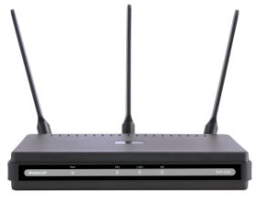
Product Competition Overview
802.11n Access Point Portfolio
Indoor
Outdoor
DAP-3520
DAP-2590
2.4/5GHz Selectable Dual Band
802.3af PoE
Embedded Dual Band Directional Antenna
Four operation mode
Support APMII、D-View 6.0
IP65 certified
Weatherproof housing design
2.4/5GHz Selectable Dual Band
802.3af PoE
Three Dual Band Antennas
Support APMII 、D-View 6.0
Four operation mode
Rugged Metal Chassis
Plenum-rated Housing
Feature
DAP-2553
2.4/5GHz Selectable Dual Band
802.3af PoE
Three Dual Band Antennas
Four operation mode
Support APMII、D-View 6.0
P r i c e
5
5

Slide 6
Agenda
Product Competition Overview
  Product Position
  Technology Briefing
  802.11n Access Point Portfolio
Product Application Guide
Competitive Comparison & Analysis
  Product Position/Main Competitors
  Key Comparison
  Art of the War
Notes:
6

Slide 7
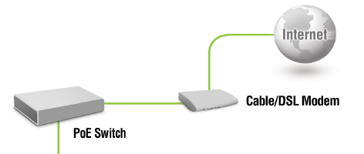
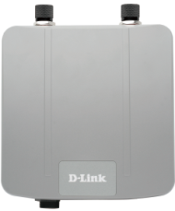
Product Application Guide
Application Diagram – Access Point Mode
DAP-3520
Wireless PCs using the DAP-3520
as a central connection point
7
Notes:
7
In Access Point mode, the DAP-3520 acts as a central connection point for any computer (client) that has a 802.11n or backward-compatible 802.11b/g wireless network adapter and is within range of the AP. Clients must use the same SSID (wireless network name) and channel as the AP in order to connect. If wireless security is enabled on the AP, the client will need to enter a password to connect to the AP. Multiple clients can connect to the AP at the same time in Access Point mode.

Slide 8


Product Application Guide
Application Diagram – WDS Mode
DAP-3520
DAP-3520
LAN 1
LAN 2
Connecting two separate LANs together through two DAP-3520
1.Wireless PCs cannot access the DAP-3520
2.Optional external high gain antenna can be used for long distance connection
8
Notes:
8
In WDS mode, the DAP-3520 wirelessly connects seperate LANs that can’t easily be connected together with a cable. For example, if there are wired LANs separated by a small courtyard, it would be expensive to bury cable between the two sides. A better solution is to use two DAP-3520 units to wirelessly connect the two LANs. In Bridge mode, both DAP-3520 units do not act as APs.
Note: WDS Mode is not completely specified in Wi-Fi or IEEE standards. It can only work using other DAP-3520 units. Communication with other APs (even other D-Link APs) is not guaranteed.

Slide 9

Product Application Guide
Application Diagram – WDS with AP Mode
DAP-3520
DAP-3520
LAN 1
LAN 2
Connecting two separate LANs together through two DAP-3520
(Wireless PCs can access the DAP-3520)
9
Notes:
9
WDS with AP mode is the same as WDS mode, but it also acts as an AP. Clients with wireless network adapters can wirelessly connect to the AP and then connect to the other LAN that the DAP-3520 bridges to.
Note: WDS with AP Mode is not completely specified in WiFi or IEEE standards. It can only work using other DAP-3520 units. Communication with other APs (even other D-Link APs) is not guaranteed.

Slide 10
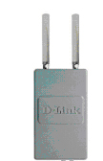
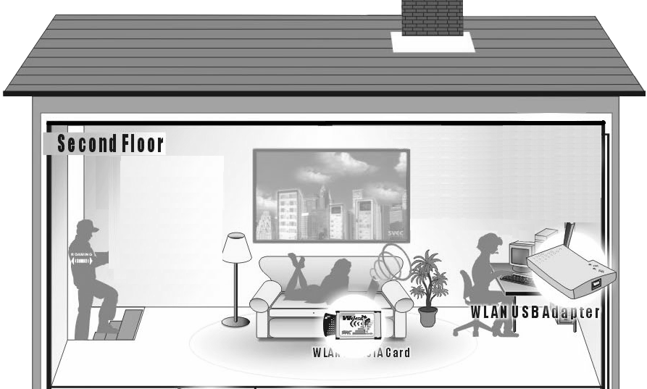
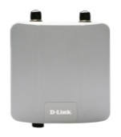
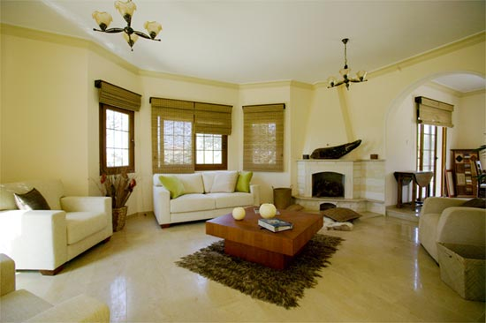

Product Application Guide
Application Diagram – Wireless Client mode
Outdoor AP
DAP-3520
Using DAP-3520 as a wireless interface
to access internet
Notes:
In Wireless Client mode, the DAP-3520 acts as a wireless network adapter for your Ethernet-enabled device (such as a game console or a TV set-top box). Connect your Ethernet-enabled device to the AP using an Ethernet cable.

Slide 11

Appendix: Outside test for 11n and 11g
100m~1500m
Use WDS mode running Chariot to test throughput
Throughput (Mbps)
Distance

