Slide 1
UNIFIED WIRELESS NETWORK
Controllers: DWS-3160 / DWC-2000 / DWC-1000
Access Points : DWL-2600/DWL-3610 / DWL-6600 / DWL-6610 / DWL-6700 / DWL-8600 / DWL-8610/ DWL-8710

Slide 2
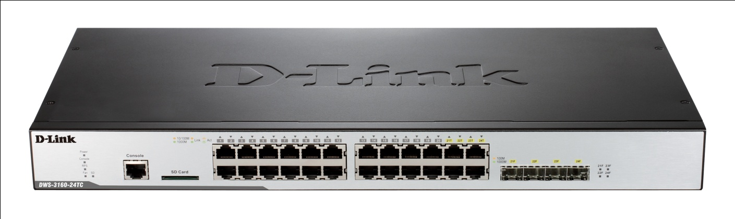
D-Link Unified Wireless Solution
DWS-3160 Series
DWS-3160-24TC Wireless Switch
24 Gigabit ports
4 Combo SFP Slots
Can Manage upto 48 Aps
Expandable up to 4 peer with 192 APs
Support WIDS

Slide 3
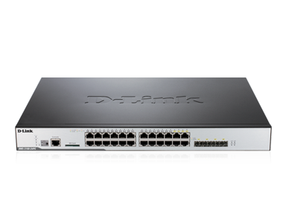
D-Link Unified Wireless Solution
DWS-3160 Series
DWS-3160-24PC Wireless Switch
24 Gigabit PoE ports
4 Combo SFP Slots
Can Manage upto 48 Aps
Expandable up to 4 peer with 192 APs
Support WIDS

Slide 4
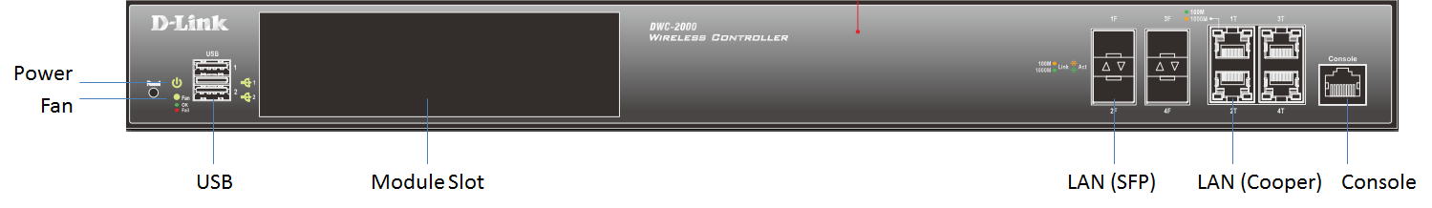
D-Link Unified Wireless Solution
              DWC-2000 Wireless Controller
4 Gigabit Copper / SFP combo ports 2 USB 2.0 ports
Optional Module Slot
Can Manage up to 256 APs
Expandable up to 8 peer supports upto 1024 APs
Support WIDS , Guest Management

Slide 5
D-Link Unified Wireless Solution
        DWC-1000 Wireless Controller
 | 4 10/100/1000 Mbps LAN ports
 | 2 10/100/1000 Mbps option ports
 | 2 USB 2.0 ports
 | Can Manage upto 66 APs
 | Expandable up upto 264 Aps with 4 peer DWC-1000 wireless controller
 | Support WIDS, Guest Management
 | Support IPSec/SSL/PPTP VPN Tunnels

Slide 6
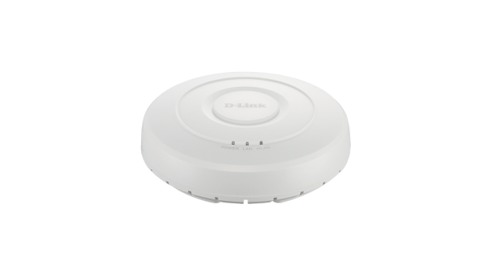
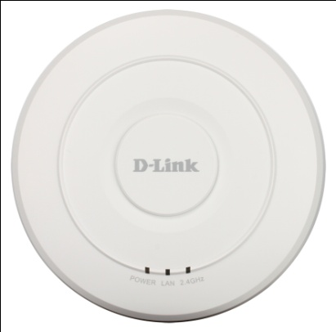
D-Link Unified Wireless Solution
DWL- 2600AP
DWL-3610AP
IEEE 802.11 b/g/n 2.4 GHZ
up to 300Mbps
10/100 Mbps PoE LAN Port
WMM-certified
Support Management/ Standalone Modes
IEEE 802.11 a/b/g/n/ac 2.4 GHZ or 5GHz
Upto 300 Mbps for 802.11n Upto 867Mbps for 802.11ac 10/100 /1000 Mbps PoE LAN Port
WMM-certified
Support Management/ Standalone Modes

Slide 7
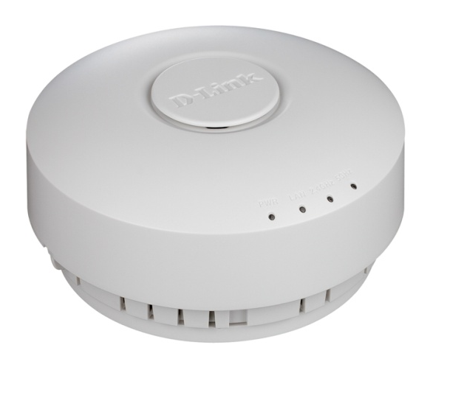
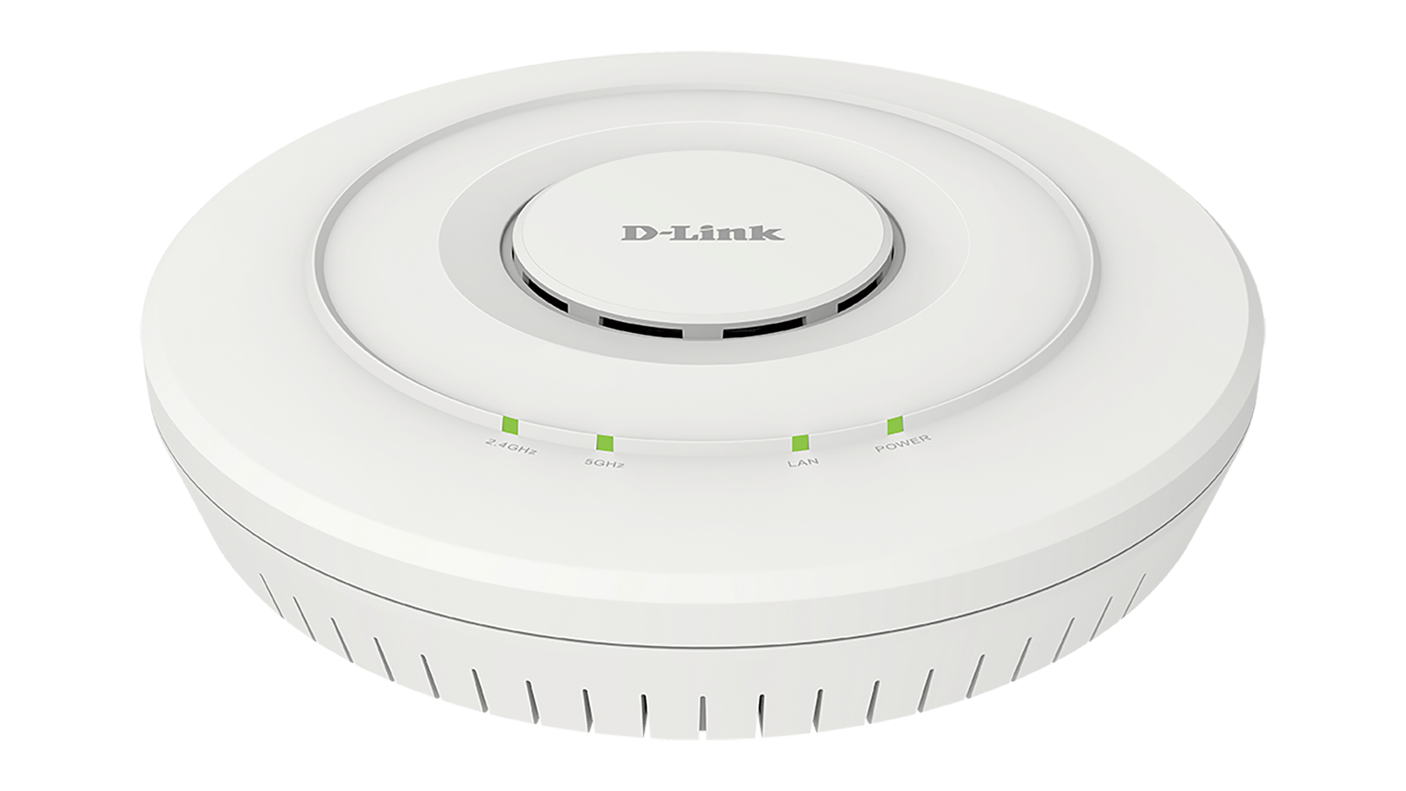
D-Link Unified Wireless Solution
DWL- 6600AP
DWL- 6610AP
IEEE 802.11 a/b/g/n 2.4 GHz & 5GHz
Upto 300 Mbps in each frequency band simultaneously
10/100/1000 Mbps PoE LAN Port
4 External antenna connectors
UL2043 certified chassis
Support Management/ Standalone Modes
IEEE 802.11 a/b/g/n/ac 2.4 GHz & 5GHz
Upto 1200 Mbps
10/100/1000 Mbps PoE LAN Port
2x2 Internal antennas
UL2043 certified chassis
Support Management/ Standalone Modes

Slide 8
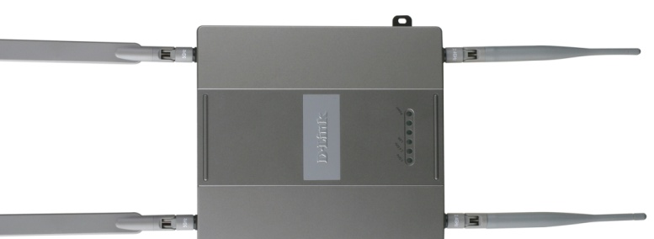
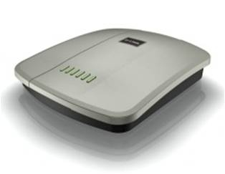
D-Link Unified Wireless Solution
D-Link Unified WLAN Solutions
DWL-8610AP
DWL- 8600AP
IEEE 802.11 a/b/g/n/ac 2.4 GHz & 5GHz
Upto 1750 Mbps
2 X 10/100/1000 Mbps LAN Ports
3x3 Internal Antennas
Plenum-rated Housing
Support Management/ Standalone Modes
IEEE 802.11 a/b/g/n 2.4 GHz & 5GHz
Upto 300 Mbps in each frequency band simultaneously
10/100/1000 Mbps PoE LAN Port
2x2 Detachable Antennas
Solid Die Cast Metal Housing
Support Management/ Standalone Modes

Slide 9
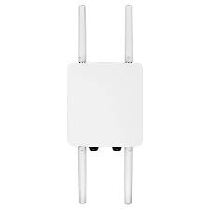
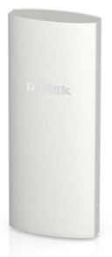
D-Link Unified Wireless Solution
DWL- 8710AP (Outdoor)
DWL-6700AP(Outdoor)
IEEE 802.11 a/b/g/n 2.4 GHz & 5GHz
Upto 300 Mbps in each frequency band simultaneously
2x 10/100 Mbps LAN Ports
Internal 2 x 2 antennas
IP-55 rated
Support Management/ Standalone Modes
IEEE 802.11 a/b/g/n/ac 2.4 GHz & 5GHz
Upto 1200 Mbps
2X 10/100/1000 Mbps LAN Ports
Detachable 2 x 2 Antennas
IP-67 rated
Support Management/ Standalone Modes

Slide 10



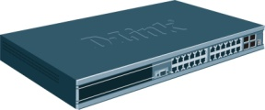



Centralized Access Point Management
Central Policy Control
  The Profile configuration is applied to a managed AP on the event such as when an AP initially transitions to managed mode, or when AP is reset. Users hence can enjoy the convenience of one-time configuration.
  The security is ensured owing to the applied configuration won’t be saved when AP is power off.
Radius Server
(Optional)
Dynamic VLAN Assignment
Client MAC list
AP MAC list
L2 or L3
Network
Firmware dispatch
Profile dispatch
RADIUS server settings
Security settings
Radio configuration
SSIDs, VLAN & Tunnel setting
QOS configuration

Slide 11
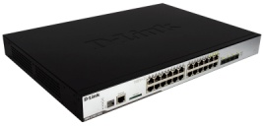

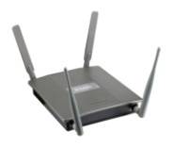
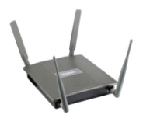


Switch Clustering
Peer Switches can form a Cluster Group
  Up to 4 DWS-3160 could be a Cluster Group
  All wireless configuration & management can be done from one switch
  One Master Switch gathers all statistics and status from peer switches, APs and clients in the group
  Provides single point of management
Similar to D-Link Single IP Management (SIM)
Master Switch
Wireless Management & Configuration
Admin
Peer Switches

Slide 12
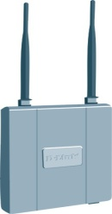

N+1/ N+N Switch Redundancy
N+1 Unified Switch Redundancy
  One extra switch works only as backup
  Allow each switch manages its maximum number of APs
Primary:
Unified Switch 1
Secondary:
Unified Switch BKP
Unified Switch 1
L2 or L3
Network
Primary:
Unified Switch 2
Secondary:
Unified Switch BKP
Unified Switch BKP
Unified Switch 2
N+N Unified Switch Redundancy
  Each switch backup its peer switches
  In order to backup peer switches, the switch needs to reserve some space for peer switch managed APs. Therefore, it cannot manage its maximum number of APs

Slide 13


Automatic Channel/Power Adjustment
Channels and Power will automatically be adjusted on any new event in the system such as an AP being added or being removed, or the switch can be programmed to automatically readjust channels and power at certain times (i.e. 2:00am each day) of the day or upon a certain interval (i.e. every 6 hours)
Channel 24
Channel 48
2. Rogue AP
Or Radio interference
Channel 48
3. Changes to
Channel 18
New AP
Channel 36
Channel 54
1. When inserting new AP, the AP scans the RF area for occupied channels and selects
a channel from the available non-interfering, or clear channels.

Slide 14
Automatic Channel/Power Adjustment
Automatic power uses a proprietary algorithm to automatically adjust the RF signal to broadcast far enough to reach wireless clients, but not so far that it interferes with RF signals broadcast by other APs.

Slide 15

Auto RF Management
Auto Power Adjustment
  In a clustering group, automatically adjust the power according to the strength changes of RF signals broadcasting by other APs, the unified switches readjust power by schedule (ex. upon a certain interval)
RF Self-Healing
  When a Managed AP is powered down, the power of its neighboring AP(s) managed by the same switch is immediately increased by 20%
  The power level will readjust again every pre-configured interval by sensing neighboring AP power status
Channel Plan
Period Power Adjustment
Clustering
Power
50%
90%
Power
Auto Power Adjustment
60%
90%
Power
50%
90%
30%
Power
50%
Power
70%
Power
Power
Power
90%
Power
Auto Power Adjustment
RF Self-Healing
Power
AP Fail

Slide 16


Advanced RF Feature: Radio Protection
Advanced “Radio Protection” design to guarantee that 802.11 transmissions do not cause interference with legacy stations or applications
  It is great feature to sustain 11n client throughput on mixed wireless clients environment (11n, 11g and 11b wireless clients work together)
  Without Radio Protection, the 11n wireless clients will run at 11g or 11b wireless speed in mixed environment.
Customers won’t need to replace all legacy wireless clients to get the benefit on 11n transmission (High throughput , High reliability)
With Radio Protection Enabled
802.11n client
802.11 b/g client
802.11n client
Run at 802.11 n Transmission rate
Run at 802.11 b/g Transmission rate
Run at 802.11 b/g Transmission rate
802.11n client
802.11 b/g client
802.11n client
Run at 802.11 n Transmission rate
Run at 802.11 b/g Transmission rate
Run at 802.11 b/g Transmission rate

Slide 17
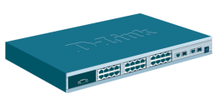

AP Traffic Load Balancing
Balance traffic load of each Managed APs
  Based on the percentage of bandwidth utilization
  Based on the Max. Wireless Clients
Force a new client associating to an overlapped neighbor AP which has lower unitization while the nearest one exceed the threshold
Periodically update APs utilization reports
Utilization Threshold: 60%
Utilization Threshold: 60%
AP-B
AP-A
Subnet B
Reject association from AP-A
AP Traffic Load Balancing
Force the association to AP-B
Subnet A
Request connection to AP-A
AP-A checks its utilization
AP-A reaches the utilization threshold value

Slide 18

Virtual Access Points
Multiple SSIDs can be configured on an AP.
Each radio of an AP can be configured up to16 networks (SSIDs).
Up to 16 networks are supported on DWL-2600 & DWL-3600.
Up to 32 networks are supported on DWL-6600 & DWL-8600 .
SSID:
Sales
VoIP
SSID:
Sales
VoIP
SSID:
R&D
VoIP
SSID:
R&D
VoIP
SSID:
Sales
VoIP
SSID:
Sales
VoIP
SSID:
R&D
VoIP
SSID:
R&D
VoIP
Sales Network
R&D Network
VoIP Network

Slide 19
Fast L2/L3 Roaming
Ideal for VoIP application
Fast roaming can be supported within a subnet (Layer 2) or across subnet boundaries (Layer 3) without changing IP address of client
Intra-switch roaming
  Fast roaming between APs which are managed by the same switch
Inter-switch roaming
  Fast Roaming between switches in a roaming group
  Up to 4 DWS-3160 can form a Roaming group
DWS-3160 I
Clustering
DWS-3160 II
Intra-Switch
L3 Roaming
Intra-Switch
L2 Roaming
AP-B1
Subnet B
Associate with AP-B1
AP-C1
Inter-Switch
L3 Roaming
AP-A2
AP-A1
Associate with AP-A2
Associate with AP-C1
Subnet A
Associate with AP-A2
Subnet C
Associate with AP-A1
Handover from AP-A1 to AP-A2

Slide 20



Fast Roaming Enhancement: AP-AP Tunnel
AP-AP Tunnel mode is used to support L3 roaming without forwarding any traffic to the Unified Switch→The APs will create tunnel and forward traffic with each other
When clients roam to another AP which is not in the same network subnet, the traffic from roamed clients is tunneled to the originally associated AP of the client
Roamed client remains on the same VLAN and has the same IP address
Benefit
  Reduce network resources because traffic is forwarded locally
  Reduce Unified Switch loading
DWS-3160
L3 Switch
AP-AP Tunnel
192.168.1.0
172.17.3.0
10.10.10.0

Slide 21









Centralized User Access Control
SSID Based Access Control
  Define Different VLANs and SSIDs for different user group (ex. Sales, RD…)
  With ACL configuration on VLAN, administrator can define particular access policy for specific user group
  The users belong to different groups need to connect with different SSIDs to get proper access right after authentication successfully
Identity Based Access Control
  Support Dynamic VLAN Assignment with WPA/WPA2-Enterprise, MAC and 802.1X authentication
  In a SSID, the clients could be assigned to different VLANs that are preconfigured in the external RADIUS server
  With ACL configuration on VLAN, administrator can define particular access policy for specific user/ user group
V1
V2
V
3
Single
SSID
RADIUS
Server
AP-A
User 1 (ex. RD)
→Server, Internet Access
User1 go to V2
User2 go to V3
User 2 ( ex. Guest)
→Internet Access Only

Slide 22
Wireless Intrusion Detection System (WIDS)
AP detection and classification
  Periodically scan and detect the AP per device or per clustered group
  Four classes for AP: Managed, Standalone, Unknown, and Rogue
Wireless client detection and classification
  Monitor disassociated, pre-authenticated, and authenticated wireless clients
  Three classes for authenticated wireless client: Authenticated, Black-listed, Rogue
-Fake managed AP
-Fake managed SSID
-AP using illegal channel
-AP using invalid channel
-Incorrect security config
-Invalid SSID
-Unexpected WDS device
-Etc…
AP Classification
?
?
MANAGED
UNKNOWN
STANDALONE
ROGUE
-Not in client database
-Probe attack
-Flooding network
-Too many failed auth
-Authenticated with
Unknown AP
-Etc…
Client Classification
Hacker
RF Scanning
AUTHENTICATED
B
BLACKLISTED
ROUGE
B
Infect

Slide 23

Wireless Intrusion Prevention System (WIPS)
AP & Wireless Client Threat Mitigation
  Protect wireless clients away from threats by sending fake de-authentication messages to de-associate the connection with rogue APs
  Inform to every managed AP the list of BSSIDs and channels on which rogue APs are operating
  Lock down the location of rogue AP via WLAN Visualization Tool for security adjustment
Visualized Alive Site Map
Detect rogue AP
Send
de-authentication message
De-association with rogue AP
Lock down location
AP Classification
MANAGED
STANDALONE
?
UNKNOWN
ROGUE
Client Classification
AUTHENTICATED
B
BLACKLISTED
ROUGE

Slide 24
Enhanced Security Enforcement
Rogue AP Management
  Any AP scanned but not in the switch’s database will be listed as a rogue AP. The administrator can get better control of the environment through knowing rogue APs’ information (MAC, SSID, Channel, etc).
Complete Security Features
  Wireless
    Managed AP MAC list
    Wireless Client MAC list
    WEP (Static/Dynamic)
    WPA Enterprise/Personal
    WPA2 Enterprise/Personal
  Wired
    ACL
    802.1X
    DoS Control
    Broadcast Storm Control
    Port Security
    Radius / TACACS+

Slide 25
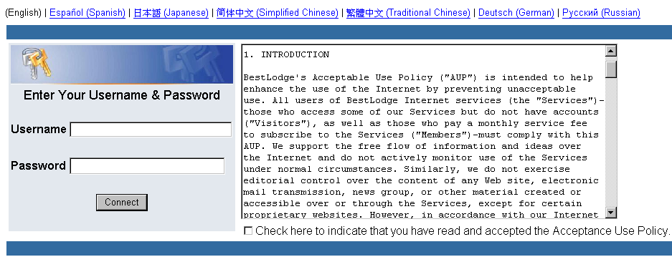
Enhanced Security Enforcement
Captive Portal
  Web-based Authentication that provides intuitive, user friendly authentication
  Forces an HTTP client on the wireless network to see a authentication web page before surfing the Internet

