Slide 1
Redefining NGFW/UTM Security

Slide 2
Formidable experience and expertise
Setting new benchmarks in data leakage prevention, threat mitigation and actionable security
Cloud based security: Anytime, Anywhere enforcement of Security Policies
Founded in 2002, HQ in Mumbai, India 8,000+ customers in over 12 countries
Disruptive leader with many firsts – 1st DLP, 1st performance management security device, 1st Indian company to be ICSA Labs certified, 1st to launch comprehensive BYOD security on network firewalls
Trusted security partner to leading lights in BFSI, enterprise, SMEs and SMBs

Slide 3
Power to CXOs: Security, Performance, Compliance
EASY SCALABILITY
SCALE UP AND OUT
CLOUD
DATA LEAKAGE PREVENTION
BUSINESS CONTINUITY
REAL-TIME VISIBILITY AND CONTROL
PERFORMANCE
ZERO HOUR THREAT PROTECTION
CONTEXT-AWARE SECURITY INTELLIGENCE
Customizable SLA’s
Notes:
Business continuity- HA , Failover, // context – user , time , application, network and content sense

Slide 4
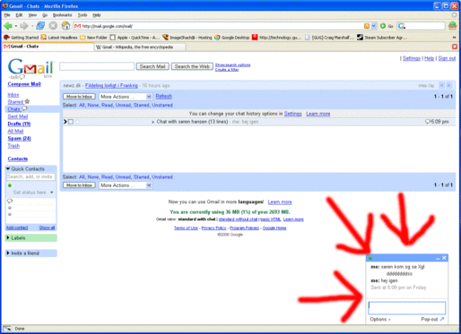
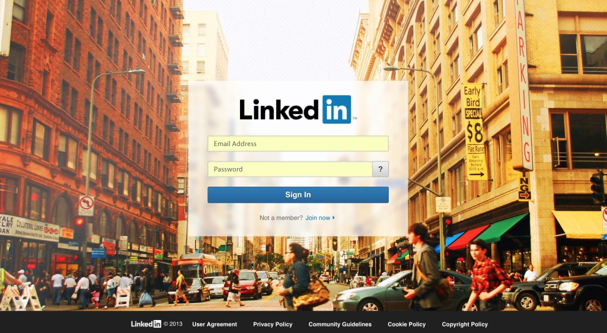
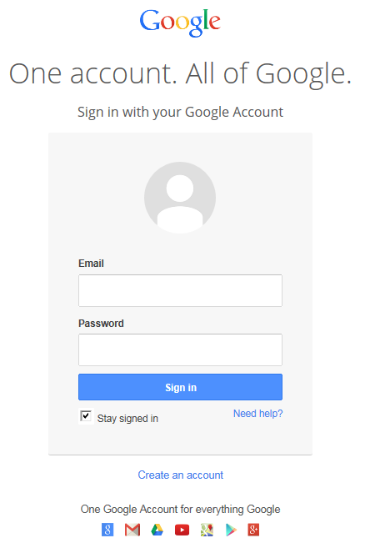
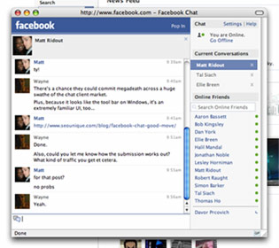
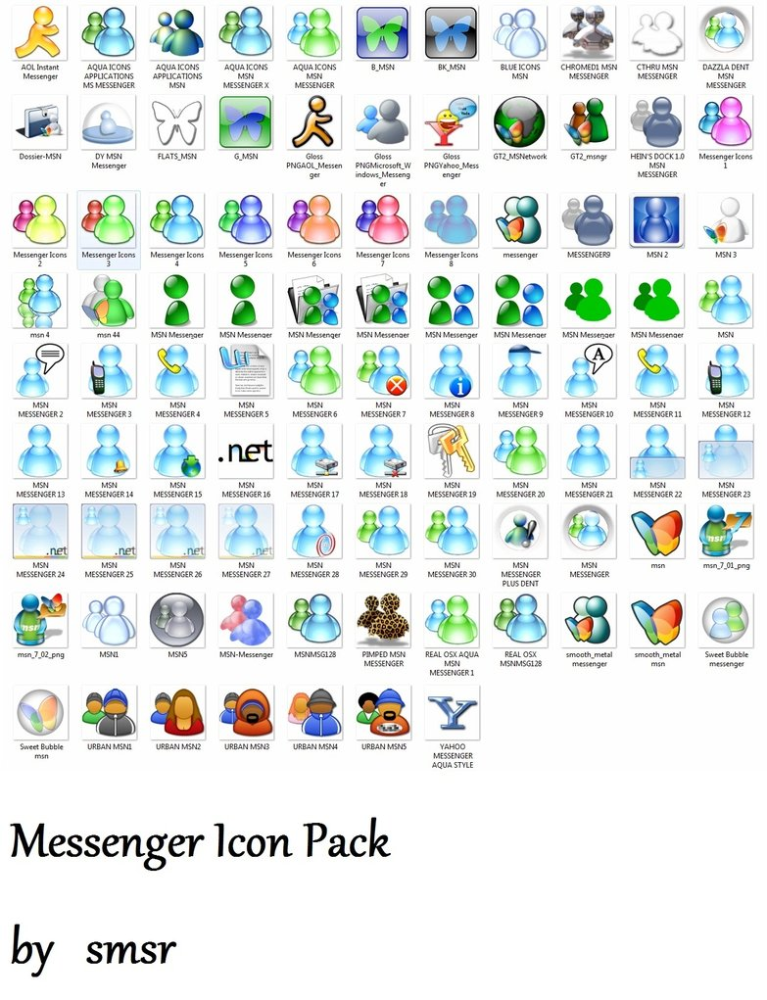
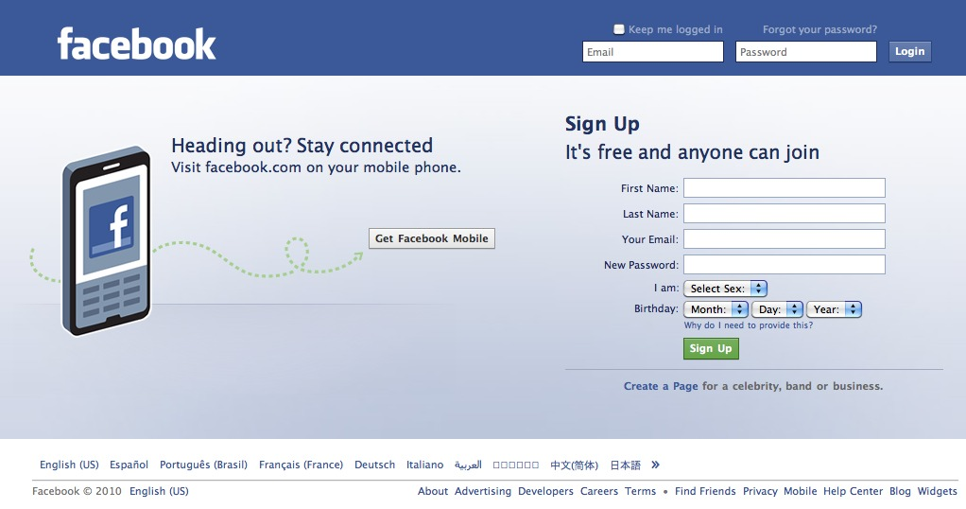
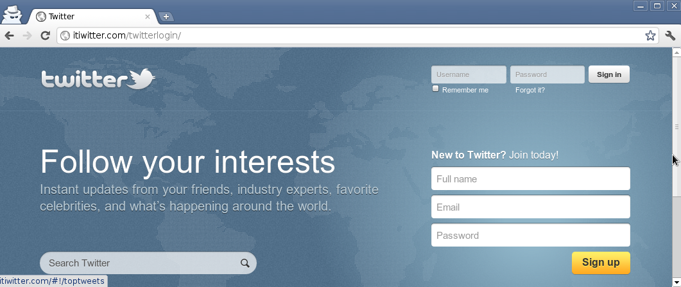
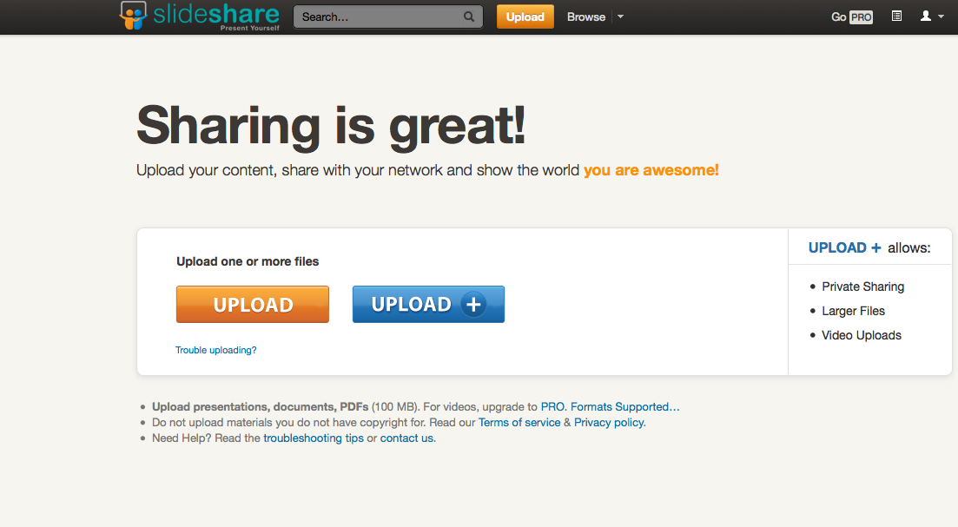
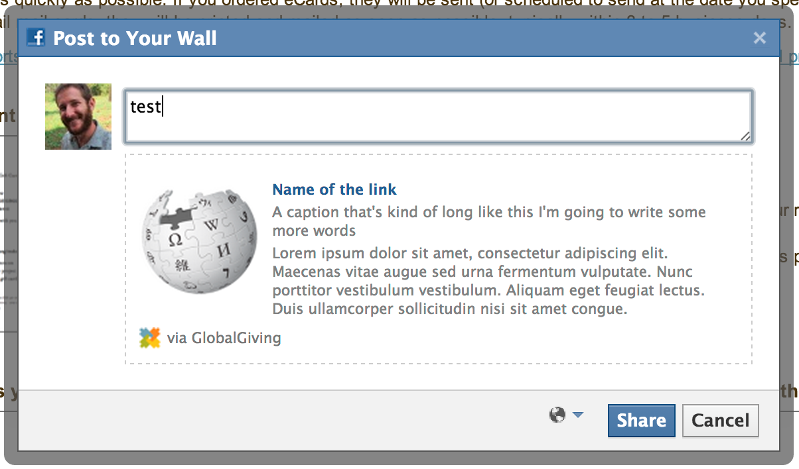
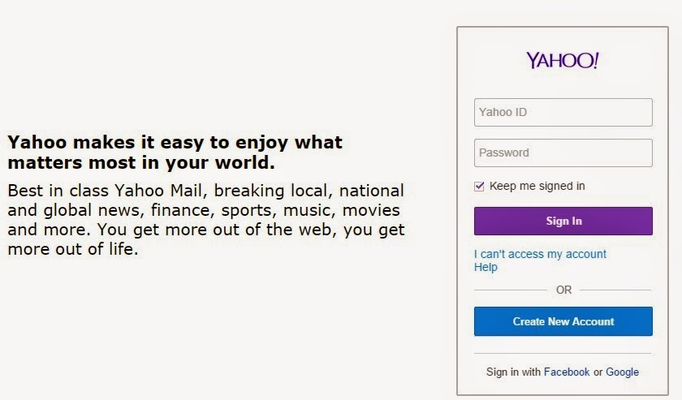
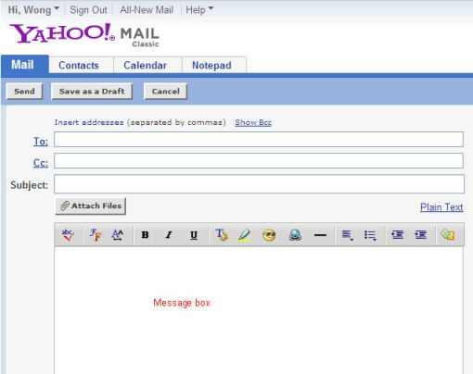
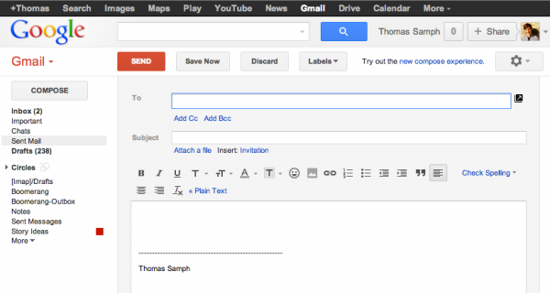

Slide 5
Data Leak Prevention
Visibility
Monitor
Detection
Precaution
User
The Content Sent
through application
Identify who is accessing
Which applications
Define policies based on
User then IP Address
Applications
HTTP,. HTTPS, SMTP
Instant Messenger
What content is being
Sent out
Add rules for popular
Mail sites to match Mails on Subject, To, CC,
BCC, Message Body, attachment size, attachment type,
User Email Addresses,
With Wide range of matching options.
Web
Mails
Utilization of internet by
usage in organization
What information is
Being Sent out through
Instant Messenger &
Web chats
Web
Uploads
Attachments going of
your network
Web Chats
& IM
Unwanted applications
Like, open proxies, P2P, Malware infected web sites – to ensure the chances of information leak
Which user is sending
Information using
Yahoo, MSN, Rediff,
Gmail, Rapidshare,
Web Mails
Add rule for popular
Social networking sites
Corporate
Mails
Set Runtime Alerts
Based on DLP rules

Slide 6
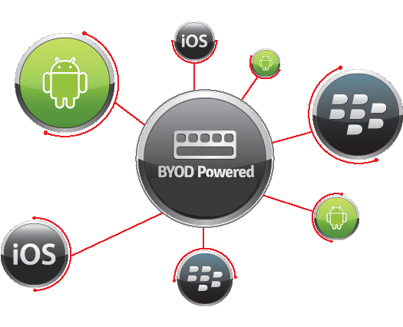
Building BYOD-happy businesses
Intelligent device-awareness
Eliminates manual efforts to configure & enforce security policy for new devices
Introduces key BYOD drivers; eliminates barriers of adoption

Slide 7
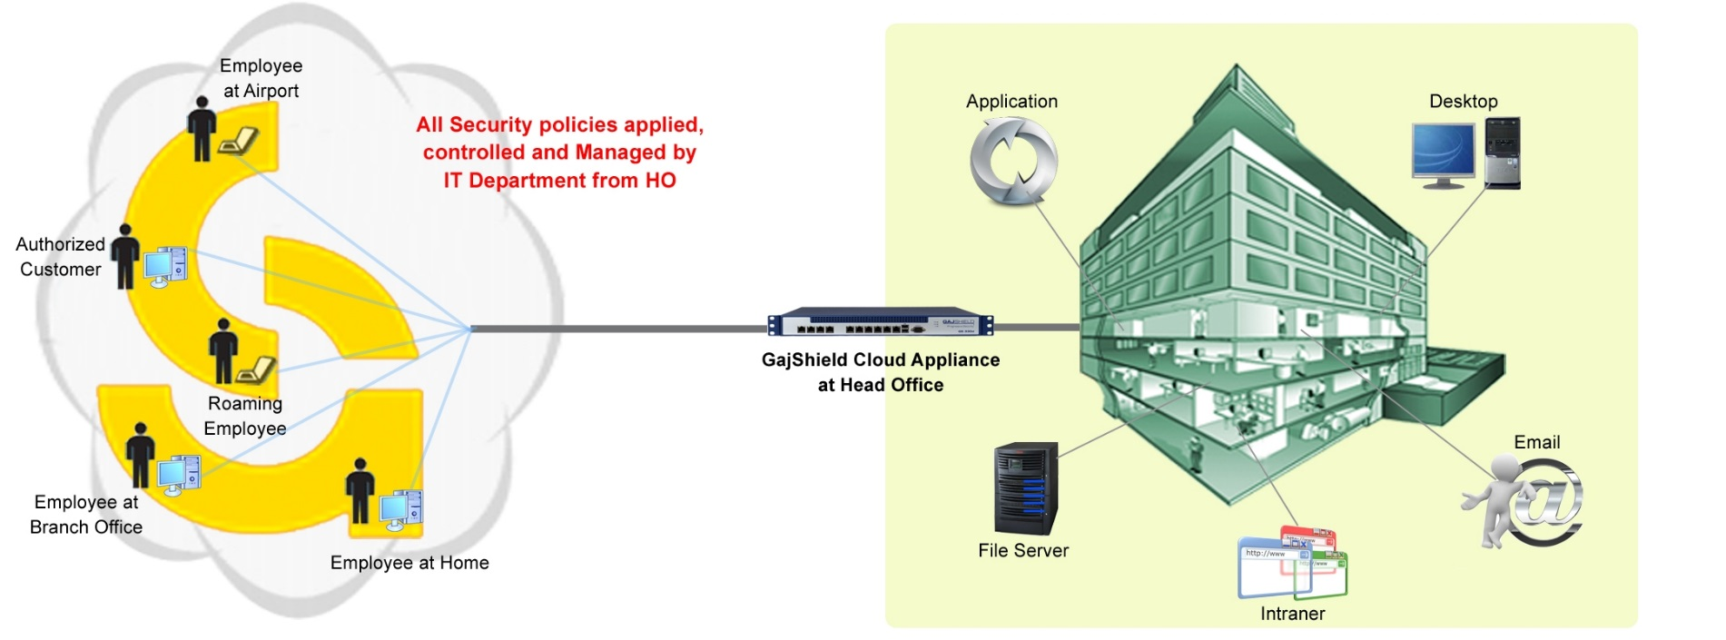
…The Technology
Enterprise Cloud Security-Remote Filter

Slide 8
NextGen UTM Features

Slide 9
Firewall
ISP Failover & Load Balancing
Bandwidth Management
VPN
On-Appliance reporting
IPS

Slide 10
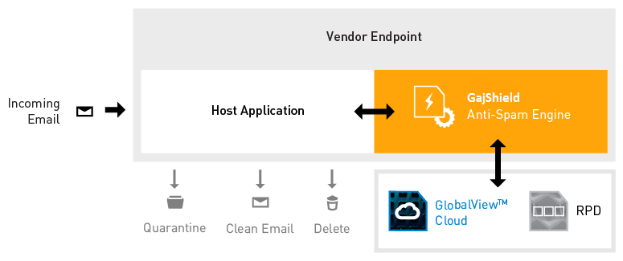
Recurrent Pattern Detection - Antispam
Outbound Spam Protection
BENEFITS
Zero False Positive guarantee with high spam, phishing, and malware catch rates.
Increased customer satisfaction—add premium anti-spam to your current offerings..
Reduced costs— your engineers will no longer need to keep up with new spam attack tactics and sources. We do it for you..
Low TCO with our high performance, low maintenance technology, and proven protection.

Slide 11
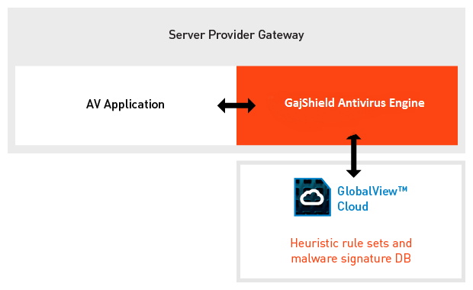
Zero Hour Protection Antivirus
Incoming
Http, Https
Traffic
With GajShield Antivirus integrated into the device or application, objects (files, web scripts, emails, etc.) are scanned and classified by our antivirus engine. This enables you to delete or quarantine these objects and block malicious web scripts before they can impact your customers.
RBL
Engine
ZERA
Engine
Incoming
Mail
Traffic
GajShield
Engine
Delete
Known
Viruses
Quarantine

Slide 12
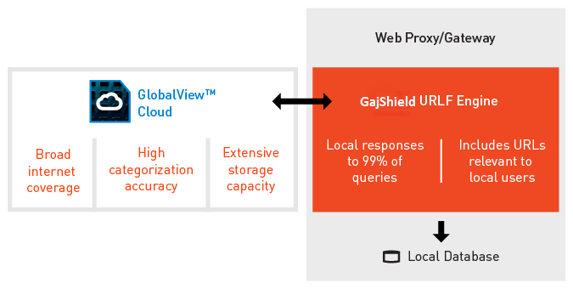
Cloud based Embedded Web-Content Filtering
Comprehensive Security against compromised
sites, Malware, and Phishing site.
Web traffic analyzed with over 100 Millions sites
into 85 categories, updates in real time.
URL Filtering increase security by :
- Stopping spam Malware sites
- Dynamic on-the-fly updates of
compromise websites
Increase Productivity by controlling access of :
- Sites, unrelated to work
- Bandwidth consumption
- Max download restriction based on users
Image safe search integration – Google, Yahoo

Slide 13
Next Generation Security with Application Filtering
Applications hidden in port 443
Basic UTM unable to detect rogue applications like Bittorent, Tor or Skype
Malware Risk | Files downloaded could be infected
Data Safety | Proxy applications could be used to leak data
Vulnerability | Applications can bypass firewall to gain access to network
Legal Troubles | Copyrighted files downloaded could cause legal trouble

Slide 14
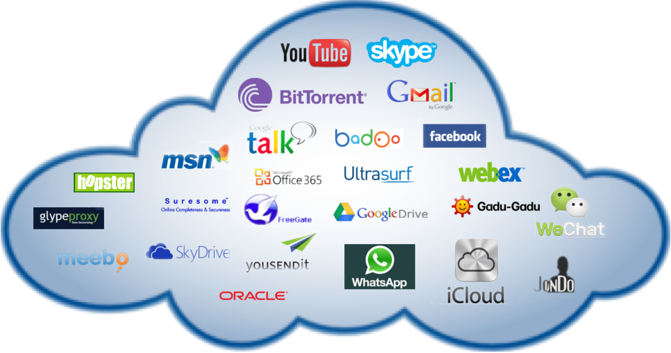
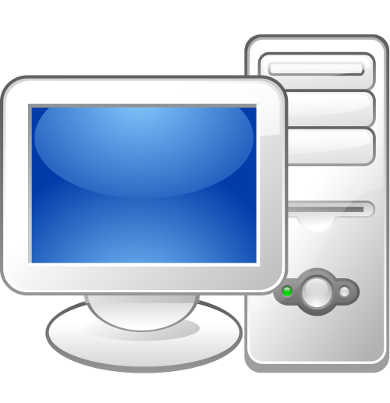
Next Generation Security with Application Filtering
Supports more than 6500+ applications

Slide 15
Next Generation Security with Application Filtering
Supports more than 6500+ applications

Slide 16
Next Generation Security with Application Filtering
Traffic Control of Non business traffic
Drop unrequired traffic
Secure against Advance Persistent Threat
More bandwidth to business and improved user experience
Prevent data leaks by application control

Slide 17
Supports Authentication against multiple database
A
B
User based network visibility
All security policies can be applied based on user and groups
Unwanted traffic can be dropped and non-business traffic can be throttled
User visibility and control leads to efficient network security management

Slide 18
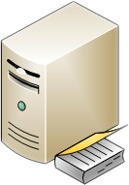
User Layer
Supports Authentication against multiple database
Radius Server
LDAP Server
Active Directory
Local Database
 | GajShield now support multiple database for user authentication | Guest users or contract workers can be created on local database thus saving cost on CAL license
 | User can login through multiple device with the same username | Do not have to create multiple logins for guest users.

Slide 19
Application Layer
Network based Data Leak Prevention
Context Sensitive Data Leak Prevention System
Gain visibility and form to outgoing data
Create rules to make applications read only
Create context sensitive rules to allow social media for business use
Archive business chats and mails for compliance
Inspect HTTP/HTTPS/SMTP traffic for data leaks

Slide 20
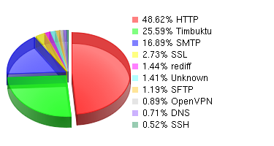
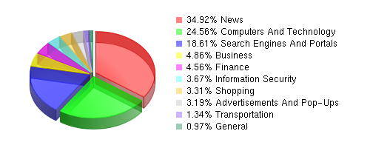
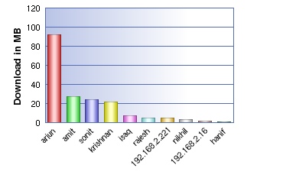
Reporting Layer
Application Layer
In-depth Visibility and Compliance
Know how secure your network traffic is
Block all non secure traffic to improve security and performance of your applications
Prevent data leaks through non-secure channels.
How secure is your traffic ?
Inspect productivity of your organisation
Block non-productive sites to improve bandwidth use
Prioritise business traffic over non-critical traffic
Productivity report
Understand the user internet use pattern
Visibility on the reason of use
Productive and non-productive users
User Report

Slide 21
Application Layer
Network based Data Leak Prevention
More than 68% of data leak happens through Web and Email
GajShield unique patent pending ‘Context Sensitive Data Leak Prevention’ help prevent data leaks

Slide 22
GajShield Product Range
 |  | Soho/SMB Market
 | Model | No of Ports
 | Gs15nu | 4 Ports
 | GS20nu | 4 Ports
 | Gs40dc | 4 Ports
 | Gs80dc | 6 Ports
 | Gs160dc | 8 Ports
 |  | Mid Market/Enterprise Market
 | Gs240dc | 6 Fixed + Modular Slot(1)
 | Gs360dc | 6 Fixed + Modular Slot(1)
 | Gs560dc | 8 Fixed + Modular Slot (2) With RPS
 | Gs980dc | 10 Fixed + Modular Slot (4) With RPS
 | Gs1160dc | 10 Fixed + Modular Slot (4) With RPS

Slide 23
Subscriptions Offerings
Basic Bundle Subscriptions | Basic Subscription includes Anti Virus, Web Content and Application Filter, Intrusion Prevention System , 8x5/24x7Support, hardware warranty and RMA fulfilment
Premium Bundle Subscriptions | Premium Subscription includes Anti Virus, Anti Spam, Web Content and Application Filter, Intrusion Prevention System , 8x5/24x7 Support, hardware warranty and RMA fulfilment
Complete Bundle Subscriptions | Complete Subscription includes Anti Virus , Anti Spam, Web Content and Application Filter, Data Leakage Prevention, Intrusion Prevention System , 8x5/24x7 Support, hardware warranty and RMA fulfilment

Slide 24
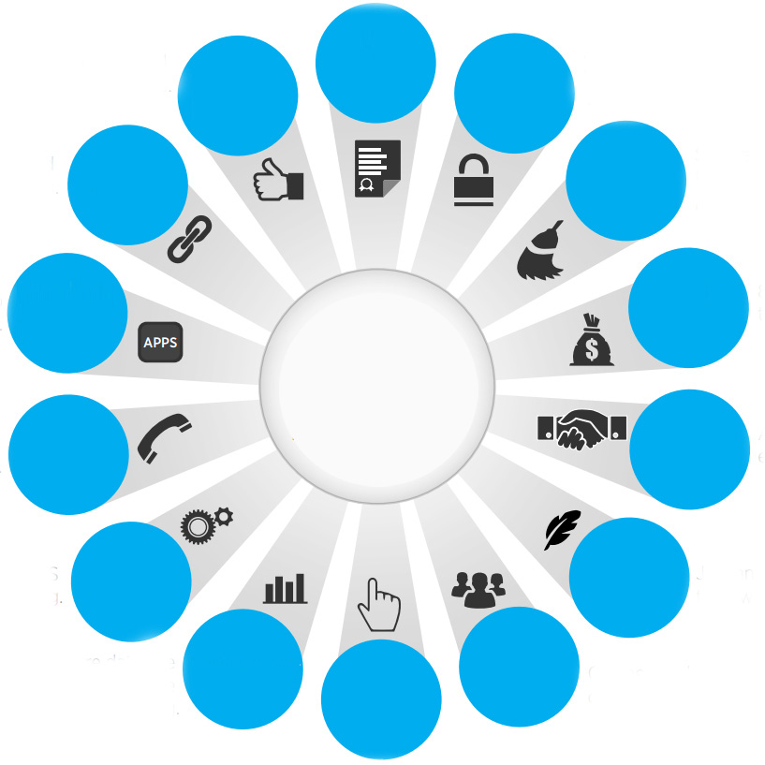
Reporting & Compliance
Easy Deployment
Data Protection
Integrates with existing environment
Clean Network
App Awareness
Cost Savings
Committed Support
Dedicated Security Expertise
Smooth Security
Manageability
High- performance Security
User Sense
Context Awareness

Slide 25
Network Security for the new world order
© 2009 Microsoft Corporation. All rights reserved. Microsoft, Windows, Windows Vista and other product names are or may be registered trademarks and/or trademarks in the U.S. and/or other countries.
The information herein is for informational purposes only and represents the current view of Microsoft Corporation as of the date of this presentation. Because Microsoft must respond to changing market conditions, it should not be interpreted to be a commitment on the part of Microsoft, and Microsoft cannot guarantee the accuracy of any information provided after the date of this presentation. MICROSOFT MAKES NO WARRANTIES, EXPRESS, IMPLIED OR STATUTORY, AS TO THE INFORMATION IN THIS PRESENTATION.

