Slide 1
D-Link Business Wireless LAN Solution

Slide 2
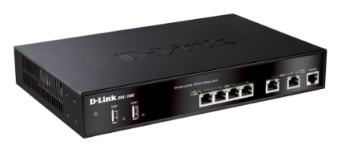
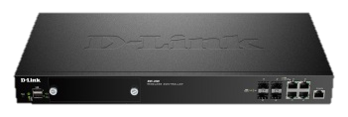
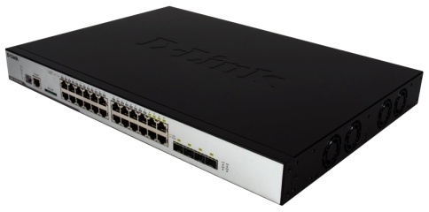
D-Link Unified Wireless Solution
Wireless controller
Unified switch
NEW
DWC-1000
Support 6~24 APs per device
Support 24~96 APs per peer group
DWC-2000
Support 64~256 APs per device
Support 256~1024 APs per peer group
DWS-4026
Support 64 APs per device
Support 256 APs per peer group
DWS-3160
Support 12~48 APs per device
Support 48~192 APs per peer group

Slide 3
Unified Wireless Solution Comparison
 | DWC-1000 | DWS-3160 | DWS-4026 | DWC-2000
Port | 4LAN+ 2Option 10/100/1000Based-T | 20 10/100/1000Base-T 4 Combo 1000 Base-T/SFP | 24 10/100/1000Base-T 4 Combo 1000 Base-T/SFP 2 10G (module/ optional) | 4 10/100/1000Base-T 4 Combo 100/1000 Base-T/SFP
PoE | No | Yes (PC model) | Yes | No
# mgmt. AP | 6 to 24 | 12 to 48 | 64 | 64 to 256
Max. # mgmt. AP/ peer group | 96 | 192 | 256 | 1,024
# clustering controller/ peer group | 4 | 4 | 8 | 8
Redundancy while full AP capacity | No | No | Yes (4+4) | Yes (4+4)
Additional VPN/ Firewall/ WCF license | Yes | No | No | No
Additional AP license increments | 6 | 12 or 24 | No | 32 or 64 or 128
v
v

Slide 4
Wireless Controller License Options
DWC-1000
AP License
To activate an additional 6 access points
DWC-1000-AP6/ DWC-1000-AP6-LIC
Feature license (DWC-1000-VPN-LIC)
To activate VPN, firewall and advanced routing features
DWC-1000-VPN/ DWC-1000-VPN-LIC
DLMS* Virtual Pack
DWC-2000
AP License
To activate additional access point support
DWC-2000-AP32/ DWC-2000-AP32-LIC
DWC-2000-AP64/ DWC-2000-AP64-LIC
DWC-2000-AP128/ DWC-2000-AP128-LIC
*Remark:
DLMS, D-Link License Management System , an on-line system delivering virtual package of appliance’s add-on services, instead of physical one.

Slide 5
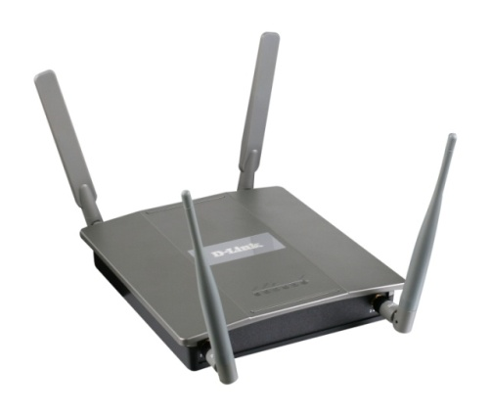
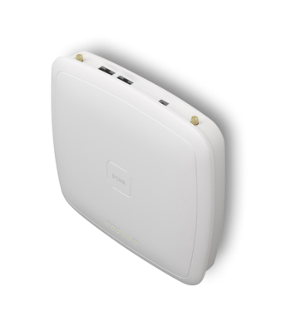
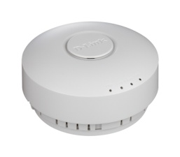
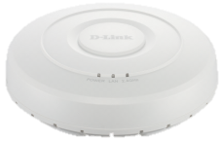
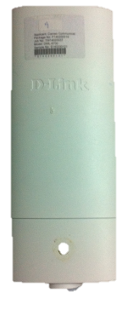
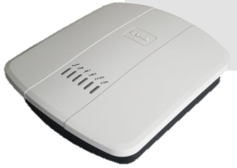
Unified Wireless Access Point
DWL-8600AP
11n concurrent dual band
2 x 2 antennas
802.3af PoE
DWL-6600AP
11n concurrent dual band
Internal PIFA antennas w/ external antenna connectors
802.3af PoE
DWL-3600AP
11n 2.4GHz single band
Internal 2 x 2 antennas
802.3af PoE
DWL-2600AP
11n 2.4GHz single band
Internal 2 x 2 antennas
802.3af PoE
DWL-6700AP
Outdoor
11n concurrent dual band
2 x 2 antennas
5GHz high gain directional
2.4GHz omni-directional
Non-standard PoE
IP65 rated
DWL-8610AP
11ac concurrent dual band
Internal 3 x 3 antennas
802.3at PoE
DWL-6610AP
11ac concurrent dual band internal 2x2 antennas
802.3at PoE

Slide 6
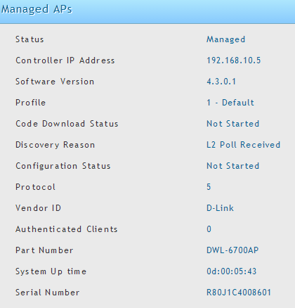
DWL-6700 Outdoor AP

Slide 7
Unified Wireless Access Point 802.11ac AP
NEW
The first unified AP 802.11ac model.
3x3 MIMO with 3 spatial streams, providing up to 1300 Mbps PHY data rate on the 5GHz interface
POE: IEEE 802.3at
Bandsteering
Beamforming technology enables longer reach, thus covering more area with less devices
16 VAPs
AP Clustering
DWL-8610AP
11ac concurrent dual band
Internal 3 x 3 antennas
802.3af PoE
1300 Mbps
450 Mbps
300
Mbps

Slide 8
DWC-2000

Slide 9
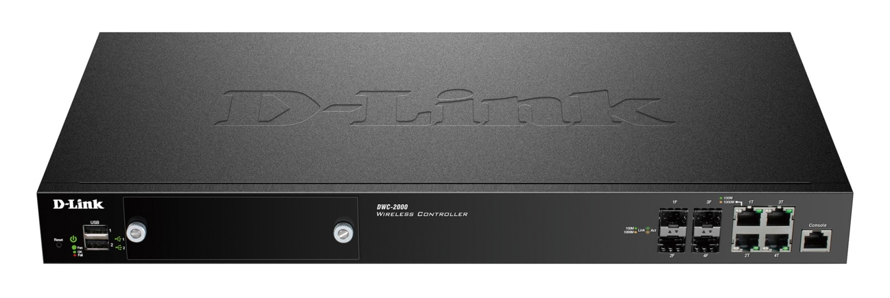
DWC-2000 Form Factor
Link Aggregation
LACP
B
A
C
D
E
F
G
H
Interface
A | Reset button
B | Power LED
C | Fan LED
D | USB Ports (1-2)
E | Hard Disk Drive Module Slot
F | Gigabit LAN SFP ports (1-4)
G | Gigabit LAN RJ-45 ports (1-4)
H | Console Port

Slide 10
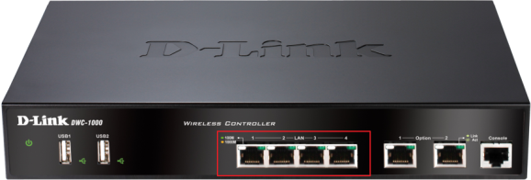
DWC-2000 vs. DWC-1000
In addition to hardware (capacity, form factor…), software features and license options, there is one significant difference between Ethernet interfaces:

Slide 11
DWC-2000 Highlight
System Performance
64 APs per controller, max. 256 APs
Max. 1,024 APs per peer group
Max. 8 controllers per peer group ( including redundant controllers)
Max. 3,072 concurrent CP authentication users
User Authentication
20K permanent accounts and 20K temporary accounts of local database
Multiple login pages associated with VLANs/ SSIDs
Hotspot Application
Single or batch accounts generation
Customized time/ traffic accounting profile
User account status monitoring
User account usage extension
Payment agent (Paypal, SecurePay, Authorize.net, WorldPay)

Slide 12
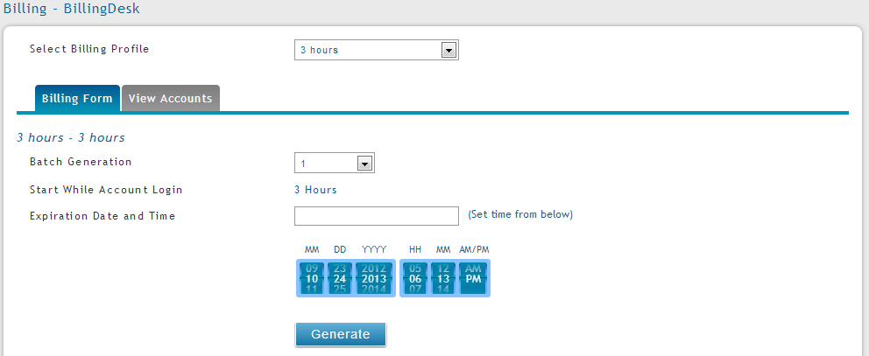
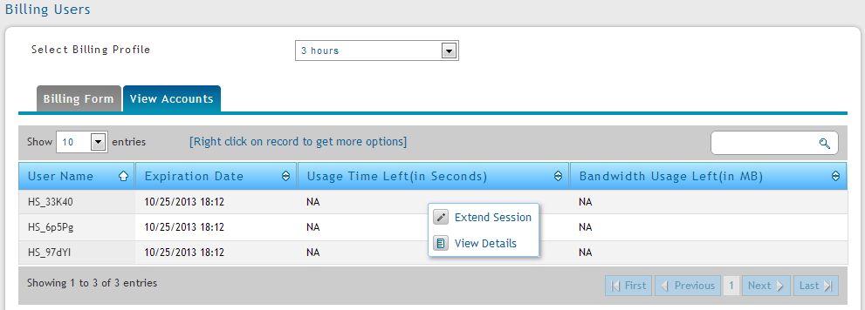
Hotspot Application Guest Management
Billing plan selection
Batch generation
Account generation from Service Desk/ Front Desk or via online purchasing*.
Up to 40 billing plans
Single or batch accounts creation
Flexible account type sorted by usage volume, usage time, and specific period.
Monitor status and extend usage via front desk account
Account usage status
Extend account usage and detail info
* Online purchasing: confirm with PP for supporting in your countries.

Slide 13
Hotspot Application Payment Gateway
Purchase the wireless service online! Customer simply picks, chooses and purchases the wireless service on his tips.
Include most popular payment gateways ( e-commerce application service providers): PayPal, Secure Pay, WorldPay, and Authorize.net.
Benefits: leverage payment gateways’ infrastructures
Collect funds cross countries and regions worldwide
Secure transaction, encryption
7
Internet
11
Firewall
9
8
10
6
Switch
DWC
[Usage Scenario]
Wireless clients associate UAP
User opens a browser
DWC redirects to service package list
User chooses service package
User fills out payment gateway account (ex. Paypal) or credit card information
DWC passes credit card information to the payment gateway
The payment gateway validates transaction information
The payment gateway confirms the transation information to DWC
DWC generates a user account
DWC passes the qualified user account to the UAP
User acquires the internet access
UAP
1
3, 4, 5
2
End Device
Customer

Slide 14
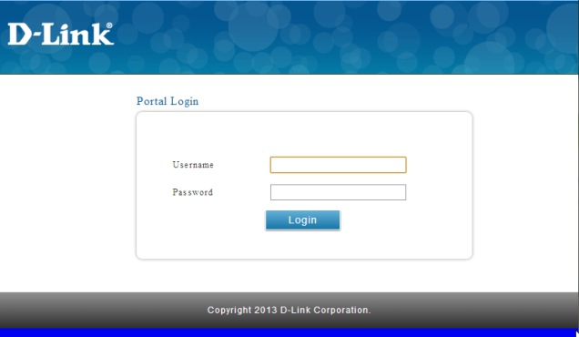
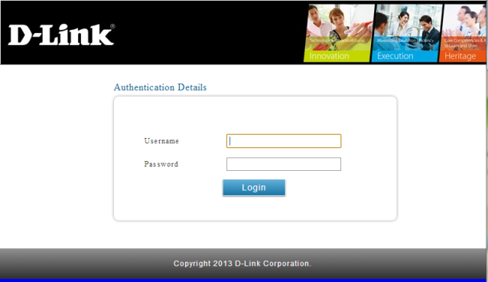
Hotspot Application Multiple Login Pages
Separate welcome pages assigned to different SSIDs or VLANs allow each company or service provider to have their own login portals, even if access points are managed by the same wireless controller.
Max. 10 login pages
Commercial Building
Company A
Internet
SSID: AAA
Company B
SSID: BBB
DWC

Slide 15
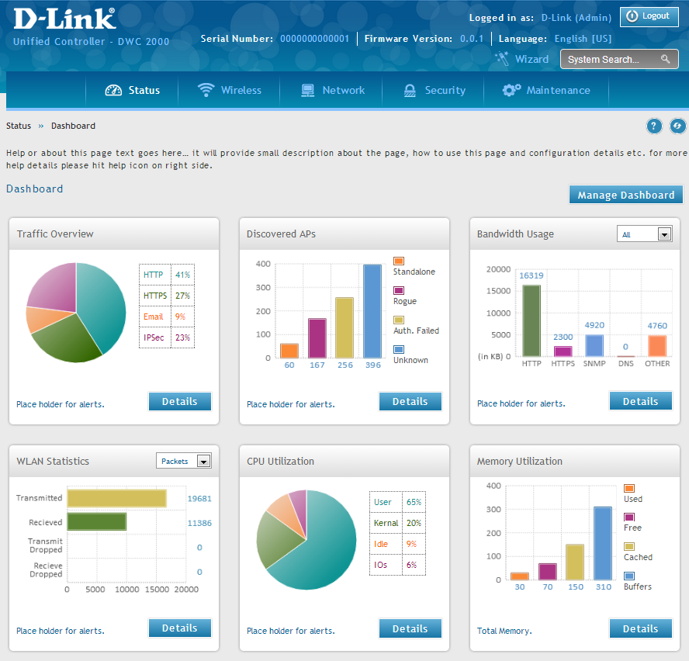
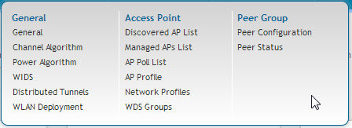
DWC-2000 User Interface
Step-by-step instruction guides users to setup the system in minutes.
Main menu bar makes it easy to navigate among configurations
The dashboard gives a quick glance on system, wireless and clients information
Traffic information is displayed neatly in a table.

Slide 16
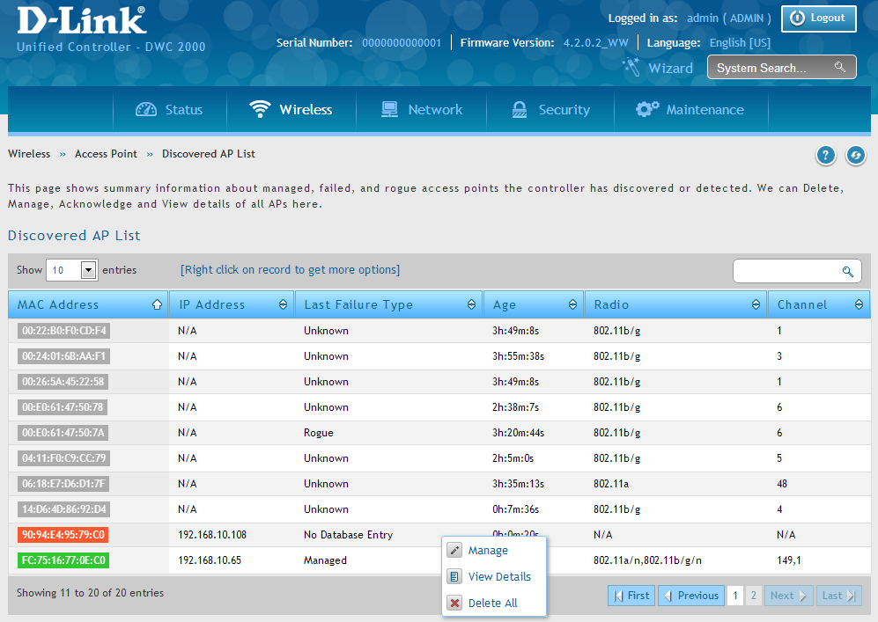
DWC-2000 GUI Tips
System function key word search
Table content key word search
Sorting info by category
Right-click on PC or long tap on touch panel on tablet to get a pop-out option list
Status is highlighted in color

Slide 17
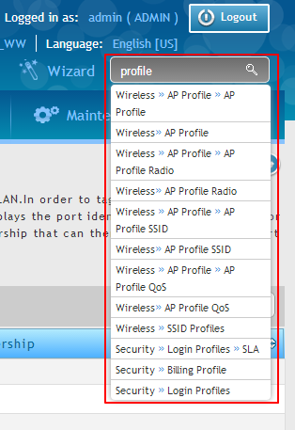
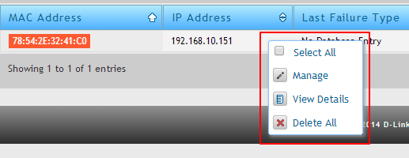
DWC-2000 GUI Tips
Always think of “search” and “right-click” when you get lost.

Slide 18
Getting Start
Avoid jumping into configuration directly without a proper plan.
Before starting configuration, make sure the following information is ready:
IP plan
VLAN plan
Network topology
Wireless features you would like to configure, including
Country
SSID
Radio
Wireless security
…more

Slide 19
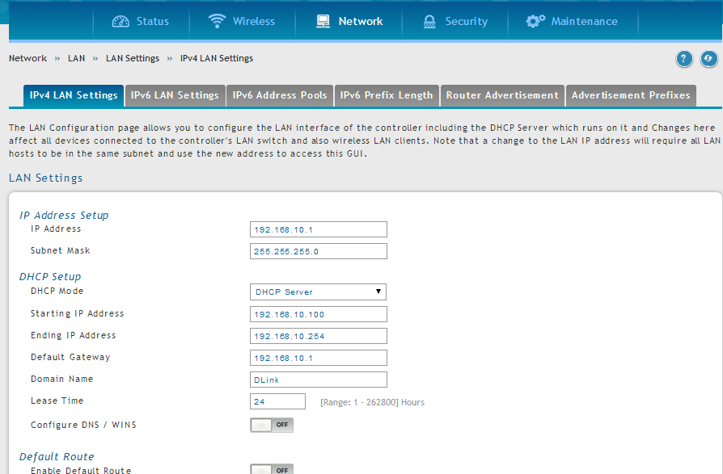
Configure LAN Settings

Slide 20
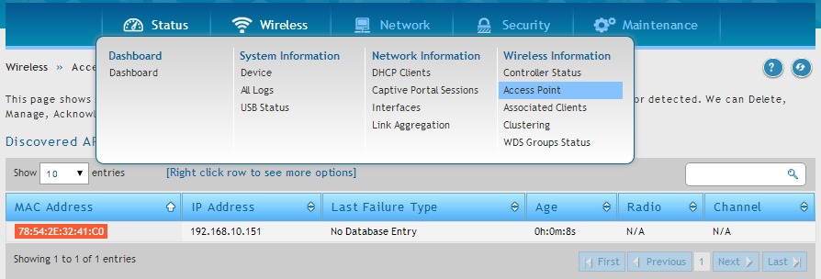
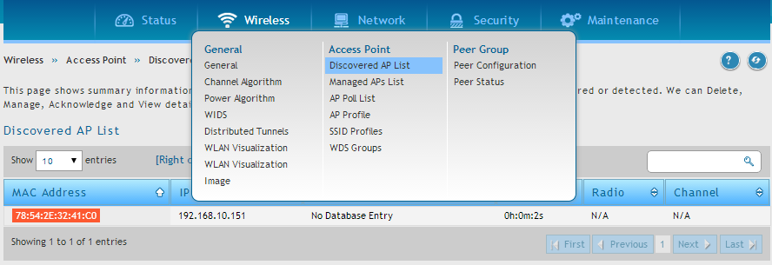
Discover Access Points(1/2)

Slide 21
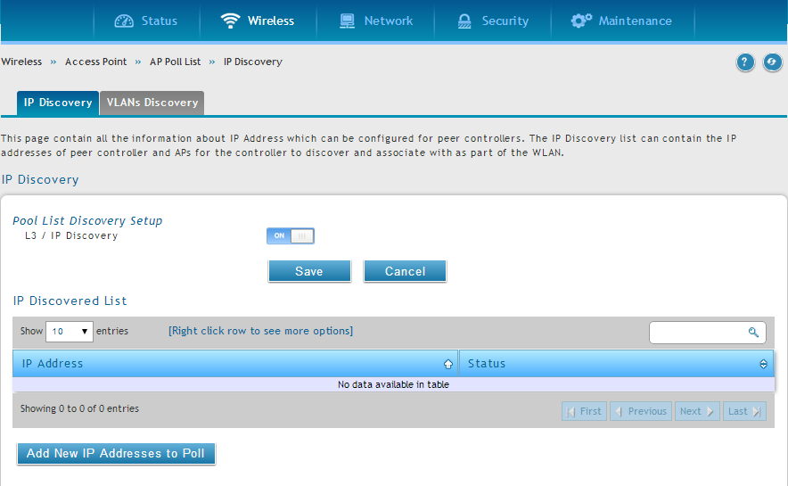
Discover Access Points(2/2)

Slide 22
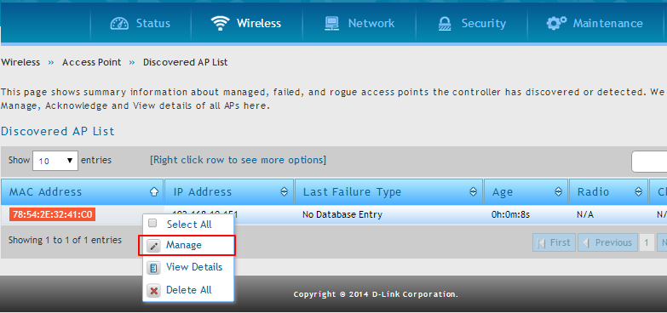
Manage Access Points(1/6)

Slide 23
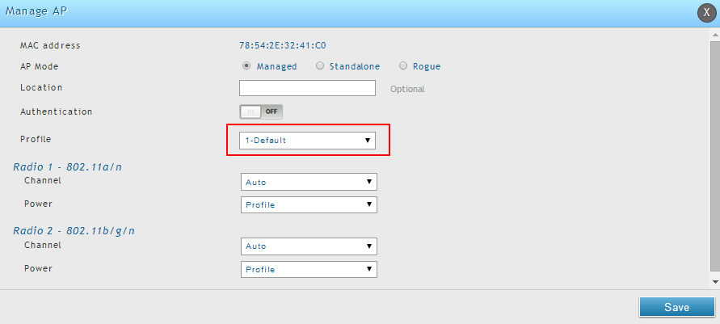
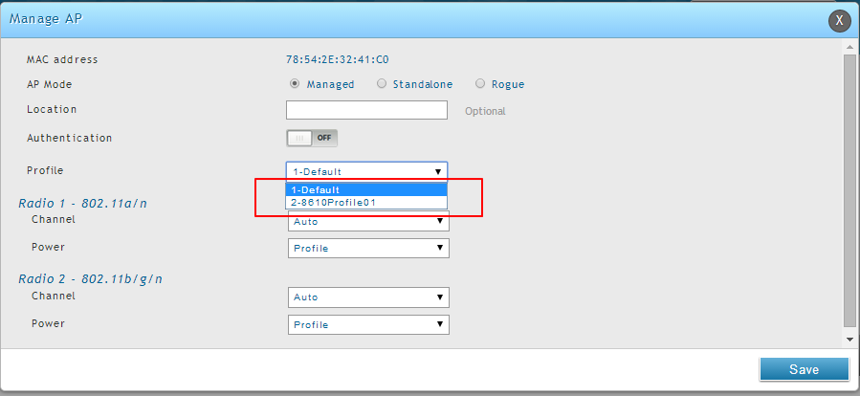
Manage Access Points(2/6)

Slide 24
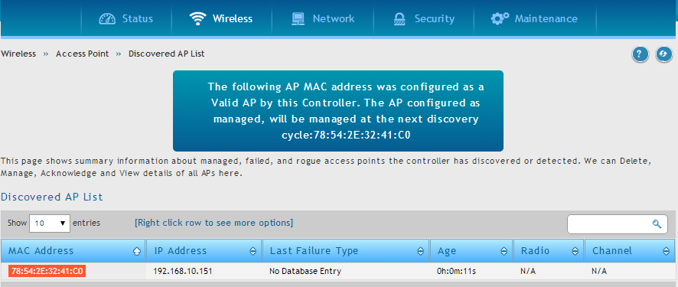
Manage Access Points(3/6)

Slide 25
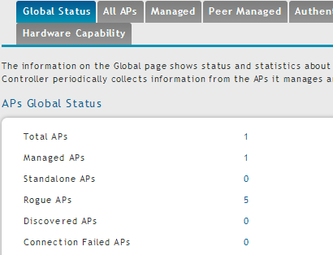
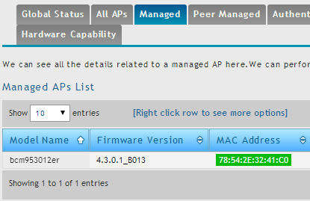
Manage Access Points(4/6)

Slide 26
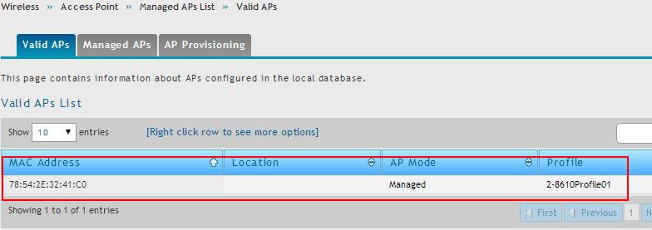
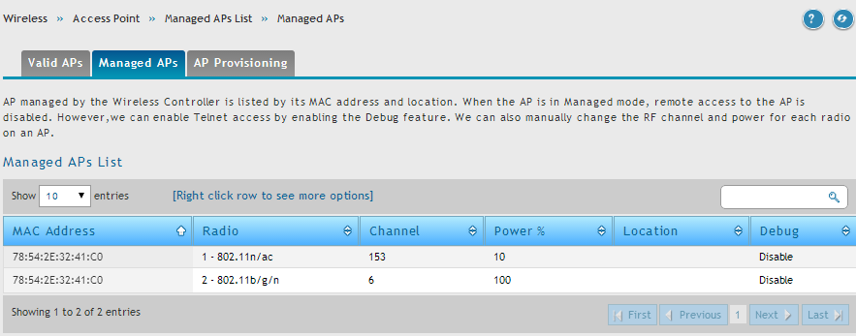
Manage Access Points(5/6)

Slide 27
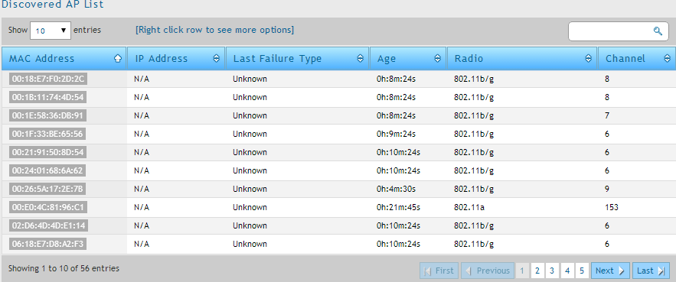
Manage Access Points(6/6) The power of search

Slide 28
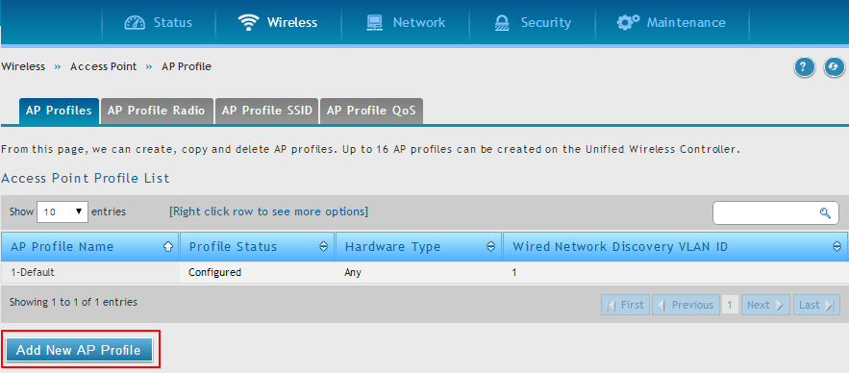
Add an AP Profile(1/5)

Slide 29
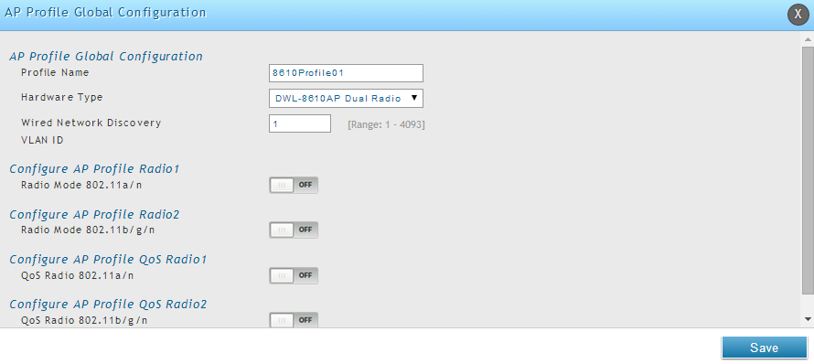
Add an AP Profile(2/5)

Slide 30
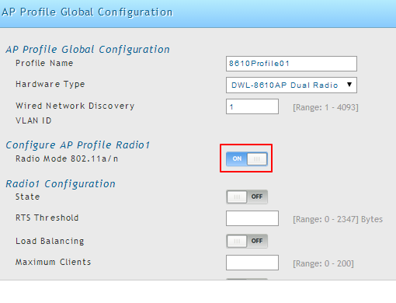
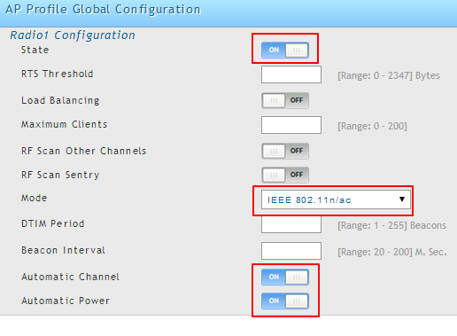
Add an AP Profile(3/5)
Turn on 5GHz radio
Select radio mode
Turn on auto-channel and auto-power
Remember to click “Save”
* Please note that values need to be given to all blank field.

Slide 31
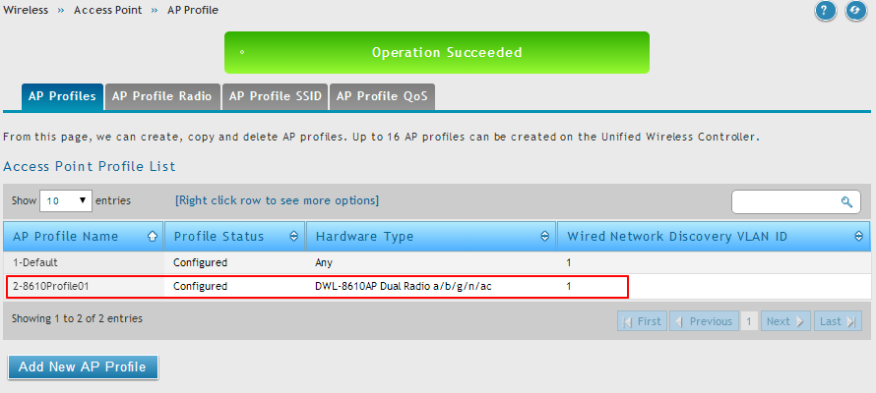
Add an AP Profile(4/5)
The newly created profile shows up in the “AP Profiles” list.

Slide 32
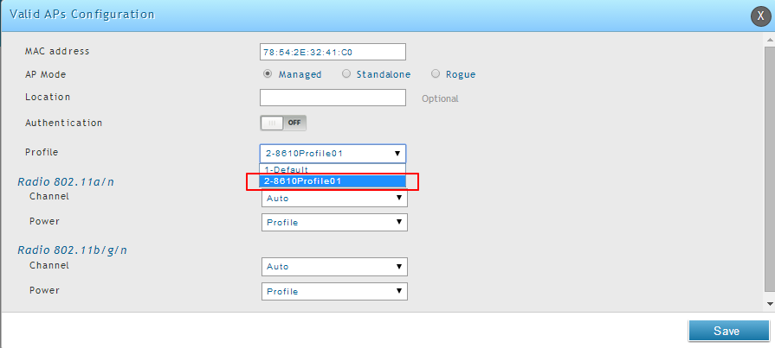
Add an AP Profile(5/5)
After the profile is created, it will show up in the profile list where it can be applied.

Slide 33
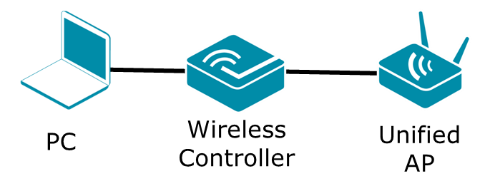
LAB 1: Use DWC-2000 to Manage APs
LAB Objectives: at the end of the lab, you will be able to use DWC-2000 to manage access points by applying a customized profile.
Tasks:
Configure the controller
Discover access points
Manage access points
Create an AP profile
Create a SSID named DEU-0x, where x stands for the group number. Use WPA2-personal, passcode: dlink123 as the security profile
Apply the AP profile to the access point
Associate to the SSID using your wireless clients
Raise your hand and tell me to verify it.
DWC-2000 IP: 192.168.10.5/24

Slide 34
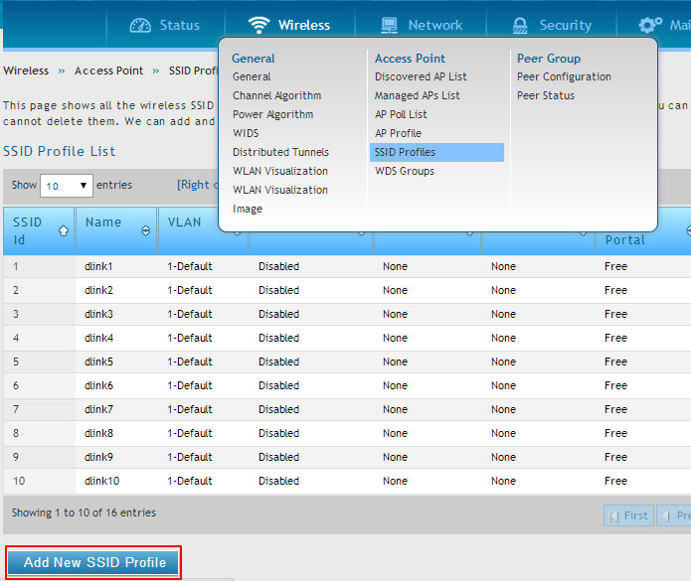
AP Profile SSID Setting(1/7)
You can select option to add a new SSID profile or modify the default SSID from the SSID profile list.

Slide 35
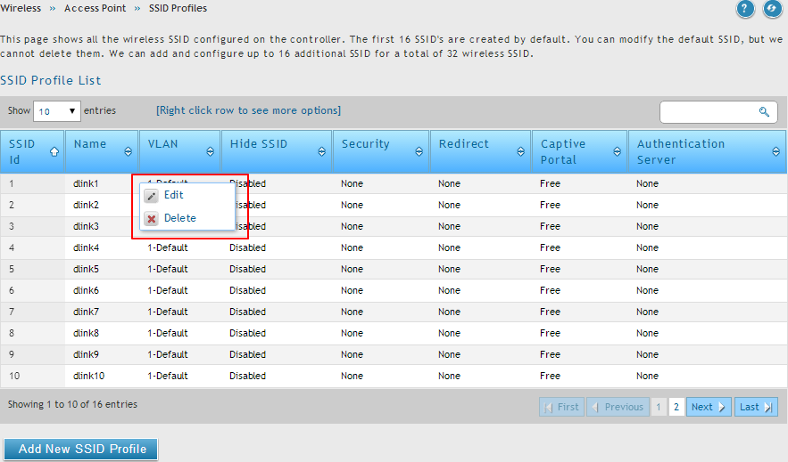
AP Profile SSID Setting(2/7)
Right click any of the 16 default SSIDs you would like to edit.

Slide 36
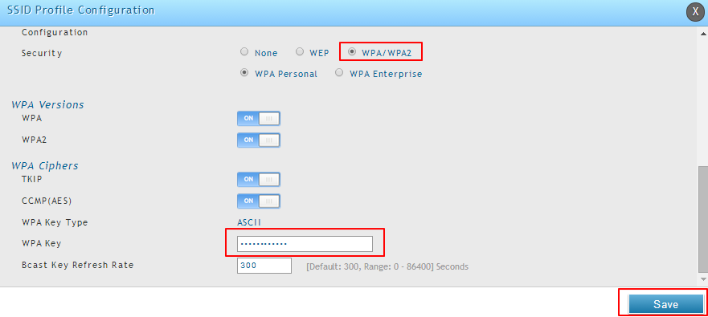
AP Profile SSID Setting(3/7)

Slide 37
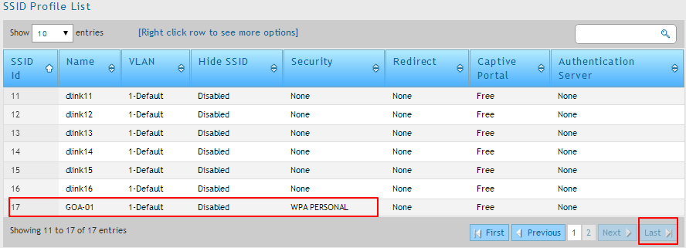
AP Profile SSID Setting(4/7)
Or you can experience the power of search again!

Slide 38
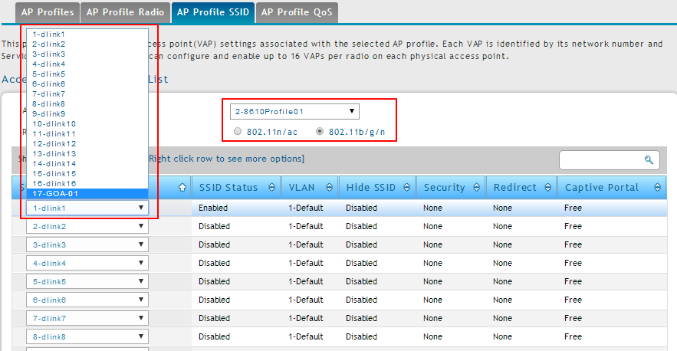
AP Profile SSID Setting(5/7)

Slide 39
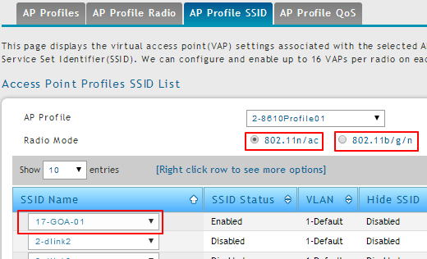
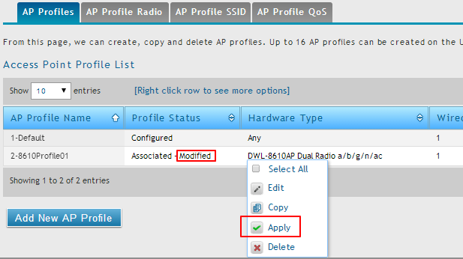
AP Profile SSID Setting(6/7)

Slide 40
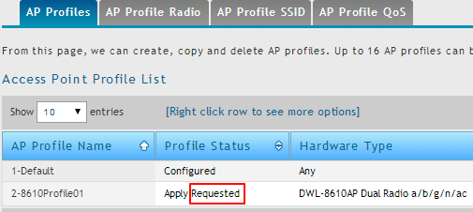
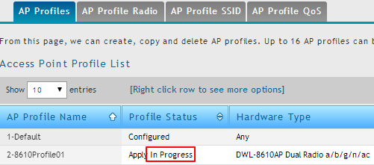
AP Profile SSID Setting(7/7)

Slide 41
Associated Wireless Clients
iPhone and the laptop wireless clients connect to GOA-1 SSID
Right click client to view more information

Slide 42
Associated Wireless Clients Actions

Slide 43
Scenario: separate and grant different privileges to company and personal devices
Description: Nowadays it’s very common for people to have multiple wireless devices, which are carried by employees to their company. A common policy of company IT team: your own device could only connect to the Internet whereas company devices could connect to both the Internet and the company resource.
Tasks:
Configure network infrastructure
Create company and BYOD VLANs
Create AP profiles and SSIDs
Configure captive portal for SSIDs
Create company user accounts
Add company device’s MAC address
Change AP’s profile to BYOD profile
Create and customize login profiles
Create captive portal accounts
Connect to both SSIDs
Verify the result
Internet
Company Resource
YOD (Your Own Device)
Company devices
Internet only
Full

Slide 44
Configure switches and gateway
VLAN | Name | IP (DSR) | IP (DWC-2000)
1 |  | 192.168.10.1 | 192.168.10.5
2 | v2 | 192.168.2.1 | 192.168.2.5
3 | v3 | 192.168.3.1 | 192.168.3.5
Internet
DSR
a
b
c
d
SSID1: company0x
SSID2: byod0x x stands for the group number
f
DGS
e
DWC
a. Port 1/trunk/ VLAN 1, 2, 3
b. Port 1/Tagged, VLAN 2, 3 /untagged VLAN1
c. Port 2/Tagged, VLAN 2, 3 /untagged VLAN1
d. Port 3/Tagged, VLAN 2, 3 /untagged VLAN1
e. Port 10/untagged/ VLAN 2
f. Port 4/Trunk/ VLAN 1, 2, 3
* Disable DSR wireless if any

Slide 45
Create VLANs on DWC(1/3)
Add VLANs

Slide 46
Create VLANs on DWC(2/3)
You are allowed to configure IP address during VLAN creation in new GUI.
You are also allowed to configure DHCP on the same page in the new GUI.

Slide 47
Create VLANs on DWC(3/3)
Verify your settings

Slide 48
Configure Port Property as Trunk

Slide 49
Create SSIDs(1/2)
Create 2 SSIDs: company0x and byod01 where x stands for group number.
MAC authentication is required for company0x SSID
SSID | company0x | byod0x
VLAN | 2 | 3
MAC Auth | Local | Default

Slide 50
Create SSIDs(2/2)
Verify your settings

Slide 51
Create an AP Profile(1/2)
Create an AP profile named BYOD, accepting any AP hardware type.

Slide 52
Create an AP Profile(2/2)
Change profile SSID setting for both radios.
Remember to enable the 2nd SSID.

Slide 53
Apply AP Profile to the AP
Apply the profile to the selected AP in Valid AP list if the access point is managed.
If access points are not managed, discover and manage them. You can assign the AP profile during AP management process.

Slide 54
Create CP User Account(1/2)

Slide 55
Create CP User Account(2/2)
Create a user name “user01” with a password “user01”

Slide 56
Add Company Device MAC

Slide 57
Connect Devices(1/3)
Connect company-owned devices to the company01.
Typing any valid IP, you will be redirected to company device portal.
Your own device could not connect to this SSID.

Slide 58
Connect Devices(2/3)
Your own device could only connect to byod01 SSID.
It is only allowed to connect to the Internet

Slide 59
Connect Devices(3/3)
You can verify the captive portal session from the “Captive Portal Session List” under Status → Network Information

Slide 60
LAB: separate and grant different privileges to company and personal devices
LAB time: 40 minutes
You need to finish all the tasks in order to separate company and personal devices and grant different privileges to those devices
Internet
Company Resource
YOD (Your Own Device)
Company devices
Internet only
Full

Slide 61
Scenario: Guest Management
Description: Nowadays it’s very common for company receptionists, hotspot managers, hotel front desk staff…etc. to manage visitors’ network access. This requirement can be carried out through DWC-2000 guest management function.
Tasks:
Create guest SSIDs
Create a front desk user
Create billing profile(s)
Login as a front desk and generate guest accounts
Test generated accounts

Slide 62
Guest Management
Create a SSID for hotel guests

Slide 63
Guest Management
Apply the SSID to both of the radios to the existing AP profile

Slide 64
Guest Management
Enable the SSID
Reapply the AP profile to access points

Slide 65
Guest Management
Create front desk accounts
Create a group for the front desk account in the first place.
Select “Front Desk” as the user type

Slide 66
Guest Management
Create accounts for the guest management group.

Slide 67
Guest Management
Create a billing profile for passcode generation.

Slide 68
Guest Management Hotel Scenario(1/9)
The usage scenario: One of our hotel customer would like to have their front desk staff to generate temporary Internet access accounts for their hotel guests.
The front desk staff is able to generate 10 codes at once.
The hotel gives their guests 24 hours complimentary wireless access for 2 devices after their first login.

Slide 69
Guest Management Hotel Scenario(2/9)
Sign in as a front desk to manage guest pass codes

Slide 70
Guest Management Hotel Scenario(3/9)
From here, the front desk staff could generate codes and view codes information.

Slide 71
Guest Management Hotel Scenario(4/9)
One code is generate; the front desk staff could print it.

Slide 72
Guest Management Hotel Scenario(5/9)
The front desk can extend the time and view code details.

Slide 73
Guest Management Hotel Scenario(6/9)
However, our customer would like its staff to generate multiple accounts at once. How could that be achieved?

Slide 74
Guest Management Hotel Scenario(7/9)

Slide 75
Guest Management Hotel Scenario(8/9)
Use one of the codes to sig in the portal

Slide 76
Guest Management Hotel Scenario(9/9)
After successful signing in, you are bring to the following message boxes.

Slide 77
Guest Management
Usage scenario: coffee shop
Requirement:
Shop clerks could generate and manage their guest Internet access codes.
Policy: the code could be only used by one device and is valid for 2 hour. The shop clerk could extend the time per request.
Usage scenario: hotspot or business lobby
Requirement:
Receptionists could generate and manage their guest Internet access codes and usage
Policy: two types of codes will be issued:
3-hour code
100 MB code
Users could consume time and traffic volume from multiple devices at the same time

Slide 78
Guest Management Coffee Shop Scenario(1/2)

Slide 79
Guest Management Coffee Shop Scenario(2/2)

Slide 80
Guest Management Hotspot Scenario(1/9)
Usage by time

Slide 81
Guest Management Hotspot Scenario(2/9)
Usage by traffic volume

Slide 82
Guest Management Hotspot Scenario(3/9)
Verify the billing profiles you created

Slide 83
Guest Management Hotspot Scenario(4/9)
Generate time-based codes.

Slide 84
Guest Management Hotspot Scenario(5/9)

Slide 85
Guest Management Hotspot Scenario(6/9)
Generate volume-based codes.

Slide 86
Guest Management Hotspot Scenario(7/9)

Slide 87
Guest Management Hotspot Scenario(8/9)
Sign in with a time-based code.
Observe from front desk management page.

Slide 88
Guest Management Hotspot Scenario(9/9)
Sign in with a volume-based code.
Generate traffic and observe from front desk management page.

Slide 89
Guest Management LAB
LAB time: 30 minutes
You need to practice the 3 Scenarios
Hotel
Coffee shop
Hotspot or lobby

