Slide 1
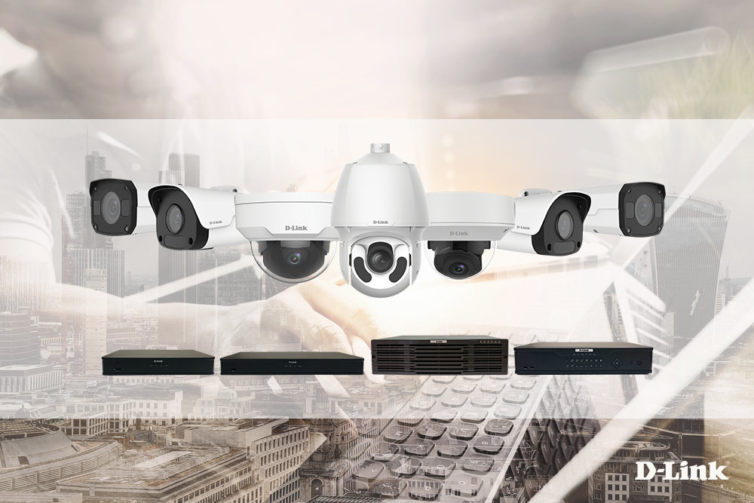
IP Cameras Product Introduction
DCS-F5xxx Series – Easy and Pro Series

Slide 2
Content
01
Product Layout
Easy/Pro product lines
02
Easy Series
Entry Level
03
Pro Series
Vertical Application

Slide 3
Product Layout
Easy Series
Pro Series

Slide 4
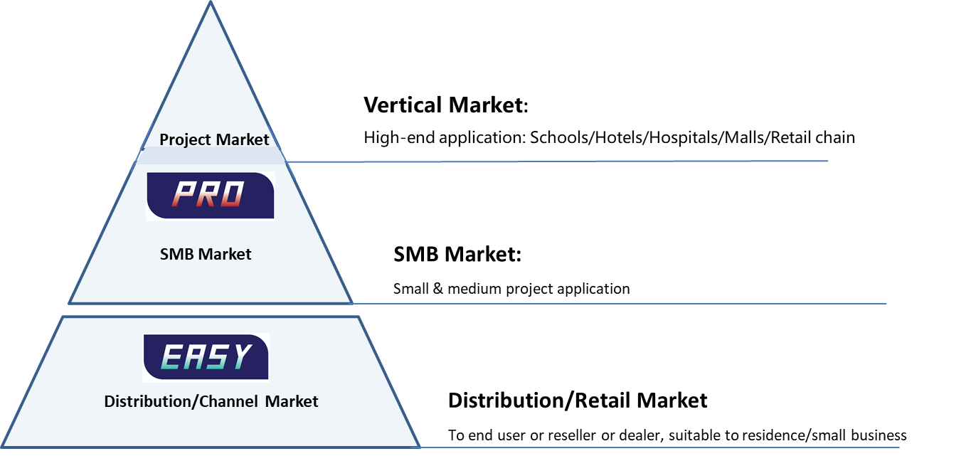
Product Overview– IP Cameras

Slide 5

Features– IP Cameras
Easy Series
Pro Series
Highlight Features
Smart Functions
PixelSense
Smart IR
Ultra 265
Face Detection
Intrusion Detection
Cross Line Detection
Object Abandon
Object Removal
People Counting
Defocus Detection
Scene Change
Auto Tracking
Vertical Application
Easy to Use/Maintain
4K Series
StarLight & Super Starlight
Pro Series Cameras also supports all the features of Easy Series Cameras
Network Security
2/5/8MP Starlight series
Low-blur mode to reduce smearing
Excellent Quality
True WDR

Slide 6
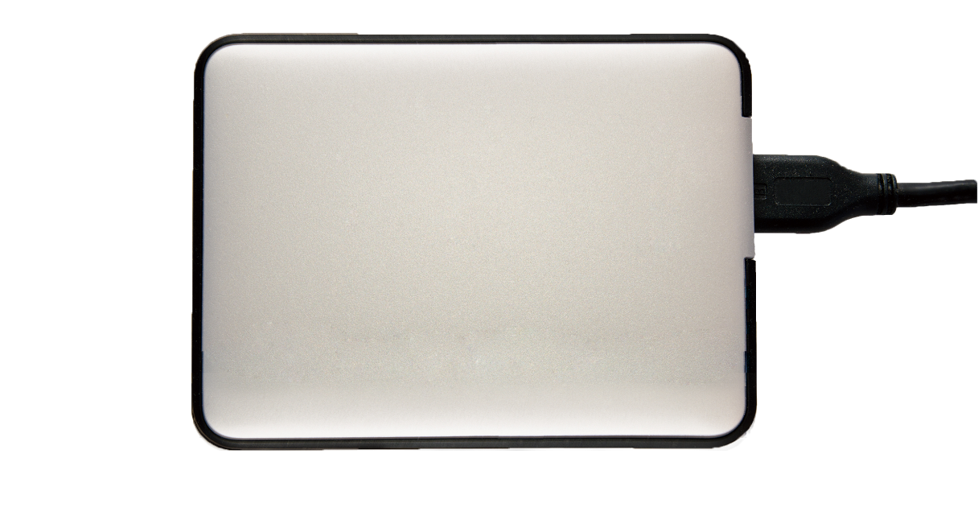




Ultra 265 Supported
+
=
H.264
Ultra
Ultra 265
H.265
H.265
H.264
Ultra 265
Ultra 265 advanced mode
The common video compression technology in video surveillance industry
The most advanced video compression technology in video surveillance industry
Up to 50% OFF
Up to 95% OFF
Up to 75% OFF
The deep video compression technology help to reduce
the bitrate based on H.265
Hard disk usage in the same application

Slide 7
Easy Series
Entry Level

Slide 8
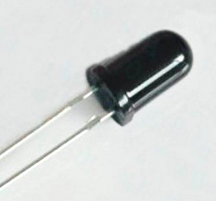
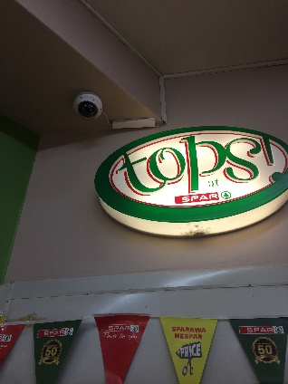
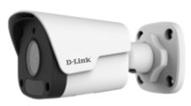
Highlight Features – PixelSense
Innovative Day & Night change detection
Based on smart software image processing
More sensitive to trigger IR cut
PixelSense
Hardware sensor
Detect illumination of installation
Detect real surveillance scene illumination
Avoid extra cost of hardware failure
Water and dust proof design

Slide 9
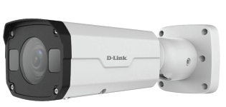
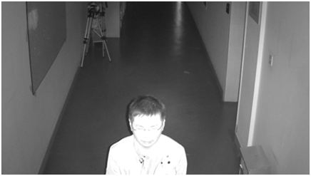
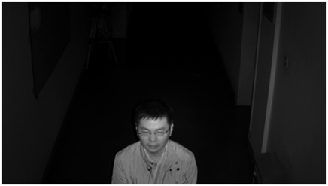
Smart IR
Smart IR
Smart IR function balances the luminance level between distant and nearby objects, providing consistently clear image of moving objects under low light scenes.

Slide 10
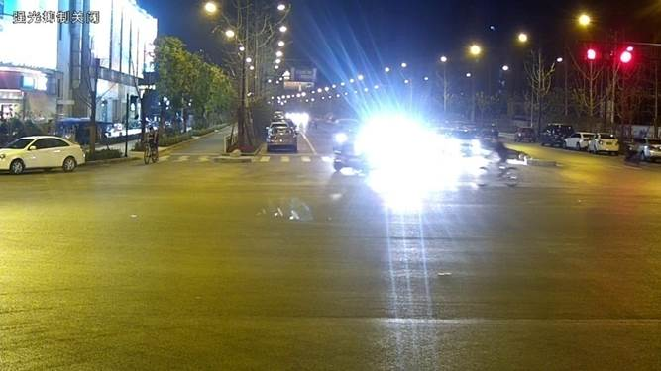
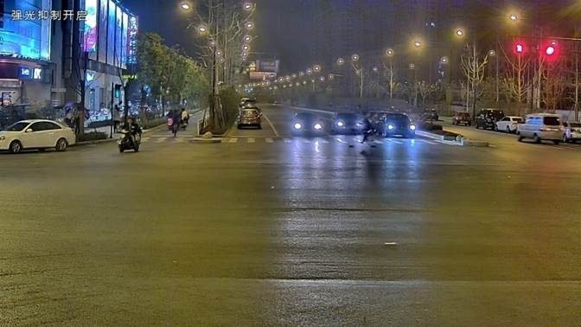
High Light Compensation
HLC On
D-Link IP cameras with HLC function, help see clearly under strong lights.

Slide 11
Feature Highlights
Separate codec for moving target and static background to reduce bitrate
Good image quality
Deep
Video compression
Triple streams
Supports triple streams
Dynamic frame rate
Control frame rate depending on the video content

Slide 12






More Efficient – Easy to Use
One-click upgrade
Cloud upgrade
Plug & Play
Easy to upgrade device by one-click
One-click upgrade IPC & NVR over cloud
FULL MEMBER
HTML5
Compatibility
Support Onvif (Profile S/G/T), LAPI and SDK

Slide 13
More Efficient – Easy to Maintain
One-click output diagnosis log
Easy to output diagnosis log for effective troubleshooting
One-click download/upload configuration
Quick configuration for all IP cameras by
One-click duplicating uploaded parameters
Network disconnection detection
Detect network connection regularly.
Automatically reset network module or reset IPC once network disconnection detected

Slide 14
More Reliable – Cyber security
Video Encryption
Digital Signature Verify on Cloud Upgrade
Digital Watermark
HTTPS
Data protection
IP Filtration
ARP Protection
Shutdown Unsafe Service/Port
Black and white list
Limited Access
Identity
Authentication
Strong & weak Password
802.1x Authentication
RTSP,Onvif,HTTP authentication
Classification for user authentication

Slide 15




Cyber security – Highlight Features
Various authentications
Illegal login protection
Password security level
802.1X
RTSP
ONVIF
LAN : Weak password
WAN : Strong password
Black/white list
Watermark
Secured architecture
Black
list
White
list
192.168.1.1
192.168.1.2
192.168.1.3
192.168.1.4
……
192.168.2.1
192.168.2.2
192.168.2.3
192.168.2.4
……
Embedded
Linux OS
More Secure
Telnet On/Off
HTTPS
ARP Protection
Multiple
network protections
802.1x
PASS
Notes:
（1）Various authentications to identify credible client to access.
（2）Input wrong password 5 times will trigger illegal login alarm. The device will be locked for 10 minutes to prevent illegal login attempts.
（3）Different password security level between LAN and WAN
（4）Black/white list can be configured to forbid or allow some clients to access device.
（5）Watermarks can be used to verify the authenticity or integrity of the video or to show the identity of its owners

Slide 16
Easy Series – Bullet Cameras
Fixed Bullet Network Cameras
Vari-Focal & Motorized Bullet Network Cameras

Slide 17
Easy Series – Dome Cameras
Fixed Dome Network Cameras

Slide 18
Easy Series – Dome / Fisheye Cameras
Vari-Focal & Motorized Dome Network Cameras
Fixed Fisheye Network Cameras

Slide 19
Pro Series
Vertical Application

Slide 20
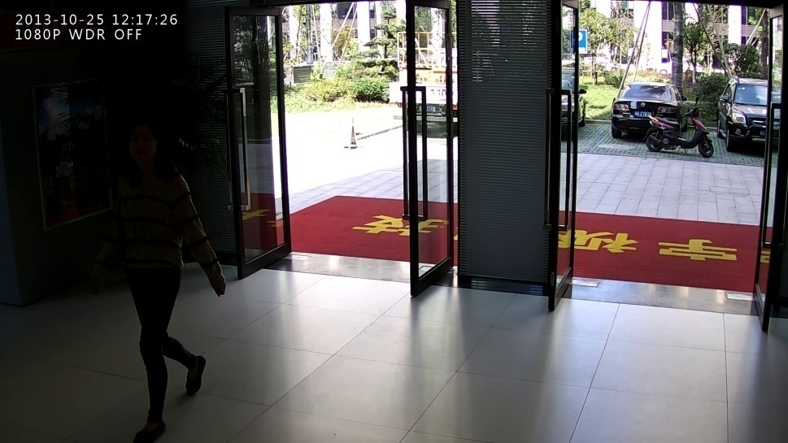
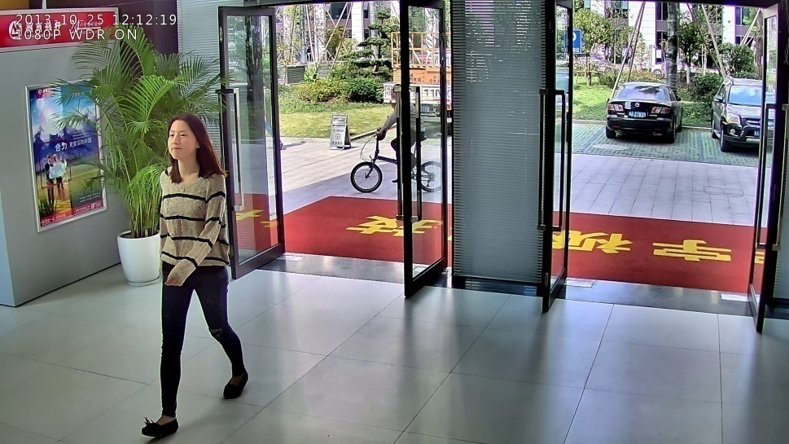
Camera Features – True WDR
WDR
“120dB” WDR balances the complicated illumination in entrances and exits

Slide 21
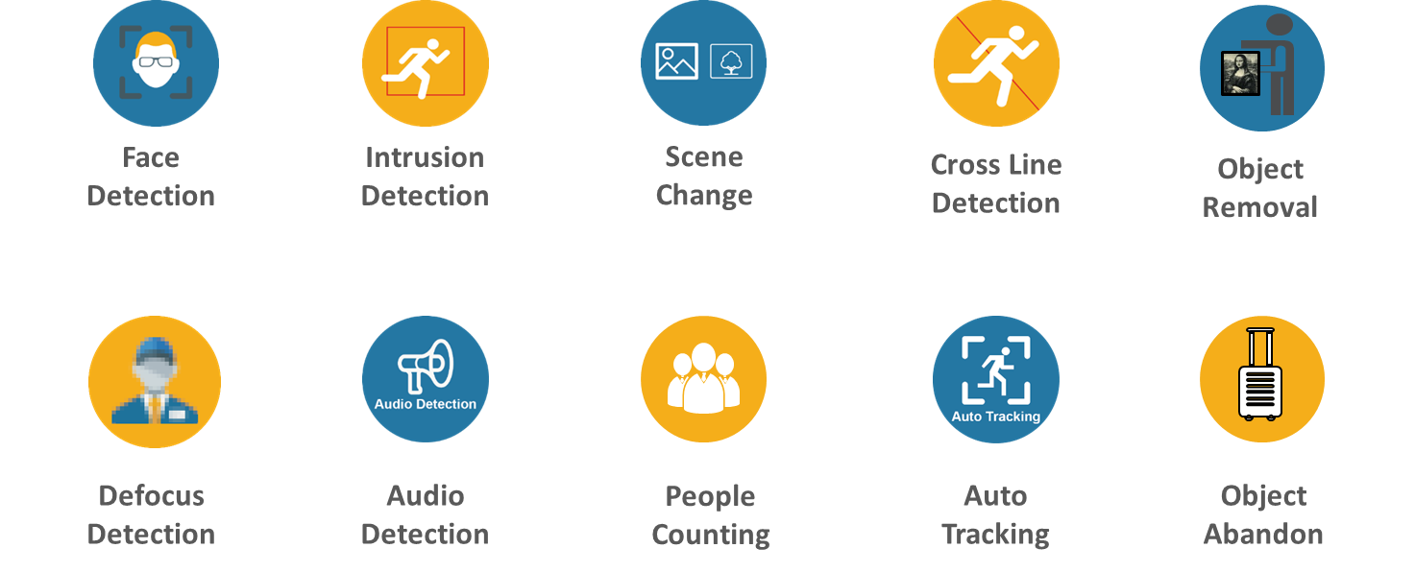
Pro Series - Smart Functions Supported

Slide 22

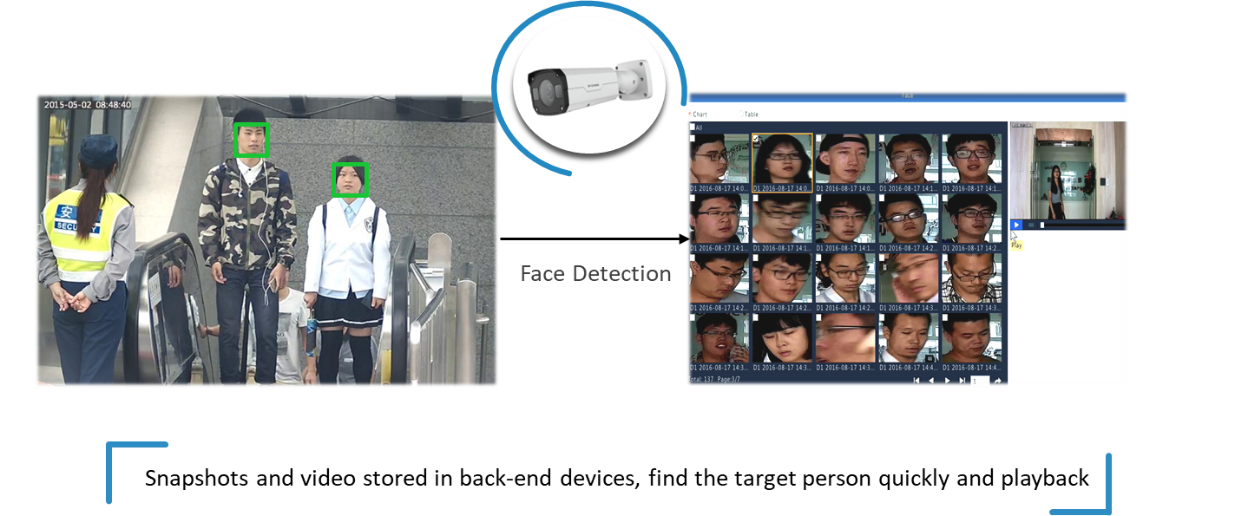
Face Detection

Slide 23

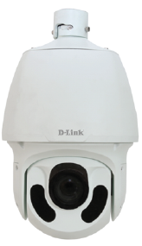
Auto Tracking
Auto Tracking helps to recognize moving objects and be tracked by D-Link Pro Series PTZ dome cameras.

Slide 24

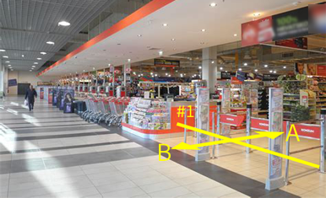



Cross Line Detection
Bullet
NVR
Cross Line Detection can be deployed at restricted areas.
When the cameras detect a cross line event, they can notify the management center immediately.

Slide 25
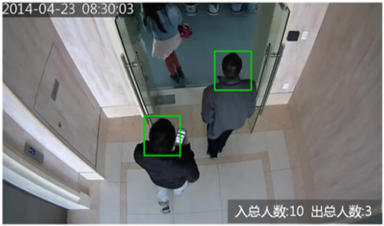

People Counting
Entrance: 10 Exit: 3
Entrance:10 Exit:8
People Counting at entrance and exit
Export Report

Slide 26

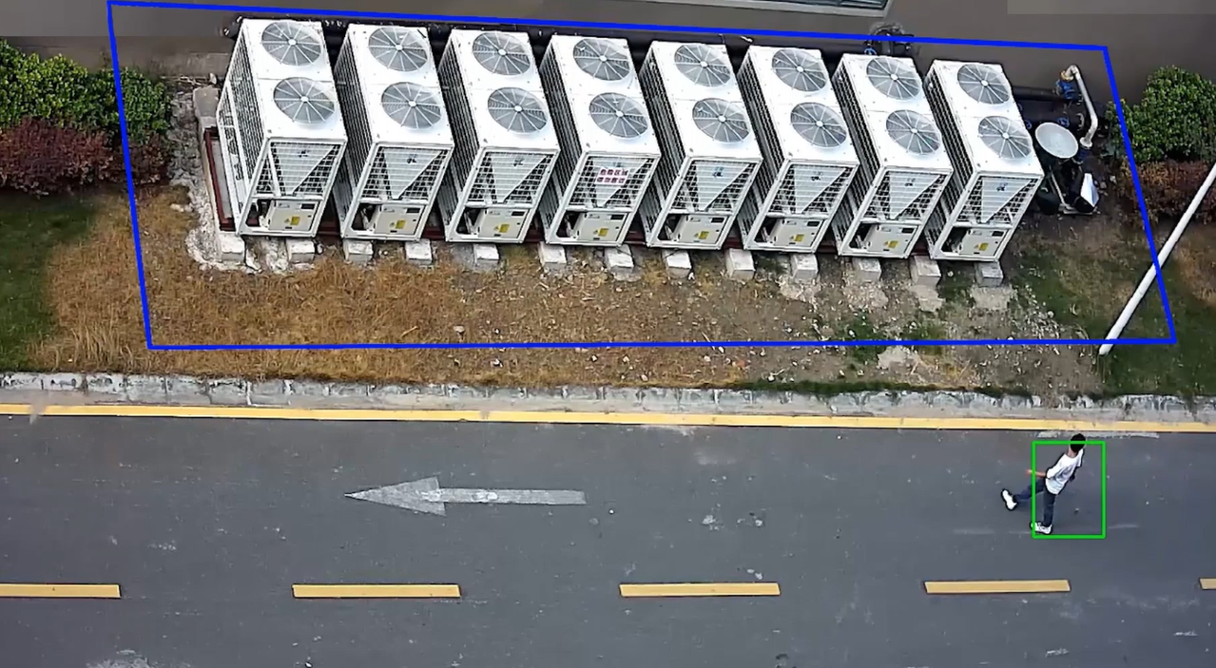
Intrusion Detection
Intrusion detection can be set in restricted zone to prevent unauthorized entry.

Slide 27
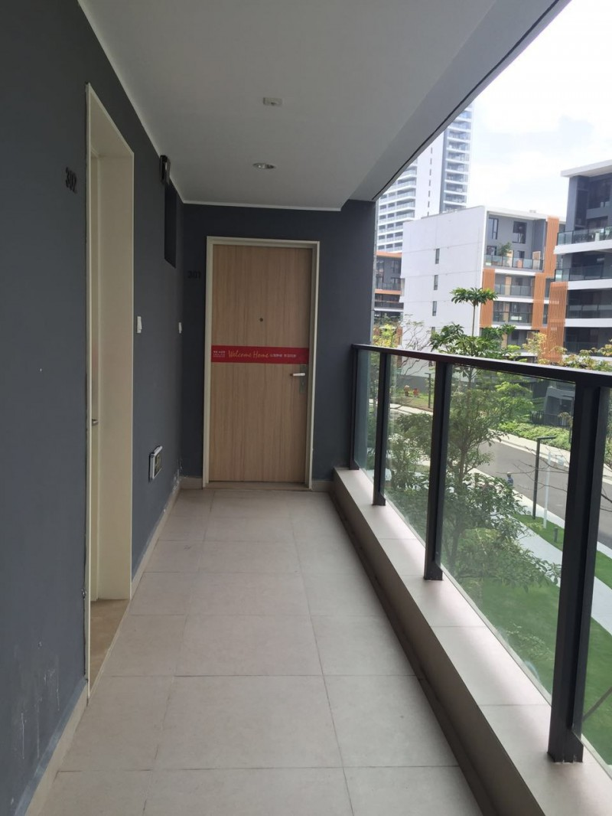
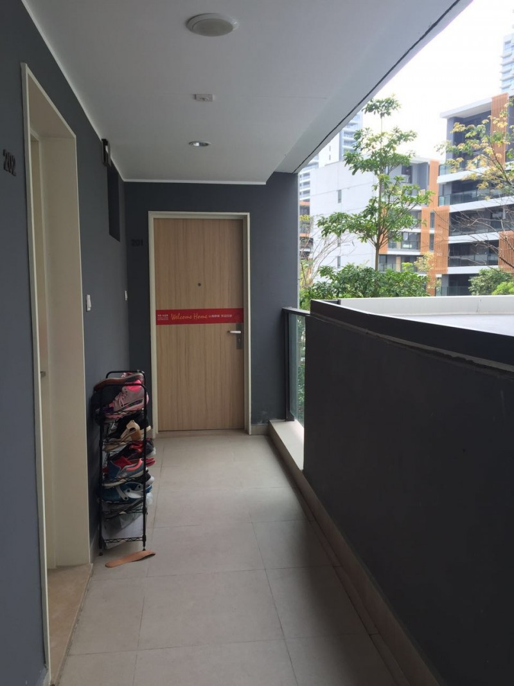
Object Abandon
Normal
Alarm
Object Abandon function can automatically detect objects in specified areas & trigger an alarm.

Slide 28
Pro Series – Fixed Bullet Cameras

Slide 29
Pro Series – Fixed Dome Cameras

Slide 30
Pro Series – Vari Focal & Motorized Bullet Cameras

Slide 31
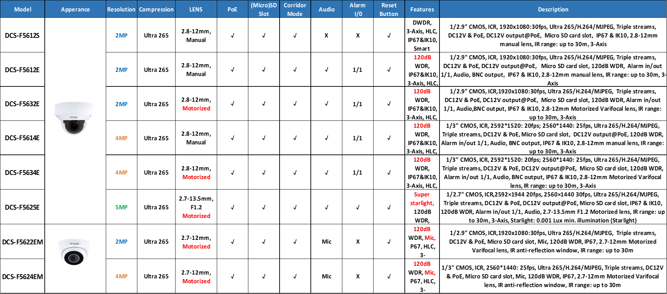
Pro Series – Vari Focal & Motorized Dome Cameras

Slide 32
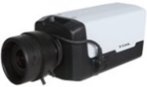
Pro Series – PTZ Network Cameras
Pro Series – PTZ Network Cameras

Slide 33
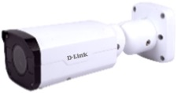
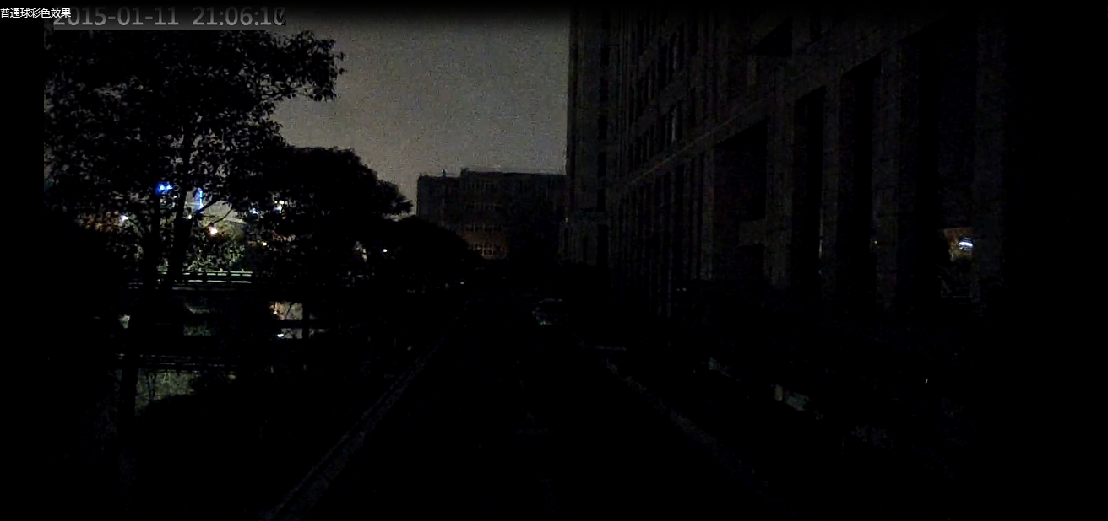
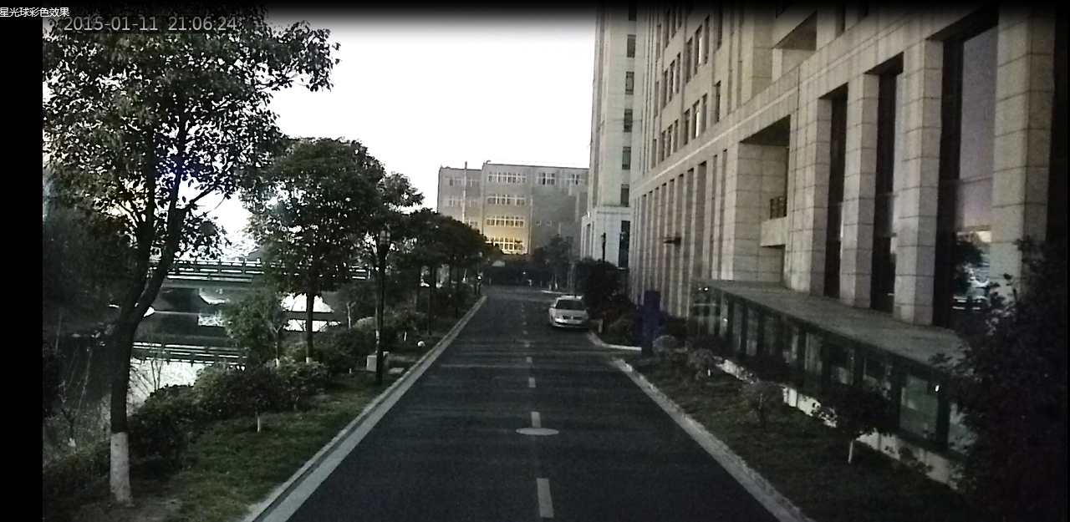
Starlight Cameras
Starlight
F1.2 aperture lens with Sony STARVIS image sensor
Colored image at low illumination scene.

Slide 34
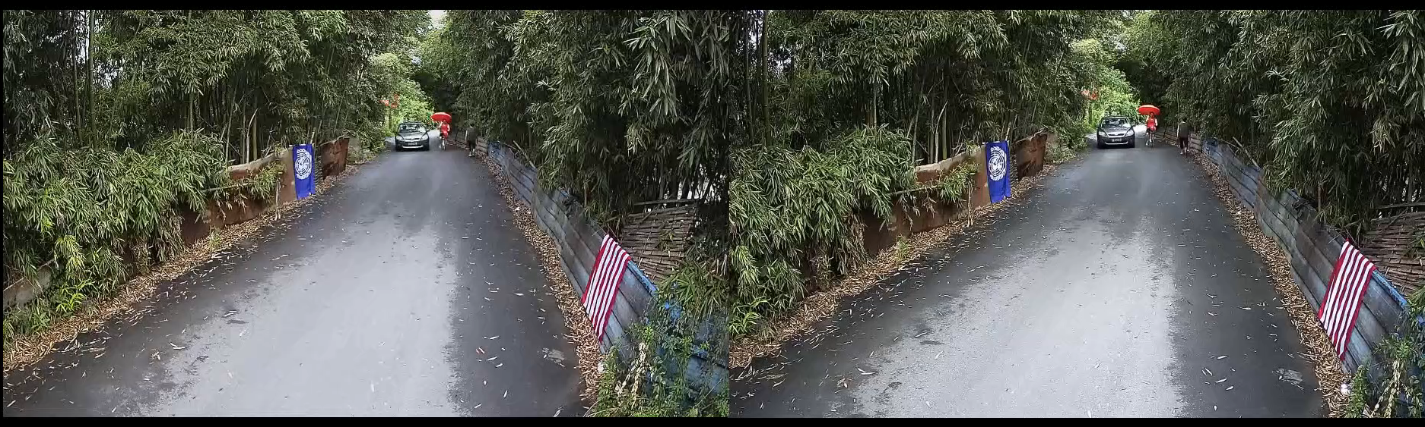
Low-blur mode to reduce smearing
D-Link Low-blur Mode with Starlight
Competitor’s Camera
Low-blur help to see both static and moving objects clearly

Slide 35
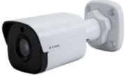
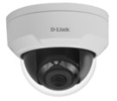

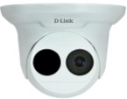
Pro Series – Starlight Network Cameras

Slide 36
Pro Series – Super Starlight Network Cameras

Slide 37


Super Starlight
Starlight
Super Starlight
Producing colorful video images under ultra-low light conditions (0.0005Lux) without losing any details.

Slide 38
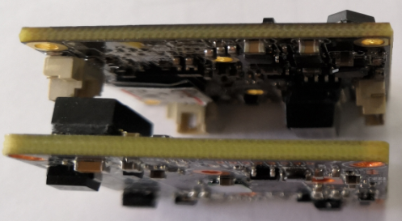
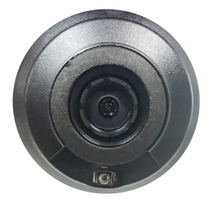

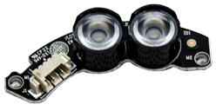

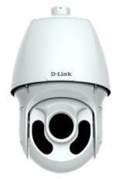
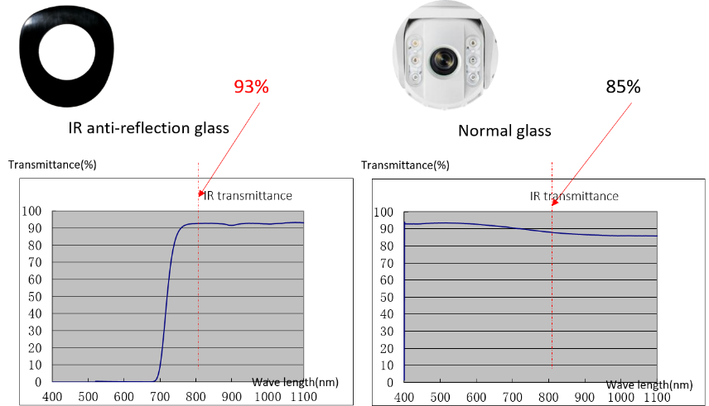
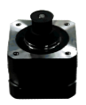
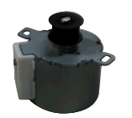
Reliable and Quality Products
1.6mm
IK10 Vandal proof
2mm
Car-grade LED
IP67 water proof
5th generation LED to
increase light compensation
2mm thickness PCBA
Avoid defocus by deformation
Anti-reflection glass
Increase the infrared transmittance as 8%
Upto 60fps
Optimized fps
Stepping motor
on all PTZ models

Slide 39





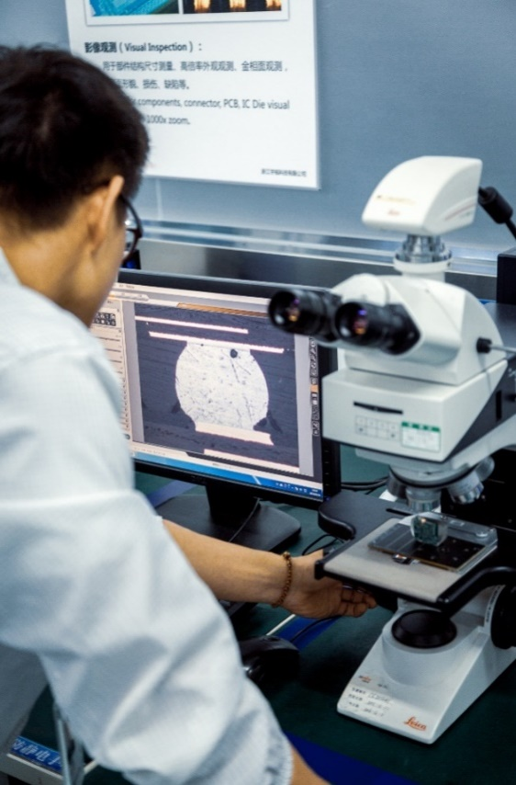
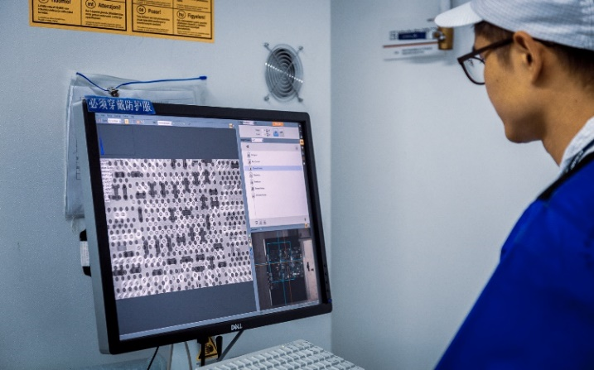


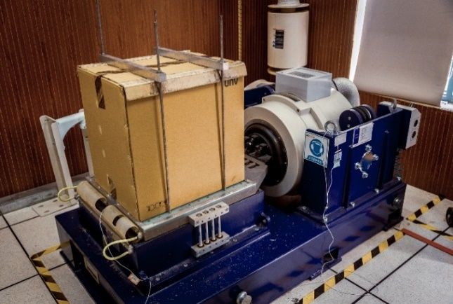

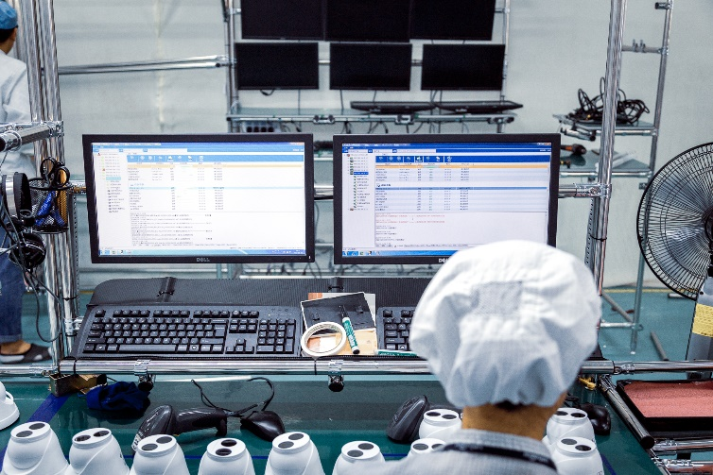
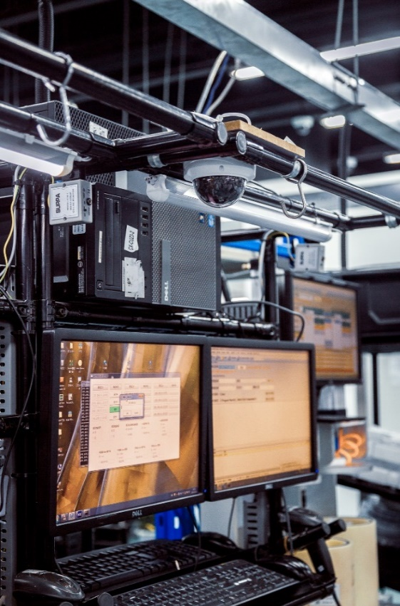
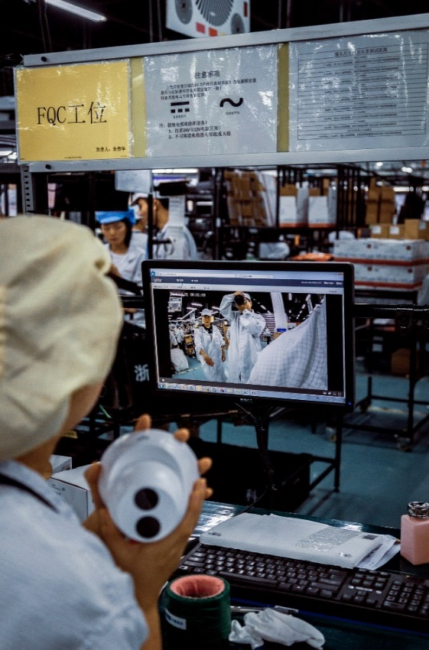

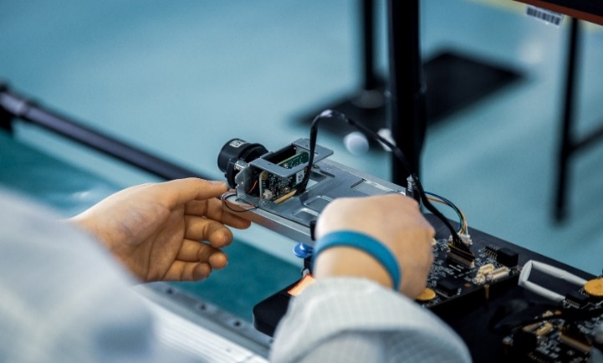
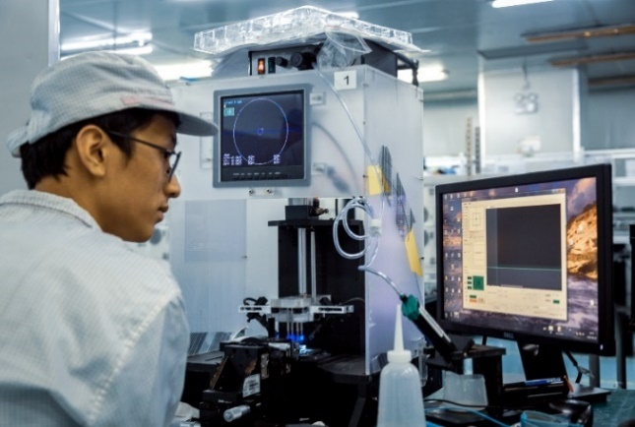
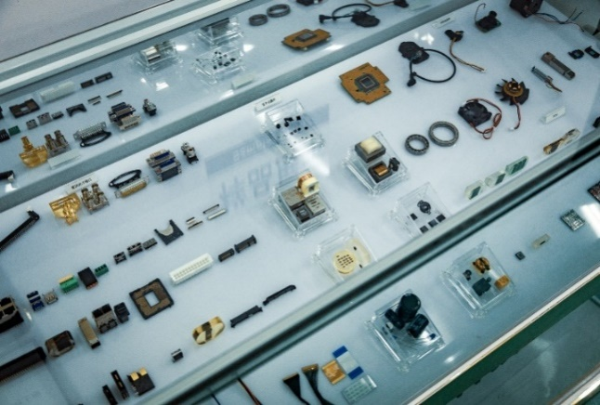
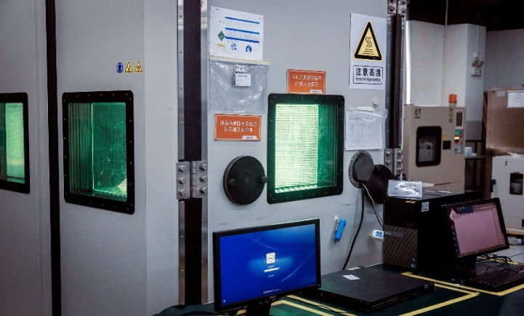

Quality & Performance Assurance
Sensor Dedusting
Sensor Flatness Test
Cross-section analysis
Salt Spray Test
X-Ray Verification
3D Measurement
Selective Component
Anti-Vibration Test
HALT Test
Auto SW Inspection
Traceability System
Sample Testing
Dust-Free room
100% Focus Tuning
Drop Test

Slide 40

D-Link Core Competence

Slide 41
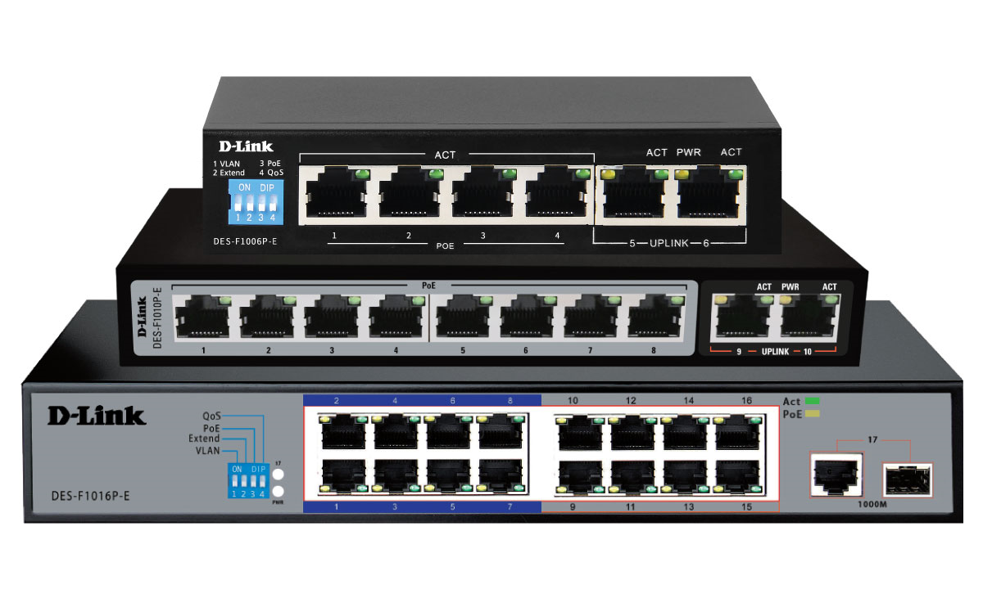

Long Range PoE+ Surveillance Switches
The D-Link Long Range PoE+ Surveillance Switches series provides a flexible and cost effective solution to power POE enabled IP Cameras and even also other PoE enabled devices like wireless access points , IP phones , access control system etc overcoming the distance limitation of 100 meters in general PoE power transmissions , the series is able to achieve a distance of upto 250m
Model | DES-F1006P-E | DES-F1010P-E | DES-F1016P-E
Description | 6-Port Fast Ethernet with 4-Port PoE+ Switch | 10-Port Fast Ethernet with 8-Port PoE+ Switch | 16-Port Fast Ethernet PoE+ Switch with 1 Gigabit Combo Port
PoE Power Budget | 60W | 96W | 150W

Slide 42
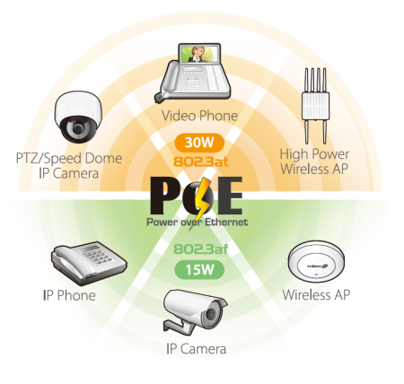
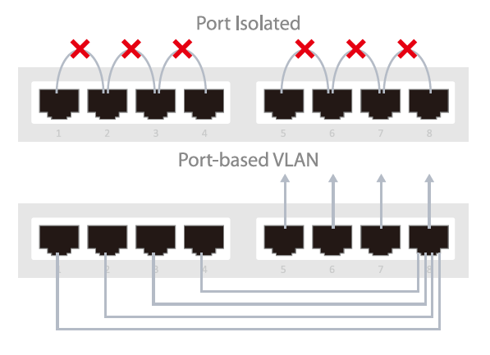


Long Range PoE+ Surveillance Switches
Flexible
PoE Deployment
Innovative
Port-Based VLAN
Easy
Hardware QoS
DIP Switches

Slide 43

2-Port Gigabit PoE+ Extender
The DPE-302GE 2-Port Gigabit PoE Extender allows a Gigabit Power over Ethernet connection to be extended up to 500 m. It is designed to transmit data and supply up to 30 W of power to PoE-capable devices such as PTZ IP cameras or 802.11ac wireless access points, using PoE
power source equipment (PSE). With several mounting options, the DPE-302GE allows PoE devices to be deployed virtually anywhere over longer distances, eliminating the need for a nearby power outlet and attached power supply.

Slide 44


Application Scenarios

Slide 45


Copper Products

Slide 46

Fiber Products

Slide 47










D-Link End to End Business Solutions
Switching
IP Surveillance
Wireless
Security
Storage
Transceivers &
Media Converters
IP Telephony
Structured Cabling

Slide 48


Moonflower Labour Camp – Building Solution
Solution Highlights:
IP surveillance solution with 1500 plus IP cameras & 128 Channel NVR’s with HDD for local recording along with VMS server DCS-F500 for centrally monitoring & managing the surveillance solution
Easy & Pro Series Cameras with Smart Features proposed
LPR cameras with 3rd party integration LPR software Digifort for management
Layer 3 Fiber Managed Redundant Core Switches , Stackable PoE Edge Switches at IDF’s
UTM Firewall for securing the school network
Fiber and Copper Structured cabling solution including loaded patch panels ,Cat6 cables and 6 /12 core SM fiber cables to support the cabling infrastructure for connecting different buildings

Slide 49

Al Ahiliya Hospital – Healthcare Solution
Solution Highlights:
IP surveillance solution with 600 plus IP cameras & 16, 32 & 128 Channel NVR’s along with HDD across 6 locations for managing , monitoring and recording the surveillance solution
Easy & Pro Series Cameras with Smart Features proposed
LPR cameras with 3rd party integration LPR software Digifort for management
Layer 3 Fiber Managed Redundant Core Switches , Stackable PoE Edge Switches at IDF’s
Copper Structured cabling solution including unloaded patch panels with accessories ,Cat6 cables to support the cabling infrastructure in each location

Slide 50

AMC Cinemas-KSA-Building Solution
Solution Highlights:
IP surveillance solution with 350 plus IP cameras & 128 Channel NVR’s along with HDD across 8 locations for managing , monitoring and recording the surveillance solution
Redundant Power supply for the NVRs
Pro Series Cameras with Smart Features proposed
IP Telephony solution with IP phones and PBX system for the locations
Supports current network infrastructure at each location

Slide 51

Gorash Hotel-KSA – Hospitality Solution
Solution Highlights:
IP surveillance solution with 250 plus IP cameras & NVR’s to centrally manage the surveillance monitoring and recording
Modular Chassis Solution for high speed performance
Stackable Edge switches for ease of IDF Management
Unified Wireless solution for centralized management of the access points
Hotspot Billing solution for guest management
IP Telephony solution for Admin & Guest Rooms
Fiber and Copper Structured cabling solution to support cabling infrastructure of the premise

Slide 52

Aqsa School-UAE – Education Solution
Solution Highlights:
IP surveillance solution with 200plus IP cameras and NVR’s to centrally manage the surveillance monitoring and recording
Layer3 Redundant switching solution for the Core network
Managed PoE+ switches at the edge to support PoE+ connectivity to the end devices
Hardware Controller Based Wireless solution to support E-Learning Platform implemented by KHDA UAE
IP Telephony solution for the school staff
Fiber and Copper Structured cabling solution to support cabling infrastructure of the premise
UTM Firewall for securing the school network

Slide 53

Al Nomais Pharmacy-KSA- Healthcare Solution
Solution Highlights:
IP surveillance solution with 125 plus IP cameras & 16 Channel NVR’s along with HDD across 15 locations for managing , monitoring and recording the surveillance solution
Easy & Pro Series Cameras with Smart Features proposed
Layer 3 Fiber Managed Core Switches , Stackable PoE Edge Switches at IDF’s
Copper Structured cabling solution including unloaded patch panels with accessories ,Cat6 cables to support the cabling infrastructure in each location

Slide 54

Konga.com-Nigeria – Building Solution
Solution Highlights:
IP surveillance solution with 200 plus IP cameras and NVR’s to centrally manage the surveillance monitoring and recording from multiple locations
Layer 3 Redundant switching solution for the Core network
Managed PoE+ switches at the edge to support PoE+ connectivity to the end devices
Hardware Controller Based Wireless solution for offices and warehouses
Fiber and Copper Structured cabling solution to support cabling infrastructure for various sites
UTM Firewall for VLAN connectivity

Slide 55



Thank you!

