Slide 1
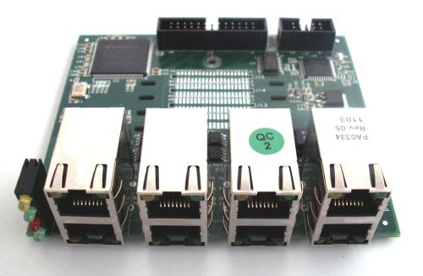
DVX - 8040 1-8 port BRI module For DVX-3000/8000/9000
2 port ( dual BRI ) supporting 4 Channel
4 ports ( quad BRI ) supporting 8 Channel
8 port ( quad-port BRI ) supporting 16 Channel

Slide 2
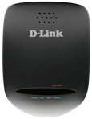
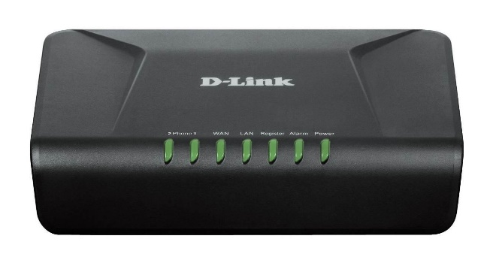
DVG-5102S
2 Port FXS Gateway
2 port analog VoIP Telephone Adapter (ATA)
1 WAN, 1 LAN, 2 FXS ports
Multi SIP Account, Call Back on Busy Digit Map ,Hot Line and Warm line calling, Direct IP-to-IP Call ,Music on hold, MWI, 3-way call conference
DVG-2102S

Slide 3
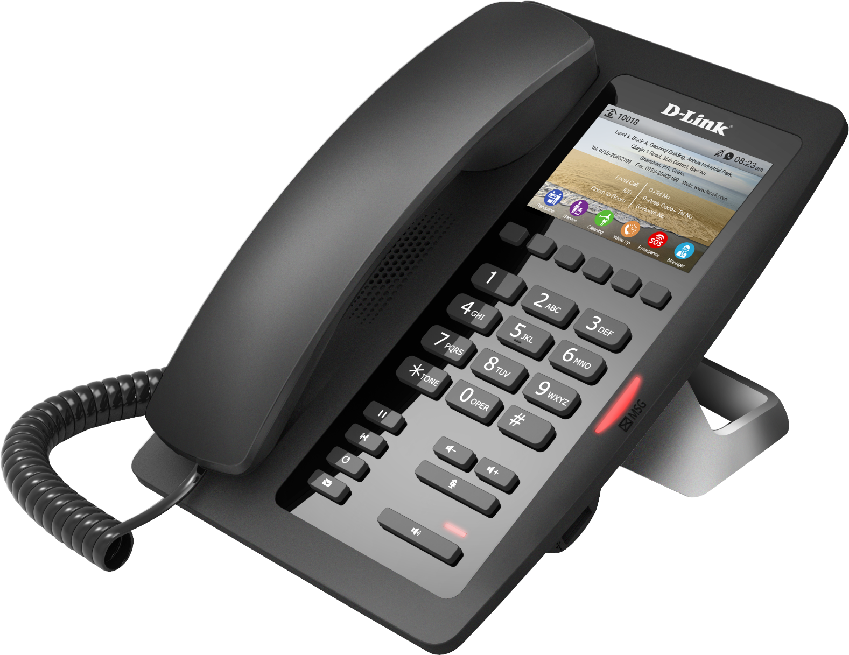
PH-200SE
Hotel IP Phone
2 RJ-45 10/100BASE-TX Ethernet ports
1 SIP line, HD Voice, Color Screen, Voice Message Waiting Indication (VMWI)

Slide 4
Thank You
Notes:
4

