Slide 1
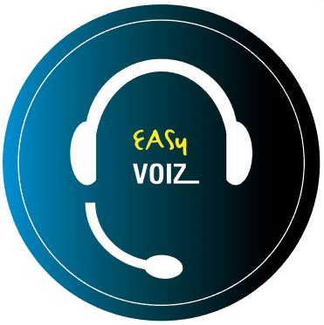
Introducing EasyVoIZ 5
Version 5

Slide 2
EasyVOIZ 5 is based on a highly responsive graphic user-interface that facilitates the management of Asterisk servers, in a fast, intuitive, and secure manner.
The system is based on a 3-level menu system that makes it very easy to locate any item that you want to manage.

Slide 3
Comparison between EASY VOIZ and DVX Elastix version
 | EasyVoIZ | Elastix (current DVX version)
Operating System | CenOS 7 contains much fresher and secured components such as Apache, MySQL etc | CentOS v.5.9
Management system | EasyVoIZ | FreePBX

Slide 4
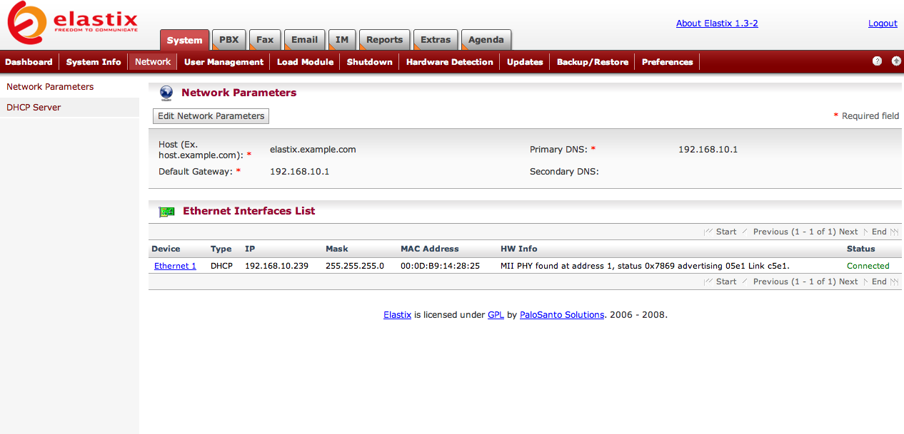
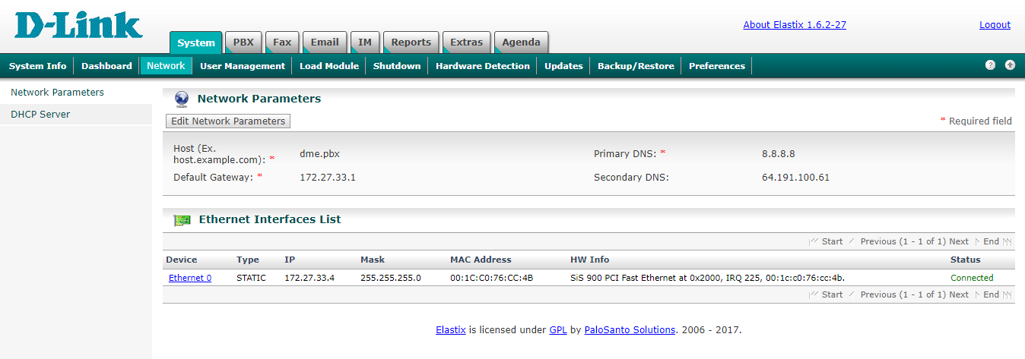

Slide 5
Highlights & Features
Class of Service
Boss/Secretary
Hot Desking
Call completion
Call Center
Each extension may have unlimited devices
Supported all voice codecs (free & unlimited)
Wake-up Calls / Reminders
Personal recording / notes
IP phone provisioning
PBX status reports
Storage monitoring
Switchboard
View

Slide 6
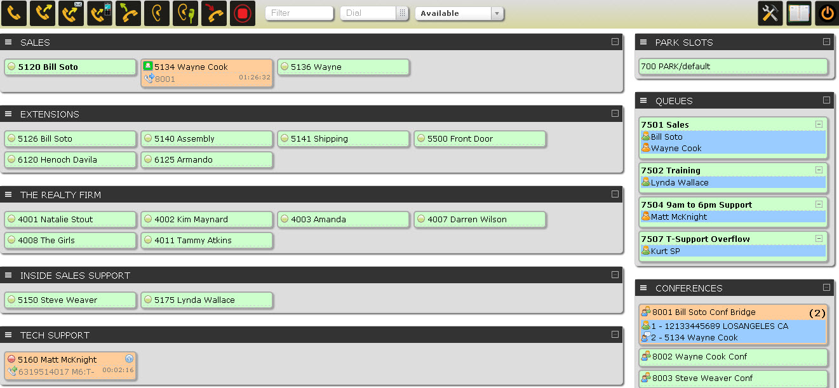
Call Center Functionality in EasyVoIZ
The standard version of EasyVoIZ includes entry-level call center functionality
Embedded browser-based switchboard
Customization options for:
Queues
Announcements
Failover
“Lite” statistics reporting

Slide 7
Feature-Rich Dashboard on Switchboard
Quick Status Check
Who’s free
Length of current call
Identification of call party
“Listen”
Listen to calls in progress
Great for quality monitoring
“Whisper"
Speak with staff during call without interrupting the conversation
Great for training
Internal dialogue
Consultation between staff during calls
Notes:
EasyVoIZ Call Center features include:
Queue Options
Agent Call Announcement*
Join Announcement
Announcement to Caller
Message On Hold by Queue
Ringing instead of MoH
Maximum Wait Time
Maximum Callers
Ring Strategy
Ring All; Round Robin; Least Amount of Calls; Random; Round Robin w/Memory
Wrap-up Timer
Call Recording
Agent Event Recording*
Queue Priority*
Customer Care Callback*
Caller Position Announcements
Frequency
Announce Positions
Announce Average Hold Time*
Failover Destination
Define a destination where the call should be transferred if Maximum Wait Time or Maximum Callers thresholds are reached
Periodic Announcements
Frequency
Option allowing caller to press a key and exit the queue
Can be sent to:
Customer Care Callback
Voicemail
Alternate Answer Point
* Indicates features that are normally optional for other call center packages

Slide 8
Queue Options
Agent Call Announcement
Announcement to Agent
Join Announcement
Announcement to Caller
Message On Hold by Queue
Ringing Instead of Message on Hold
Maximum Wait Time
Maximum Callers
Ring Strategy
Ring All; Round Robin; Least Amount of Calls; Random; Round Robin w/Memory
Wrap-up Timer
Call Recording
Agent Event Recording
Queue Priority
Customer Care Callback

Slide 9
Announcements & Failover Options
Caller Position Announcements
Frequency
Announce Positions
Announce Average Hold Time
Periodic Announcements
Frequency
Option to have caller press a key and exit the queue
Can be sent to:
Customer Care Callback
Voicemail
Alternate Answer Point
Failover Destination
If Maximum Wait Time or Maximum Callers intervals are reached, define destination where the call should be transferred

Slide 10
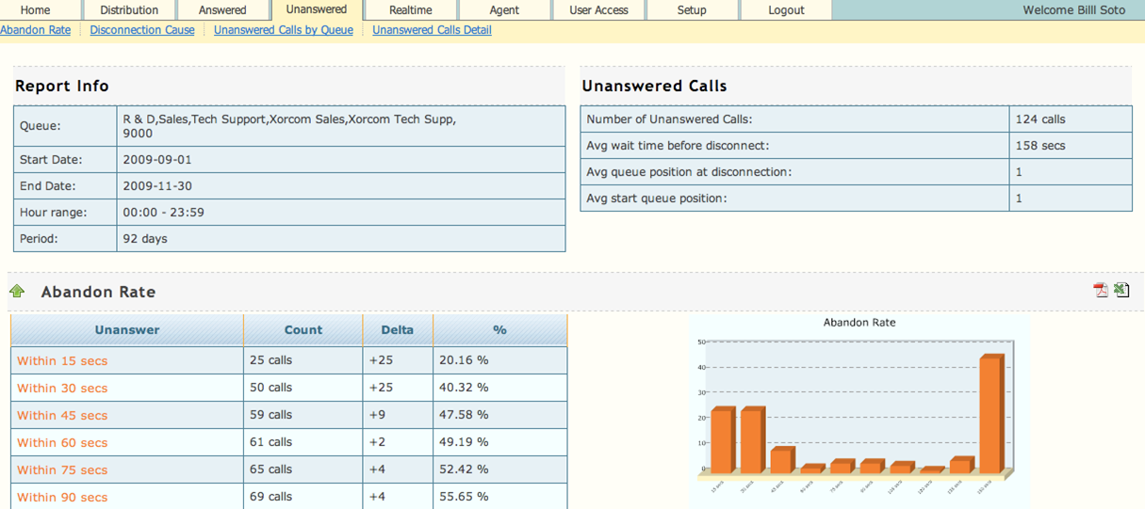
Call Center Statistics Reporting
Great for monitoring activity to improve efficiency of organization / employees
Two versions are available:
Lite - Default on all EasyVoIZ systems
Pro - Add-on module for DVX-9000

Slide 11
Call Statistics Modules Comparison
Lite & Pro
Answered
Unanswered
Distribution
Service-level
Charting
Import/Export
Pro Only
Real-time
Queue Summary
Call Waiting Detail
Agent Status
Search
CallerID
Agent
Queue
Period
Duration
Customization options

Slide 12
Lite: Standard Functionality
Data import | Data is available by using a cron job to import new data at scheduled intervals
Export | Export reports into PDF format for presentations, or csv format for external data crunching
Reporting | Answered, Unanswered, or Distribution
Distribution Reporting | Analysis by day, week day, or hour
Answered Calls Reporting | Analysis by queue, agent, disconnection cause, or service level
Service Level Reporting | Answered Service Level Report
Unanswered Call Reporting | Analysis by queue or disconnection cause
Sundry Reporting | Agent Status, Queue Summary, or Call Waiting Detail
Charting | Uses HTML5 and Java script, so no need for a flash-enabled browser

Slide 13
Pro: Additional Functionality
Data import | Data is available as the event occurs, i.e. in real-time
Export | Export reports into PDF format for presentation purposes, or csv format for external data crunching
Reporting | Service Level Agreement, Abandon Rates, Call Distribution, Agent Activity
Distribution Reporting | Analysis by queue, month, week, day, week day, hour, URL, as well as detailed reporting
Answered Calls Reporting | Analysis by queue, wait time, agent, disconnection cause, duration, transferred calls, as well as a detailed reporting
Service Level Reporting | Answered and Unanswered Service Level Reports
Unanswered Call Reporting | Analysis by queue, disconnection cause, URL, as well as detailed reporting
Sundry Reporting | Agent Availability, Sessions and Pause Durations, Call Disposition, as well as Detailed Paused Report and Session Report
Charting | Uses HTML5 and JavaScript, so no need for a flash-enabled browser

Slide 14
Pro: Additional Functionality, cont’d
Search | Search data by Caller ID, agent, queue, duration ranges, or date ranges
Report distribution | Schedule automatic email distribution of multiple reports
Notifications | Create automatic email notifications when variables exceed user-defined threshold values
Recordings | Listen to recordings by clicking on icon in the report
Customization | Customize reports with your own language, color schemes, date and time formatting, metrics, formulas, etc.
Real-time Monitoring | SPY option to listen to calls in progress with option to ‘steal’ the call
Real-time Coaching | Coach agents using whisper method during calls

Slide 15
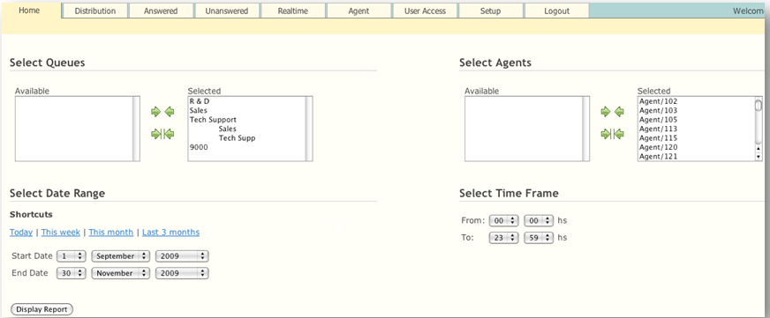
Select Time Frame to Report

Slide 16
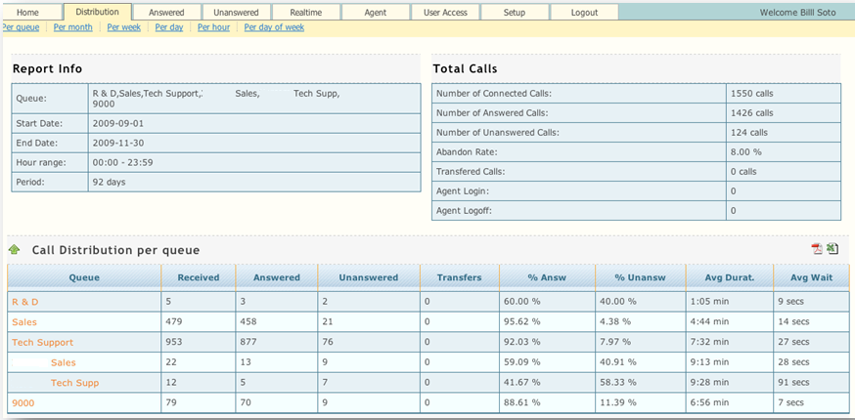
Distribution of Calls Per Queue

Slide 17
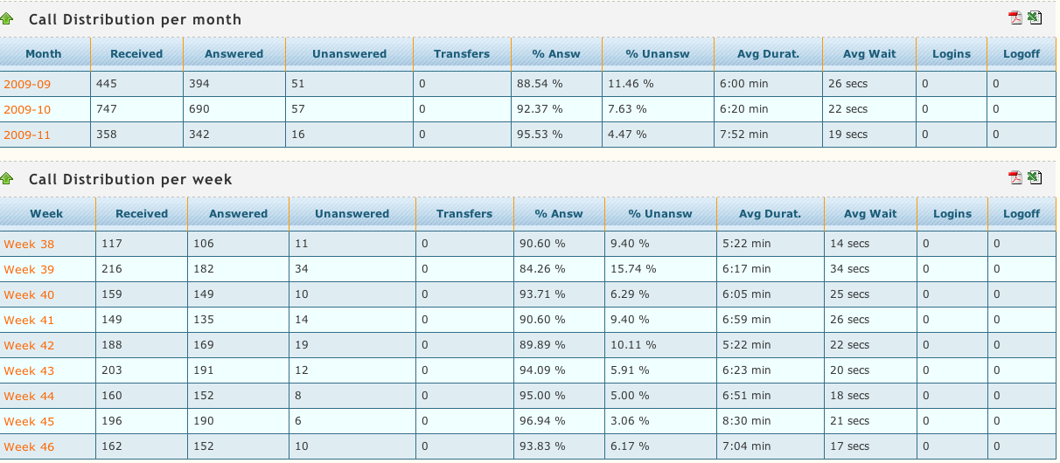
Distribution of Calls Per Month & Week

Slide 18
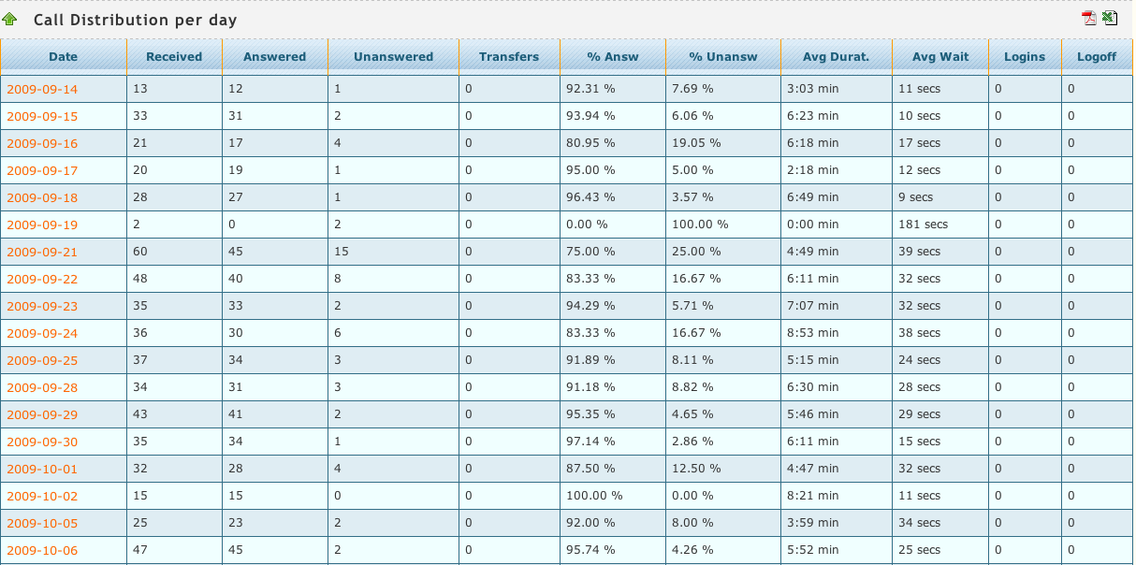
Distribution of Calls Per Day

Slide 19
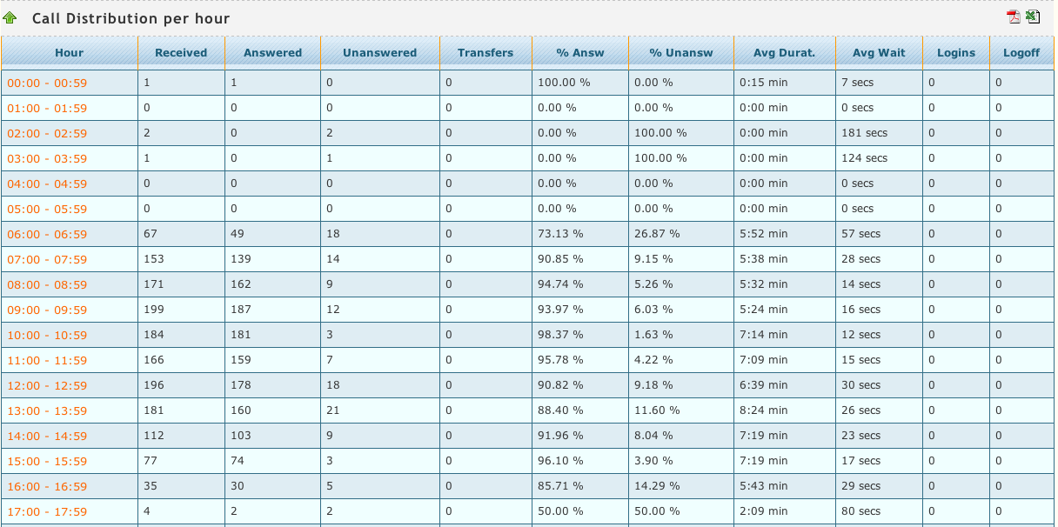
Distribution of Calls Per Hour

Slide 20
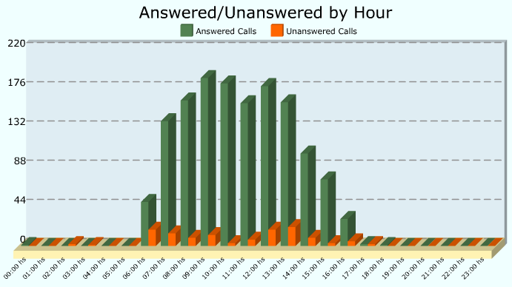
Call Center Graphic Reports

Slide 21
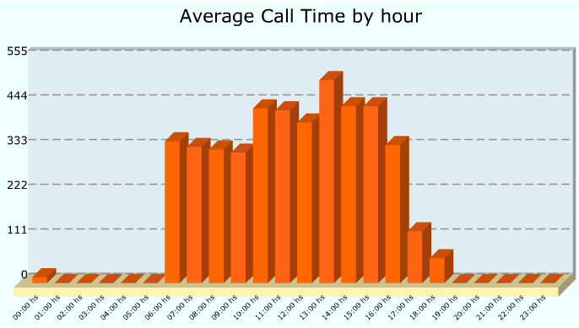
Call Center Graphic Reports

Slide 22
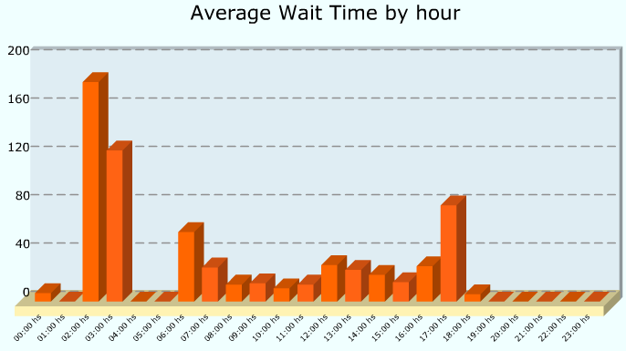
Call Center Graphic Reports

Slide 23
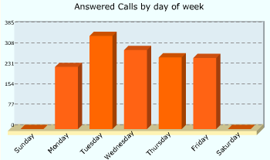
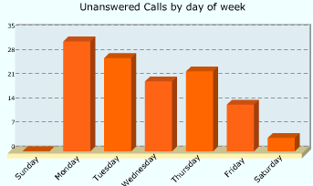
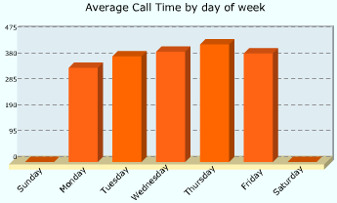
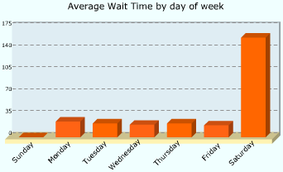
Call Center Graphic Reports

Slide 24
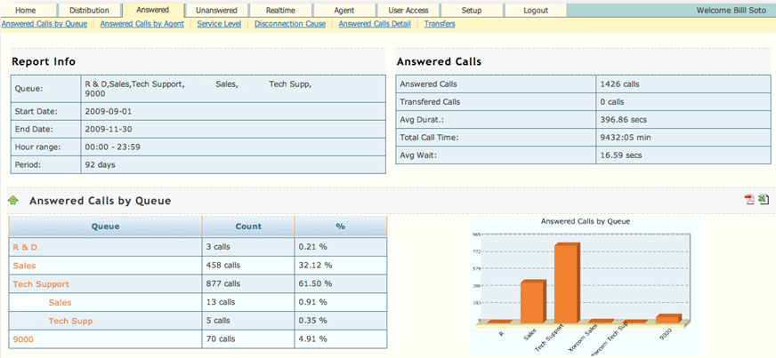
Answered Calls Report

Slide 25
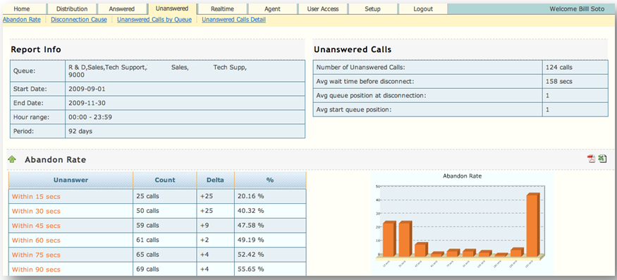
Unanswered Calls Report

Slide 26
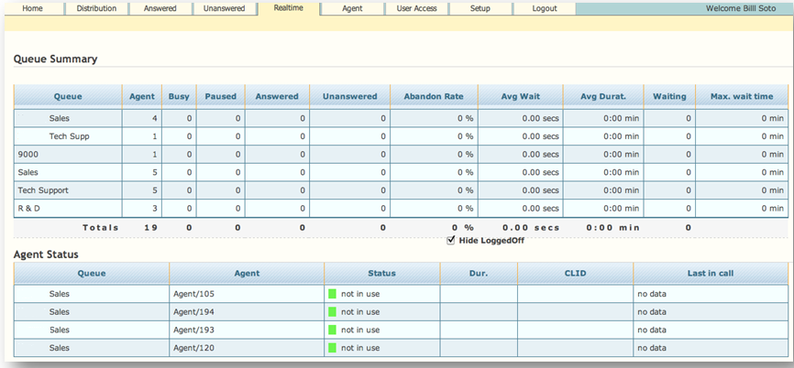
Real-time Queue Summary

Slide 27
Security
Avoid the Risk – EasyVoIZ PBX is Your Best Defense Against Cyber Attacks
With second-to-none security, EasyVoIZ includes these four layers of protection:

Slide 29
Thank You
Notes:
29

