Slide 1
D-Link Multi-Tenant Manager
Conduct your cloud PBX services

Slide 2
Virtual Cloud Telephony
Quick response to customers requirements
Tenant scalability
Simplicity for the customer
No CAPEX
Remote extensions
Low overhead costs
Takes responsibility away from the end user

Slide 3
Obstacles
Infrastructure
Complexity
Initial capital investment
Security

Slide 4
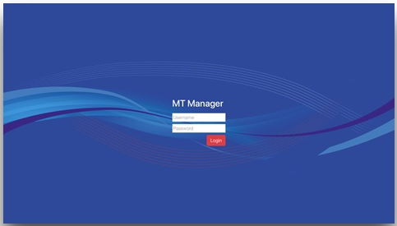
MT Manager - Cloud PBX Simplified
Conducting multiple tenants with elegance

Slide 5
Main Features
Create a new PBX in 1 minute
Start / Stop / Delete Tenant
Manage resellers
Separation between tenants
Individual web login for each tenant
SSH and AMI access per tenant
Server resource management
Each tenant is a fully-features EasyVOIZ PBX system

Slide 6
Security
Separate database per tenant
Whitelists for service access
SIP access by fully qualified domain name
Topology hiding - impossible to learn the path from trace
Enforced EasyVOIZ password policy (no override option)

Slide 7
How it works
MT Manager Admin
Reseller A
Reseller B
ABC, Inc.
Power Motors Ltd.
CT Auto Center
EasyVOIZ PBX MT Host
Server Hardware

Slide 8
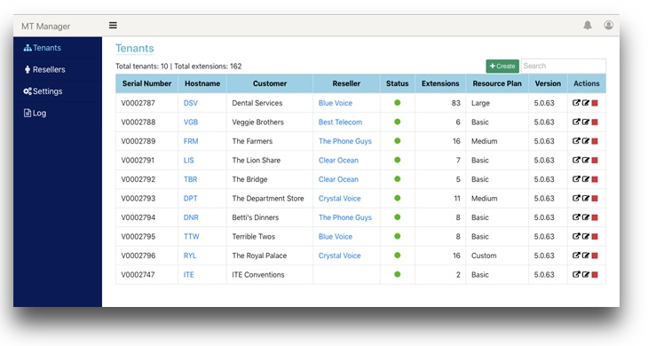
Pay-Per-Use
Easy commercial interaction
Automatic license creation & assignment - no delays
Monthly invoice based on the average extensions & add-ons use for the month
Monthly report indicates systems by reseller
Option to stop non-paying customers’ PBX

Slide 9
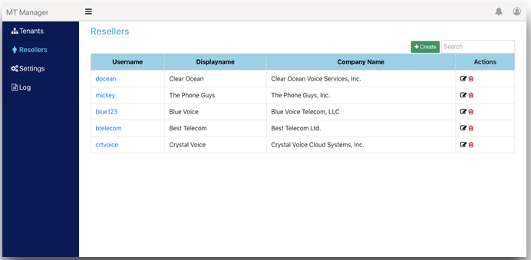
Resellers
Provide services via dealers
Easily create & manage resellers
Reseller can create own customer PBXs
Reseller sees only their customers’ information
Admin can move tenants between resellers
Admin can delete a reseller

Slide 10
Target Market
Direct customers
Carriers
Hosted PBX Service providers
Provide your own service
Provide your own service via resellers

Slide 11
Advantages
Setup & operations
Simplicity of operation - no long training required
Minimal capital investment up front
Short setup time
Bring your own trunks
Scalability
Resource efficiency
Updates & upgrades included
Host Anywhere
any other
provider…

Slide 12
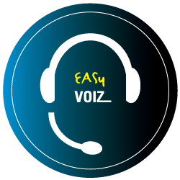
Advantages
Customer experience
Fully-featured EasyVOIZ PBX system
Instant setup - short response time
One-click module activation
EasyVOIZ Concierge
Stats Explorer (basic call center)
Switchboard
Wallboard

Slide 13
EASY VOIZ IP PBX Call Features
EasyVoIZ is based on a highly responsive graphic user-interface that facilitates the management of Asterisk servers, in a fast, intuitive, and secure manner.
The system is based on a 3-level menu system that makes it very easy to locate any item that you want to manage.
Auto-Redial / Camp on
Boss/Secretary + Whitelist
Call back
Call forward (busy, no answer, unconditional)
Call parking
Call pickup
Call Transfer (blind, attended)
DISA (Direct Inward System Access)
DND (Do Not Disturb)
Emergency call handling
Find me / Follow me
Routing
Caller ID
Customization (incoming/outgoing)
Display
Lookup
Blocking
Screening
On Call Waiting
Override caller ID
Use original caller ID on forward
CDR (Call Details Record)
Corporate phone books
Direct Inward Dial Numbers (DIDs)
Inbound/Outbound fax support
Line status indication (BLF)
Message Waiting Indicator (MWI)
Paging & Intercom
Short-code dialing
Speed Dial
User-friendly Web interface
Video calls
Voicemail
Voicemail-to-email
Voicemail broadcast
Wake-up Calls / Reminders
Personal recording / notes
Direct trunk to trunk connection
One digit dialing

Slide 14
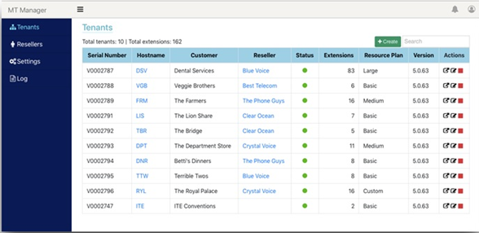
Availability
NOW!

Slide 15
Thank you

