Slide 1


Slide 2




D-link’s Long History of Open Source
Android is a Registered Trademark of Google Inc.
Asterisk is a Registered Trademark of Digium

Slide 3


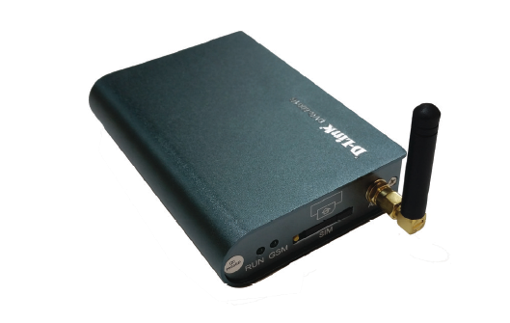
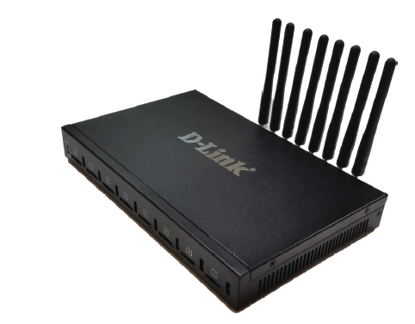
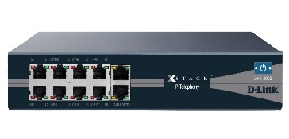
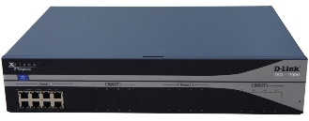

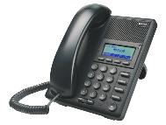
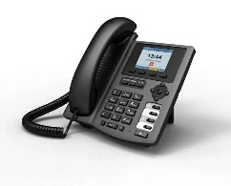
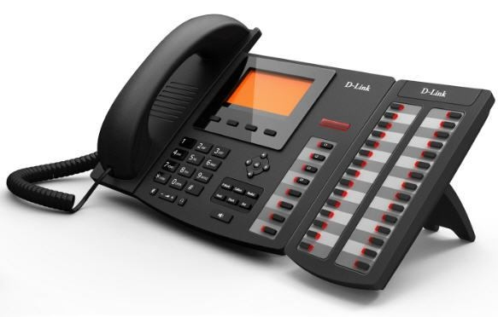
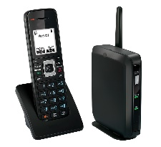
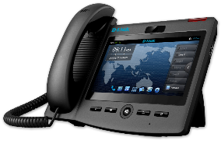
D-link IP PBX Series
GSM Network
DVG-6001G
DVG-6008G
DVX-2002F
DVX-2005F
DVX-3000
DVX-8000
DVX-9000
Notes:
Simton IPX CPE systems
P100, Office, H500, Enterprise, B2000 have similar capabilities, but with different scales.
Support: normal PSTN lines, VoIP lines, VoIP trunks, Analog phones, IP phones, soft phones.
Simton IPX S600 is the server model for large scale:
voice intranet call routing
ISP network platform
conference bridge
voice mail server
Simton IPF71 IP phone support 2 lines
Simton FWT has single channel, support all GSM spectrum

Slide 4
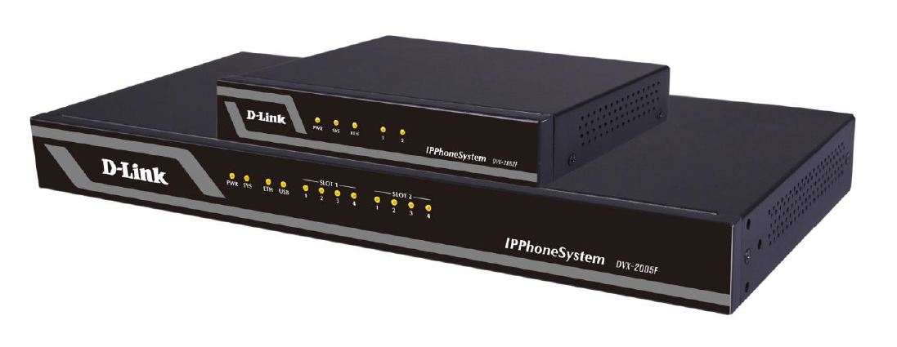
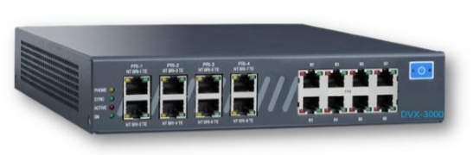

DVX-2005 & DVX-3000 SOHO IP PBXs
Delivering high quality, secure and reliable voice, video, data & mobility to SMBs
IP-PBX
Asterisk-based IP-PBX
Up to 10 concurrent calls
Up to 30 users
DVX-2002F
DVX-2005F
IP-PBX
Asterisk-based IP-PBX
Up to 20 concurrent calls
Up to 50 users
DVX-3000
IP-PBX
Asterisk-based IP-PBX
Up to 30 concurrent calls
Optional ½ PRI (up to 16 channels

Slide 5
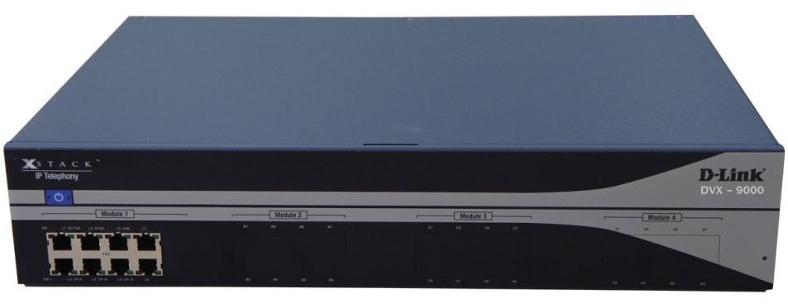

D-link Business IP PBX Series
IP-PBX
Asterisk-based IP-PBX
Up to 60 concurrent calls
Up to 300 users
DVX-8000
IP-PBX Enterprise
Asterisk-based IP-PBX
Available with 4 port E1
Up to 300 concurrent calls
Up to 800 users
DVX-9000
Enhanced Business Telephony
Asterisk-based IP-PBX
Available with 24 port E1
Up to 880 concurrent calls
Up to 1500 users
DVX-9000E

Slide 6
DVX-2005F Brief Introduction - :
The DVX-2005F IP Phone System is an ideal solution for small and medium business with up to 100 extensions. Adopting the innovative modular design, it is very convenient to increase telephony ports to expand the system. The DVX-2005 supports industry standard SIP trunks, analog PSTN trunks (FXO Module), analog stations (FXS Module),
Highlights & Features
No User License Fee
All Standard PBX Features
Many Advanced PBX Features
Desktop Call Management
Firewall
Intrusion Detection
Enhanced Security Policies
Disaster Recovery
Fax to Email
WebRTC/ Web Dial
Voicemail to Email
Console Port for easy management
Stronger Security to Protect System
Remote Backup Service

Slide 7

DVX-3000 Capabilities
Up to 30 extensions
Optional ½ PRI (up to 16 channels)
Up to 16 analog ports (FXS and/or FXO)
Up to 8 BRI ports (16 channels)
Up to 30 concurrent SIP calls
Up to 16 concurrent E1/T1 calls
Up to 16 concurrent E1/T1/BRI/
FXS/FXO calls

Slide 8

DVX-3000 Specifications
EASY VOIZ PBX v. 4.5x
900MHz quad-core ARM Cortex-A7 CPU
10/100 Ethernet port
1GB RAM
Two USB2 ports
8GB micro SD storage

Slide 9
What is D-Link DVX 8000 ?
The DVX8000 is stand-alone, pre-configured, out-of-the-box Asterisk IP PBX featuring the EasyVOIZ . The DVX9000 may be equipped with up to 32 analog ports, up to eight BRI ISDN ports or 1 E1/T1 PRI,19" 2U chassis.
for a total of up to 60 PSTN/analog phones ports, up to 300 users and up to 60 concurrent calls
Cisco CME
Trunks
Software |  |  | Hardware
Asterisk version | 13.Xx |  | Processor | Intel Atom
Linux version | CentOS 8.x |  | RAM | 2 GB
GUI | EasyVOIZ 5 |  | Hard disk | From 300 GB 2.5''
 |  |  | USB | 4 external USB 2.0

Slide 10
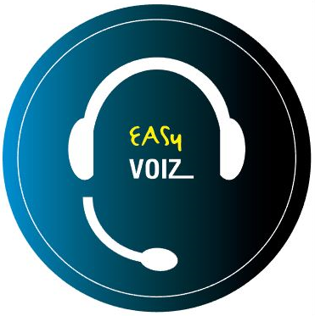

Introducing “ DVX-9000E”
Robust, heavy-duty IP-PBX featuring:
Two hot swappable, 24x7 server grade HDDs
  Easily accessible from the front panel
  Lockable
Two hot swappable, 250 Watt power supplies
Fault notification for both components:
  On LCD panel
  Buzzer sounds
  e-mail to admin

Slide 11
DVX-9000E Specifications
EASY VOIZ 5x
Intel Xeon Processor E3-1225V2 8M cache (3.20GHz)
8GB RAM
Two hot swappable 1TB HDD

Slide 12
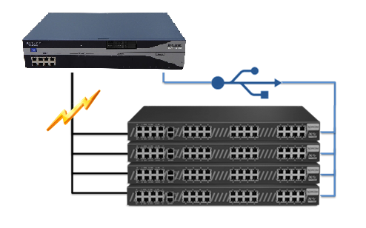
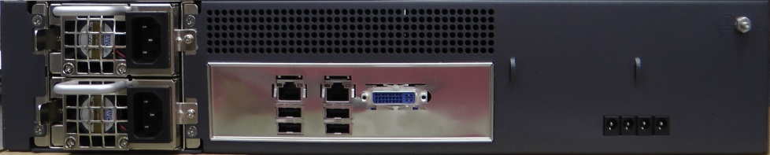
Supports up to 20 external fully-populated DVX-8050

Slide 13

Full and Automatic IP PBX redundancy
Provides full redundancy for a complete
PBX system, incl. telephony interfaces
Quick and automatic failover process
keeps downtime to an absolute minimum
Auto detection of server failure & switch
to backup server
Firmware-based switching mechanism
is not network-dependent
Solution components:
  Two DVX-9000 IP PBX units with identical configurations
  DVX-8050(s) with dual USB ports

Slide 14
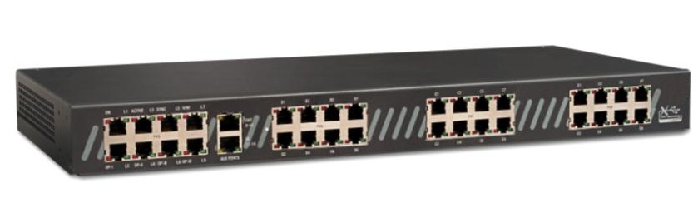
Two DVX 9000+ Dual-USB DVX8050
DVX 9000(primary)
DVX 9000(backup)
USB
USB
LAN/WAN
PSTN
SIP Trunking
IP Phones

Slide 15
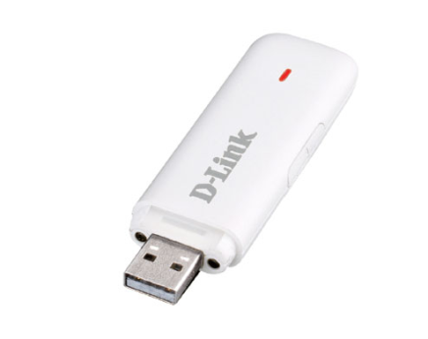
PBX Disaster Recovery Made Simple
Never worry about:
      natural disasters
      hardware failure
      human error
Now you can create, save and
restore your PBX files in minutes!
Backs up entire PBX including
user-defined options:
  .configuration files
  .voice prompts
  .voice mail

Slide 16
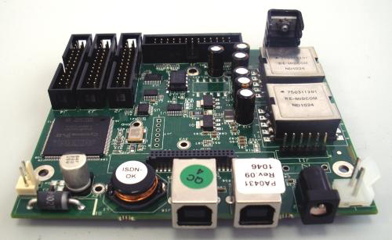
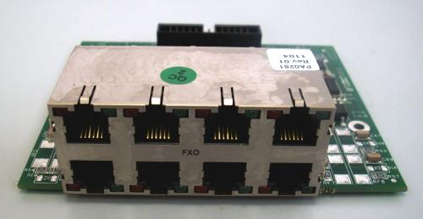
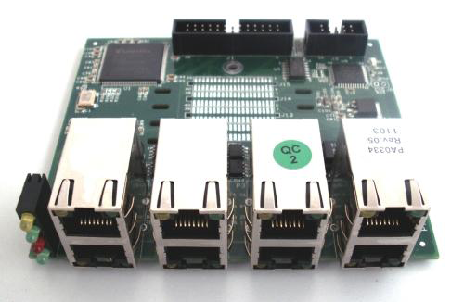
DVX- 9000 I/O Modules
DVX 8010 Main Module
DVX 8020 8 Port FXO Module
DVX 8030 1-4 port PRI module
DVX 8025 8 port FXS module

Slide 17
Introducing EASY VOIZ 5

Slide 18
EASY VOIZ 5
EasyVoIZ is based on a highly responsive graphic user-interface that facilitates the management of Asterisk servers, in a fast, intuitive, and secure manner.
The system is based on a 3-level menu system that makes it very easy to locate any item that you want to manage.
Simple Management
  desktop call management
  visual voicemail
  browser-based administration
Inbound Call Center / Customer Service Aids
  call recording
  graphical call reporting
  integrated chat
  unlimited auto attendants
  Efficient Communications
  inbound/outbound fax
  smart phone integration
  unified messaging
  presence management
  conference bridges
  video calling

Slide 19








Major Benefits of EASY VOIZ PBX
Web-based interface for easy implementation and management
Enterprise-class communication features, unified communication options and basic call center functionality are standard, with
no per user license fees
Modular support for PRI, BRI, FXO and FXS telephony interfaces
Interoperability with SIP standard endpoints, including flexible tool for adding new vendors/models
.
Built-in mechanisms to regulate access for heightened security
Hospitality-ready integrated solution that interfaces with leading property management systems (PMS)
Easily tailored to suit a wide variety of vertical markets: e.g., healthcare; legal; manufacturing; car dealerships; campuses; consultants; contractors
Open application programmable interface enabling easy integration of third party products

Slide 20
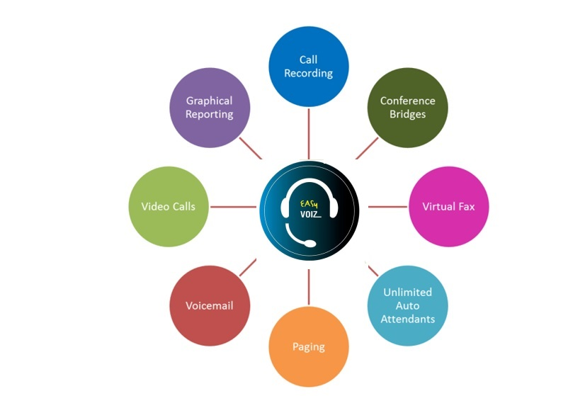
Sampling of Included Telephony Apps

Slide 21

User Experience
Basic Call Features
  Call back
  Call forward
  Call parking
  Call pickup
  Call waiting
  Camp on
  DISA (Direct Inward
  System Access)
  DND (do not disturb)
  Find me / Follow me
  Transfer (blind, attended)
  Voicemail
  Customization incoming/outgoing
  Display
  Lookup
  Blocking
  Routing
  Screening
  On Call Waiting
  CDR (Call Details Record)
  Corporate phone books
  Direct Inward Dial Numbers (DIDs)
  Inbound/Outbound fax support
  Language support
  Message Waiting Indicator (MWI)
  Short-code dialing
  Speed Dial
  User-friendly Web interface
  Video calls
  Voicemail-to-email
  Wake-up Calls / Reminders

Slide 22

Unified Communications
Audio conferencing
Call recordings access
Corporate phone book
Disaster recovery
Fax-to-email
Instant messaging/chat*
One number reach
Operator panel (switchboard)
Paging and intercom
Presence
Short-code dialing
Survivability
Video conferencing
VMX Locator
Voicemail to e-mail
Web access to voicemail, fax, and recordings

Slide 23

Workgroup Features
Call monitoring
Call queues
Call recording
Caller Name Lookup
CDR (Call Details Record)
Click-to-call
Conferencing (on-the-fly)
Hot-desking
Hunting groups
IVR / Auto-attendants
Instant messaging/chat*
Pick-up groups
Presence (agent status)
Queue priorities
Ring group strategies
Statistical reporting
Time-based routing
Visual switchboard

Slide 24

Administration
Backup and Restore
Endpoint provisioning tool
Feature codes
Music / Announcements
Network settings tool
Pre-defined user roles
Remote administration
Storage monitoring
System status screen
System-wide speed dial
Time Conditions
User-friendly Web interface

Slide 25

Interfaces & Integration
PRI, BRI ISDN, FXO, FXS
SIP phones
Soft phones, smartphones, tablets
TDM/SIP/IAX trunks
TDM-VoIP gateway

Slide 26

My Extension
Accessible by any defined user
Each user sees/manages own extension only
Increases productivity & availability: never miss a sales call!
Options
  Call Monitor to review call log
  Voicemail to play and download voicemail
  Faxes to send/receive faxes
  Feature Codes lists available feature codes
  Follow Me defines Follow Me behavior
  Phone Features menu defines phone features
  Define VmX Locator
  Settings sets language and notification settings

Slide 27
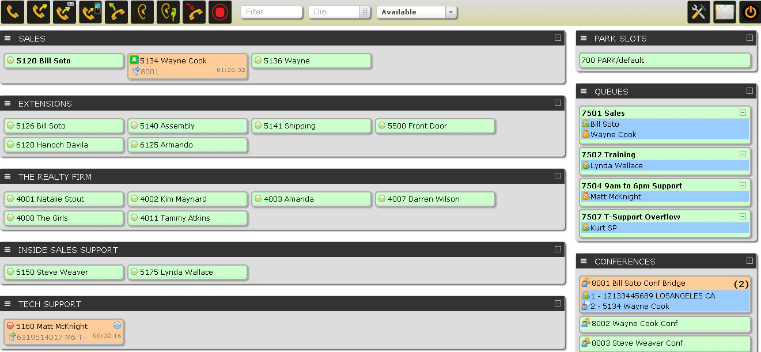
Call Center Functionality in EasyVoIZ
EasyVoIZ includes call center functionality
Embedded browser-based switchboard
Customization
options for:
  Queues
  Announcements
  Failover

Slide 28

Feature-Rich Dashboard on Switchboard
Quick Status Check
  Who’s free
  Length of current call
  Identification of call party
“Listen”
  Listen to calls in progress
  Great for quality monitoring
“Whisper"
  Speak with staff during call without interrupting the conversation
  Great for training
  Internal dialogue
  Consultation between staff during calls
Notes:
EasyVoIZ Call Center features include:
Queue Options
Agent Call Announcement*
Join Announcement
Announcement to Caller
Message On Hold by Queue
Ringing instead of MoH
Maximum Wait Time
Maximum Callers
Ring Strategy
Ring All; Round Robin; Least Amount of Calls; Random; Round Robin w/Memory
Wrap-up Timer
Call Recording
Agent Event Recording*
Queue Priority*
Customer Care Callback*
Caller Position Announcements
Frequency
Announce Positions
Announce Average Hold Time*
Failover Destination
Define a destination where the call should be transferred if Maximum Wait Time or Maximum Callers thresholds are reached
Periodic Announcements
Frequency
Option allowing caller to press a key and exit the queue
Can be sent to:
Customer Care Callback
Voicemail
Alternate Answer Point
* Indicates features that are normally optional for other call center packages

Slide 29
Queue Options
Agent Call Announcement
  Announcement to Agent
Join Announcement
  Announcement to Caller
Message On Hold by Queue
Ringing Instead of Message on Hold
Maximum Wait Time
Maximum Callers
Ring Strategy
  Ring All
  Round Robin
  Least Amount of Calls
  Random
  Round Robin w/Memory
Wrap-up Timer
Call Recording
Agent Event Recording
Queue Priority
Customer Care Callback

Slide 30
Announcements & Failover Options
Caller Position Announcements
  Frequency
  Announce Positions
  Announce Average Hold Time
Periodic Announcements
  Frequency
  Option to have caller press a key and exit the queue
  Can be sent to:
    Customer Care Callback
    Voicemail
    Alternate Answer Point
    Failover Destination
    If Maximum Wait Time or Maximum Callers intervals are reached, define destination where the call should be transferred

Slide 31

IP PHONES

Slide 32
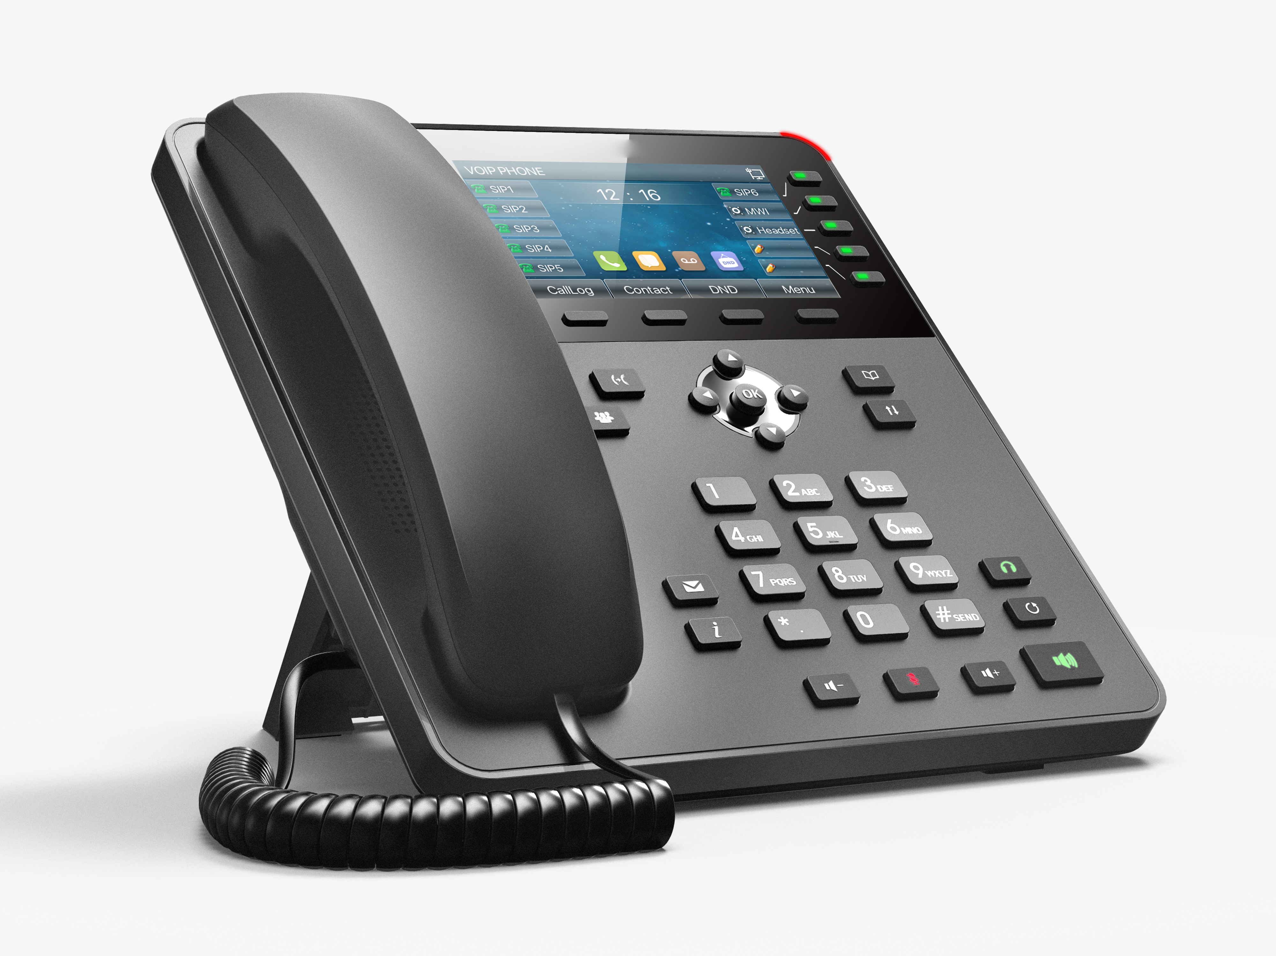
RECEPTION IP PHONE
New

Slide 33
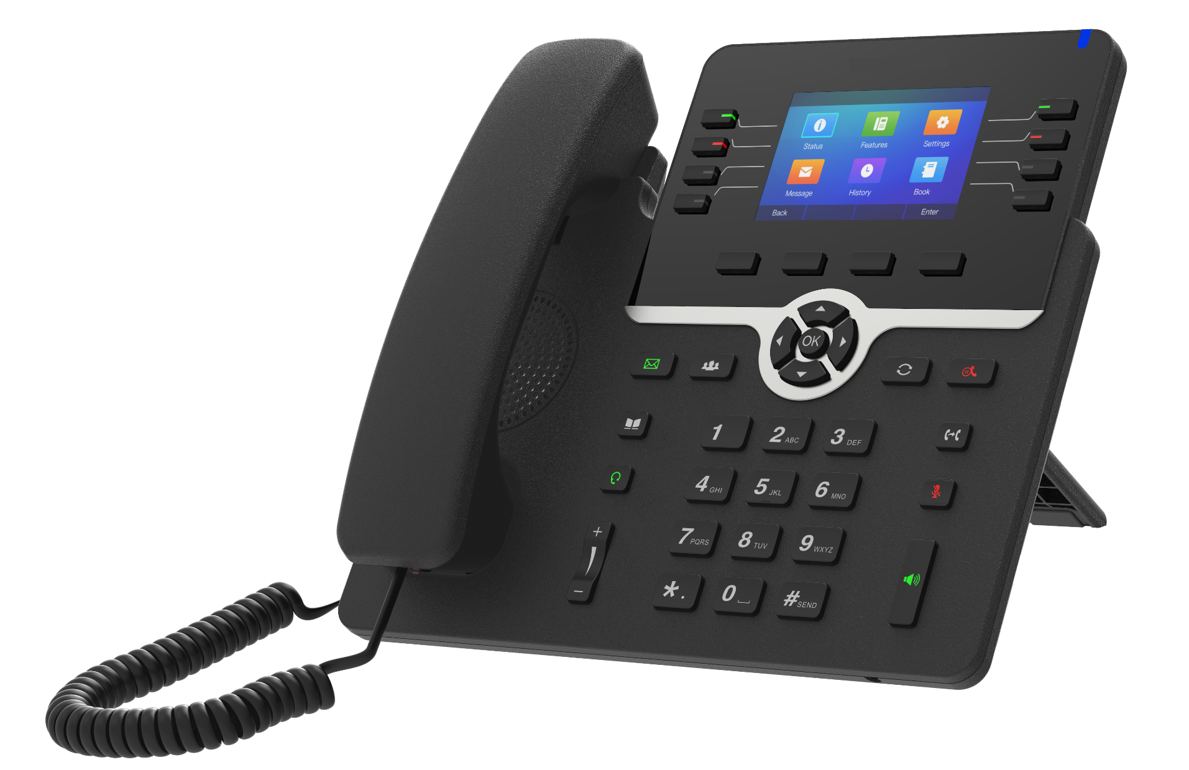
New
EXECUTIVE IP PHONES

Slide 34
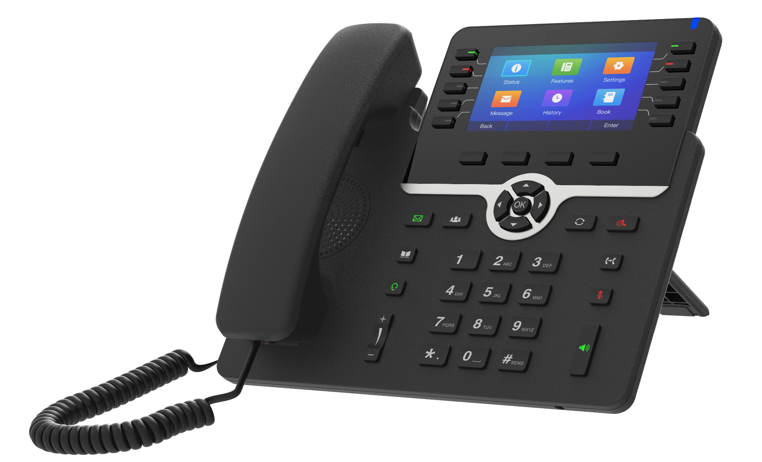
New

Slide 35
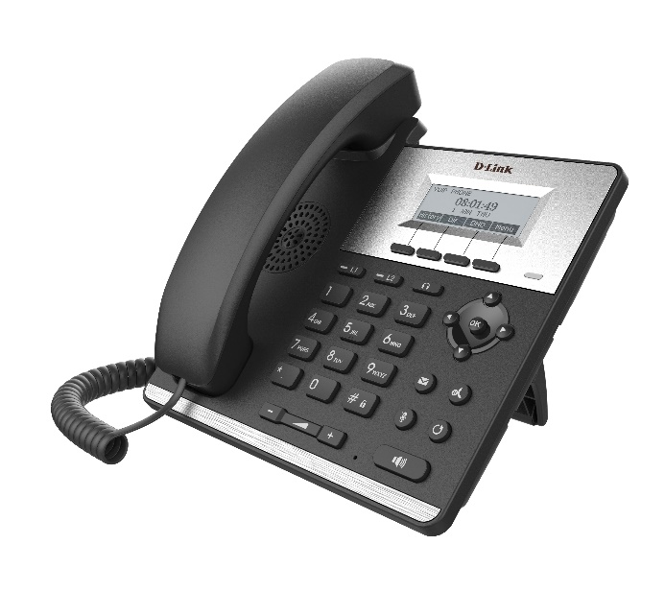
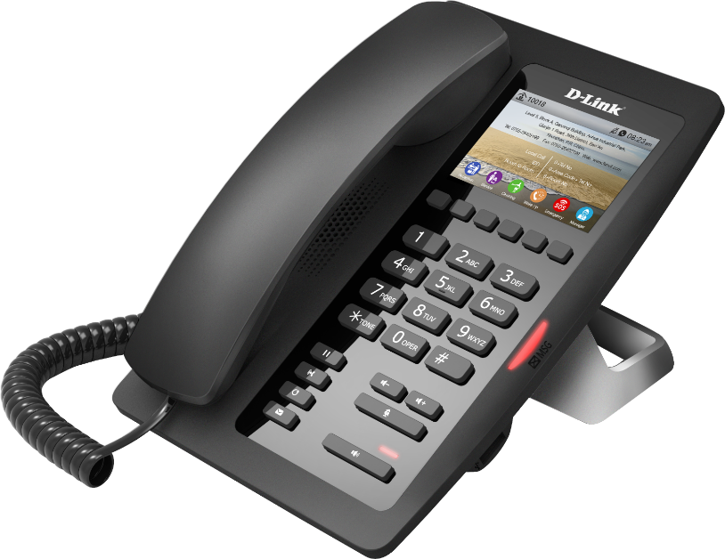
DPH-120SE
Basic IP phone with 2 SIP Line with POE
Sleek desktop speakerphone with full-feature keypad, phone book, speed-dial, volume control, and ringtone selection
2 10/100Mbps Ethernet ports
Optional power adapter
DPH-200SE Hotel IP Phone
2 RJ-45 10/100BASE-TX Ethernet ports
1 SIP line, HD Voice, Color Screen, Voice Message Waiting Indication (VMWI)

Slide 36
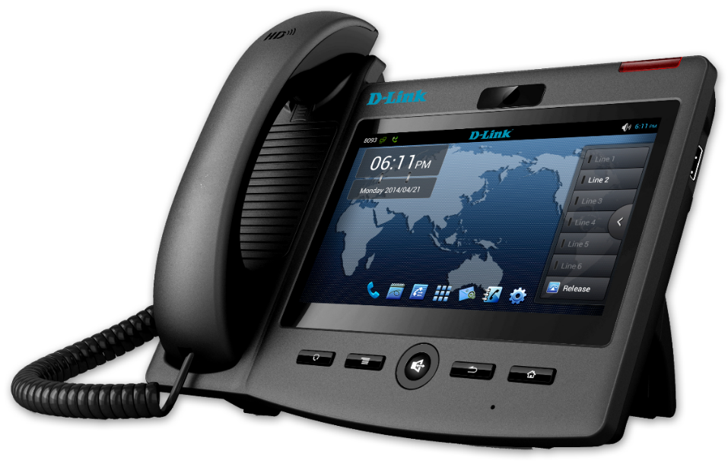
VIDEO IP PHONES
DPH-860S
DPH-860S F1 is the advanced IP video phone based on Android OS 4.0. It is equipped with the latest Freescale video chipset, a 7" LCD capacitive touch screen with 800x480 pixels and a 5M pixel camera. Android OS guarantees the easy customization for telecom operator and service provider.
The Intelligent OS, superior video quality, rich applications and affordable price , ensure DPH-860S F1 IP video phone is the Pioneer for next generation smart video telephone.
Dual-port Gigabit Ethernet ,Android OS ,CPU Freescale Core Quad 1 Ghz
7” TFT Capacitive Multi Touch Screen, Configure the Keypad
Video Codec: H.264 / H.26

Slide 37

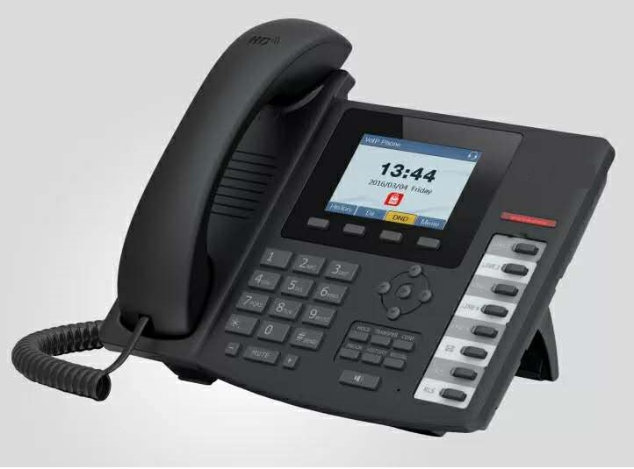
IP PHONES
DPH-150SE/ F5
Executive IP phone with 4 SIP Line with POE
Sleek desktop speakerphone with full-feature keypad, Color display , phone book, speed-dial, volume control, and ringtone selection
Dual-port Gigabit Ethernet
DPH-400SE / F5
Reception/Executive IP phone with 6 SIP Line with POE , color display
Sleek desktop speakerphone with full-feature keypad, phone book, speed-dial, volume control, and ringtone selection
Optional extended dial module (DPH-400sEDM) for BLF Keys.
Support s 5 Expansion modules
Dual-port Gigabit Ethernet

Slide 38
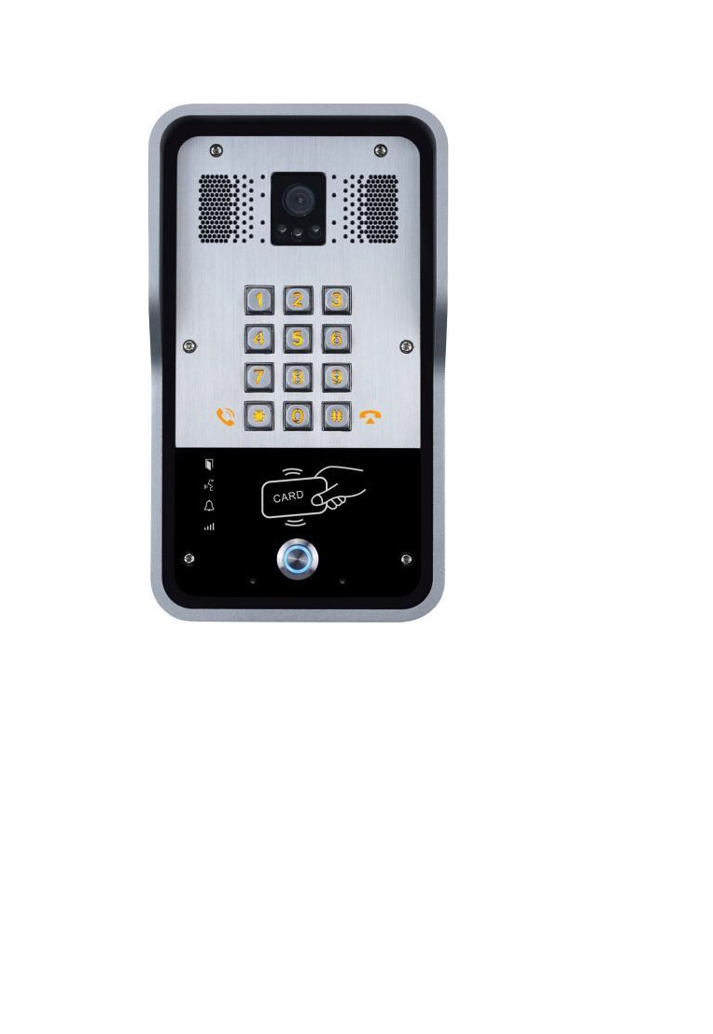
Intercom and Door Access System
DPH-600
Offering Audio/Video SIP intercom and door phone, as well as Gateway for your customization.
Audio Intercom
i12

Slide 39



Exceptional HD Audio & Video
HD duplex video communication
Video, 720P camera supports full
HD Audio with Full Duplex Echo Cancellation (AEC)

Slide 40
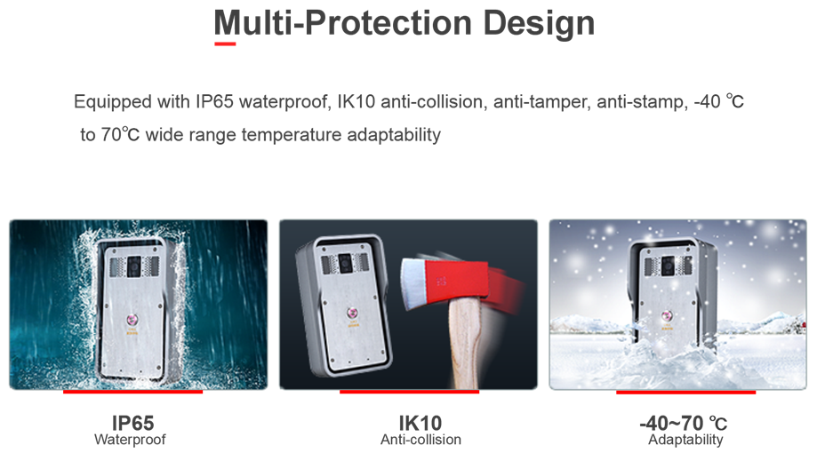

Slide 41
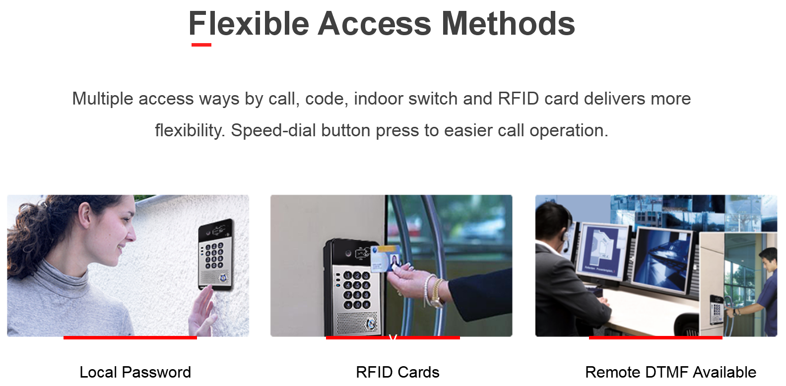

Slide 42
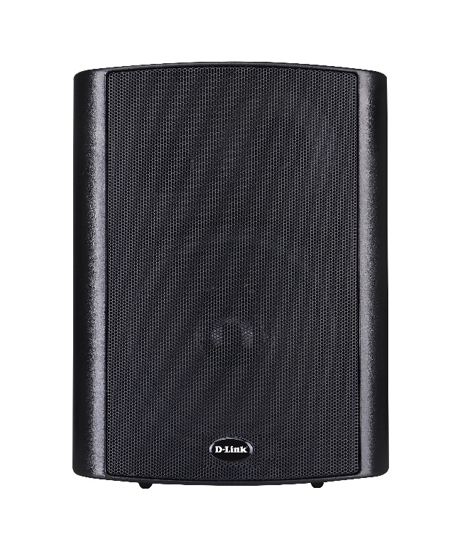
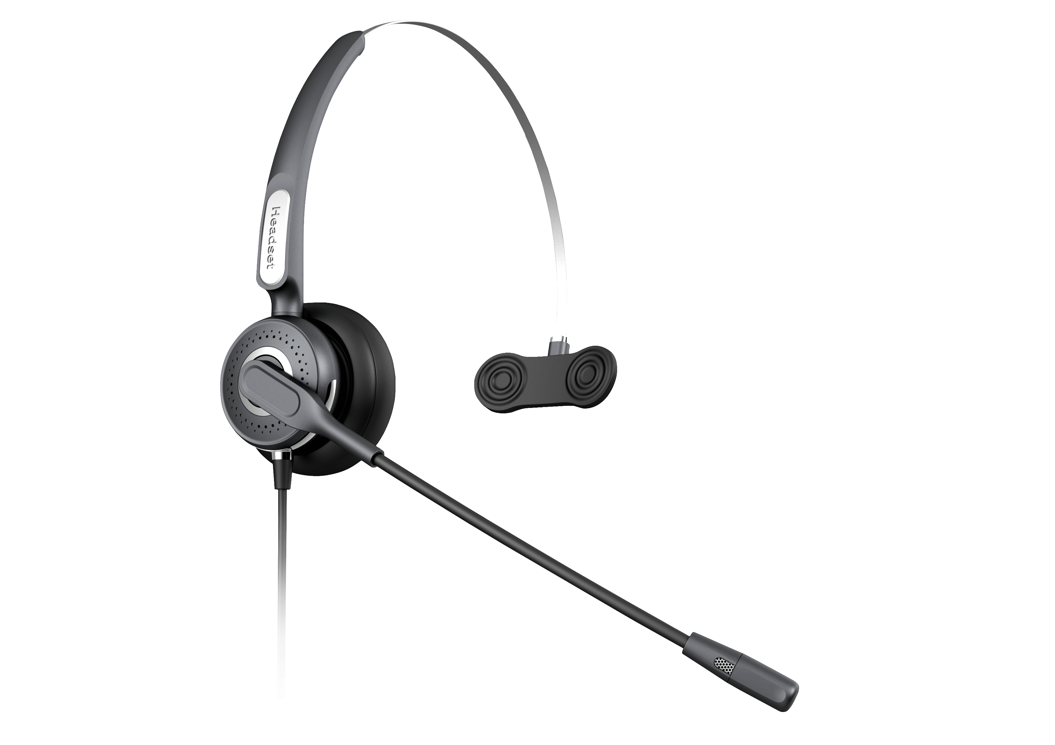
Accessories
Choose accessories for your professional VoIP Communication System. We have mono/duo headsets, SIP speaker etc.

Slide 43

INTRODUCING NEW GENERATION HANDSETS

Slide 44
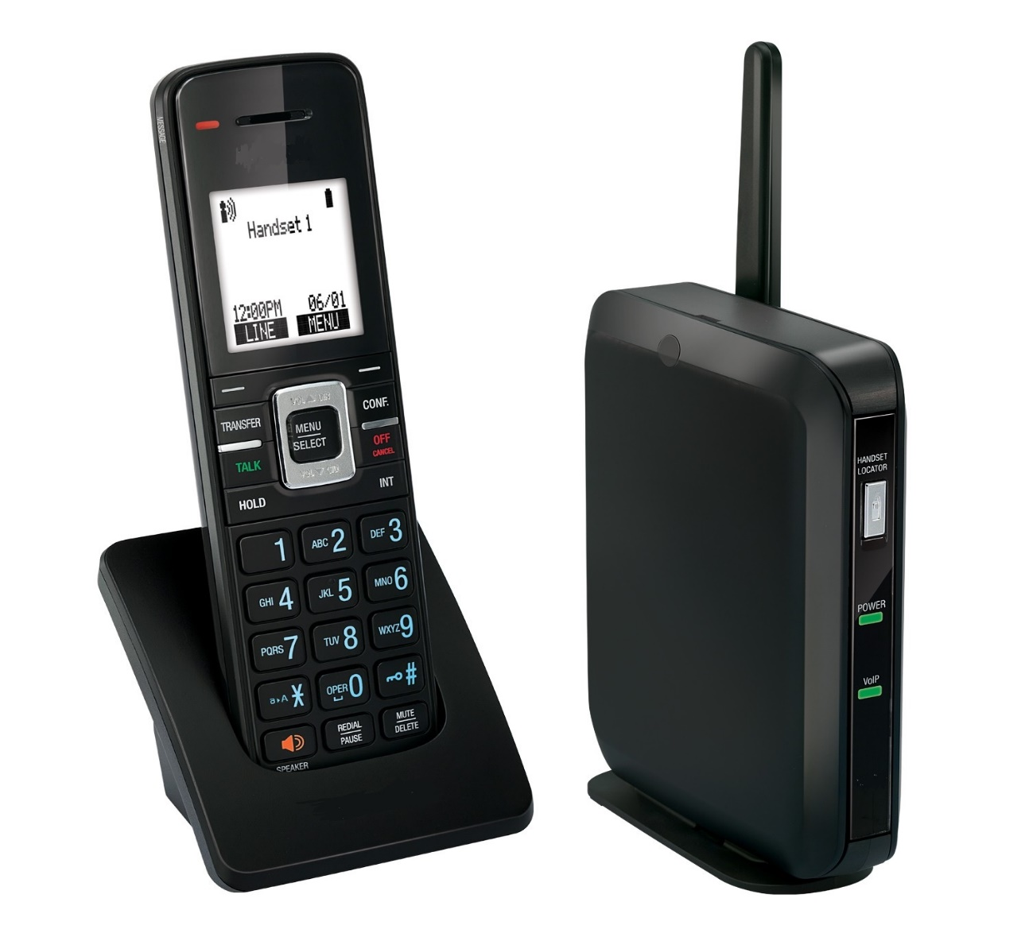
DVSP600A DECT SIP Cordless Base Station and Cordless Handset

Slide 45
SIP-DECT Overview
Facility-wide wireless communication solution to make, receive and confirm receipt of voice calls
Integrates seamlessly with your existing IP-PBX
Integrates with all major clinical information systems, such as nurse call and patient monitoring systems, and more…
Super-clear mobility with Orbitlink Wireless Technology.™ Leave your desk without leaving your work behind and enjoy DECT 6.0 sound quality and reception
Scalability. Growing pains? Register up to six cordless handsets to the DVSP600 base station and program each one with its own phone number or extension.
Flexibility. With support for up to six SIP lines/accounts, you can manage multiple calls with advanced call handling features.

Slide 46
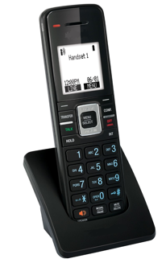
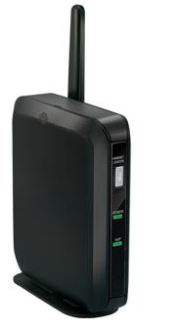
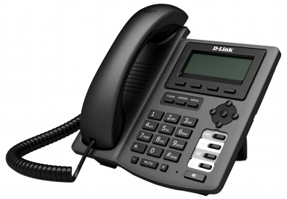

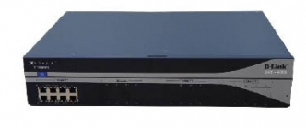
Solution Architecture
DVSP600A SIP-DECT
Access Point
Handsets
LOCAL AREA NETWORK (LAN)
DVSP600A SIP-DECT
Access Point
Handsets
PSTN
SIP
IP PBX
Notes:
Presentation Name Month Year
46

Slide 47
VOIP GATEWAYS

Slide 48
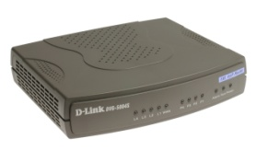

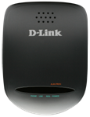

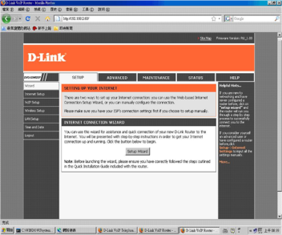
FXO & FXS Gateway Solution
4 Port GW
8 Port GW
16/32 Port GW
Telephone
Adapter
SOHO / SMB
SOHO / SMB
SMB / SME
SOHO
4 FXS / FXO ports
5 Ethernet
SIP
2/4/6/8 FXO / FXS ports
5 Ethernet
SIP
8 /16 / 32 FXS / FXO ports
2 Ethernet
SIP
2 FXS ports
1 Ethernet
SIP
Configuration and Management Applications
VoIP Configuration Wizard

Slide 49
GSM VOIP Gateway Solutions
1 Port GSM Gateway
4/8 Port GSM Gateway
SOHO / SMB
SMB / SME
1 GSM port
1 WAN / 1 LAN port
SIP
4/8 GSM ports
2 LAN port
SIP
Configuration and Management Applications
VoIP Configuration Wizard

Slide 50

Thank You
Notes:
50

