Slide 1


Slide 2




D-link’s Long History of Open Source
Android is a Registered Trademark of Google Inc.
Asterisk is a Registered Trademark of Digium

Slide 3


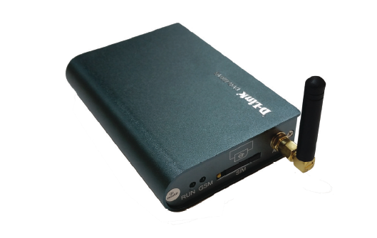
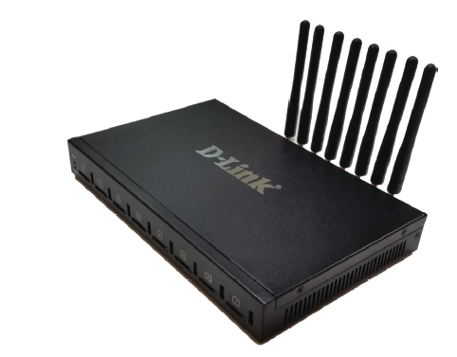
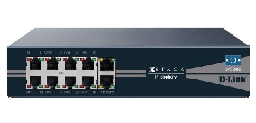
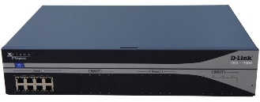

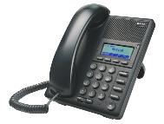
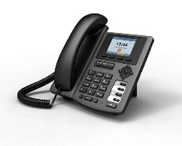
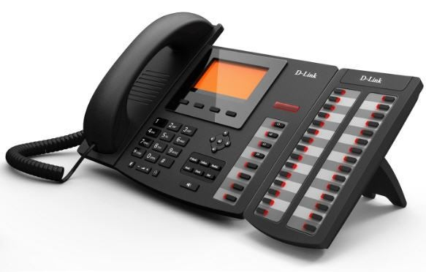
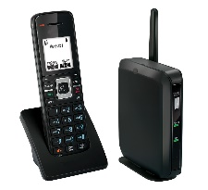
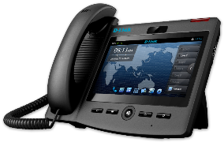
D-link IP PBX Series
GSM Network
DVG-6001G
DVG-6008G
DVX-2002F
DVX-2005F
DVX-3000
DVX-8000
DVX-9000
Notes:
Simton IPX CPE systems
P100, Office, H500, Enterprise, B2000 have similar capabilities, but with different scales.
Support: normal PSTN lines, VoIP lines, VoIP trunks, Analog phones, IP phones, soft phones.
Simton IPX S600 is the server model for large scale:
voice intranet call routing
ISP network platform
conference bridge
voice mail server
Simton IPF71 IP phone support 2 lines
Simton FWT has single channel, support all GSM spectrum

Slide 4
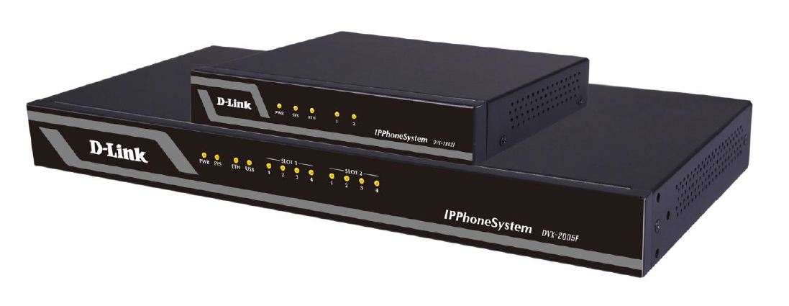
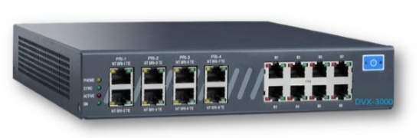

DVX-2005 & DVX-3000 SOHO IP PBXs
Delivering high quality, secure and reliable voice, video, data & mobility to SMBs
IP-PBX
Asterisk-based IP-PBX
Up to 10 concurrent calls
Up to 30 users
DVX-2002F
DVX-2005F
IP-PBX
Asterisk-based IP-PBX
Up to 20 concurrent calls
Up to 50 users
DVX-3000
IP-PBX
Asterisk-based IP-PBX
Up to 30 concurrent calls
Optional ½ PRI (up to 16 channels

Slide 5
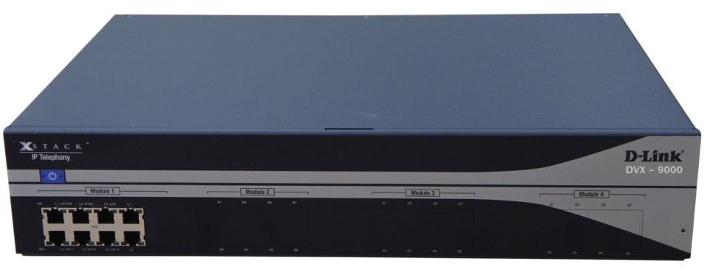

D-link Business IP PBX Series
IP-PBX
Asterisk-based IP-PBX
Up to 60 concurrent calls
Up to 300 users
DVX-8000
IP-PBX Enterprise
Asterisk-based IP-PBX
Available with 4 port E1
Up to 300 concurrent calls
Up to 800 users
DVX-9000
Enhanced Business Telephony
Asterisk-based IP-PBX
Available with 24 port E1
Up to 880 concurrent calls
Up to 1500 users
DVX-9000E

Slide 6
DVX-2005F Brief Introduction - :
The DVX-2005F IP Phone System is an ideal solution for small and medium business with up to 100 extensions. Adopting the innovative modular design, it is very convenient to increase telephony ports to expand the system. The DVX-2005 supports industry standard SIP trunks, analog PSTN trunks (FXO Module), analog stations (FXS Module),
Highlights & Features
No User License Fee
All Standard PBX Features
Many Advanced PBX Features
Desktop Call Management
Firewall
Intrusion Detection
Enhanced Security Policies
Disaster Recovery
Fax to Email
WebRTC/ Web Dial
Voicemail to Email
Console Port for easy management
Stronger Security to Protect System
Remote Backup Service

Slide 7

DVX-3000 Capabilities
Up to 30 extensions
Optional ½ PRI (up to 16 channels)
Up to 16 analog ports (FXS and/or FXO)
Up to 8 BRI ports (16 channels)
Up to 30 concurrent SIP calls
Up to 16 concurrent E1/T1 calls
Up to 16 concurrent E1/T1/BRI/
FXS/FXO calls

Slide 8

DVX-3000 Specifications
EASY VOIZ PBX v. 4.5x
900MHz quad-core ARM Cortex-A7 CPU
10/100 Ethernet port
1GB RAM
Two USB2 ports
8GB micro SD storage

Slide 9
What is D-Link DVX 8000/9000 ?
The DVX9000 is a heavy-duty, stand-alone, pre-configured, out-of-the-box Asterisk IP PBX featuring the Elastix™ Asterisk distribution. The DVX9000 may be equipped with up to 32 analog ports, up to eight BRI ISDN ports, and up to 4 E1/T1 PRI, or E1 R2 ports in a single, 19" 2U chassis. Additional PSTN/analog phone ports can be provided by connecting up to 24 external USB Gateway units via the USB2 ports, for a total of up to 800 PSTN/analog phones ports, up to 800 users and up to 300 concurrent calls
Cisco CME
Trunks
Software |  |  | Hardware
Asterisk version | 11.x (Elastix 2.4x |  | Processor | Intel G850 2.9 GHZ
Linux version | CentOS 5.x |  | RAM | 4 GB
GUI | FreePBX |  | Hard disk | From 300 GB 2.5'' (500GB optional)
 |  |  | USB | 4 external USB 2.0

Slide 10
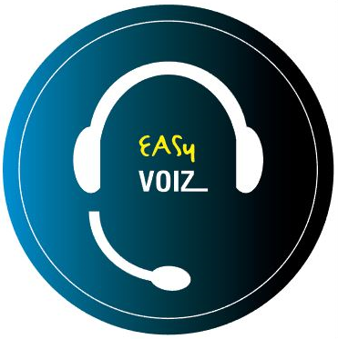

Introducing “ DVX-9000E”
Robust, heavy-duty IP-PBX featuring:
Two hot swappable, 24x7 server grade HDDs
  Easily accessible from the front panel
  Lockable
Two hot swappable, 250 Watt power supplies
Fault notification for both components:
  On LCD panel
  Buzzer sounds
  e-mail to admin

Slide 11
DVX-9000E Specifications
EASY VOIZ 5x
Intel Xeon Processor E3-1225V2 8M cache (3.20GHz)
8GB RAM
Two hot swappable 1TB HDD

Slide 12
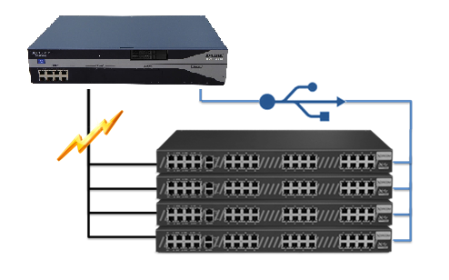
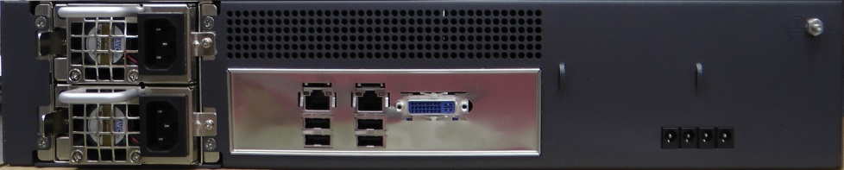
Supports up to 20 external fully-populated DVX-8050

Slide 13

Full and Automatic IP PBX redundancy
Provides full redundancy for a complete
PBX system, incl. telephony interfaces
Quick and automatic failover process
keeps downtime to an absolute minimum
Auto detection of server failure & switch
to backup server
Firmware-based switching mechanism
is not network-dependent
Solution components:
  Two DVX-9000 IP PBX units with identical configurations
  DVX-8050(s) with dual USB ports

Slide 14
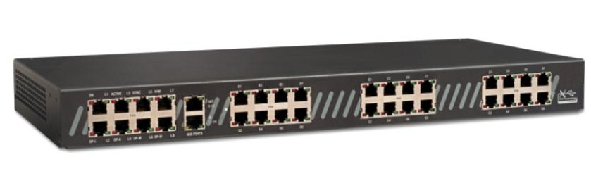
Two DVX 9000+ Dual-USB DVX8050
DVX 9000(primary)
DVX 9000(backup)
USB
USB
LAN/WAN
PSTN
SIP Trunking
IP Phones

Slide 15
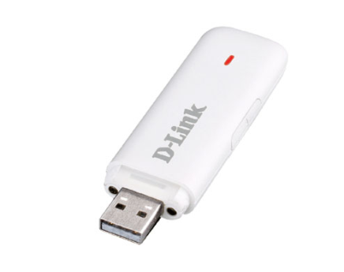
PBX Disaster Recovery Made Simple
Never worry about:
      natural disasters
      hardware failure
      human error
Now you can create, save and
restore your PBX files in minutes!
Backs up entire PBX including
user-defined options:
  .configuration files
  .voice prompts
  .voice mail

Slide 16
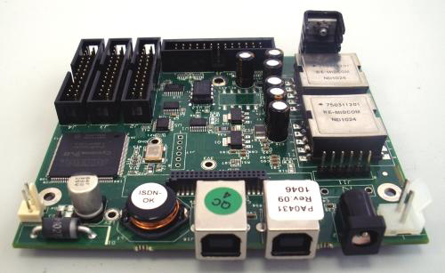
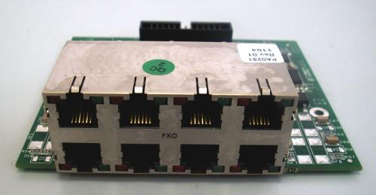
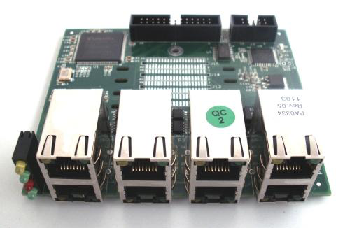
DVX- 9000 I/O Modules
DVX 8010 Main Module
DVX 8020 8 Port FXO Module
DVX 8030 1-4 port PRI module
DVX 8025 8 port FXS module

Slide 17
Introducing EASY VOIZ 5

Slide 18
EASY VOIZ 5
EasyVoIZ is based on a highly responsive graphic user-interface that facilitates the management of Asterisk servers, in a fast, intuitive, and secure manner.
The system is based on a 3-level menu system that makes it very easy to locate any item that you want to manage.
Simple Management
  desktop call management
  visual voicemail
  browser-based administration
Inbound Call Center / Customer Service Aids
  call recording
  graphical call reporting
  integrated chat
  unlimited auto attendants
  Efficient Communications
  inbound/outbound fax
  smart phone integration
  unified messaging
  presence management
  conference bridges
  video calling

Slide 19
Streamlined Maintenance
Streamlined endpoint management
  Auto-provision and configure over 150 phone models from user interface
Advanced upgrade settings
  System allows single-point access for updates
  Free upgrades under terms of service agreement
  During update the system keeps the old settings while adding the new
Simple procedure for adding modules
  Purchased
  Custom development
Notes:
One of the drawbacks of working with an open source platform that doesn’t provide full manufacturer support is the process of applying updates, upgrades, and new functionality.
Xorcom has stabilized the software and upgrade process and is the sole source for support, maintenance, and upgrades.

Slide 20

My Extension
Accessible by any defined user
Each user sees/manages own extension only
Increases productivity & availability: never miss a sales call!
Options
  Call Monitor to review call log
  Voicemail to play and download voicemail
  Faxes to send/receive faxes
  Feature Codes lists available feature codes
  Follow Me defines Follow Me behavior
  Phone Features menu defines phone features
  Define VmX Locator
  Settings sets language and notification settings

Slide 21
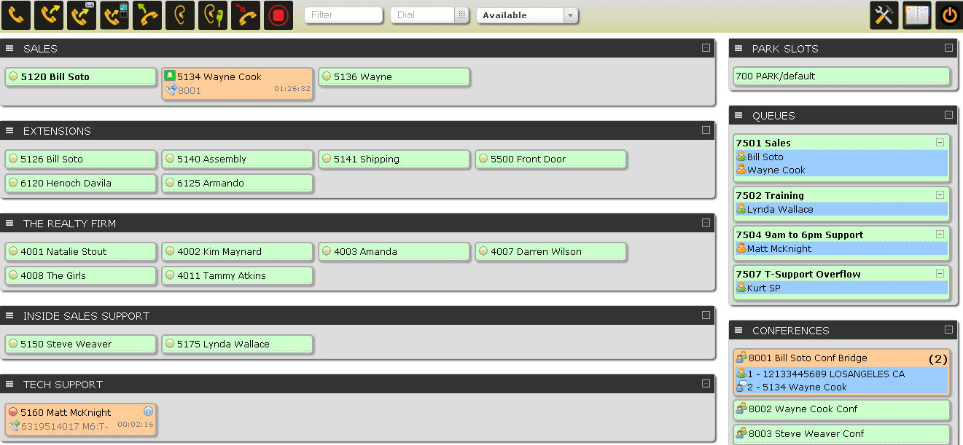
Call Center Functionality in EasyVoIZ
The standard version of EasyVoIZ includes entry-level call center functionality
Embedded browser-based switchboard
Customization
options for:
  Queues
  Announcements
  Failover
“Lite” statistics reporting

Slide 22

Feature-Rich Dashboard on Switchboard
Quick Status Check
  Who’s free
  Length of current call
  Identification of call party
“Listen”
  Listen to calls in progress
  Great for quality monitoring
“Whisper"
  Speak with staff during call without interrupting the conversation
  Great for training
Internal dialogue
  Consultation between staff during calls
Notes:
EasyVoIZ Call Center features include:
Queue Options
Agent Call Announcement*
Join Announcement
Announcement to Caller
Message On Hold by Queue
Ringing instead of MoH
Maximum Wait Time
Maximum Callers
Ring Strategy
Ring All; Round Robin; Least Amount of Calls; Random; Round Robin w/Memory
Wrap-up Timer
Call Recording
Agent Event Recording*
Queue Priority*
Customer Care Callback*
Caller Position Announcements
Frequency
Announce Positions
Announce Average Hold Time*
Failover Destination
Define a destination where the call should be transferred if Maximum Wait Time or Maximum Callers thresholds are reached
Periodic Announcements
Frequency
Option allowing caller to press a key and exit the queue
Can be sent to:
Customer Care Callback
Voicemail
Alternate Answer Point
* Indicates features that are normally optional for other call center packages

Slide 23
Queue Options
Agent Call Announcement
  Announcement to Agent
Join Announcement
  Announcement to Caller
Message On Hold by Queue
Ringing Instead of Message on Hold
Maximum Wait Time
Maximum Callers
Ring Strategy
  Ring All; Round Robin; Least Amount of Calls; Random; Round Robin w/Memory
Wrap-up Timer
Call Recording
Agent Event Recording
Queue Priority
Customer Care Callback

Slide 24
Announcements & Failover Options
Caller Position Announcements
  Frequency
  Announce Positions
  Announce Average Hold Time
Periodic Announcements
  Frequency
  Option to have caller press a key and exit the queue
  Can be sent to:
    Customer Care Callback
    Voicemail
    Alternate Answer Point
Failover Destination
  If Maximum Wait Time or Maximum Callers intervals are reached, define destination where the call should be transferred

Slide 25
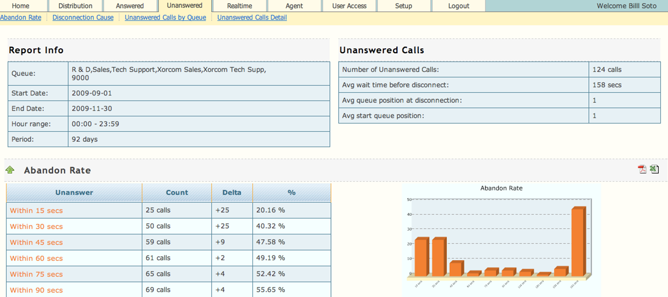
Call Center Statistics Reporting
Great for monitoring activity to improve efficiency of organization / employees
Two versions are available:
  Lite - Default on all EasyVoIZ systems
  Pro - Add-on module for DVX-9000

Slide 26
Call Statistics Modules Comparison
Lite & Pro
  Answered
  Unanswered
  Distribution
  Service-level
  Charting
  Import/Export
Pro Only
  Real-time
    Queue Summary
    Call Waiting Detail
    Agent Status
  Search
    CallerID
    Agent
    Queue
    Period
    Duration
  Customization options

Slide 27
Lite: Standard Functionality
Data import | Data is available by using a cron job to import new data at scheduled intervals
Export | Export reports into PDF format for presentations, or csv format for external data crunching
Reporting | Answered, Unanswered, or Distribution
Distribution Reporting | Analysis by day, week day, or hour
Answered Calls Reporting | Analysis by queue, agent, disconnection cause, or service level
Service Level Reporting | Answered Service Level Report
Unanswered Call Reporting | Analysis by queue or disconnection cause
Sundry Reporting | Agent Status, Queue Summary, or Call Waiting Detail
Charting | Uses HTML5 and Java script, so no need for a flash-enabled browser

Slide 28
Pro: Additional Functionality
Data import | Data is available as the event occurs, i.e. in real-time
Export | Export reports into PDF format for presentation purposes, or csv format for external data crunching
Reporting | Service Level Agreement, Abandon Rates, Call Distribution, Agent Activity
Distribution Reporting | Analysis by queue, month, week, day, week day, hour, URL, as well as detailed reporting
Answered Calls Reporting | Analysis by queue, wait time, agent, disconnection cause, duration, transferred calls, as well as a detailed reporting
Service Level Reporting | Answered and Unanswered Service Level Reports
Unanswered Call Reporting | Analysis by queue, disconnection cause, URL, as well as detailed reporting
Sundry Reporting | Agent Availability, Sessions and Pause Durations, Call Disposition, as well as Detailed Paused Report and Session Report
Charting | Uses HTML5 and JavaScript, so no need for a flash-enabled browser

Slide 29
Pro: Additional Functionality, cont’d
Search | Search data by Caller ID, agent, queue, duration ranges, or date ranges
Report distribution | Schedule automatic email distribution of multiple reports
Notifications | Create automatic email notifications when variables exceed user-defined threshold values
Recordings | Listen to recordings by clicking on icon in the report
Customization | Customize reports with your own language, color schemes, date and time formatting, metrics, formulas, etc.
Real-time Monitoring | SPY option to listen to calls in progress with option to ‘steal’ the call
Real-time Coaching | Coach agents using whisper method during calls

Slide 30
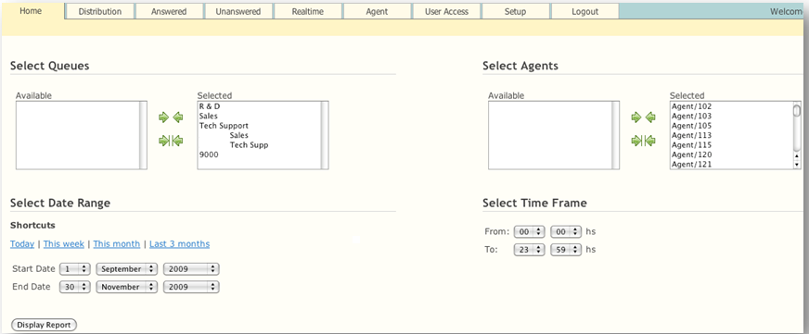
Select Time Frame to Report

Slide 31


Call Center Statistics Reporting
Great for monitoring activity to improve efficiency of organization / employees
Two versions are available:
  Lite - Default on all EasyViOZ systems
  Pro - Add-on module for DVX-9000 and DVX-9000E series

Slide 32
Call Statistics Module Comparison
Lite & Pro
  Answered
  Unanswered
  Distribution
  Service-level
  Charting
  Import/Export
Pro Only
  Real-time
    Queue Summary
    Call Waiting Detail
    Agent Status
  Search
    CallerID
    Agent
    Queue
    Period
    Duration
  Customization

Slide 33








Major Benefits of EASY VOIZ PBX
Web-based interface for easy implementation and management
Enterprise-class communication features, unified communication options and basic call center functionality are standard, with
no per user license fees
Modular support for PRI, BRI, FXO and FXS telephony interfaces
Interoperability with SIP standard endpoints, including flexible tool for adding new vendors/models
.
Built-in mechanisms to regulate access for heightened security
Hospitality-ready integrated solution that interfaces with leading property management systems (PMS)
Easily tailored to suit a wide variety of vertical markets: e.g., healthcare; legal; manufacturing; car dealerships; campuses; consultants; contractors
Open application programmable interface enabling easy integration of third party products

Slide 34
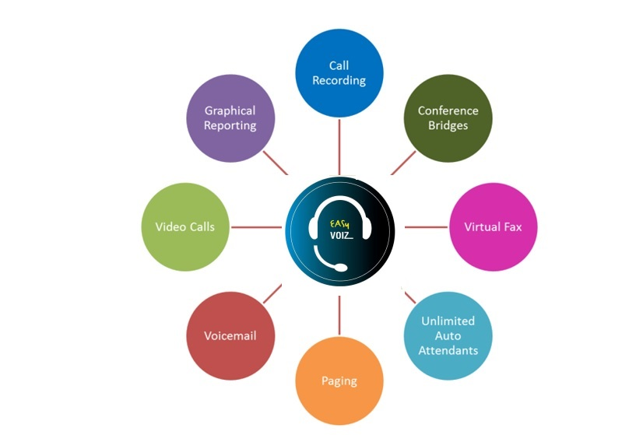
Sampling of Included Telephony Apps

Slide 35

User Experience
Basic Call Features
  Call back
  Call forward
  Call parking
  Call pickup
  Call waiting
  Camp on
  DISA (Direct Inward
  System Access)
  DND (do not disturb)
  Find me / Follow me
  Transfer (blind, attended)
  Voicemail
  Customization incoming/outgoing
  Display
  Lookup
  Blocking
  Routing
  Screening
  On Call Waiting
  CDR (Call Details Record)
  Corporate phone books
  Direct Inward Dial Numbers (DIDs)
  Inbound/Outbound fax support
  Language support
  Message Waiting Indicator (MWI)
  Short-code dialing
  Speed Dial
  User-friendly Web interface
  Video calls
  Voicemail-to-email
  Wake-up Calls / Reminders

Slide 36

Unified Communications
Audio conferencing
Call recordings access
Corporate phone book
Disaster recovery
Fax-to-email
Instant messaging/chat*
One number reach
Operator panel (switchboard)
Paging and intercom
Presence
Short-code dialing
Survivability
Video conferencing
VMX Locator
Voicemail to e-mail
Web access to voicemail, fax, and recordings

Slide 37

Workgroup Features
Call monitoring
Call queues
Call recording
Caller Name Lookup
CDR (Call Details Record)
Click-to-call
Conferencing (on-the-fly)
Hot-desking
Hunting groups
IVR / Auto-attendants
Instant messaging/chat*
Pick-up groups
Presence (agent status)
Queue priorities
Ring group strategies
Statistical reporting
Time-based routing
Visual switchboard

Slide 38

Administration
Backup and Restore
Endpoint provisioning tool
Feature codes
Music / Announcements
Network settings tool
Pre-defined user roles
Remote administration
Storage monitoring
System status screen
System-wide speed dial
Time Conditions
User-friendly Web interface

Slide 39

Interfaces & Integration
PRI, BRI ISDN, FXO, FXS
SIP phones
Soft phones, smartphones, tablets
TDM/SIP/IAX trunks
TDM-VoIP gateway

Slide 40

Thank You
Notes:
40

