Slide 1


Slide 2




D-link’s Long History of Open Source
Android is a Registered Trademark of Google Inc.
Asterisk is a Registered Trademark of Digium

Slide 3

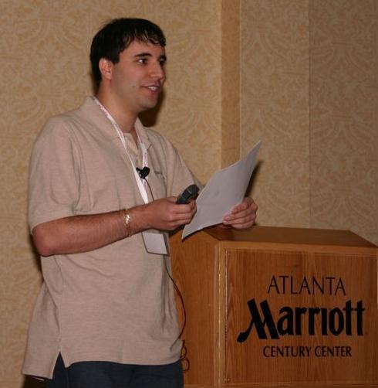

Introduction to Open source PBX
What Is Asterisk?
When: 1999
Who : Mark Spencer
Why : “I needed a phone system and with as small a startup budget as I had for Linux Support Services, I wasn't about to buy one, so building one seemed a logical way to go.”
Officially, Asterisk is an Open Source hybrid TDM and packet voice PBX and IVR platform with ACD functionality. Unofficially, Asterisk is quite possibly the most powerful, flexible, and extensible piece of integrated telecommunications software available.
Its name comes from the asterisk symbol, *, which represents a wildcard, matching any filename.
Similarly, Asterisk the PBX is designed to interface any piece of telephony hardware or software with any telephony application, seamlessly and consistently.
A Linux Based PBX w/ Minimal Hardware
A Community Driven Development Project
A Really, Really Disruptive Technology
Asterisk is any call, any time, from anywhere to anywhere else

Slide 4


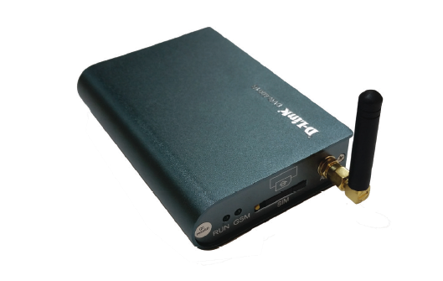
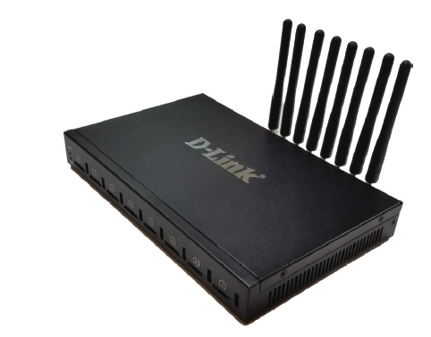
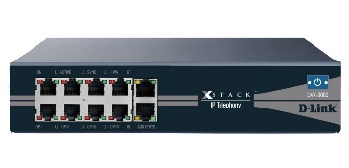
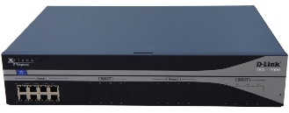

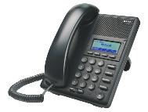
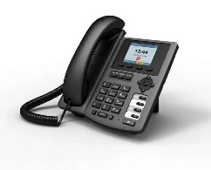
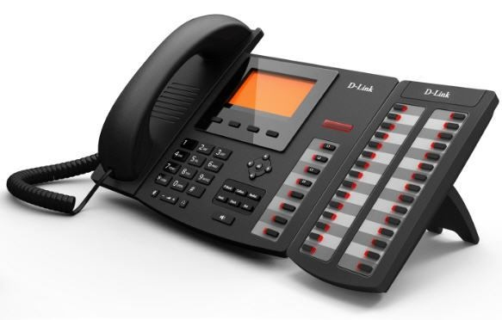
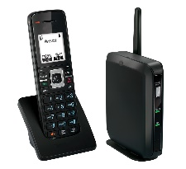
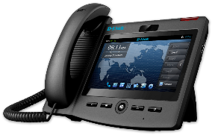
D-link IP PBX Series
GSM Network
DVG-6001G
DVG-6008G
DVX-2002F
DVX-2005F
DVX-3000
DVX-8000
DVX-9000
Notes:
Simton IPX CPE systems
P100, Office, H500, Enterprise, B2000 have similar capabilities, but with different scales.
Support: normal PSTN lines, VoIP lines, VoIP trunks, Analog phones, IP phones, soft phones.
Simton IPX S600 is the server model for large scale:
voice intranet call routing
ISP network platform
conference bridge
voice mail server
Simton IPF71 IP phone support 2 lines
Simton FWT has single channel, support all GSM spectrum

Slide 5
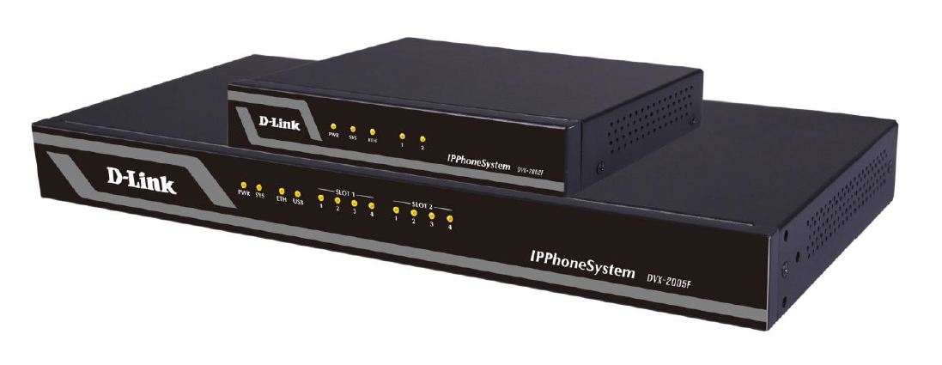
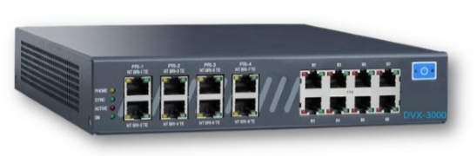
DVX-2005 & DVX-3000 SOHO IP PBXs
Delivering high quality, secure and reliable voice, video, data & mobility to SMBs
IP-PBX
Asterisk-based IP-PBX
Up to 10 concurrent calls
Up to 30 users
DVX-2002F
DVX-2005F
IP-PBX
Asterisk-based IP-PBX
Up to 20 concurrent calls
Up to 50 users
DVX-3000
IP-PBX
Asterisk-based IP-PBX
Up to 30 concurrent calls
Optional ½ PRI (up to 16 channels

Slide 6
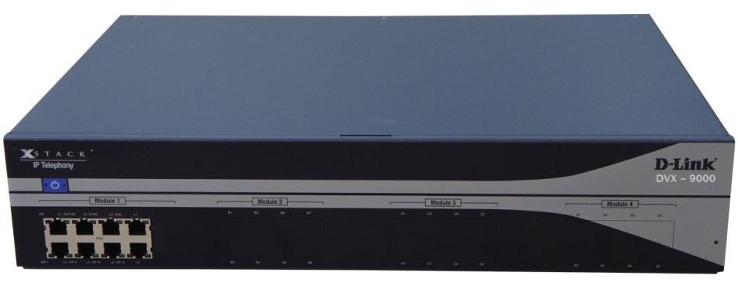
D-link Business IP PBX Series
IP-PBX
Asterisk-based IP-PBX
Up to 60 concurrent calls
Up to 300 users
DVX-8000
IP-PBX Enterprise
Asterisk-based IP-PBX
Available with 4 port E1
Up to 300 concurrent calls
Up to 800 users
DVX-9000

Slide 7
DVX-2005F Brief Introduction - :
The DVX-2005F IP Phone System is an ideal solution for small and medium business with up to 100 extensions. Adopting the innovative modular design, it is very convenient to increase telephony ports to expand the system. The DVX-2005 supports industry standard SIP trunks, analog PSTN trunks (FXO Module), analog stations (FXS Module),
Highlights & Features
No User License Fee
All Standard PBX Features
Many Advanced PBX Features
Desktop Call Management
Firewall
Intrusion Detection
Enhanced Security Policies
Disaster Recovery
Fax to Email
WebRTC/ Web Dial
Voicemail to Email
Console Port for easy management
Stronger Security to Protect System
Remote Backup Service

Slide 8


DVX 8000 & DVX 9000 IP-PBX Overview
DVX 8000
DVX 9000

Slide 9
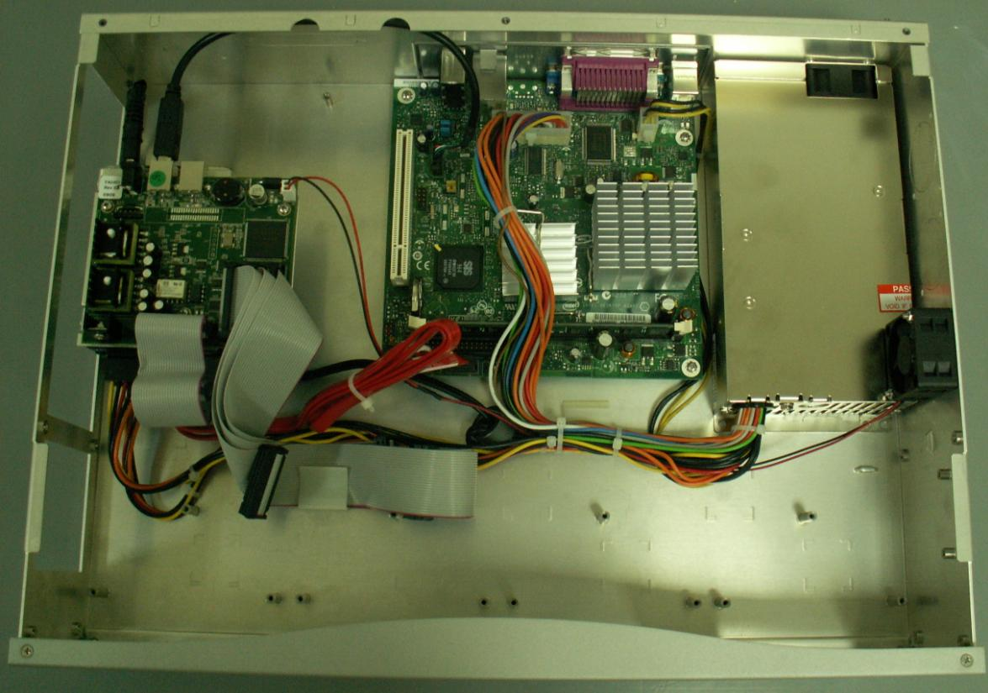
USB cable to the Main board
Cable for 1st Module
Cables for Other Modules
1st Position Module
2nd Position Module
3rd Position Module
4th Position Module

Slide 10
IP-PBX Features
User-friendly Web Interface
Interface in Different Languages
CDR - Call Details Record
Call recording
TDM/SIP/IAX Trunks
Remote Extensions
Voicemail
Fax Support
Voicemail to Email
Auto-Attendant
IVR Menu System
Ring Groups
Call Queues
Video calls
Follow-Me
Conference Rooms
Time-Based Routing
Advanced Dialing Rules
Music On Hold
Call center Module
Web Access to Voicemail
Admin Status Screen
Package Manager
(for easy updates)
Call Back
Call spy

Slide 11
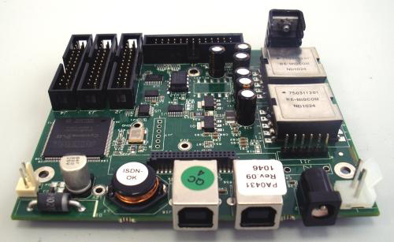
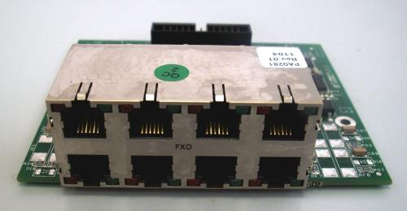
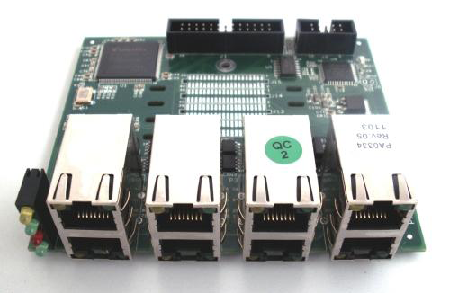
DVX- 9000 I/O Modules
DVX 8010 Main Module
DVX 8020 8 Port FXO Module
DVX 8030 1-4 port PRI module
DVX 8025 8 port FXS module

Slide 12
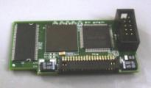
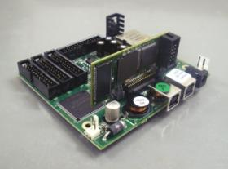
Hardware Echo Cancellation
High level EC and voice enhancement
1 module per USB Gateway/PBX(w/telephony port)
32-144 speech channels per module
Removes load from the CPU
Basic module supports 32 channels
Additional channels are licensed in
bundles based on port type

Slide 13

Full and Automatic IP PBX redundancy
Provides full redundancy for a complete
PBX system, incl. telephony interfaces
Quick and automatic failover process
keeps downtime to an absolute minimum
Auto detection of server failure & switch
to backup server
Firmware-based switching mechanism
is not network-dependent
Solution components:
  Two DVX-9000 IP PBX units with identical configurations
  DVX-8050(s) with dual USB ports

Slide 14
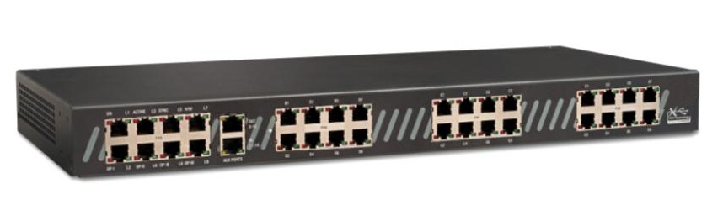
Two DVX 9000+ Dual-USB DVX8050
DVX 9000(primary)
DVX 9000(backup)
USB
USB
LAN/WAN
PSTN
SIP Trunking
IP Phones

Slide 15
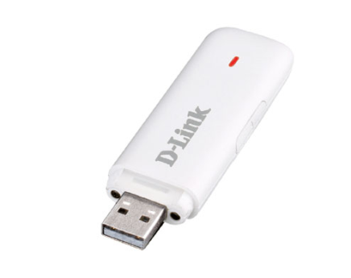
PBX Disaster Recovery Made Simple
Never worry about:
      natural disasters
      hardware failure
      human error
Now you can create, save and
restore your PBX files in minutes!
Backs up entire PBX including
user-defined options:
  .configuration files
  .voice prompts
  .voice mail

Slide 16

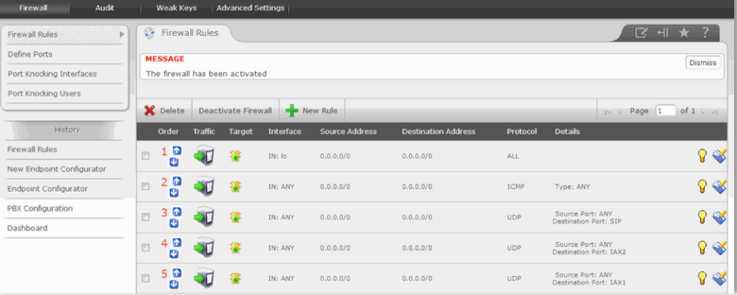
DVX-9000 Embedded firewall
SIP is a very high value target for hackers and people are constantly scanning the internet for open connections on port 5060.
When they find one the first thing they usually do is to try and brute force attack common extensions and get access to the server.
The DVX GUI interface allows you to control your server’s firewall settings by taking control of IPTables which is Linux’s software based firewall.

Slide 17
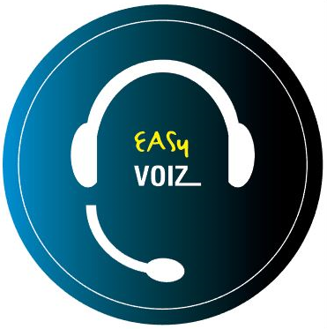

Introducing EASY VOIZ

Slide 18

DVX-3000
Ideal for:
  small businesses
  multi-site implementations
Compact: 19” 1U chassis
Feature-rich: EASY VOIZ PBX v. 4.5x
Budget-friendly

Slide 19

DVX-3000 Capabilities
Up to 30 extensions
Optional ½ PRI (up to 16 channels)
Up to 16 analog ports (FXS and/or FXO)
Up to 8 BRI ports (16 channels)
Up to 30 concurrent SIP calls
Up to 16 concurrent E1/T1 calls
Up to 16 concurrent E1/T1/BRI/
FXS/FXO calls

Slide 20

DVX-3000 Specifications
EASY VOIZ PBX v. 4.5x
900MHz quad-core ARM Cortex-A7 CPU
10/100 Ethernet port
1GB RAM
Two USB2 ports
8GB micro SD storage

Slide 21
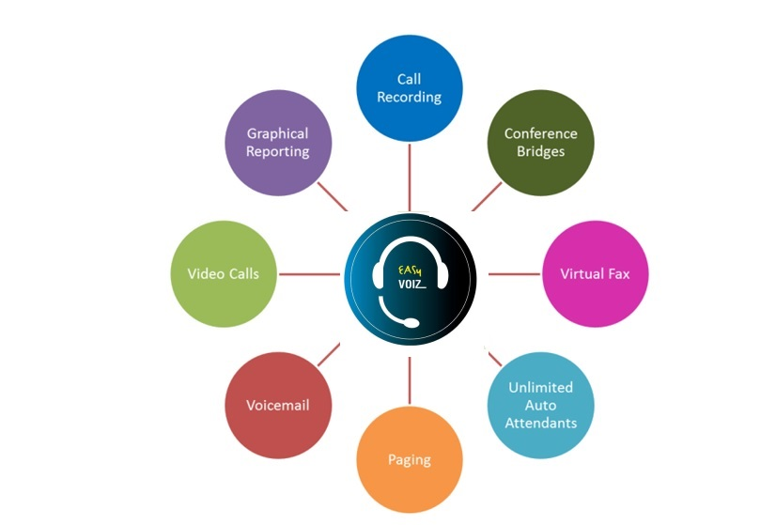
Sampling of Included Telephony Apps

Slide 22

User Experience
Basic Call Features
  Call back
  Call forward
  Call parking
  Call pickup
  Call waiting
  Camp on
  DISA (Direct Inward
  System Access)
  DND (do not disturb)
  Find me / Follow me
  Transfer (blind, attended)
  Voicemail
  Customization incoming/outgoing
  Display
  Lookup
  Blocking
  Routing
  Screening
  On Call Waiting
  CDR (Call Details Record)
  Corporate phone books
  Direct Inward Dial Numbers (DIDs)
  Inbound/Outbound fax support
  Language support
  Message Waiting Indicator (MWI)
  Short-code dialing
  Speed Dial
  User-friendly Web interface
  Video calls
  Voicemail-to-email
  Wake-up Calls / Reminders

Slide 23

Unified Communications
Audio conferencing
Call recordings access
Corporate phone book
Disaster recovery
Fax-to-email
Instant messaging/chat*
One number reach
Operator panel (switchboard)
Paging and intercom
Presence
Short-code dialing
Survivability
Video conferencing
VMX Locator
Voicemail to e-mail
Web access to voicemail, fax, and recordings

Slide 24

Workgroup Features
Call monitoring
Call queues
Call recording
Caller Name Lookup
CDR (Call Details Record)
Click-to-call
Conferencing (on-the-fly)
Hot-desking
Hunting groups
IVR / Auto-attendants
Instant messaging/chat*
Pick-up groups
Presence (agent status)
Queue priorities
Ring group strategies
Statistical reporting
Time-based routing
Visual switchboard

Slide 25

Administration
Backup and Restore
Endpoint provisioning tool
Feature codes
Music / Announcements
Network settings tool
Pre-defined user roles
Remote administration
Storage monitoring
System status screen
System-wide speed dial
Time Conditions
User-friendly Web interface

Slide 26

Security
Built-in firewall
Call encryption (SIP TLS, sRTP)
Intrusion detection and blocking
Customizable user roles
Limiting or blocking of outbound calls
PIN-protected outbound calls
Routing Groups

Slide 27

Interfaces & Integration
PRI, BRI ISDN, FXO, FXS
SIP phones
Soft phones, smartphones, tablets
TDM/SIP/IAX trunks
TDM-VoIP gateway

Slide 28

Sales Benefits of DVX-3000
Simple, pre-configured, 100% integrated: works ‘out of the box’ to save time and money
Small, professional, 9” 1U chassis
Full telephony connectivity: FXS, FXO, PRI (E1/T1), T1 CAS, E1/R2, BRI ISDN
Connects to VoIP (SIP, IAX),
incl. soft phones
Built-in security!

Slide 29

IP PHONES

Slide 30

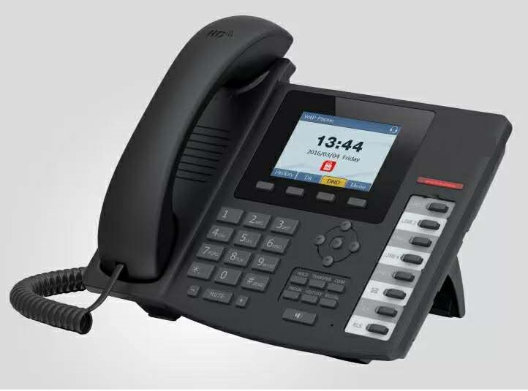
IP PHONES
DPH-150SE/ F5
Executive IP phone with 4 SIP Line with POE
Sleek desktop speakerphone with full-feature keypad, Color display , phone book, speed-dial, volume control, and ringtone selection
Dual-port Gigabit Ethernet
DPH-400SE / F5
Reception/Executive IP phone with 6 SIP Line with POE , color display
Sleek desktop speakerphone with full-feature keypad, phone book, speed-dial, volume control, and ringtone selection
Optional extended dial module (DPH-400sEDM) for BLF Keys.
Support s 5 Expansion modules
Dual-port Gigabit Ethernet

Slide 31

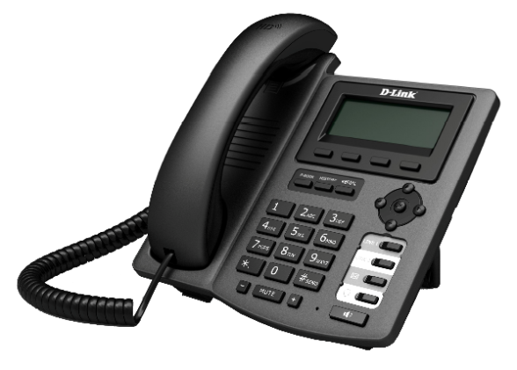
BASIC IP PHONES
DPH-120SE
Basic IP phone with 1 SIP Line with POE
Sleek desktop speakerphone with full-feature keypad, phone book, speed-dial, volume control, and ringtone selection
2 10/100Mbps Ethernet ports
Optional power adapter
DPH-150SE /F4
Executive IP phone with 2 SIP Line with POE
Sleek desktop speakerphone with full-feature keypad, phone book, speed-dial, volume control, and ringtone selection
2 10/100Mbps Ethernet ports
Optional power adapter

Slide 32
RECEPTION IP PHONE
DPH-400SE /F4
Reception/Executive IP phone with 5 SIP Line with POE
Sleek desktop speakerphone with full-feature keypad, phone book, speed-dial, volume control, and ringtone selection
Optional extended dial module (DPH-400sEDM) for BLF Keys. Support s 5 Expansion modules
Two10/100Mbps Ethernet ports
Dual-port Gigabit Ethernet (Only DPH-400GE)
Optional power adapter

Slide 33
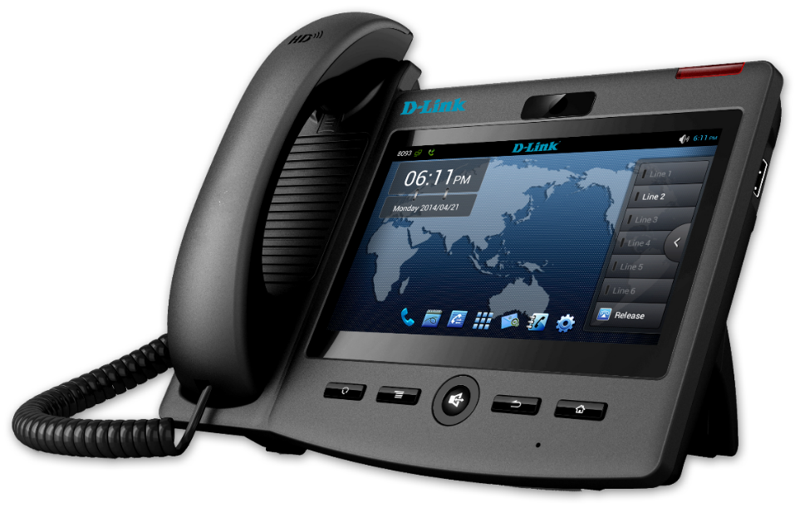
VIDEO IP PHONES
DPH-860S
DPH-860S F1 is the advanced IP video phone based on Android OS 4.0. It is equipped with the latest Freescale video chipset, a 7" LCD capacitive touch screen with 800x480 pixels and a 5M pixel camera. Android OS guarantees the easy customization for telecom operator and service provider.
The Intelligent OS, superior video quality, rich applications and affordable price , ensure DPH-860S F1 IP video phone is the Pioneer for next generation smart video telephone.
Dual-port Gigabit Ethernet ,Android 4.2 OS ,CPU Freescale Core Quad 1 Ghz
7” TFT Capacitive Multi Touch Screen, Configure the Keypad
Video Codec: H.264 / H.26

Slide 34

INTRODUCING NEW GENERATION HANDSETS

Slide 35
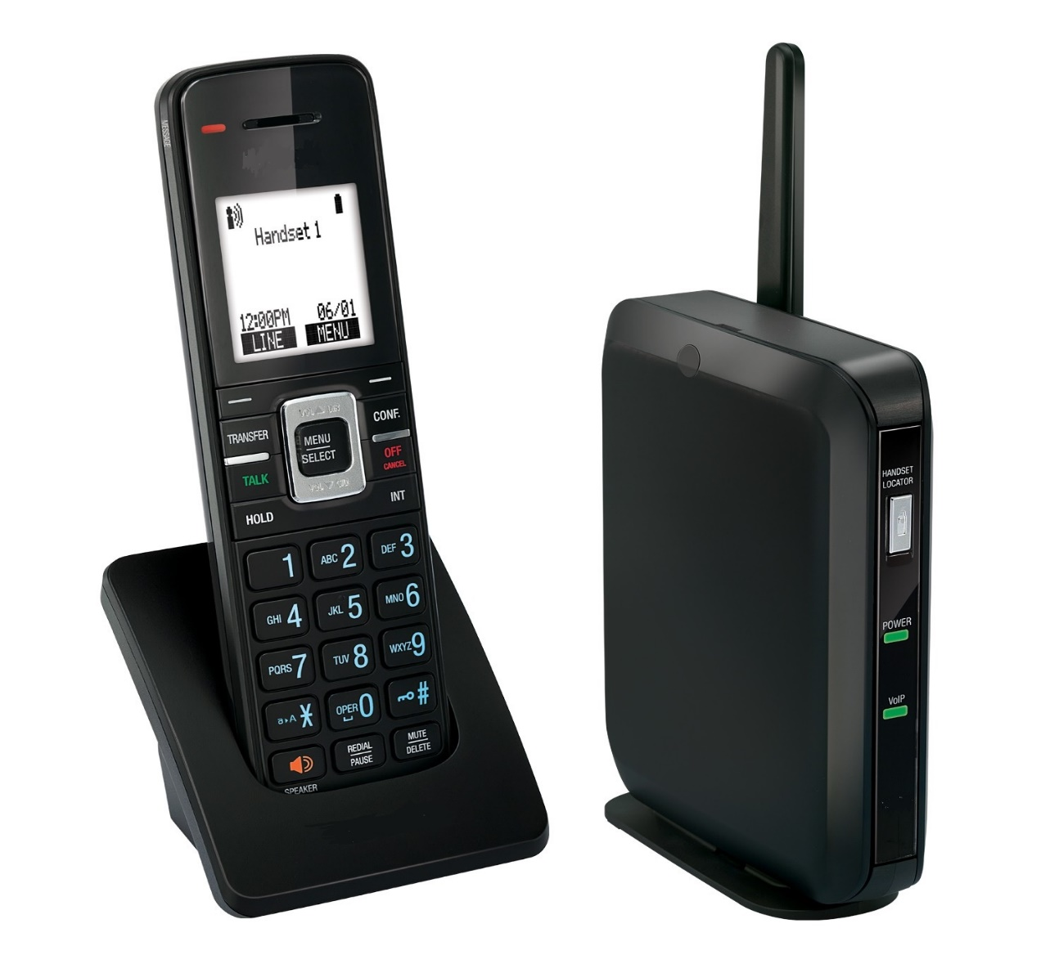
DVSP600A DECT SIP Cordless Base Station and Cordless Handset

Slide 36
SIP-DECT Overview
Facility-wide wireless communication solution to make, receive and confirm receipt of voice calls
Integrates seamlessly with your existing IP-PBX
Integrates with all major clinical information systems, such as nurse call and patient monitoring systems, and more…
Super-clear mobility with Orbitlink Wireless Technology.™ Leave your desk without leaving your work behind and enjoy DECT 6.0 sound quality and reception
Scalability. Growing pains? Register up to six cordless handsets to the DVSP600 base station and program each one with its own phone number or extension.
Flexibility. With support for up to six SIP lines/accounts, you can manage multiple calls with advanced call handling features.

Slide 37
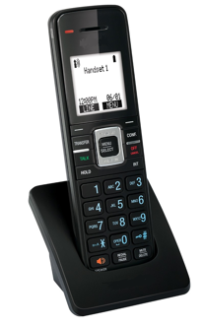
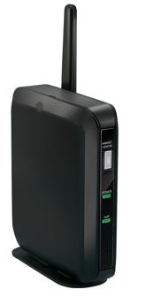
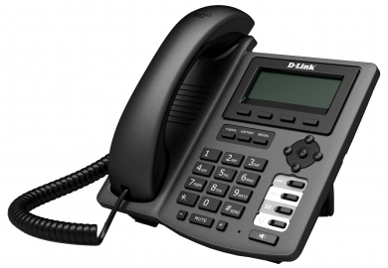

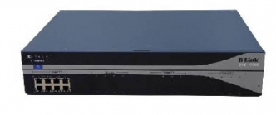
Solution Architecture
DVSP600A SIP-DECT
Access Point
Handsets
LOCAL AREA NETWORK (LAN)
DVSP600A SIP-DECT
Access Point
Handsets
PSTN
SIP
IP PBX
Notes:
Presentation Name Month Year
37

Slide 38
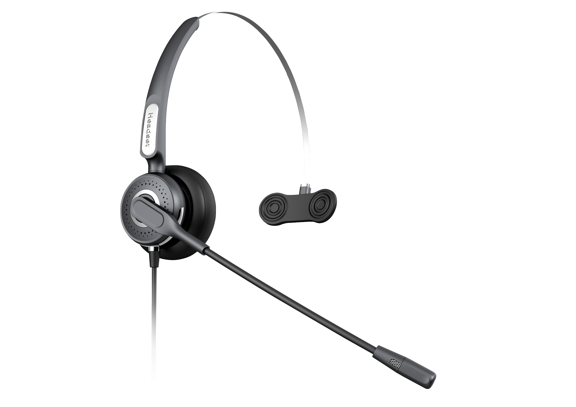
Operator Phone Headset
DPH-100 Head Set
EMI Shield ,T-Bar Pad
Connector plug-Telephone cable plug or direct dual 3.5mm
Wiring Kevlar/Shielded/Anti-oxidant tin plated
Bendable arms - 320 degree rotation
Leatherette cushioned ear pad

Slide 39
VOIP GATEWAYS

Slide 40
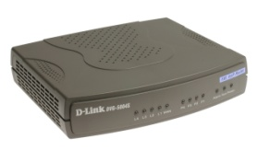

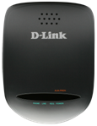

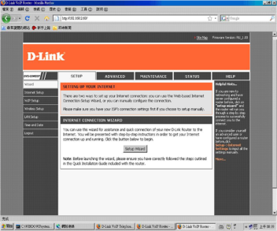
FXO & FXS Gateway Solution
4 Port GW
8 Port GW
16/32 Port GW
Telephone
Adapter
SOHO / SMB
SOHO / SMB
SMB / SME
SOHO
4 FXS / FXO ports
5 Ethernet
SIP
2/4/6/8 FXO / FXS ports
5 Ethernet
SIP
8 /16 / 32 FXS / FXO ports
2 Ethernet
SIP
2 FXS ports
1 Ethernet
SIP
Configuration and Management Applications
VoIP Configuration Wizard

Slide 41

4 Port Gateway Solution
  Realtek 8650B(VD) Chipset
  Control Protocol
    SIP V2 (RFC 3261)
  Interface
    1 WAN RJ-45 Port
    4 LAN RJ-45 Port
    4 RJ-11 Ports
  Codec
    G.711 A/μ
    G.723.1
    G.726
    G.729 A/B
  Echo Cancellation
    G168 / G165
  NAT traversal
    STUN
    Outbound Proxy
  QoS Support
    TOS
    VLAN Tagging
  FAX Support
    G.711
    T.38
  Other
    Support PPPoE, DHCP, Static IP
    Support Static Routing
    Support VPN Pass-Through
    Support Provisioning Security
    Https & SSL/TLS
DVG-5004S
DVG-6004S
DVG-7022S

Slide 42

8 Port Gateway Solution
  Realtek 8650B(VD) Chipset
  Control Protocol
    SIP V2 (RFC 3261)
  Interface
    1 WAN RJ-45 Port
    4 LAN RJ-45 Port
    8 RJ-11 Ports
  Codec
    G.711 A/μ
    G.723.1
    G.726
    G.729 A/B
  Echo Cancellation
    G168 / G165
  NAT traversal
    STUN
    Outbound Proxy
  QoS Support
    TOS
    VLAN Tagging
  FAX Support
    G.711
    T.38
  Other
    Support PPPoE, DHCP, Static IP
    Support Static Routing
    Support VPN Pass-Through
    Support Provisioning Security
    Https & SSL/TLS
DVG-5008S
DVG-6008S
DVG-7062S

Slide 43

16/32 Port Gateway Solution
  Realtek 8650B(VD) Chipset
  Control Protocol
    SIP V2 (RFC 3261)
  Interface
    1 WAN RJ-45 Port
    1 LAN RJ-45 Port
    16/32 RJ-11 Ports
  Codec
    G.711 A/μ
    G.723.1
    G.726
    G.729 A/B
  Echo Cancellation
    G168 / G165
  NAT traversal
    STUN
    Outbound Proxy
  QoS Support
    TOS
  FAX Support
    G.711
    T.38
  Other
    Support PPPoE, DHCP, Static IP
    Bridge Only
    Support VPN Pass-Through
    Support Provisioning Security
    Https & SSL/TLS
DVG-2016S
DVG-2032S
DVG-4032S

Slide 44
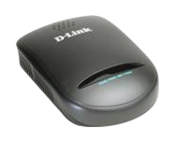



2Port ATA Solution
  Realtek-8651B Chipset
  Control Protocol
    SIP V2 (RFC 3261)
  Interface
    1 WAN
    2 FXS
  Codec
    G.711 A/μ
    G.723.1
    G.726
    G.729A/B
  Echo Cancellation
    G168 / G165
  VPN
    VPN Pass Through
    L2TP / PPTP Client
  NAT traversal
    STUN
    Outbound Proxy
  QoS Support
    TOS
    Diffserv-DSCP
  FAX Support
    G.711
    T.38
  Other
    IVR / MWI / VMWI
    Inbuilt Local Mixer
    Automatic Provisioning
    SNMP and Web-based Management & TR-069/104(Optional)
DVG-2102S

Slide 45
GSM VOIP Gateway Solutions
1 Port GSM Gateway
4/8 Port GSM Gateway
SOHO / SMB
SMB / SME
1 GSM port
1 WAN / 1 LAN port
SIP
4/8 GSM ports
2 LAN port
SIP
Configuration and Management Applications
VoIP Configuration Wizard

