Slide 1



DCS
-
DCS-2802KT
re
-
HD
Wire Free
Full HD
Outdoor
Camera
KIT

Slide 2

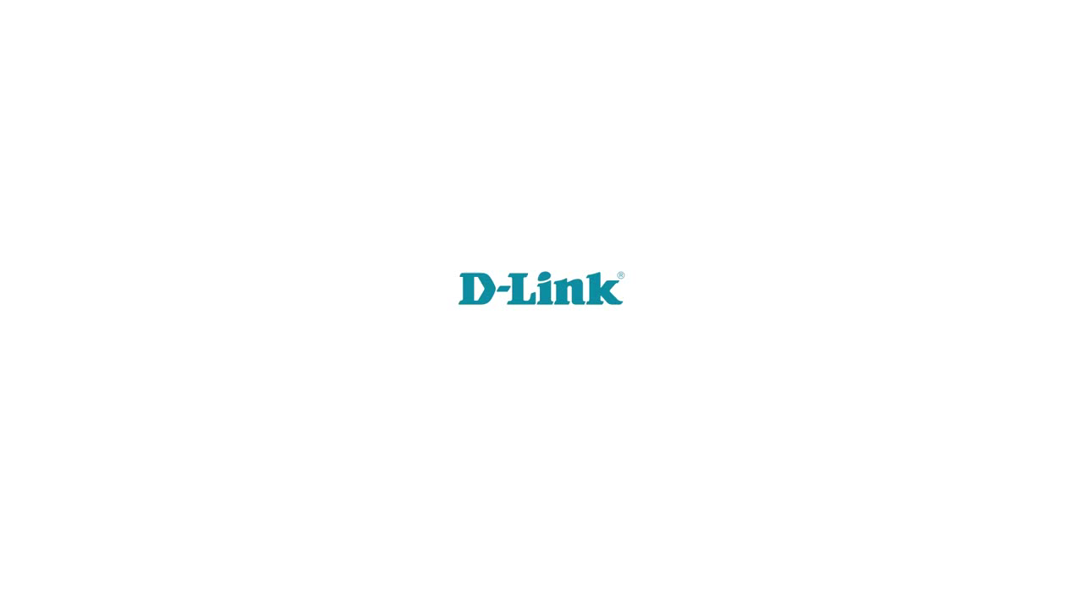

Slide 3

Table of Content
● Production Descriptions
➢ Product Appearance
➢ Applications
● Product Highlights
● Comparisons with Arlo pro
2

Slide 4


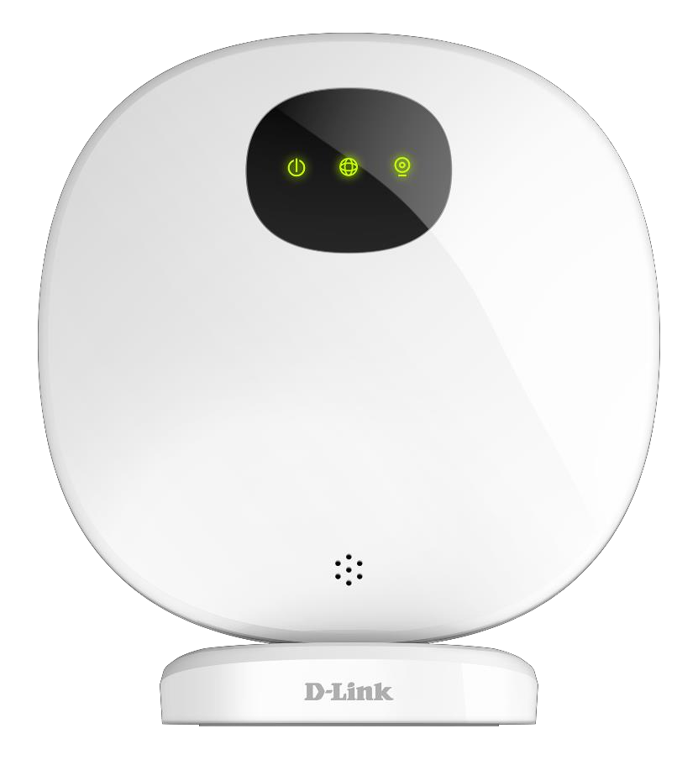
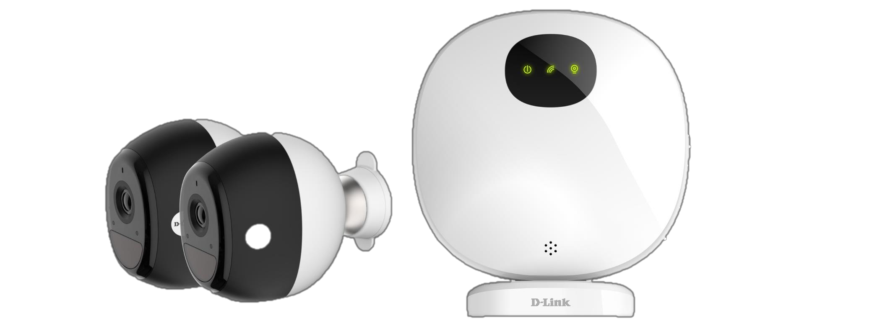
DCS
-
DCS-2802KT
Appearance
DCS-2802KT = DCS-2800LH X2
+
DCS-H100 X 1
3

Slide 5


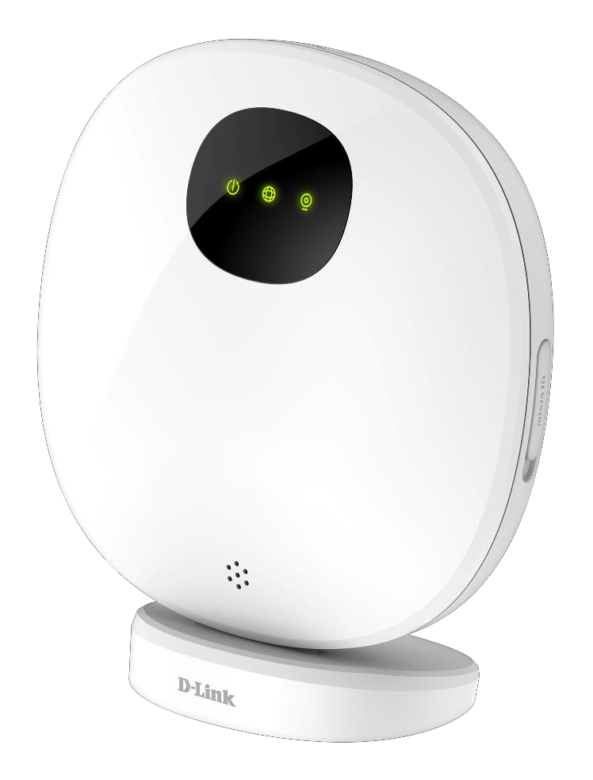
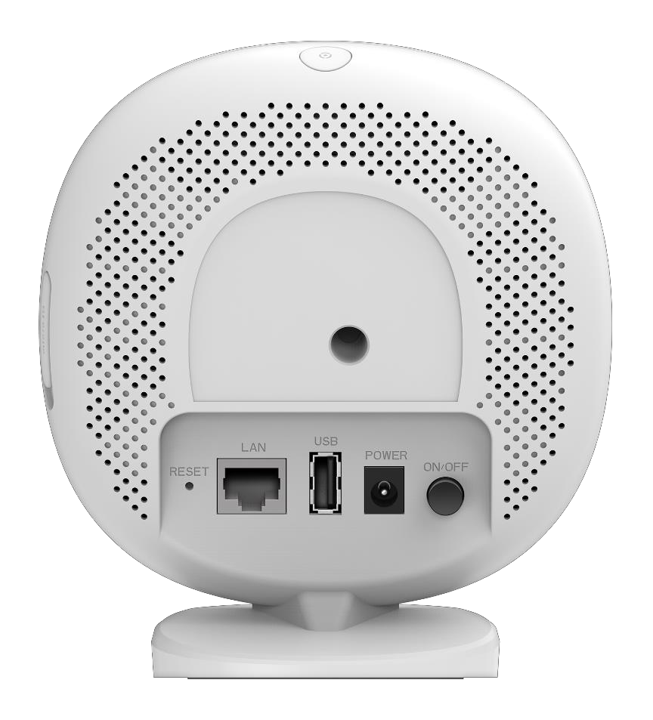
DCS
-
H100
Hub
Appearance
LED panel
SYNC button
Siren inside
MicroSD slot
Reset button
Power button
LAN
USB 2.0
12V/1.5A Power jack
4

Slide 6


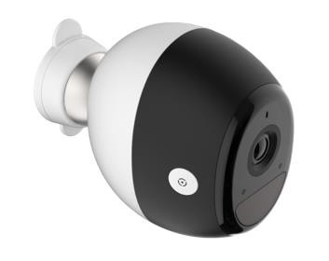
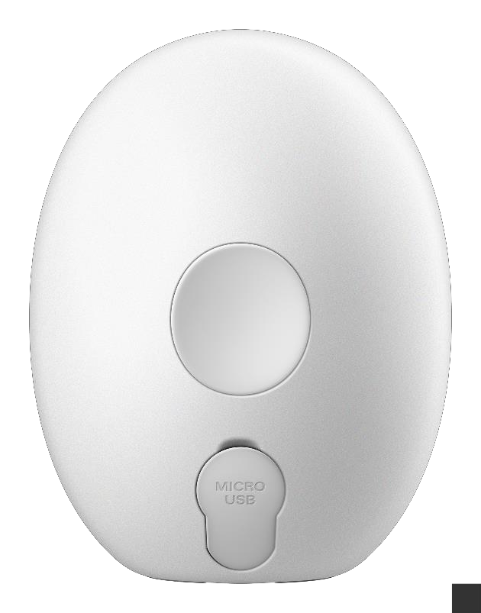
DCS
-
DCS-2800LH
Full
HD Battery
Cam
Appearance
Bracket
MIC
IR LEDs inside
Lens
Light Sensor
LED
Magnet
PIR window
Micro USB port
SYNC button
5

Slide 7



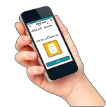

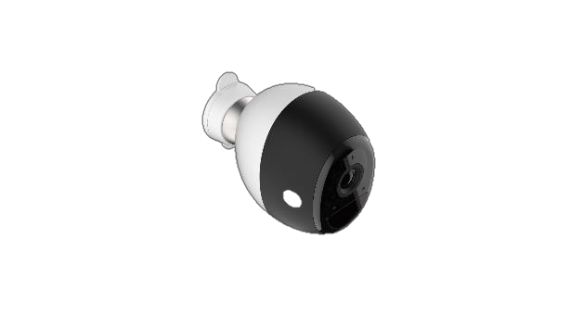







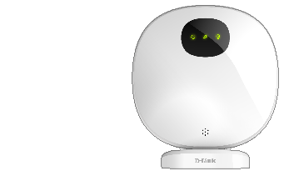
IPv6
Applications
Ethernet
Wi-Fi
mydlink cloud
service
router
DCS-2800LH
Battery Cam
DCH-H100 Hub

Slide 8
Table of Content
● Production Descriptions
● Product Highlights
➢ Positioning Overview
➢ Selling Points
● Comparisons with Arlo Pro
2

Slide 9


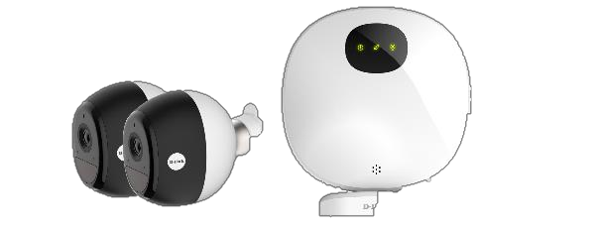
✓ Wire Free outdoor/indoor battery Came
Positioning Overview
ras working
✓ Support up to 4 Full HD battery cameras per hub.
✓ Long Battery life than competitors.
with
Hub
✓ Moving object detection to help reduce false
alarm.
✓ Cloud
and
Local (microSD/HDD) recordings
Cloud/local
recording
Wire free
camera
Full HD
1920x1080
DCS-2802KT
Moving object detection
Long life
Battery
8

Slide 10
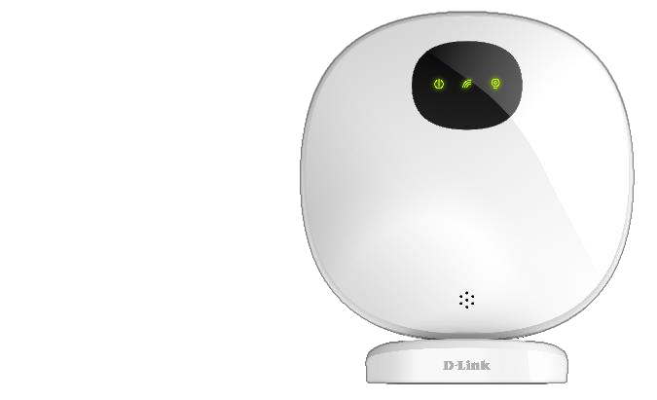
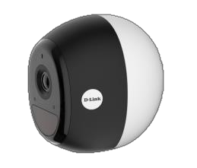
Selling points: Wire Free indoor/outdoor Camera
✓ No power and Ethernet cable needed for Camera
connection
✓ Camera battery life
operation 3 mins.)
up to 11 months.(Full
HD
24fps,
daily
✓ Waterproof
camera
enclosure,
rating
IP65
9

Slide 11




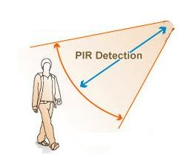


Precisely
Selling points: Precisely
Reduce False Alarm
Cameras in the market too many useless alerts !
DCS-2800LH has PIR design and support smart Moving
Object detection, which
alarms!
is
able to precisely
reduce
false
Distance 7.5 meters
Moving Object detection
•Horizontal range 115
degree
10

Slide 12

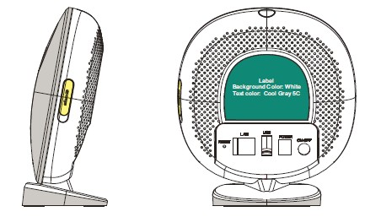
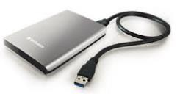

Selling points: Recording
✓ Video Recording
with
coherent interface
to
to
to
USB2.0: for Hard drive
microSD card
mydlink cloud
mydlink
service
cloud
✓ Coherent user interfaces
Easy
to
access
11

Slide 13
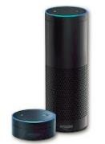

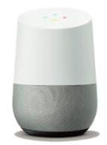



Selling points: Alexa/Google
Assistant/IFTTT
support
Be
able
to
work
with
12

Slide 14
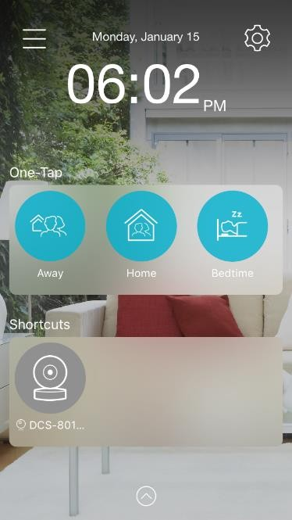
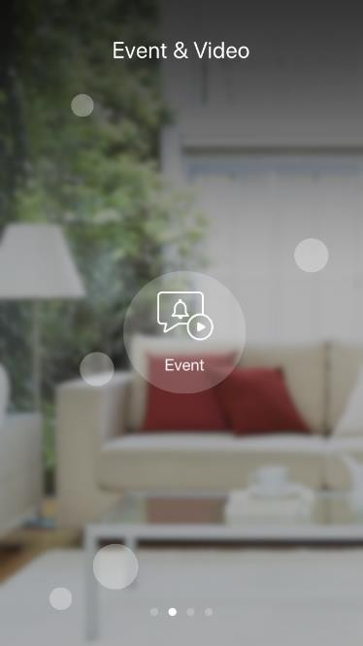
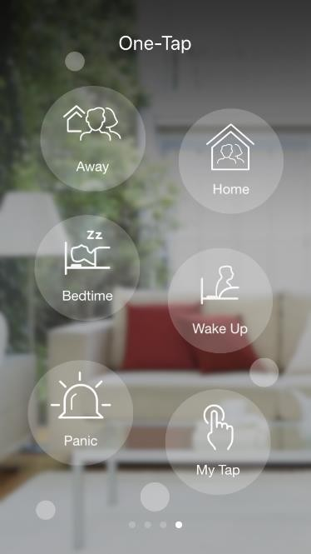
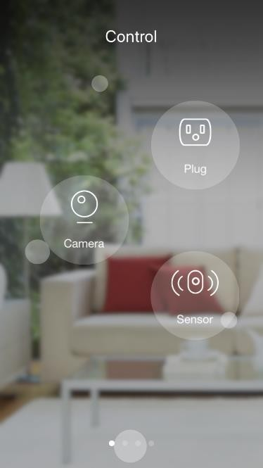
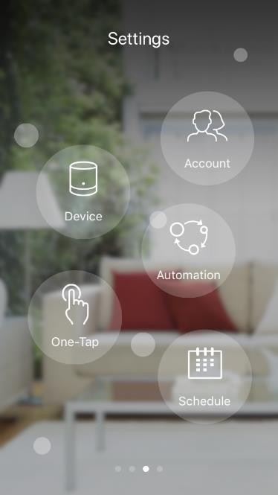
Selling points: new mydlink APP for operation
✓ mydlink APP provides the brand-new user interface for operation. It combines Camera, Sensor, Gateway, and Plug into a single APP. The functionality icon makes operation more intuitive and enhance the user experience.
13

Slide 15



IPv6
g
p
More sellin
oints
✓ 1/4” 2 megapixel CMOS
✓ H.264 compression
sensor
✓ Full HD resolution 1920x1080
✓ Wide angle 140 degree FOV (Diagonal)
✓ 7.5M IR LED support for night mode
✓ Camera build in microphone and speaker
✓ Build in two 18650 Hi-Efficiency 3350mAh camera
✓ Built-in security siren on Hub
Batteries for

Slide 16


Table
of
Content
●
Production Descriptions
●
Product Highlights
●
Comparisons with Arlo Pro
2

Slide 17
Battery Life Comparison
✓ Arlo Pro 2 claims 3-6 months battery life (Refer to Arlo support web page)
Average use assumes that you are using Optimized or Best Battery Life video settings and that your cameras record for approximately three / five minutes per day. Arlo Wire-Free and Arlo Pro 2 batteries last approximately 3-6 months with average use.
✓ Lab test Conditions for DCS-2800LH and Arlo Pro 2:
IR-LED off all the time; Room temperature 70F; Two way on, output; Distance of camera and Hub less than 2m
but speaker is no audio
Battery Camera with different design
Resolution spec
Battery Capacity (mWh)
Standby Power Consumption (mW)
Activating Power Consumption (mW)
Camera Activating time per day
Battery Life
(Months)
(sec)
Arlo Pro 2 / 1080P camera
1080P
17570
1.700
1089
300~180
4.46~6.15
DCS-2800LH / 1080P camera
1080P
23595
0.220 (*Note)
1220
300~180
7.36~11.87
✓ Test result:
With the same test conditions, assuming 300~180 seconds activating time per day, Arlo Pro 2 can reach 4.46~6.15 months battery life (under 720P resolution), and DCS-2800LH can reach 7.36~11.87 months battery life (under 1080P resolution).
*Note: US patent pending No. 15/277,165
16

Slide 18
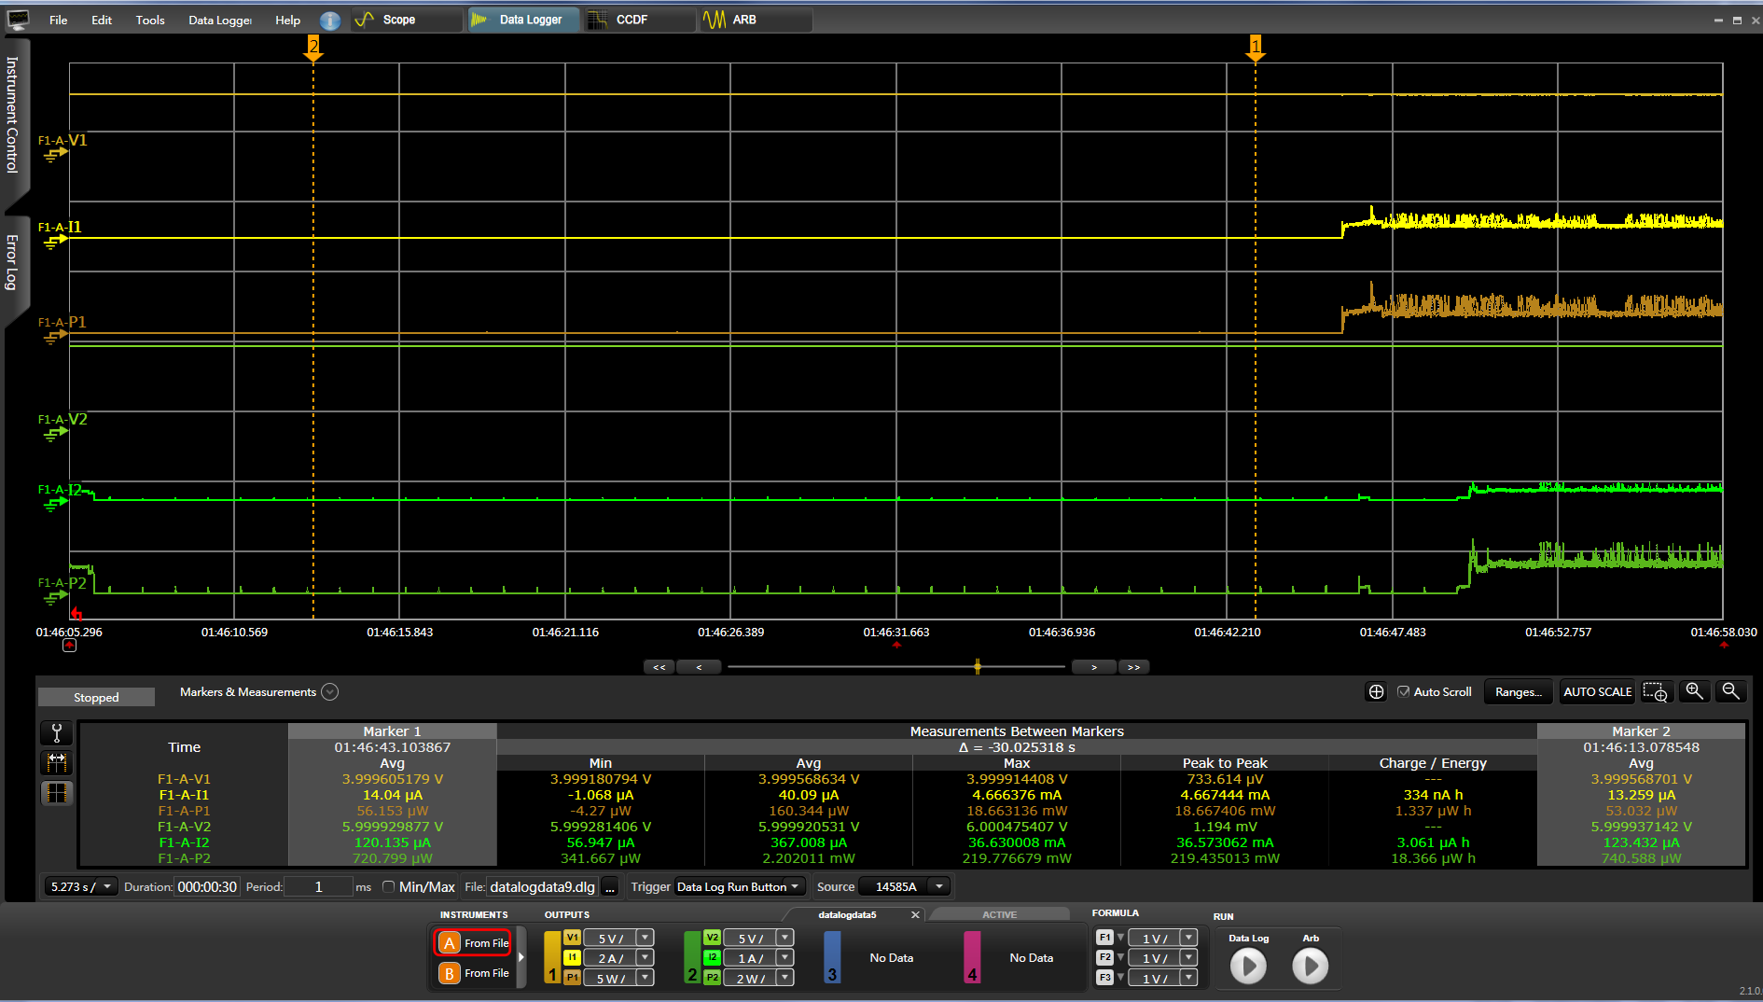
Power
Consumption Comparison
•DCS-2800LH operation mode
•DCS-2800LH standby mode
•0.22mW
•1.22W
•Arlo Pro 2 operation mode
•1.089W
•Arlo Pro 2 standby mode
•1.7mW
✓ DCS-2800LH consume 0.22mW in standby mode, and 1.22W in operation mode;
Arlo Pro 2 consume 1.7mW in standby mode, and 1.089W in operation mode.
(DC Power Analyzer: KEYSIGHT N6705B)
✓ DCS-2800LH standby mode power consumption is 1/8 of Arlo Pro 2.
17

Slide 19
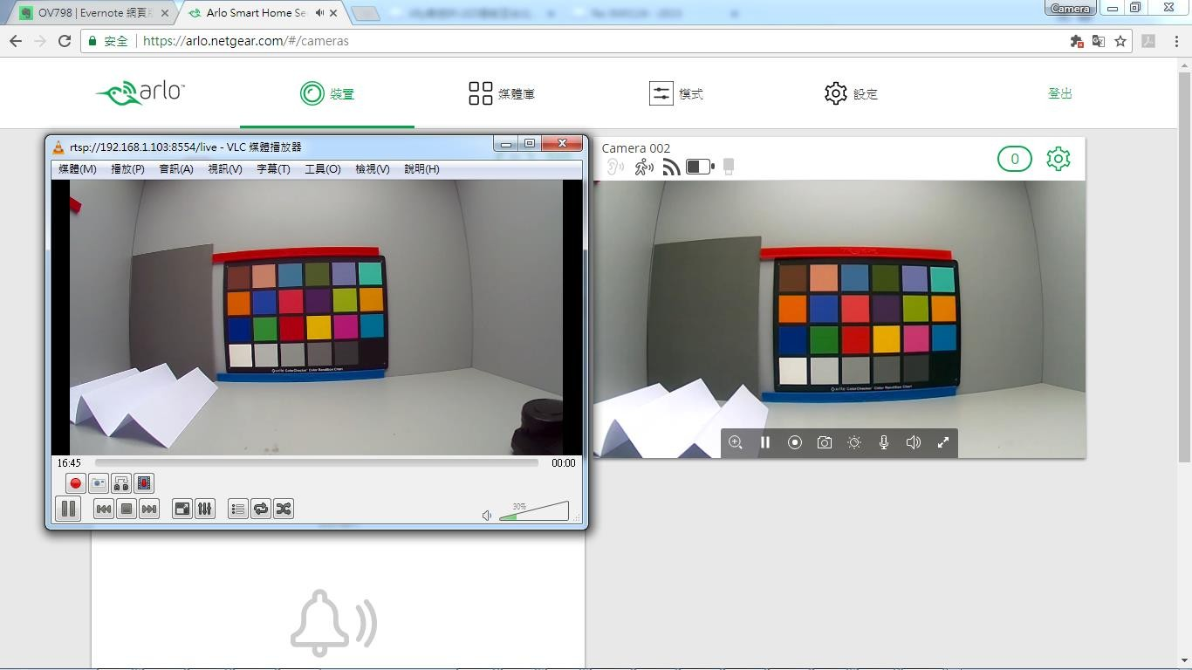
FOV
Comparison
Arlo Pro 2
DCS-2800LH
DCS-2800LH FOV
(140°) is wider than Arlo Pro 2 (130°)
18

Slide 20

Camera
Security
Enhancement
Hub and Camera periodic
talk with each
other to enhance camera
security, giving
a camera out of range notice.
Arlo pro2 doesn’t have this scenario.
19

Slide 21

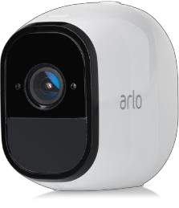


More
comparisons
Model
Netgear Arlo Pro 2
D-Link DCS-2800LH
Image
Video Compression
H.264
H.264
Max. Resolution
2 Megapixel (Full HD)
2 Megapixel (Full HD)
Video Resolution @ FPS (16:9)
1920x1080 @ 24fps
1920x1080 @ 24fps
Day & Night
Yes
Yes
Night vision (IR LED)
7.5 Meters
7.5 Meters
Sound detection
Yes
No
Moving Object detection
No
Yes
Angle of View (D)
130°
140°
Built-in Microphone and Speaker
Yes
Yes
Built-in Speaker
Yes
Yes
Passive Infrared (PIR)
Yes
Yes
Wireless IEEE Standard
802.11n
802.11n
Recording Response Time
234ms
187ms
Live View Response Time
9-11 seconds
3-5 seconds
20
Battery Life
(Camera working time: 3 min/day)
Up to 6 months
Up to 11 months

