Slide 1
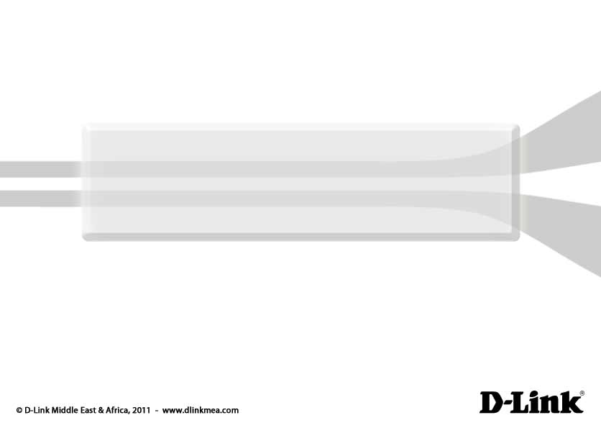
DVX-8000
Asterisk-based PBX Solution
X-Stack IP Telephony

Slide 2
Selling Points
Modular and scalable
Single IP PBX supports multiple users across multiple sites
Save money by using Internet Phone Service
Simple integration of software
applications – Asterisk API
User-Friendly Administration Interface

Slide 3
IP-PBX Features
User-friendly Web Interface
Interface in Different Languages
CDR (Call Details Record)
SIP/IAX Trunks
Remote Extensions
Voicemail
Voicemail to Email
IVR Menu System
Ring Groups
Call Queues
Conference Rooms
Follow-Me
Call Park
Time-Based Routing
Advanced Dialing Rules
Music On Hold
Paging and Intercom
Web Access to Voicemail
Admin Status Screen
Network Settings Tool
Skype for Asterisk

Slide 4
IP-PBX Specifications
Feature Model | DVX-8000
Recommended Capacity | 300 users
Max. Concurrent Calls | 60
Max. PSTN Ports | 32
Asterisk Version | 1.4x
GUI | FreePBX
Asterisk Distribution | Elastix CE®
Mass Storage | 250GB
RAID1 (Dual Hard Drive)** | (Optional)
Chassis | 19” 2U rack-mountable
Power Supply | Internal
Telephony Modules | FXO,PRI (Additonal Gateways like DVG-6008S, DVG-5008S, etc.)
Ethernet Port | 10/100 Mbps
Internet Updates | Yes
Moving Parts | HDD, fan
Operating Voltage | 110/220 Volts 50/60 Hz

Slide 5

DVX-8000 Series
Leading-Edge IP-PBX for SMB

Slide 6
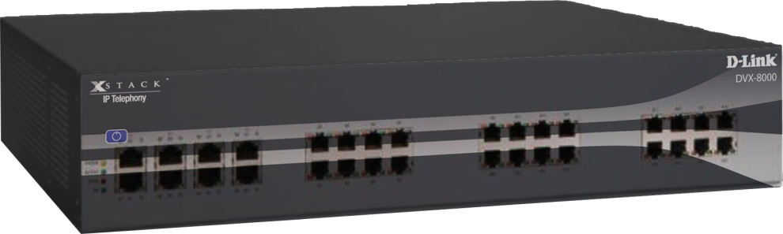
DVX-8000: Overview
Leading-Edge IP-PBX for SMB
Stand-alone Asterisk-based IP-PBX
Up to 60 concurrent calls
Up to 300 users
Remote access
RAID1 option (dual HDD redundancy)

Slide 7
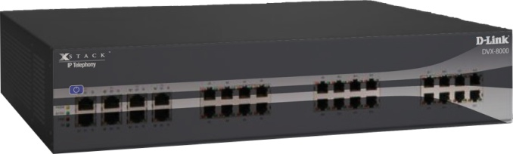
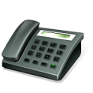
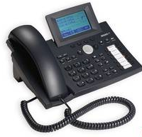
PSTN Connections
Analog
  Up to 32 internal FXO ports (analog lines)
PRI
  1 E1/T1 PRI
PSTN
IP
  Up to 300 SIP
  Up to 300 IAX
Total (mixed)
  Up to 300 users
LAN

Slide 8

User Interface & Management
Elastix
FreePBX

Slide 9
Supported Extras
Simplifying And Extending The Usability Of Open
Source Telephony

Slide 10
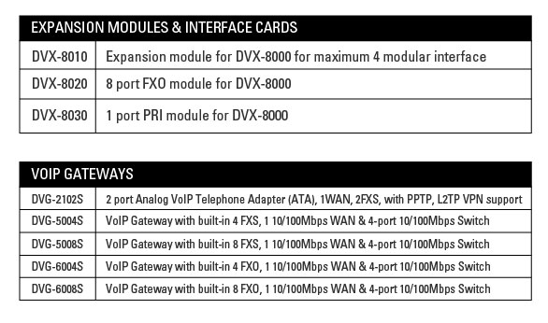
Expansion Modules & VoIP Gateways

Slide 11
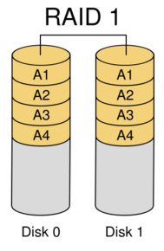
RAID1 Support
Increases IP-PBX hard-drive reliability
Two hard disks are supplied;
all blocks replicated/mirrored
PBX continues working seamlessly
Optional feature

Slide 12
Web Interfaces
Interface and Management Systems

Slide 13
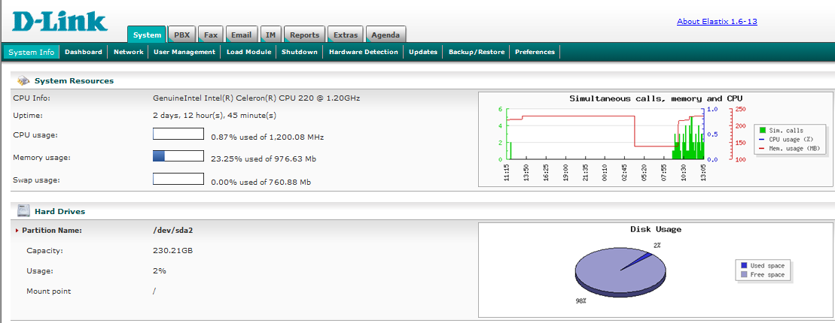
Elastix Management Interface

Slide 14
Application Scenarios

Slide 15

Office Setup
PSTN
VoIP Provider
and/or
Corporate Office
WiFi Router
WiFi
IP-PBX
LAN
Analog Extensions
GSM/WiFi
Phone Extensions

Slide 16
Home/Hotel Scenario
Remote user connected to the office as an extension
WAN
Home/Hotel LAN and WiFi
Corporate Office

Slide 17

Off-Premise WiFi Scenario
Roaming user in office with cell phone
Café LAN
WAN
WiFi
Corporate Office

Slide 18



Large Corporate Set-up
PBX connected to PSTN, ITSP (like Skype)
Corporate Office
PSTN
and/or
VoIP Provider
PRI/FXO
WiFi
IP-PBX
LAN
WiFi
Phone Extensions
FXS Gateways
Analog Extensions

Slide 19
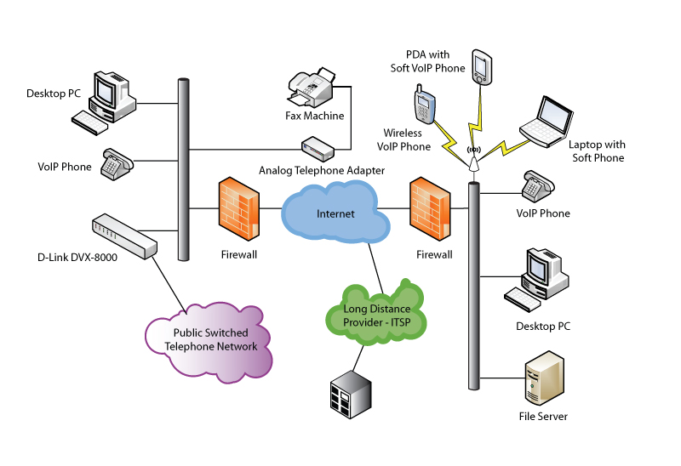
Multi-site Connectivity
Corporate and Branch offices interconnected through PBX

Slide 20
Disclaimer
Asterisk is a registered trademark of Digium, Inc. Elastix is a registered trademark of
PaloSantos Solutions. All other trademarks are the property of their respective owners.

