Slide 1
NetDefend UTM Firewall
DFL-260E/860E
DFL-1660/2560/2560G
Sales Guide v1.2
D-Link HQ SSPD Team
D-Link Confidential

Slide 2
Contents
NetDefend Firewall Family
Security Trend on NetDefend Firewall
  Single View vs. Holistic View
  UTM Functionality Highlight
NetDefend UTM Firewall Introduction
  Product Position and Target Market
  Functionality and Technology
  Product introduction
  Deployment Scenario
Competitive Landscape

Slide 3
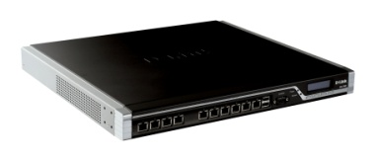
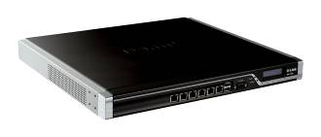
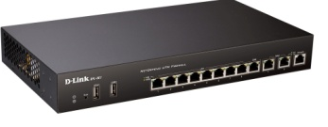
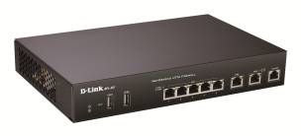
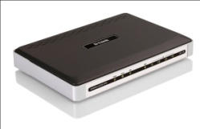
Security Product Strategy
NetDefend Firewall Family
NetDefend UTM Firewall
DFL-2560/2560G
DFL-1660
DFL-860E
DFL-260E
NetDefend SOHO UTM
DFL-160
Notes:
DFL-160 is NOT ICSA or VPNC certified.

Slide 4
Contents
NetDefend Firewall Family
Security Trend on NetDefend Firewall
  Single View vs. Holistic View
  UTM Functionality Highlight
  UTM Subscription Services
NetDefend UTM Firewall Introduction
  Product Position and Target Market
  Functionality and Technology
  Product introduction
  Deployment Scenario
Competitive Landscape

Slide 5

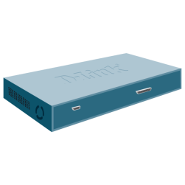
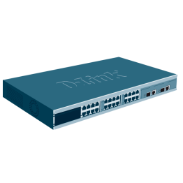
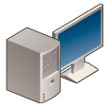
Security Trend: Single View vs. Holistic View
Single View: Traditional Multiple Point Solutions in Network
ISP1
Load Balancing
IPS/IDP Appliance
Firewall/VPN
Anti-Virus
ISP2
Anti-Spam
Web URL filtering
Disadvantage:
Complex network architecture.
Multiple vendors & appliances.
Higher appliance operation and maintenance cost.
Increases management effort.
Switch
Users
Server
Farm

Slide 6
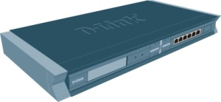
Single View vs. Holistic View
Single View: NetDefend Multi-Layered Security Solutions in Network
Advantage:
Provide comprehensive security approach.
Minimizes down time from individual threats.
Reduces number of vendors and appliances.
Simplifies security management.
Improves detection capabilities.
ISP1
ISP2
Multi-Layered Security
NetDefend
UTM Firewall
Load Balancing
Traffic Shaping
IPS/IDP
Switch
Anti-Virus
Users
Web Content Filtering
Anti-Spam
Firewall
Server
Farm
IPSec/PPTP/L2TP
Network/Content Processing

Slide 7
Security Trend: Single View vs. Holistic View
Holistic View: Integrate NetDefend and xStack for Multi-Layered Security
If Malicious Attack
happened !
Wireless
802.1x Enforcement
Guest
System Health Server
Guest Access Scenario :
Guests are assigned
restrictive access right to
the network
Microsoft
Network Policy Server
Non-Compliant Scenario :
If client’s patch is not
updated, it just can go to
remediation server, health
server and network policy
server
Worms
Remediation Scenario :
The client gets patch/virus
pattern etc, To correct its
health status
Client
Server
DHCP Enforcer
On-Demand
Policy Manager
NetDefend Firewall informs xStack Switch to block malicious attacker’s IP traffic
Router
xStack Switch
NetDefend
APplications
Remediation
NetDefend
DHCP
Kiosk
Applications
Mobile User
Hackers
EAP
Status
Host Integrity Rule
Status
Host Integrity Rule
Status
Telecommuter
Anti-Virus On
UNPROTECTED
WAN
Anti-Virus On
Partner
User Name
Anti-Virus Updated
Anti-Virus Updated
Personal Firewall On
Thieves
Personal Firewall On
Password
Integrated Client to Gateway Protection that Ensures Secure Network
Service Pack Updated
Service Pack Updated
Token
Patch Updated
Patch Updated

Slide 8
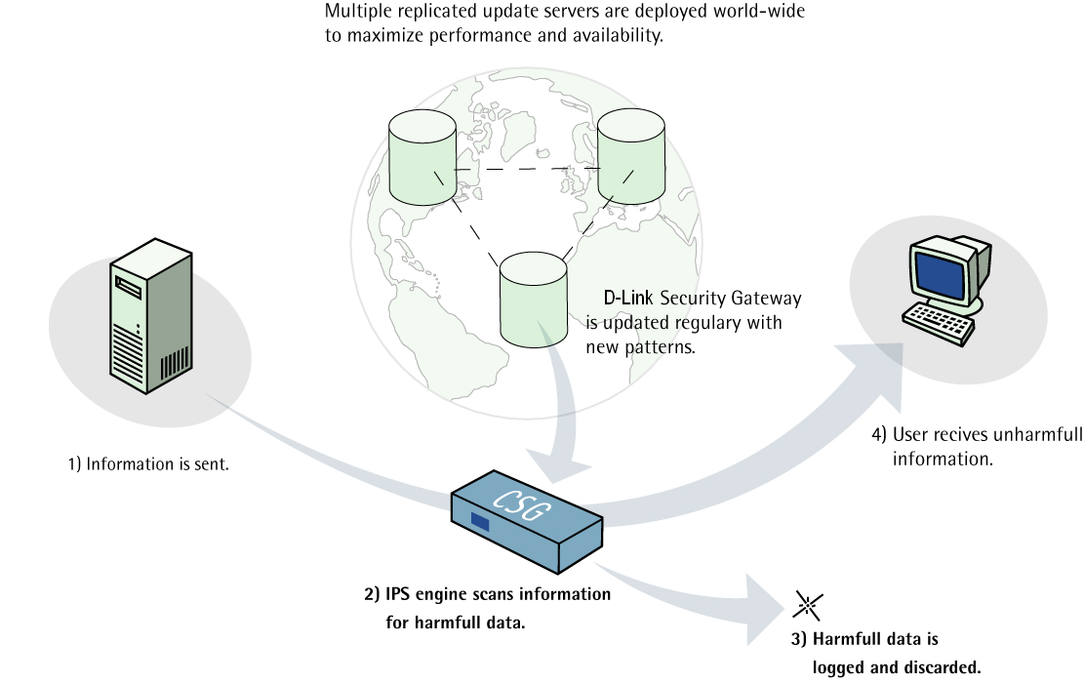

UTM Functionality Highlight
IPS/IDP Highlight
Purpose built inline Intrusion Detection and Prevention scan engine
  Close-Knit integration with rest of the system to trigger ZoneDefense
  In-Depth inspection from Layer 2 to Layer 7
  Extreme performance for demanding networks
Unique Signature Set
  Database is Powered by Endeavor
  Component based signatures – Zero-Day attack protection
  Vulnerability Signatures –Virtual Patching
Advanced Protection Mechanisms
  Protocol Anomaly – Catches unknown attacks
  Re-Assembly – Catches fragmented attacks
  Backdoor detection mechanisms
  Insertion / Evasion Protection
Secure Global Network of NetDefend Center
  Timely provisioning of new IPS signatures
  Reliable and authenticated access to NetDefend Center

Slide 9


UTM Functionality Highlight
Anti-Virus Highlight
Extremely high performance in combination with Stream-Based virus scanning technology.
Detect the most dangerous and widespread malware threats at Wire-Speed
Stream-based virus scanning, unlike in traditional proxy-based scanning, network traffic is processed packet by packet without file size limitation
Little memory and computing power required for packet sequencing and reassembly
Kaspersky 7x24 VirusLab continuously monitors “Virus Weather” all over the world and release signature database updates.
The signature database is utilized in Kaspersky best-of-breed end point products to deliver optimal protection.

Slide 10
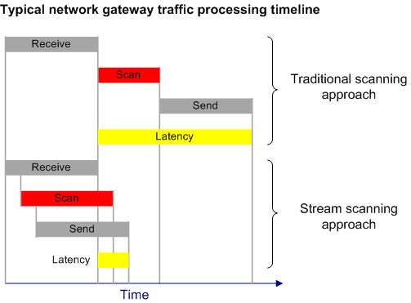
UTM Functionality Highlight
Anti-Virus Scanning Approach in DFL UTM series
Traditional File-based scanning approach
  requires cache memory for object scanning
  Dependent on file size
  additional latency on traffic scanning
Stream-based scanning approach
  Doesn’t require additional memory cache
  Without file size limitation
  Real-Time packet based scanning
  minimal latency on traffic scanning
  possibility of hardware acceleration
Conclusion:
Stream-based technology is perfect for high performance of network appliances with optimal protection level

Slide 11






UTM Functionality Highlight
Features of Web Content Filtering
D-Link’s Web Content Filtering Service provides various mechanisms for ensuring organizations infrastructure being used in an appropriated way. Before every web access establish, NetDefend firewall verifies website contents by matching database of the Web Service Cloud, which collects over XXXX website information every hour .
D-Link’s Web Content Filtering service features include:
Active Content Filtering
Object Removal
Active X
Flash
Java Applets
Jscript/VBStript
Cookies
Invalid UTF-8 Characters
Static Content Filtering
Blacklists/Whitelists
Use of wildcards
Dynamic Content Filtering
Managed Service
Per Device Service Licensing
Internal URL Cashe
Audit/ Blocking Mode
Override Options
Re-Categorization Options
Customizable Block Pages
Hourly Database Update
31 Content Categories
Block Access to peer-to-peer (P2P), Phishing and Spyware Sites

Slide 12
UTM Functionality Highlight
Benefits of Web Content Filtering
D-Link’s Web Content Filtering Service helps organizations Monitor, Manage, and Control employee usage of and access to Internet resources. It puts management back in control, protects system from Internet borne threats, ensures more business focused and implements cost effective usage of the Internet.
D-Link’s Web Content Filtering Service allows organizations:
WASTED BANDWIDTH
Protect network from threats by matching the most updated web database center to filter high risk websites
Reduce information leakage via social networking platform (such as web mail, blogs, image/video sharing website, etc.)
Maintain network performance and availability by limiting and/or controlling non-business related use, and improve network response
Cut spending of unnecessary Internet access and staff time by reducing in appropriate web surfing.
Lower illegal exposure to work place relations (e.g. sexual harassment cases / child pornography and the adverse publicity that an incident would generate)
Match your needs via setting flexible policy management rules.
$
100 STAFF x
10% BANDWIDTH
@ $$$$$
=$ $$$$$$$$
WASTED STAFF TIME COST
$
100 STAFF x
10% MINUTES
PER DAY
@ 60.00
PER HOUR
= $240,000 PER YEAR

Slide 13
Contents
NetDefend Firewall Family
Security Trend on NetDefend Firewall
  Single View vs. Holistic View
  UTM Functionality Highlight
NetDefend UTM Firewall Introduction
  Product Position and Target Market
  Functionality and Technology
  Product introduction
  Deployment Scenario
Competitive Landscape

Slide 14
Product Position and Target Market
D-Link – Value Innovation Leader
D-Link is security solution provider which delivers complete product portfolio from edge to core, from border to backbone.
Solution
Oriented
Product
Oriented
Solution
Oriented
Rookie
Level
Cisco
Juniper
Symantec
Fortinet
Sonicwall
Watchguard
D-Link
Linksys
Netgear
Risk Taker
Fancy Maker
Pragmatist
Procrastinator
Innovators
Early Adopters
Early Majority
Late Majority
Laggards
Value Innovation
Solution / Integration
Best of Breed
Gateway / Client
Mainly Gateway Security Only
Low Cost
Commoditization

Slide 15
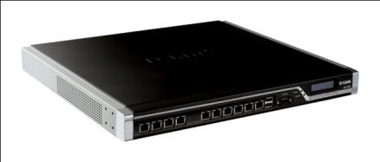
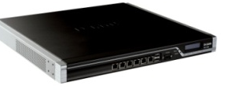
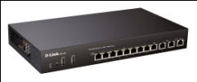


Product Position and Target Market
D-Link UTM firewall portfolio target from SOHO to Enterprise market which secure IT infrastructure, and protect customers against hybrid threats with NetDefend UTM security services, including Anti-Virus, Intrusion Detection Prevention, Web Content Filtering and Anti-Spam.
Positioning
Enterprise
DFL-2560
DFL-2560(G)
Medium Office
DFL-1660
DFL-860E
Small Office
DFL-260E
SOHO
DFL-160
70Mbps
150Mbps
250Mbps
1.2Gbps
2Gbps
Performance

Slide 16
Product Position and Target Market
Target Market：
  SOHO Market: The DFL-160 is a simple-to-deploy wired UTM firewall designed specifically for the Small Office/Home Office (SOHO) market that demands superior performance and security in a compact desktop chassis.
  SMB Market: DFL-210/260/800/860 delivers rich advanced features to enable the stability, flexibility and scalability of IT infrastructure, and it is a cost-effective solution for Small to Medium Business.
  Business Market: DFL-1660/2560(G) provides outstanding firewall/VPN/UTM throughput designing for the environment with 1,200~2,000 users.
  Vertical Market: DFL-210/800/800/860/1660/2560(G) all series cooperating with D-Link switch products construct D-Link E2ES solution offering a high level security for education and government environments.

Slide 17




Functionality and Technology
Inherits advanced and security feature set from NetDefendOS
Following feature sets are available on FCS release
  Outbound Traffic Load Balancing
  LDAP Authentication
  IM/P2P bandwidth control
  ZoneDefense Triggered by Anti-Virus
  Customized Web page for user Authentication and WCF
NetDefend IPS/UTM Firewall Family
ICSA Firewall Corporate and IPSec 1.3 Enhanced Certificates
Security
Integration
Intrusion Prevention
Gateway Anti-Virus
ZoneDefense
Stateful Packet Inspection
Productivity
Control
Anti-Spam
Web Content Filtering
IM/P2P Blocking
Quality of Service
Network
Resilience
High Availability
Outbound Load Balancing
Policy-Based Routing
Server Load Balancing
User
Authentication
LDAP Authentication
RADIUS Authentication
Web-Based Authentication
RADIUS Accounting
Comprehensive Services via NetDefend Smart Cloud Infrastructure

Slide 18
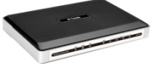

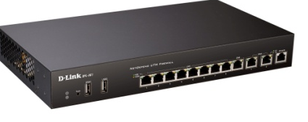


Functionality and Technology
Energy-Efficient Commitment to Sustain D-Link Green Strategy
DFL-160/260E/860E implements D-Link Green Technology
which includes power-saving features such as
Cable Length Detection and Power Saving Mode.
Power levels are automatically adjusted based on the length of connected cables.
Ports with no link are automatically powered down, drastically reducing the amount of power used for that port.
In addition, the firewall’s power adapter is certified by ENERGY STAR. Generally, ENERGY STAR compliant adapters are 30% more efficient than conventional models.
DFL-160
DFL-260E
DFL-860E

Slide 19
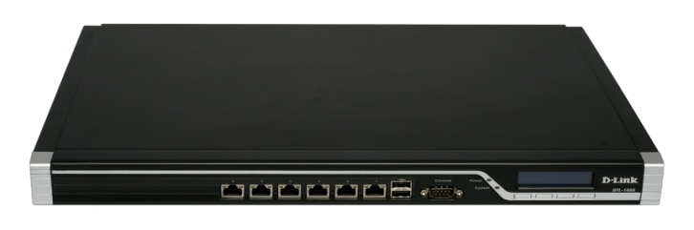
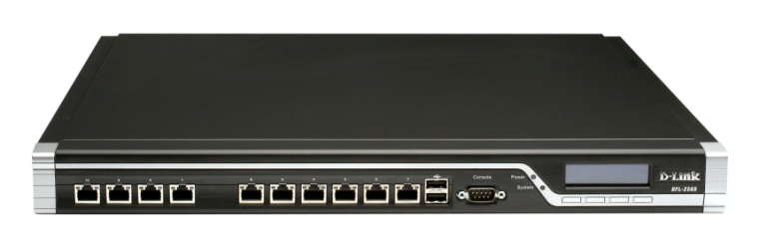
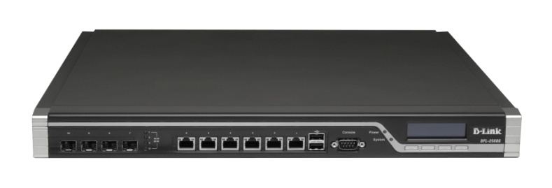

Functionality and Technology
Energy-Efficient Commitment to Sustain D-Link Green Strategy
DFL-1660/2560/2560G are designed to run energy-efficient with 80 PLUS certificate power supply.
Benefits of 80 PLUS Qualified Appliance
  Increased power supply reliability due to grater efficiency
  Maintenance: Lower TCO due to longer equipment life
  Environmental: Prevent pollution by reducing
  energy consumption.
  HVAC(Heat Ventilation & Air-Condition): cut cooling costs
DFL-1660
DFL-2560
Percent Loading | Efficiency
20% | 81.45%
50% | 83.13%
100% | 80.04%
DFL-2560G
Average Efficiency: 81.54%

Slide 20
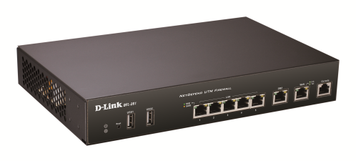
Product Introduction
Performance Overview
DFL-160 (IPS/AV/WCF one year subscription bundled)
1 x 10/100 for WAN
1 x 10/100/1000 for DNZ
4 x 10/100/1000 for LAN
70Mbps plaintext firewall throughput
25Mbps 3DES/AES VPN throughput
15Mbps IPS throughput
15Mbps Anti-Virus throughput
DFL-260E
1 x 10/100/1000 for WAN
1 x 10/100/1000 for DNZ
5 x 10/100/1000 for LAN
150Mbps plaintext firewall throughput
45Mbps 3DES/AES VPN throughput
60Mbps IPS throughput
35Mbps Anti-Virus throughput

Slide 21
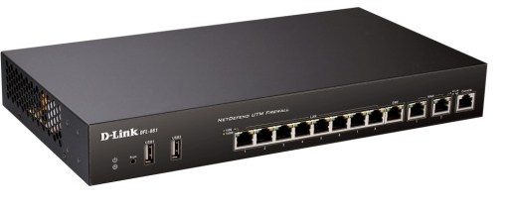
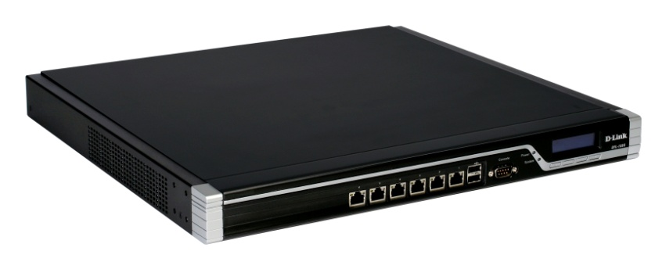
Product Introduction
Performance Overview
DFL-860E
2 x 10/100/1000 for WAN
1 x 10/100/1000 for DNZ
8 x 10/100/1000 for LAN
200Mbps plaintext firewall throughput
60Mbps 3DES/AES VPN throughput
80Mbps IPS throughput
50Mbps Anti-Virus throughput
DFL-1660(IPS/AV one year subscription bundled)
6 x 10/100/1000Mbps configurable ports
1.2Gbps plaintext firewall throughput
350Mbps 3DES/AES VPN throughput
400Mbps IPS throughput
225Mbps Anti-Virus throughput

Slide 22
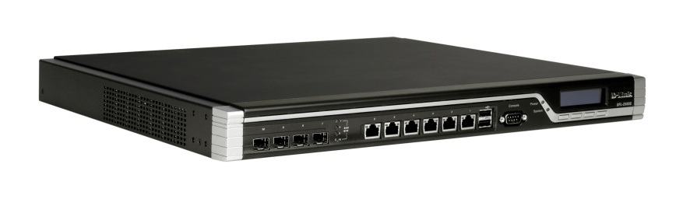
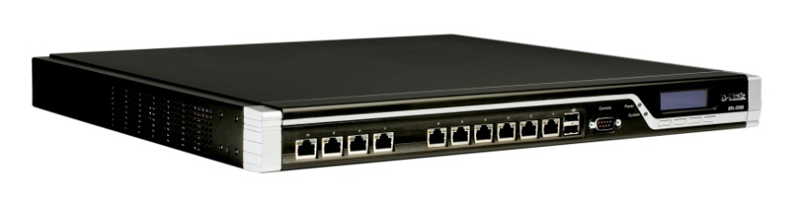
Product Introduction
Performance Overview
DFL-2560/2560G (IPS/AV one year subscription bundled)
10 x 10/100/1000Mbps configurable ports (DFL-2560)
6 x 10/100/1000Mbps + 4 x SFP configurable ports (DFL-2560G)
2Gbps plaintext firewall throughput
1Gbps Mbps 3DES/AES VPN throughput
600Mbps IPS throughput
450Mbps Anti-Virus throughput

Slide 23
Product Introduction
Subscription Packages
DFL-160
  Default: One-year IPS/AV/WCF subscriptions
  Renewal: ALL-in-ONE (IPS, AV, WCF) subscription sku only
DFL-260E/860E/1660/2560 NB (Non-Bundle)
  UTM firewall appliance only
  Default : 90-day IPS/AV/WCF trial subscriptions
  Renewal: Customer can purchase any one of three, or any combination as their needs
DFL-260E/860E/1660/2560 IA1(IPS and AV bundled)
  Default: One-year free IPS and AV subscriptions
  Renewal: Customer can purchase any one of three, or any combination as their needs

Slide 24

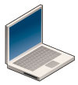




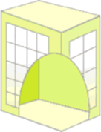
Deployment Scenario
Secured VoIP
Business Partner
Secured
VoIP
Roaming
User
UTM
Firewall
Secured VoIP
IPSec
VPN
UTM Firewall
Taipei Headquarter
IPSec
VPN
IPSec
VPN
Moscow Office
IPSec
VPN
UTM
Firewall
Server
Farm
Secured VoIP
London Office

