Slide 1
Gary Kao
D-Link HQ, August, 2009
Sales Guide of DWS-4026 + DWL-8600AP v1.0
Unified Wired/Wireless Solution
D-Link Confidential

Slide 2
Highlight of WLAN Market
Centralized WLAN Solution Becomes Main Stream
  Revenue from sales of WLAN switches and controllers increased 92% year on year, totalling $572 million (equivalent to 43% of the WLAN market revenue).
  The business market will continue the gradual shift from the traditional stand-alone WLAN architecture to the newer, centralized one (WLAN switches and controllers managing coordinated access points) in 2007
Source: Infonetics Research, 2007
802.11n Takes Hold
  Shipments of draft 11n products grew by 18.3% from Q208 to Q308, reaching more than 18% of total access point (AP) shipments.
Source: In-Stat, Q3,2008

Slide 3

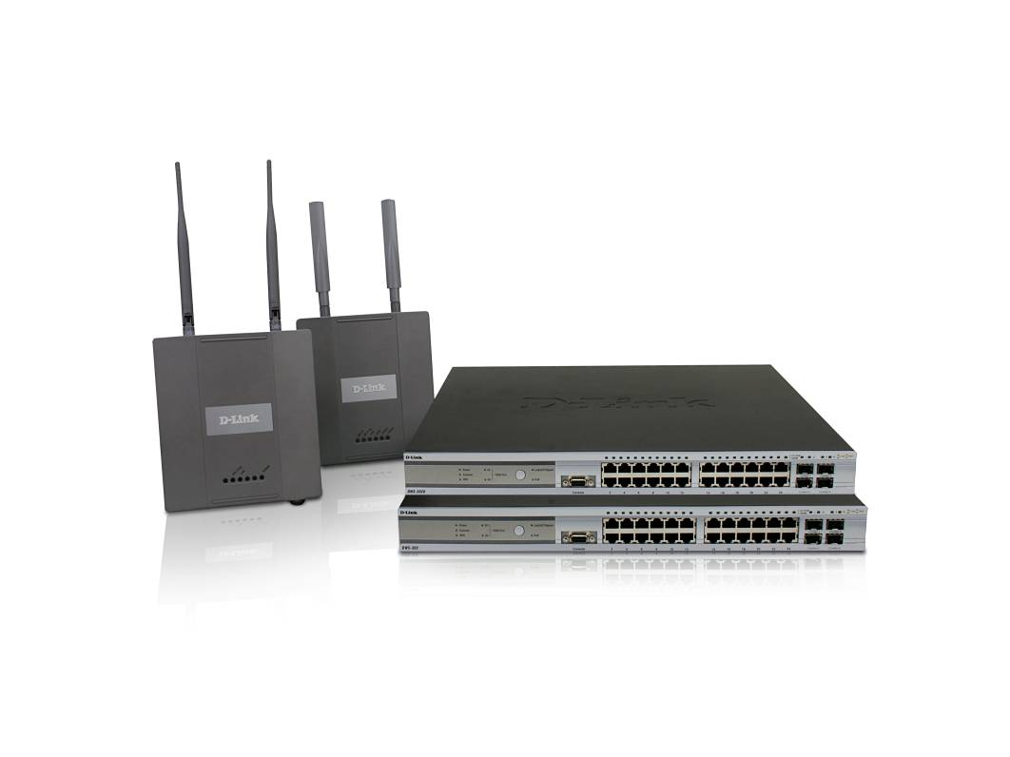
Contents
Challenges of Legacy WLAN Management
Trend of Convergence
D-Link Unified Access System Solution ~2009
D-Link Unified Access System Solution ~ 2010
  Technology Brief
  Application Guide
Backward Compatibility
Competitive Comparison & Analysis
  Product Position/Main Competitors
  Key Comparison
  Art of the War

Slide 4
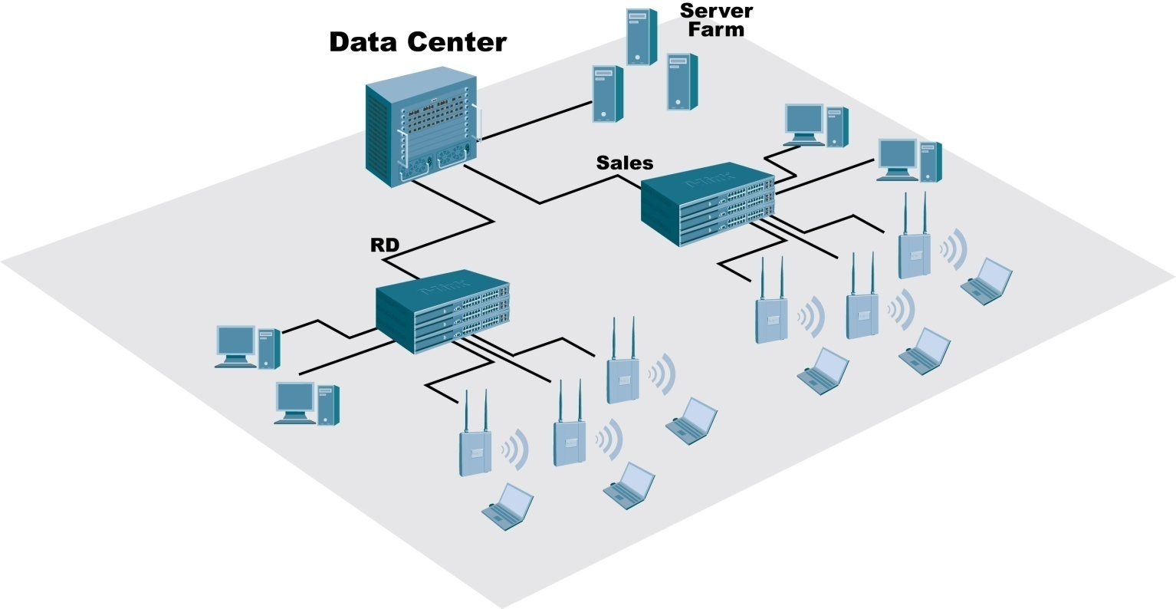
Challenges of Legacy WLAN Management
Connectivity
How do I guarantee the coverage?
Security
How to authenticate 100~1000+ wireless users?
Consistence of security policy?
Rogue AP?
Settings on each AP
SSID
RF/Channel
Security
QoS
……
VoIP
Roaming across L2/L3 network?
Performance?
Management
AP configuration/Firmware upgrade?
Change management?

Slide 5
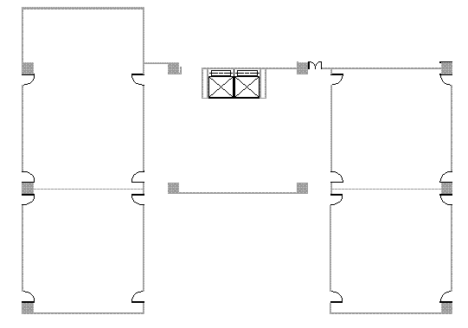

Invisible WLAN
Channel overlap causes
performance down 50%
Channel 1
Channel 1
Channel 6

Channel 6
Channel 6
Coverage hole
Rogue AP –
RF interference
Security breach
Power level is too weak

Slide 6
Trend of Convergence
Customers are looking for:
  Cutting-edge Technology
    Unified Wired & Wireless Access System
  United Management & Security
    Centralized AP & Client Management
    Rouge AP Detection/ Mitigation
  Better Connectivity
    Auto Channel/Power adjustment
  VoIP Application
    Seamless Roaming

Slide 7
D-Link Unified Access System Solution ~2009
Current D-Link Unified Access System Solution Provides:
  Unified Switching (=Wireless Controller + L2⁺ Switch)
  Centralized Policy Management
  Automatic Power/Channel Adjustment
  Self-Healing Network
  Fast L2/L3 Roaming
  Enhanced Security
  Comprehensive Statistics & report
  Visualization Management Tool
Switch | DWS-3024L | DWS-3024 |  | DWS-3026
H/W Config | 24-port Gigabit L2+ PoE Unified Switch |  |  | 24-port Gigabit L2+ PoE Unified Switch and 2 10GE Open Slots
# of Supported AP | 24 | 48 |  | 48
Note | AC input with RPS support
Access Point | DWL-3500AP/DWL-8500AP
H/W Config | 802.11g Indoor Access Point |  | Dual band Indoor Access Point
Note | PoE Capable |  | PoE Capable

Slide 8
D-Link Unified Access System Solution ~2010
D-Link Unified Access System Solution
  NEW:
    DWS-4026 Unified Switch
    DWL-8600AP 802.11n Unified AP
    Management: Switch Clustering / 802.1X Authenticator
    Enhanced Security: Wireless Intrusion Detection (WIDS)
    Roaming Enhancement: AP-AP Tunnel
    8600AP Standalone function: AP Clustering
    8600AP Standalone function: Wireless Distribution System (WDS)
Switch | DWS-3024L / 3024 | DWS-3026 | DWS-4026
Description | 24-port Gigabit L2+ PoE Unified Switch | 24-port Gigabit L2+ PoE Unified Switch and 2 10GE Open Slots
Access Point | DWL-3500AP / DWL-8500AP DWL-8600AP* |  | DWL-8600AP
# of AP | 24 / 48 | 48 | 64
Note | PoE Capable
*: Release 3.0

Slide 9
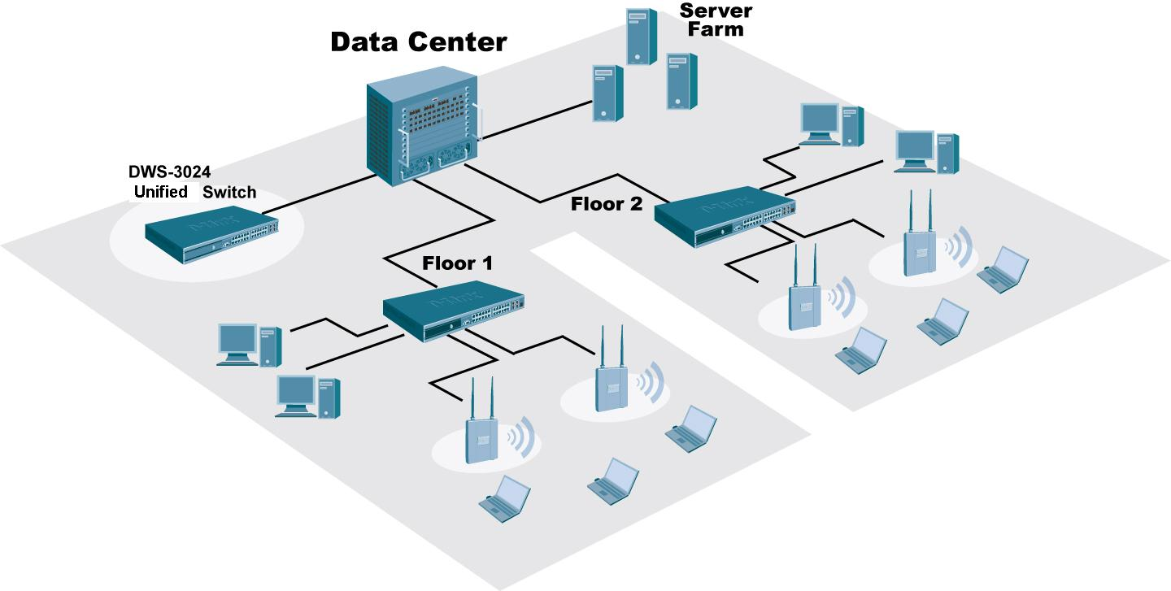
Flexible Deployment – Unified Switching
Overlay Solution – Wireless Controller Deployment
  Deploy deeper into existing network infrastructure to protect current investment in network infrastructure

Slide 10
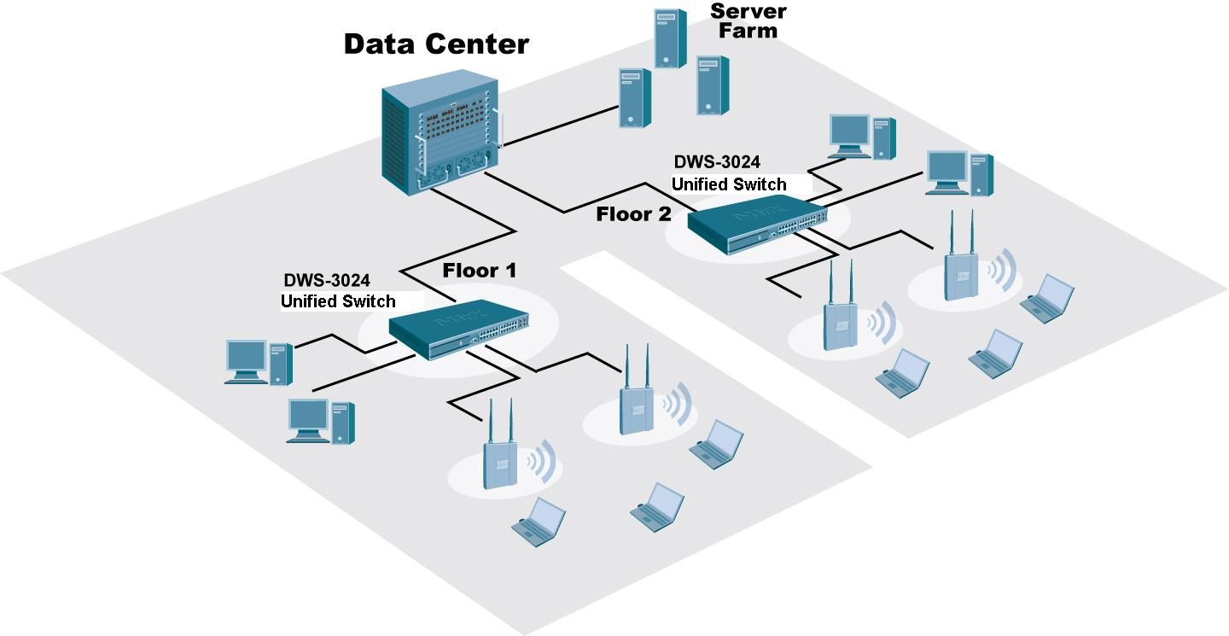
Flexible Deployment – Unified Switching
Unified Solution – Converged Edge Deployment
  Deploy at the network edge with all the benefits of Unified Switching - acting as both a wireless controller and a switch.
  Full GbE speed for next generation 802.11n

Slide 11
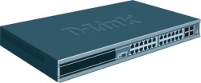

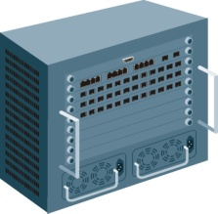





Flexible Deployment – Adaptable Wireless
Adaptable Wireless
  Wireless traffic can be local-switched at the AP or Central-switched at the Unified Switch depending on users’ needs
  No need to purchase additional license or upgrade firmware
Unified Switch
Internet
Server Farm
Local-Switched (Non-Tunnel Mode)
Better performance
Central-Switched (Tunnel Mode)
Better centralized security control

Slide 12





Centralized Access Point Management
Central Policy Control
  The Profile configuration is applied to a managed AP on the event such as when an AP initially transitions to managed mode, or when AP is reset. Users hence can enjoy the convenience of one-time configuration.
  The security is ensured owing to the applied configuration won’t be saved when AP is power off.
Radius Server
(Optional)
AP MAC list
Dynamic VLAN Assignment
Client MAC list
L2 or L3
Network
Firmware dispatch
Profile dispatch
RADIUS server settings
Security settings
Radio configuration
SSIDs, VLAN & Tunnel setting
QOS configuration
Notes:
一科 AP 壞掉 SI 要去修

Slide 13




Centralized Access Point Management & Roaming
4
1
3
Unified Switch
AP-1
2
5
AP-2
Management Process
  1. AP-1 is attached to a switch port and switch will discover AP-1 automatically
  2. Network admin can determine whether AP-1 is a rogue or a legal AP to be management.
  3. Network admin can perform central management of AP, including configuration / firmware download, security and RF control.
  4. All clients are authenticated by the Central Policy Control on switch.
  5. Roaming from AP-1 to AP-2 without re-allocate IP and re-authentication to keep connection alive

Slide 14

Centralized Management: Switch Clustering
Peer Switches can form a Cluster Group
  One Master gathers statistics and status from all APs and Clients in the group
  All wireless configuration & management can be done from one switch
  Provides single point of management
Similar to D-Link Single IP Management (SIM)
Wireless Management & Configuration
Master Controller
Admin
Peer Switches
Unified Switch
Unified Switch

Slide 15

Ease of Management: 802.1X Authenticator
On DWS-3000’s 802.1X process, each Access Point authenticates clients individually
  Switch forwards traffic
  All AP’s IP are configured in RADIUS database
New Software Architecture on DWS-4026 enables Switch to act as 802.1X Authenticator
  Switch will interface with RADIUS server instead of AP
  Only Switch’s IP will need to be entered in RADIUS database
  Significantly simplifies management and reduces admin overhead
IP: 192.168.0.123
 | Authenticator IP
 | 10.10.0.1
Unified Switch
 | Authenticator IP
 | 192.168.0.123 192.168.0.221 10.10.0.3 …. …. ….
IP:10.10.0.1
IP: 192.168.0.221
IP: 10.10.0.3
Authenticator
RADIUS Server
Supplicant
Authenticator

Slide 16

Automatic Channel/Power Adjustment
Channels and Power will automatically be adjusted on any new event in the system such as an AP being added or being removed, or the switch can be programmed to automatically readjust channels and power at certain times (i.e. 2:00am each day) of the day or upon a certain interval (i.e. every 6 hours)
Channel 24
Channel 48
2. Rogue AP
Or Radio interference
Channel 48
3. Changes to
Channel 18
New AP
Channel 36
Channel 54
1. When inserting new AP, the AP scans the RF area for occupied channels and selects
a channel from the available non-interfering, or clear channels.

Slide 17
Automatic Channel/Power Adjustment
Automatic power uses a proprietary algorithm to automatically adjust the RF signal to broadcast far enough to reach wireless clients, but not so far that it interferes with RF signals broadcast by other APs.

Slide 18

Self-Healing Wireless Network
Fail-Safe
  When a Managed AP is powered down, the power of its neighboring AP(s) managed by the same switch is immediately increased by 20%.
  The power level will adjust again every pre-configured Interval by sensing neighboring AP power status.
Failure detected
Failed
Increase 20% of power!

Slide 19







Self-Healing Wireless Network
Load Balancing
  Unified Switch performs load utilization across the switch-managed access points on per radio basis based on AP’s utilization rate.
  The APs report bandwidth utilization to the Unified Switch regularly
  If the bandwidth utilization reaches a configured threshold then the new client associations are rejected. The new client will be forced to connect to an overlapped neighbor AP with lower utilization.
Utilization rate increased
Unified Switch
Default bandwidth utilization: 60%
Reach utilization threshold!!!
User4 rejected
Utilization rate for AP-2: 10%
AP-1
Force to connect to Ap-2
AP-2
user4
User4 connect to AP-2
user4
Attempt to connect AP-1
Notes:
Unified Switch can perform load utilization across the managed AP’s on per radio basis. Load utilization is achieved by tracking the wireless bandwidth utilization on each AP. You can set the maximum bandwidth utilization on the Unified Switch.
Load utilization sets thresholds for client associations and AP utilization. If the bandwidth utilization reaches a configured threshold then the new client associations are rejected. The default value for the wireless bandwidth utilization threshold is 60%.

Slide 20

Virtual Access Points
Multiple SSIDs can be configured on an AP.
Each radio of an AP can be configured up to 8 networks (SSIDs). Up to 8 networks are supported on DWL-3500. Up to 16 networks are supported on DWL-8500. Up to 32 networks are supported on DWL-8600AP
SSID:
Sales
VoIP
SSID:
Sales
VoIP
SSID:
R&D
VoIP
SSID:
R&D
VoIP
SSID:
Sales
VoIP
SSID:
Sales
VoIP
SSID:
R&D
VoIP
SSID:
R&D
VoIP
Sales Network
R&D Network
VoIP Network
Notes:
DWL-3500/8500AP supports 8 SSIDs per radio
DWL-8600AP supports 16 SSIDs per radio

Slide 21

Fast Roaming
Ideal for VoIP Application
Fast L2/L3 Roaming
  One DWS-3000 switch can support fast roaming across up to 48 APs.
  One DWS-4000 Switch can support fast roaming across up to 64 APs.
  This fast roaming can be supported with in a subnet (Layer 2) or across subnet boundaries (Layer 3).
Unified Switch
Subnet A
Subnet B
AP-1
AP-2
AP-3
L2 Roaming
L3 Roaming

Slide 22
Fast Roaming (Cont.)
Inter-Switch Roaming
  For DWS-3000, 4 Peer Switches in the same Roaming group
  For DWS-4000, 8 Peer Switches in the same Roaming group
    Not only can DWS Series support fast roaming between APs being managed by a particular switch, but can support roaming between switches
  DWS-3000 supports up to 192 APs
  DWS-4000 supports up to 256 APs
L2 or L3 Inter-Switch Roaming
Note: The maximum number of managed AP only applies on APs in THE SAME ROAMING GROUP.
There is no constraint for the number of managed APs at a site if not for roaming. Still, each DWS-3000 can manage up to 48 APs and each DWS-4000 up to 64 APs

Slide 23

Fast Roaming (Cont.)
Pre-Shared Keys
PSK
Fast Roaming
No relocating IP
Re-auth time is tiny
Reduce configuration error
- Key was centrally distributed by Switch to APs
PSK
PSK
Dynamic Keys (WPA2 Enterprise)
Radius Server
PMK
PMK
Fast Roaming
No relocating IP
Re-auth time is tiny
– the dynamic key - PMK (Pairwise Master Key) can be cached in Switch and forwarded to APs in the same roaming group
Management of thousands of users is possible
802.1x Auth
PMK

Slide 24


Roaming Enhancement: AP-AP Tunnel
AP-AP Tunneling
  Support L3 roaming without forwarding traffic back to Unified Switch
  When client roams to another AP in a different subnet, the APs will create tunnel and forward traffic with each other
Advantage:
  Reduces network resources because traffic is forwarded locally
  Reduces Wireless Switch loading
DWS-4026
L3 Switch
AP-AP Tunnel
192.168.1.0
172.17.3.0
10.10.10.0
Notes:
AP-AP Tunneling is supported on top of Adaptable Wireless

Slide 25
Enhanced Security Enforcement
Rogue AP Management
  Any AP scanned but not in the switch’s database will be listed as a rogue AP. The administrator can get better control of the environment through knowing rogue APs’ information (MAC, SSID, Channel, etc).
Wireless Intrusion Detection System (WIDS)
Complete Security Features
  Wireless
    Managed AP MAC list
    Wireless Client MAC list
    WEP (Static/Dynamic)
    WPA Enterprise/Personal
    WPA2 Enterprise/Personal
  Wired
    ACL
    802.1X
    DoS Control
    Broadcast Storm Control
    Port Security
    RADIUS / TACACS+

Slide 26


Enhanced Security: Wireless Intrusion Detection (WIDS)
DWS-4026 supports advanced Wireless Intrusion Detection and Mitigation:
  Detect and Classify AP
    Managed, Standalone, Unknown
    Rogue (fake managed AP, fake SSID, illegal channel, etc…)
  Detect and Classify Wireless Client
    Authenticated, Black-listed
    Rogue (probe attack, flooding network, etc…)
Detect & Classify
Mitigate Rogue
  Mitigate attacks from Rogue AP
    Disable Rogue AP once detected
  Mitigate attacks from Rogue Clients
    Disable Rogue Client once detected
Managed Standalone Unknown Rogue
-Fake managed AP
-Fake managed SSID
-AP using illegal channel
-AP using invalid channel
-Incorrect security config
-Invalid SSID
-Unexpected WDS device
-Etc…
Wireless AP
Unified Switch
-Not in client database
-Probe attack
-Flooding network
-Too many failed auth
-Authenticated with
Unknown AP
-Etc…
Authenticated
Black-Listed
Rogue
Wireless Client

Slide 27
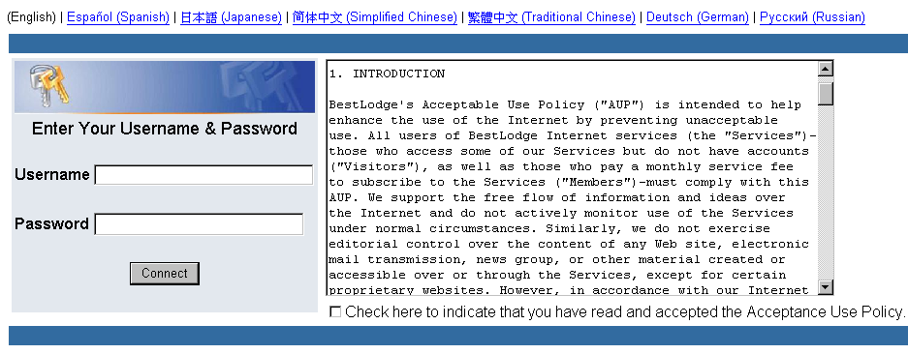
Enhanced Security Enforcement
Captive Portal
  Web-based Authentication that provides intuitive, user friendly authentication
  Forces an HTTP client on the wireless network to see a authentication web page before surfing the Internet

Slide 28
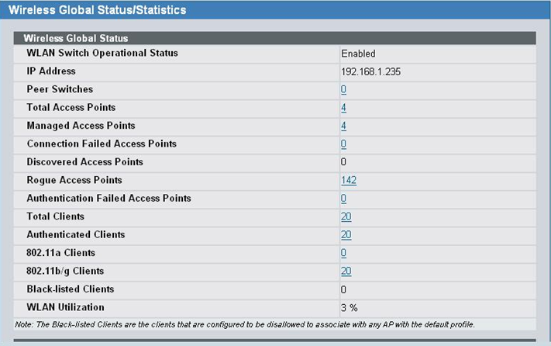
Comprehensive Statistics/Alerts
Logging for Dynamic RF Status
  The administrator will be benefited by the rich logging/trap function provided by DWS-3000. Information like AP status, RF scan, and client status makes DWS-3000 a powerful RF monitor.
Statistics on Web GUI

Slide 29
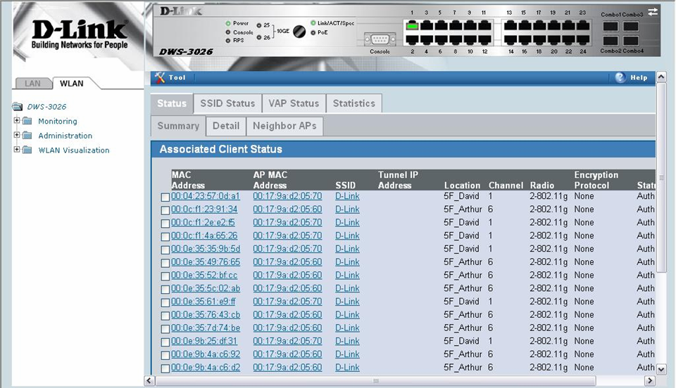
Comprehensive Statistics/Alerts (Cont.)
Associated Client Status on Web GUI

Slide 30
Easy-to-use Visualized Management Tool
The diagram below shows an example of a floor plan and network with a D-Link Unified Switch that manages two APs. The graph also shows a peer switch and a rogue AP in the network.

Slide 31
Complete Switching Features
L2
  IGMP Snooping
  8021.D/802.1w/802.1s Spanning Tree
  802.3ad Link Aggregation
  Port mirroring
  802.1Q VLAN
  GVRP
  Voice VLAN *
L3
  RIP v1 / v2 *
  Floating Static Route
  VLAN Routing
  VRRP
QoS
  802.1p
  DSCP
  CoS based on Switch Port/VLAN/TCP UDP port/TOS/MAC/IP
  Per-queue/Per-flow Bandwidth Control
Security
  ACL
  802.1X
  DoS Control
  Port Security
Management
  DHCP Server
  Etc…
*: Supported on DWS-4000 FCS
Supported on DWS-3000 R3.0

Slide 32

Unified Access Point
Start from Standalone mode
  LAN
  L2 Switch
Manually set up the following
- SSIDs
- User Authentication
- Power level
- QoS
- etc
  Unified AP –
        Can work in both standalone and managed mode
        Provides upgrade /deployment flexibility

Slide 33
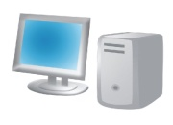
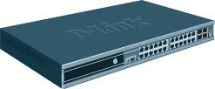
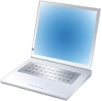
Unified Access Point
Start from Standalone mode
Migrate to Managed mode with Unified Switch
  LAN
  L2 Switch
Manually set up the following
- SSIDs
- User Authentication
- Power level
- QoS
- etc
  Unified Switch
Centralized AP profile dispatch
Centralized security policy enforcement
Centralized wired/wireless VLAN/QoS/ACL control
Auto Power/Channel adjustment
AP Self healing & Fail-over
Fast Roaming

Slide 34
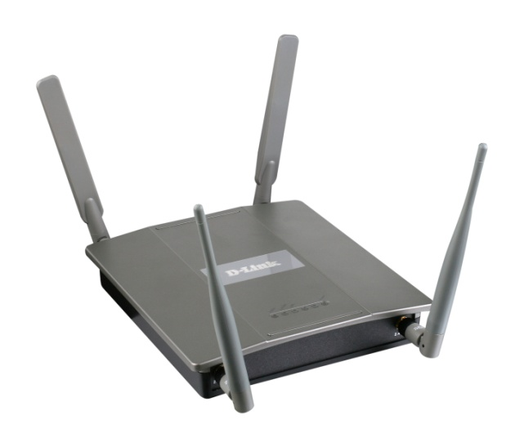
DWL-8600AP: 802.11n Unified AP
D-Link’s next-generation Unified AP, managed by DWS-4026 and DWS-3000 series*
New Functions:
Supports 802.11n Draft 2.0
  Up to 300Mbps wireless throughput, 5x than 802.11g
  4 Antenna design using MIMO Technology
Virtual AP (VAP)
  Up to 16 SSIDs per Radio, 32 SSIDs per AP
AP Clustering
Wireless Distribution System (WDS)
  Can act as wireless bridge
  Supports 802.1d Spanning Tree Protocol
D-Link GREEN Concept:
  Low Power Design using next-generation chip
  Concurrent Dual Radio architecture using 802.3af
  No need for PoE+
  Compatible with 802.3af power injector
*: Release 3.0
Notes:
Dual-band concurrent APs from other vendor (such as Aruba AP125 and Cisco 1250) require PoE+ to fully function.

Slide 35
Standalone Feature: AP Clustering
Previously, admin can configure APs one by one
Now, admin can treat a group of 8600APs in the same subnet as one single device
AP Clustering
  Same concept as Switch Clustering
  APs share configuration information with each other
  Provide single point of management for the AP Cluster
Configuration
Configuration
Admin
AP Cluster
Notes:
This feature is supported under standalone mode

Slide 36

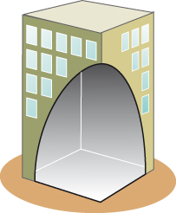

Standalone Feature: Wireless Distribution System (WDS)
WDS allows standalone 8600AP to act as wireless bridge and connect two wireless networks
  Can also encrypt data sent between two networks
  No need to run cables across two sites
Can enable multiple WDS links for redundancy
  Supports 802.1d STP to prevent loops
Network 1
Network 2
Notes:
This feature is supported under standalone mode

Slide 37
Selling Points
Cutting-edge Technology
  Unified Switch = Wireless Controller + Powerful Switching capability
  Unified Dual band 802.11n AP
  Adaptable Wireless technology
Ease of Management / Flexible Deployment
  Switch Clustering
  802.1X Authenticator
Advanced Security
  Wireless IDS + Rogue AP Mitigation
Self-Healing Wireless Network
Scalable deployment
  Up to 256 APs, 8 switches in a Roaming group
    Per switch - 1024 tunneled users, 2048 non-tunneled users
    Up to 8,192 users in a Roaming group
    AP-AP Tunnel
Captive Portal Rate-limiting
  Per-user bandwidth control
D-Link – Years of Number 1 in Wireless industry

Slide 38
Backward Compatibility
Since DWS-3000 will be able to manage DWL-8600AP in R3.0 (Q2, 2010), how does it work in a mixed environment with both DWS-3000 and DWS-4000?
DWL-8600AP: Single firmware only!
  Can be managed by either DWS-3000 or DWS-4000
  Can distinguish different DWS during discovery
  No need to maintain two different firmware for different DWS
How to control in a mixed environment?
  DWL-8600AP receives discovery messages from both DWS-3000 and 4000
  Switch checks if the AP’s MAC is in the Valid AP List
    If yes, manage the AP
    If not, cannot manage the AP
Notes:
No problem in DWS-3000-only environment
No problem in DWS-4000-only environment

Slide 39
Target Customers
University
Hospitals & distributed clinics
Retail stores
Manufacturing floors / Warehouse
Airport
Convention Centers
Any enterprises who need centralized WLAN management or VoIP application.

Slide 40






Application – A New Company Building
Servers
Layer 3 Switch
PC
D-Link DGS-3450 x 2
D-Link DGS-3427 x 1
D-Link DWS-3024
Deutshe Telekom WiFi Phone
D-Link DWL-8500AP x 24
to cover the whole building
Application:
Use WiFi phone in the whole building
Benefits:
Seamless roaming at/between every floor
AP configuration dispatch & centralized management
Automatic Power/Channel adjustment

Slide 41






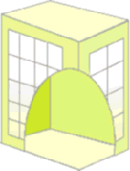
Application – A Chemistry Factory
Lab
Application:
Extend the network coverage
Retrieve/transmit data from/to Lab immediately via WLAN & VPN
Centralized AP management
Benefits:
Leverage existing infrastructure
Cost effective Unified architecture
Wireless Equipments
DWL-3500 AP x 10
Desktop/Server
D-Link DES-1228P
POE Enabled
D-Link DWS-3024
POE Enabled
VPN
D-Link DES-1228P
POE Enabled
Headquarters
DWL-3500 AP x 20
DWL-3500 AP x 10
Wireless Equipments

Slide 42
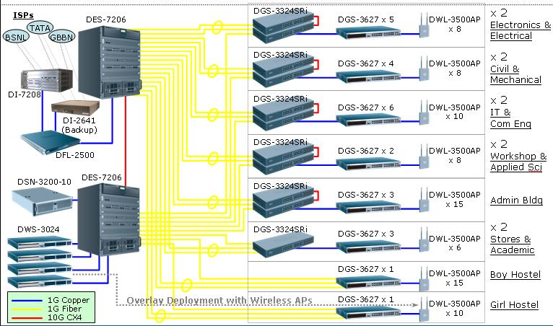
Success Stories - India
Goa College of Engineering
  DWS-3024 x4, DWL-3500AP x120

Slide 43
Success Stories - India
Café Coffee Day –
  DWS-3024 x 1
  DWL-3500AP x 45
American School –
  DWS-3024 x 3
  DWL-3500AP x 60
ICICI Bank –
  DWS-3024 x 2
  DWL 3500AP x 40
  Pilot Project – Replication in all branches

Slide 44
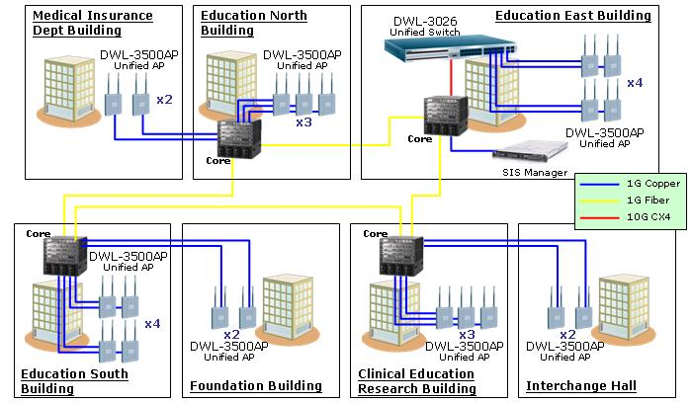
Success Stories - Japan
Sapporo Medical School
  DWS-3026 x 1, DWL-3500AP x 20

Slide 45

Success Stories - Germany
Customer: Lankwitzer Premium Coatings group
DWS-3024
DWL-8500AP x 24
WLAN construction for a new
building
WiFi Phone Fast Roaming
Auto RF Channel & Power
Adjustment

Slide 46
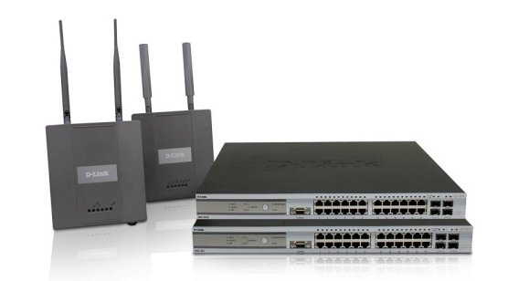
Success Stories - Dubai
Project’s Name | Managed wireless Network
Customer’s Name | American School in Dubai (ASD)
Country/Region | Dubai, United Arab Emirates
Vertical Market | Educatión
Customer Requirement | To provide seamless wireless coverage to over 600 wireless users in school.
The Solution | Clustering 3 x DWS-3026 wireless Switches for easy management and centralized security features
Competitors | Aruba & traditional wireless solution
Implementation | Site survey covering 5 blocks of the campus to determine the AP requirement based on wireless signal strength requirement and load per class rooms
Equipment used | DWS-3026 x 3 Units DWL-3500 x 58 Units DWL-8500 x 2 units DES-3828P x 1 unit

Slide 47

Success Stories - Malaysia
Customer: CONCORDE Hotel : 22 hotels in 8 countries
D-Link Malaysia won the project against 3Com
D-Link Malaysia won the project because of the following reasons:
  Arrange equipment loan to Concorde Hotel to verify key features which allow the hotel management to gain confidence in the product
  Willingness to work with client to understand their requirement and recommend the needed solution to the client
  Solution recommended was better and less costly then competitor
  Able to deliver and setup the solution in the time frame required by the client
  D-Link local office provides a local presence and assurance to the client
  Support for the customer with onsite site survey, AP planning and technical training for the costumer
Solution Details
Model | Qty | Main Features/Functions that users look for
DWL-3500AP | 95 | Deploy 5 Wireless AP/Floor in common area .
DWS-3024 | 2 | Wireless AP management and security with auto channel and RF management

Slide 48
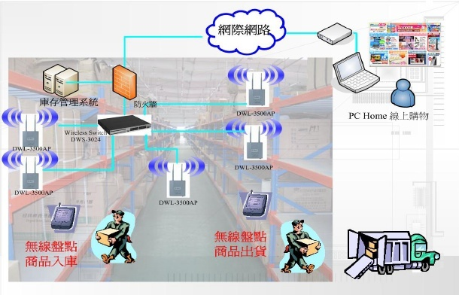
Success Stories - Taiwan
Customer: PCHome On-line Store
  DWS-3024x1, DWL-3500x22
Internet
Inventory
back-end System
Firewall
PCHome Online Shop
Wireless PDA scans
Incoming stocks into inventory
Wireless PDA scans
shipping stocks

Slide 49
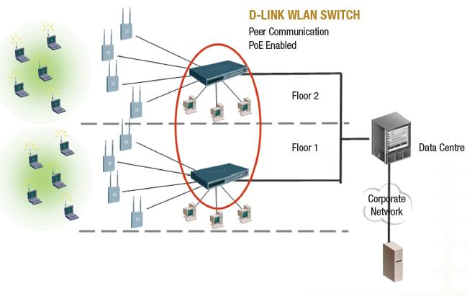
Success Stories - Australia
Somerville House boarding school
  DWS-3024 x4, DWL-8500AP x75
  1200 students, 800 laptops

Slide 50
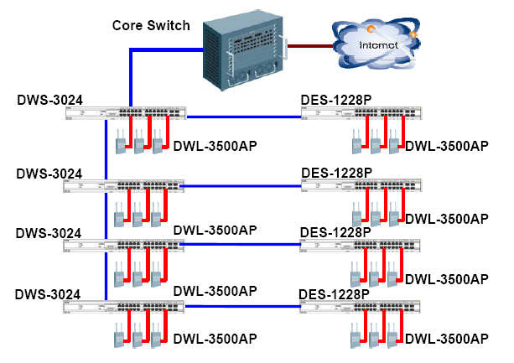
Success Stories - Taiwan
Customer: Nan-Jeon Institute of Technology
  DWS-3024 x 4, DWL-3500AP x 153
  Inter-switch Roaming, Captive Portal

Slide 51
Questions?

