Slide 1

Overview of DVX 9000

Slide 2
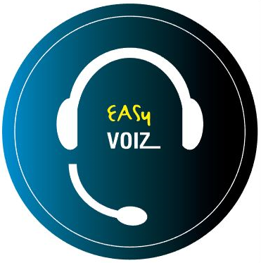
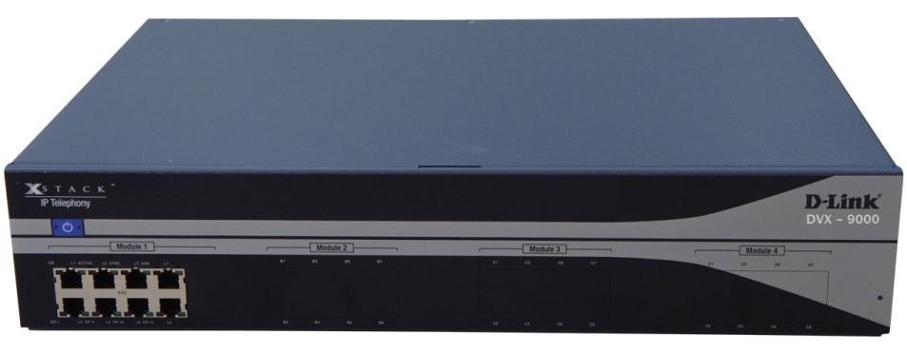
What is D-LINK DVX 9000 ?
The DVX9000 is a heavy-duty, stand-alone, pre-configured, out-of-the-box Asterisk IP PBX featuring the EasyVOIZ. The DVX9000 may be equipped with up to 32 analog ports, up to eight BRI ISDN ports, and up to 4 E1/T1 PRI, or E1 R2 ports in a single, 19" 2U chassis. Additional PSTN/analog phone ports can be provided by connecting up to 24 external USB Gateway units via the USB2 ports, for a total of up to 800 PSTN/analog phones ports, up to 1000 users and up to 300 concurrent calls .
Cisco CME
Trunks
Software |  |  | Hardware
Asterisk version | 13.Xx |  | Processor | Intel G850 2.9 GHZ
Linux version | CentOS 8.x |  | RAM | 4 GB
GUI | EasyVOIZ 5 |  | Hard disk | From 300GB 2.5'' (500GB optional)
 |  |  | USB | 4 external USB 2.0

Slide 3
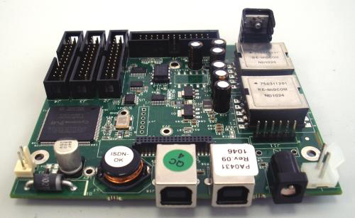
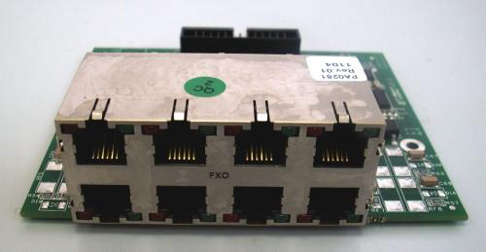
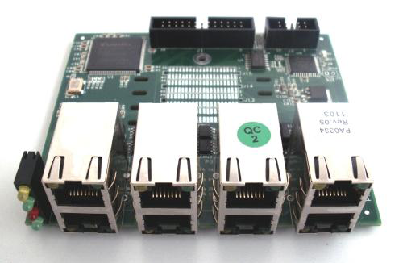
DVX- 9000 I/O Modules
DVX 8010 Main Module
DVX 8020 8 Port FXO Module
DVX 8030 1-4 port PRI module
DVX 8025 8 port FXS module

Slide 4
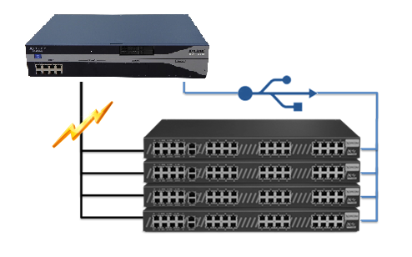
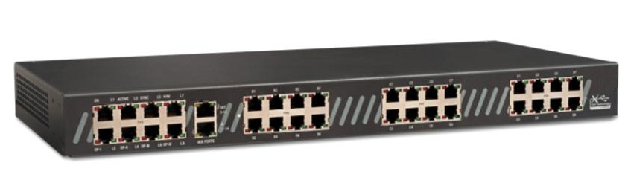
D-link DVX8050 X-Stack USB Modular Voice gateway
D-link DVX8050 USB Modular Gateway , Offering a wide variety of FXS,FXO,PRI ISDN and I/O port combination

Slide 5

Full and Automatic IP PBX redundancy
Provides full redundancy for a complete
PBX system, incl. telephony interfaces
Quick and automatic failover process
keeps downtime to an absolute minimum
Auto detection of server failure & switch
to backup server
Firmware-based switching mechanism
is not network-dependent
Solution components:
  Two DVX-9000 IP PBX units with identical configurations
  DVX-8050(s) with dual USB ports

Slide 6
Two DVX 9000+ Dual-USB DVX8050
DVX 9000(primary)
DVX 9000(backup)
USB
USB
LAN/WAN
PSTN
SIP Trunking
IP Phones

Slide 7
Introducing EASY VOIZ 5

Slide 8

EASY VOIZ 5
EasyVoIZ is based on a highly responsive graphic user-interface that facilitates the management of Asterisk servers, in a fast, intuitive, and secure manner.
The system is based on a 3-level menu system that makes it very easy to locate any item that you want to manage.
Simple Management
  desktop call management
  visual voicemail
  browser-based administration
Inbound Call Center / Customer Service Aids
  call recording
  graphical call reporting
  integrated chat
  unlimited auto attendants
  Efficient Communications
  inbound/outbound fax
  smart phone integration
  unified messaging
  presence management
  conference bridges
  video calling

Slide 9
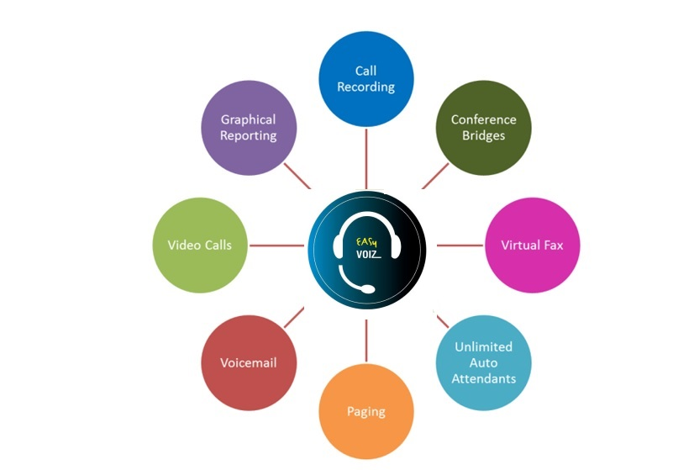
Sampling of Included Telephony Apps

Slide 10
User Experience
Basic Call Features
  Call back
  Call forward
  Call parking
  Call pickup
  Call waiting
  Camp on
  DISA (Direct Inward
  System Access)
  DND (do not disturb)
  Find me / Follow me
  Transfer (blind, attended)
  Voicemail
  Customization incoming/outgoing
  Display
  Lookup
  Blocking
  Routing
  Screening
  On Call Waiting
  CDR (Call Details Record)
  Corporate phone books
  Direct Inward Dial Numbers (DIDs)
  Inbound/Outbound fax support
  Language support
  Message Waiting Indicator (MWI)
  Short-code dialing
  Speed Dial
  User-friendly Web interface
  Video calls
  Voicemail-to-email
  Wake-up Calls / Reminders

Slide 11

Unified Communications
Audio conferencing
Call recordings access
Corporate phone book
Disaster recovery
Fax-to-email
Instant messaging/chat*
One number reach
Operator panel (switchboard)
Paging and intercom
Presence
Short-code dialing
Survivability
Video conferencing
VMX Locator
Voicemail to e-mail
Web access to voicemail, fax, and recordings

Slide 12

Workgroup Features
Call monitoring
Call queues
Call recording
Caller Name Lookup
CDR (Call Details Record)
Click-to-call
Conferencing (on-the-fly)
Hot-desking
Hunting groups
IVR / Auto-attendants
Instant messaging/chat*
Pick-up groups
Presence (agent status)
Queue priorities
Ring group strategies
Statistical reporting
Time-based routing
Visual switchboard

Slide 13

Administration
Backup and Restore
Endpoint provisioning tool
Feature codes
Music / Announcements
Network settings tool
Pre-defined user roles
Remote administration
Storage monitoring
System status screen
System-wide speed dial
Time Conditions
User-friendly Web interface

Slide 14

Interfaces & Integration
PRI, BRI ISDN, FXO, FXS
SIP phones
Soft phones, smartphones, tablets
TDM/SIP/IAX trunks
TDM-VoIP gateway

Slide 15

My Extension
Accessible by any defined user
Each user sees/manages own extension only
Increases productivity & availability: never miss a sales call!
Options
  Call Monitor to review call log
  Voicemail to play and download voicemail
  Faxes to send/receive faxes
  Feature Codes lists available feature codes
  Follow Me defines Follow Me behavior
  Phone Features menu defines phone features
  Define VmX Locator
  Settings sets language and notification settings

