Slide 1
iSCSI SAN Storage
DSN-4000 series Introduction

Slide 2
Technology Overview
Direct Attached Storage (DAS) – storage devices directly attached to a computer i.e. internal disk drive.
Network Attached Storage (NAS) – file server attached directly to a network, imbedded file system allows users to share pool of storage.
Storage Area Network (SAN) – block level storage pools attached to a private network for mounting to host machines.
  Fiber Channel
  iSCSI – cost alternative to FC, based on Ethernet

Slide 3

FC SAN vs iSCSI SAN
Major difference between iSCSI SAN and FC SAN is COST
  iSCSI Network is significantly less expensive based on Ethernet
  iSCSI storage devices and SAN components are much less expensive than FC, such as switches, array controllers and HBAs
 | iSCSI SAN | FC SAN
Host Bus Adaptor, HBA | Free Software Initiator | USD 500/ port
Switch | < USD 100/ port (1GbE) | USD 300+/ port
SFF/ Cable | No SFF required (1GbE) | USD 100/ port
RAID controller/ Array | 1x | 1.5x or more
Tape/ Disk Backup | 1X | 2X or more
Data Replication | The same IP network | Additional FCIP router/ NAS gateway is required
Maintenance | Relatively low cost, leverage IP expertise | Complex and relatively high cost

Slide 4
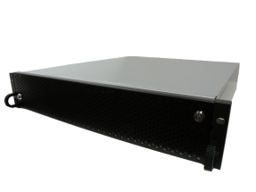
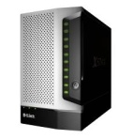
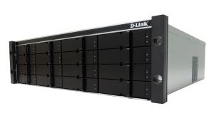

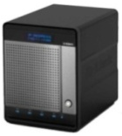
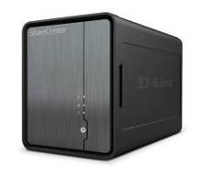
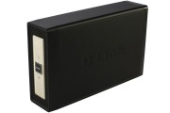
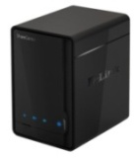
D-Link Storage Product line
DSN-6000 series
12 x SAS/SATA drive bays
Redundant controllers
Scalable
SMB/
Entry SME
NAS & SAN
DNS-1550-04
1U 4-bay Rack
DSN-1100
5-Bay Desktop
DSN-4000 Series
Single Controller
SAS/ SATA Drives
SAN
DNS-1100-04
4-Bay SMB Storage
SOHO
NAS
DNS-1200-05
5-Bay SMB NAS
ShareCenter Shadow DNS-325
DNS-315
SOHO/
Consumer
ShareCenter Solo
DNS-313
ShareCenter Pulse
DNS-320
Capacity and Performance
Notes:
4
4

Slide 5
D-Link iSCSI SAN Market position
Model | Characteristic | Applications
 | Fully redundant design (HA) 10GbE Ethernet (SFP+) Hardware RAID6 Advanced data protection by snapshot, volume clone and replication technology | D-Link DSN-6000 provides full compatibility with all major virtualization platforms – VMware, Hyper-V and Citrix. Ideal to be used as a basis for providing storage in the cloud, to work with SQL database, ISP storage, email servers or backup applications data.
 | The highest C/P iSCSI storage. Up to 80,000 IOPS 425/ 850MB/s (DSN-4100/ 4200) The biggest capacity storage, up to 160TB via JBOD expansion. | New DSN-4000 systems can also be used for data backup, recovery and disaster recovery, but are an especially good fit for storage behind D-Link’s video surveillance gear
 | The fastest tower type storage. Up to 400MB/s | Ideal for secondary storage applications such as backup and archiving. Especially for SME users who has no rack in the office.
DSN-6000 series
2U-12bay SAS/ SATA
Redundant controllers
Scalable
DSN-4000 Series
Single Controller
SAS/ SATA Drives
DSN-1100
5-Bay Desktop

Slide 6
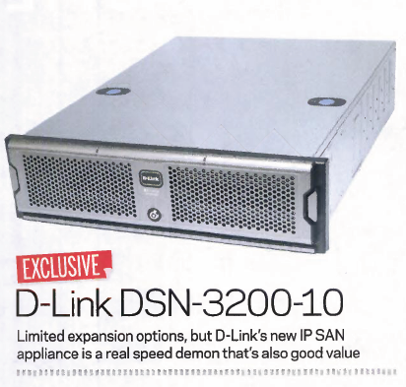

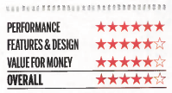
DSN-3200 - PC Pro Recommended
Highlights:
“The DSN-3200-10 offers a high storage capacity and, as you'll see from our lab tests, truly stunning performance.”
“For sheer performance it can easily hold its own against many more expensive solutions.”

Slide 7




Successful Story
Virtualization
 | American Land Lease and Virtualization Performance Implement Virtual Storage Solution Featuring D-Link DSN-3200 iSCSI SAN
 | The University of Massachusetts Amherst’s Isenberg School of Management consolidated its servers and implemented a reliable SAN with a unique, affordable D-Link iSCSI-SAN solution
Metropolitan Public Defender (MPD), Portland | D-Link® xStack® Storage System with Volume Virtualization Offers Portland Non-Profit Law Firm Expandable Network Capacity
Campus
 | Maximize ROI on Network Storage for K-12 D-Link® high performance SAN supports district’s virtual desktop infrastructure and frees technology budget for new initiatives.
 | D-Link® Provides Grantsburg School District with Scalable Switching and Storage Solutions That Boost Connectivity, Of fer Price Advantage

Slide 8


Successful Story
Small business IT
 | D-Link Helps The Covenant Group Accommodate Growth Network Storage Data Solution from D-Link Gives Executives In-House Email and Calendar Sharing, Boosts Productivity
IP Surveillance
 | D-Link Demonstrates End-To-End Video Surveillance Solution at Interop 2008
Media Entertainment
New Hampshire Public Radio | D-Link® Switching Solutions Provide the Reliability New Hampshire Public Radio Needs to Stay “On the Air”

Slide 9
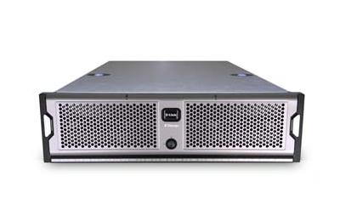
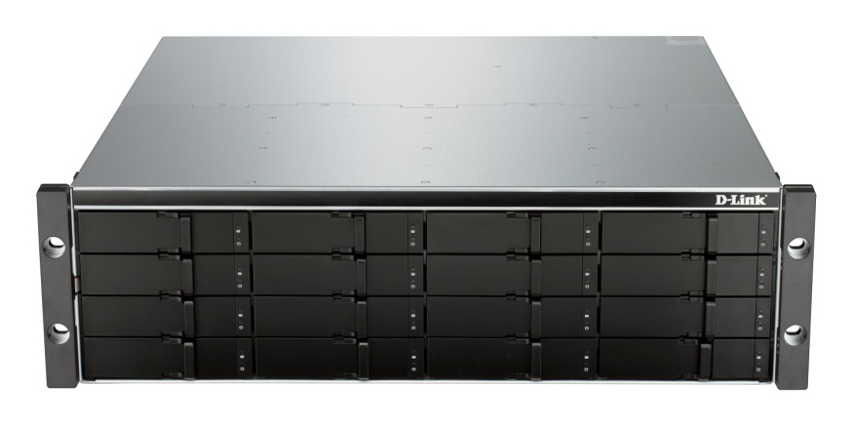
Evolution of D-Link SAN Solutions
Where we’re coming from.......
Stand alone High Performance SAN arrays
  SoC Controller
  SATA drives only
  Non-scalable
Secondary/Nearline storage applications
  Departmental storage, disk backup, archive and video surveillance
Where we’re going……..
Higher reliability, easy maintenance
  Cableless enclosure with hot swappable FRU
  SAS and/or SATA drives
  Scalability (up to 80 HDD via JBOD expansion)
Eco- Friendly, high efficiency power supply

Slide 10
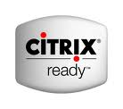

DSN-2100/ 3000/ 4000 Comparison
Model | DSN-2100 | DSN-3200 | DSN-4100 | DSN-4200 | Remark
Form Factor | 2U 19" | 3U 19” | 3U 19" Rackmount
iSCSI Network Interface | 4x GbE | 8x GbE | 4x GbE | 8x GbE
Drive Interface | SATA I& II only |  | SAS& SATA II support |  | Higher reliability
Drive bay | 8 | 15 | 16 | 16
JBOD expansion | No | No | 4 (by DSN-4000)
Storage Capacity (Max. TB) | 16 TB | 30 TB | SATA: 160 TB Near line SAS: 240 TB |  | 8 times bigger
Max. Throughput (MB/s) | 425 MB/s | 850 MB/s | 425 MB/s | 850 MB/s
Power Supply | 400W | Redundant 760W | Redundant 450W (80 plus certified) |  | Eco-Friendly
Availability | 2011/E EOL |  | 2011/9 | 2011/12
OBU Price | USD 2600 | USD 3390 | USD 2143 | USD 2154 | 37% cost down
DSN-2100/ 3200/ 3400 will be replaced by DSN-4x00 in 2011/ Q4

Slide 11
Preparing a 240TB configuration
75% cost down
Before
DSN-3200-10 x 8 units USD 3390 x8 = USD 27120
+ SATA 2TB HDD x 120 units
DSN-3200-10 x 8 units
Now
DSN-4100 x 1 unit USD 2143 x1 = USD 2143
+ DSN-4000 x 4 units USD 1200 x4 = USD 4800
Total USD 6943
+ Near line SAS HDD 3TB x 80 units
DSN-4100 + 4 units of JBOD

Slide 12
DSN-4000 Series features
System on a chip, SoC implementation: Up to 80,000 IOPS, low power cost (66W)
iSCSI host interface (RJ-45)
  DSN-4100: Four 1GbE data ports
  DSN-4200: Eight GbE data ports
  DSN-4000:Expansion enclosure for DSN-4100/ 4200
Supported RAID levels
  RAID-0: Stripe (up to 16 members)
  RAID-1: Mirror (2 members)
  RAID-5: Parity (up to 17 members)
  RAID-10: Stripe/Mirror (up to 32 members)
  JBOD: includes concatenation of multiple physical drives
Support for SATA-II (3-Gbps) or SAS drives (up to 6-Gbps)
Expandable to 80 drives for dynamic capacity growth

Slide 13
DSN-4000 Series features
Storage volume virtualization to maximize utilization of LUN (see detail in backup slides)
  Up to 1024 volumes, with any combination of RAID types
  Volumes with different RAID types can co-exist on the same hard drive
Maximum volume size of 32TB
  Selectable block-size of 512B or 4096B for supporting >2TB volume on Windows XP/ 2000.

Slide 14
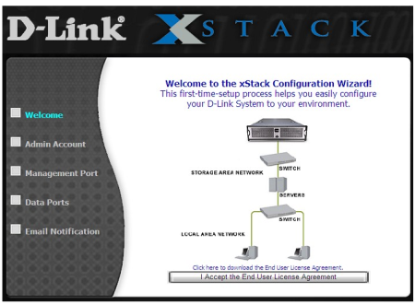
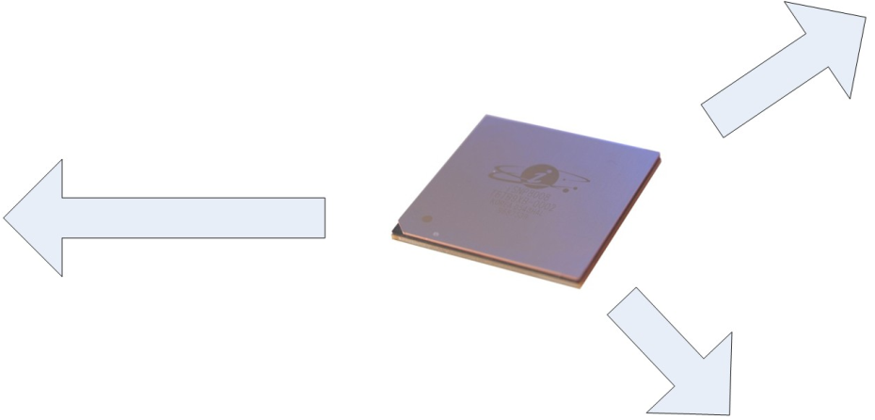
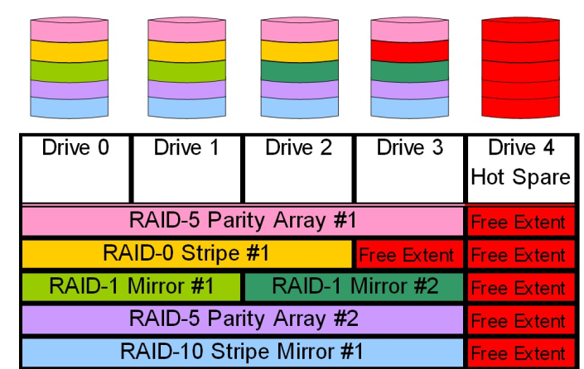
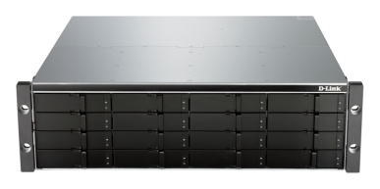
D-Link Storage Virtualization
Storage Virtualization is an approach for resource pooling or sharing in order to decrease costs, increase efficiency and utilization. D-Link has the technology and expertise to help you achieve real business benefits from virtualization today….
DSN-3200-10
3U-15bay 8GbE
D-Link System-on-a-Chip
SoC Solution+ Volume virtualization
DSN-4000 series
3U-16bay 4/ 8GbE

Slide 15
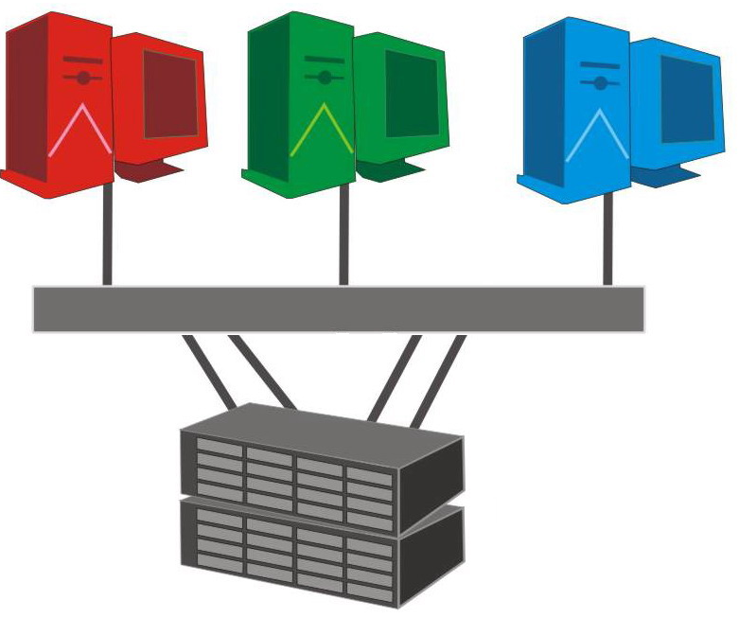
Traditional Disk Storage Approach
Database
Mail Server
File Server
Steps to allocate disk capacity to Application Servers:
Determine RAID level and capacity
Create Disk Groups
Partition disk groups (if necessary)
Map Partitions to LUNs
Assign LUNs to each AP Servers
500GB
1TB
2TB
LAN
Disk Array
LUN 0
LUN 1
LUN 2
Physical Disk Allocation
LUN 0
RAID 1 Disk Group
LUN 1
RAID 1+0 Disk Group
LUN 2
RAID 5 Disk Group

Slide 16
Traditional Disk Storage Approach
Database
Mail Server
File Server
Challenges:
Capacity Utilization
- Over provisioning @ installation
- Excess spaces can’t be shared by other Apps
Result in higher capital cost upfront
Performance
Imbalanced I/O distribution. Performance is limited by HDD spindles when Apps with fewer capacity demand requires high IOPS (such as Database)
Availability
Data rebuild = Re-write entire HDD. The bigger HDD the higher probability of Unexpected system downtime occurs during HDD rebuild
LUN 0
LUN 1
LUN 2
500GB
1TB
2TB
LAN
Disk Array
Physical Disk Allocation
LUN 0
Fewer Spindles= Poor Performance !
LUN 1
Rebuild Entire HDD= High Risk !
LUN 2
Waste Space= Increase Cost !

Slide 17
The D-Link way of Virtualization
Database
Mail Server
File Server
Application Based Volume Creation:
Vol. DB
Vol. Mail
Vol. Files
Select RAID level and disks to File Server(s)
Select RAID level and disks to Database Server(s)
Select RAID level and disks to Mail Server(s)
Select RAID level and disks to File Server(s)
Select RAID level and disks to Database Server(s)
Select RAID level and disks to Mail Server(s)
500GB
1TB
2TB
LAN
Disk Array
Vol. Files
Vol. DB
Vol. Mail
Shared Pool
Disks/ Virtual Volume Allocation
RAID 5 Disk Group
RAID 1 Disk Group
RAID 1+0 Disk Group

Slide 18
The Value of D-Link Virtualization
Traditional Disk Storage:
xStack Storage Virtualization:
Capacity Utilization
- Over provisioning @ installation
- Excess spaces can’t be shared by other Apps
Result in higher capital cost upfront
Performance
Imbalanced I/O distribution. Performance is limited by HDD spindles when Apps with fewer capacity demand requires high IOPS (such as Database)
Availability
Data rebuild = Re-write entire HDD. The bigger HDD the higher probability of Unexpected system downtime occurs during HDD rebuild
Capacity Utilization
- Less Capacity Requirement @ installation
- Disk pool (Free Space) is shared with all Apps
Only Buy What You Need Today
Performance
- Increases performance by spreading data among
greater spindle of drives
- Optimized RAID level for each Application
Availability
Minimize Rebuild time by Micro Rebuild Technology. Reduce data corruption probability and System Downtime.
LUN 0
LUN 1
RAID 5 Disk Group
RAID 1 Disk Group
LUN 2
RAID 1+0 Disk Group

Slide 19
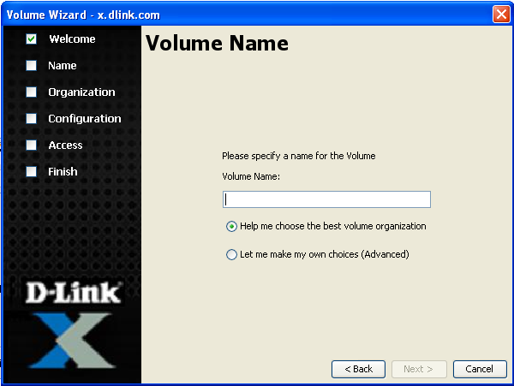
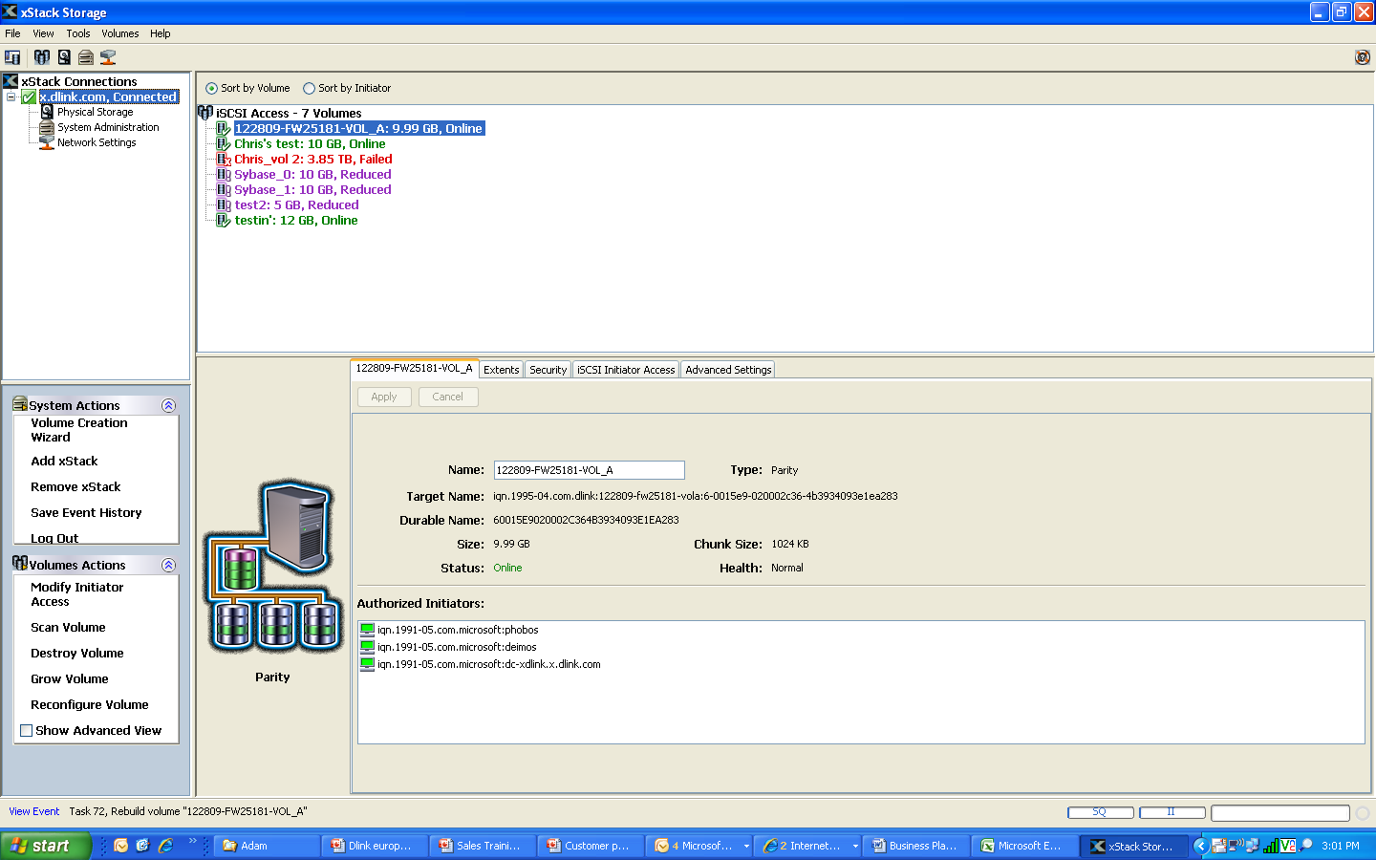
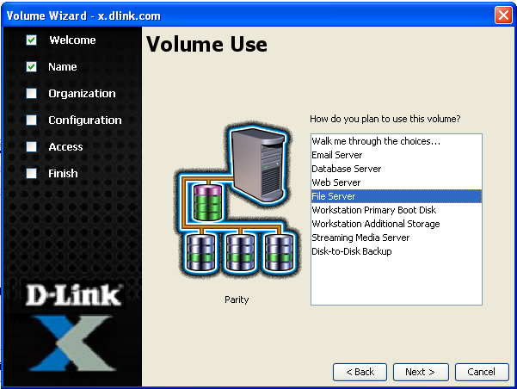
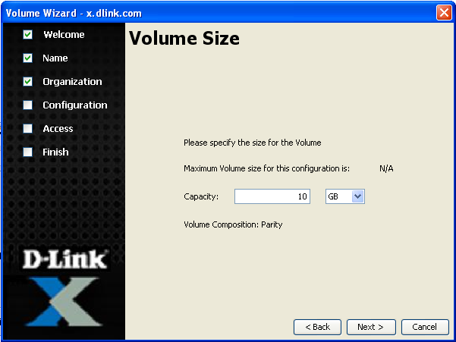
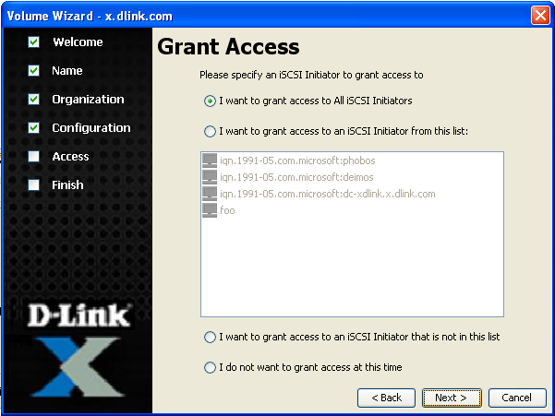

5 mouse clicks to get volume online
Application Based Volume Creation: Get Volume On-Line in 5 Clicks

Slide 20
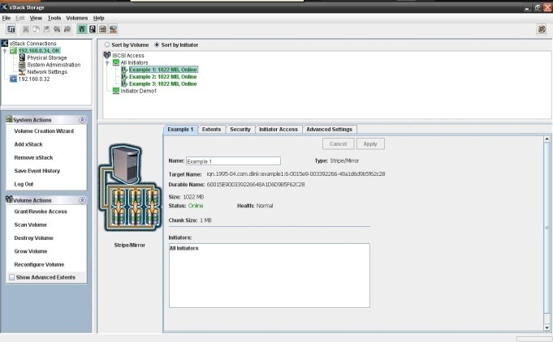
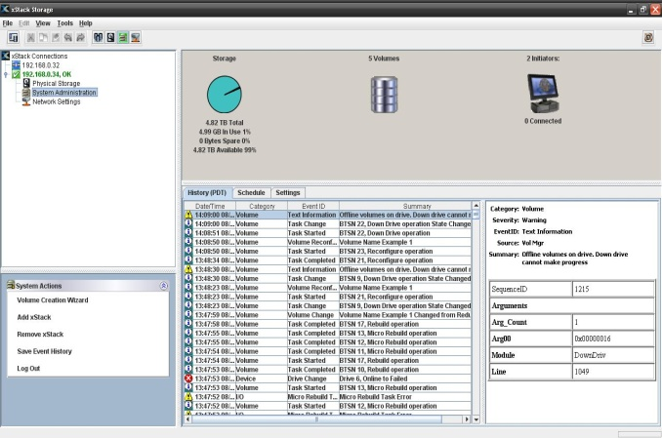
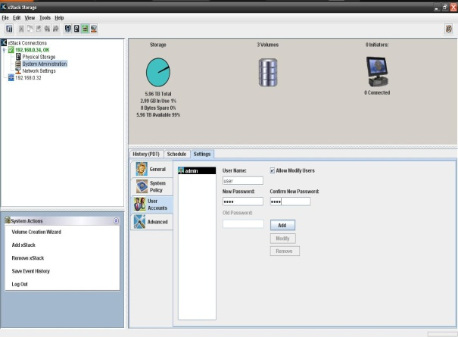
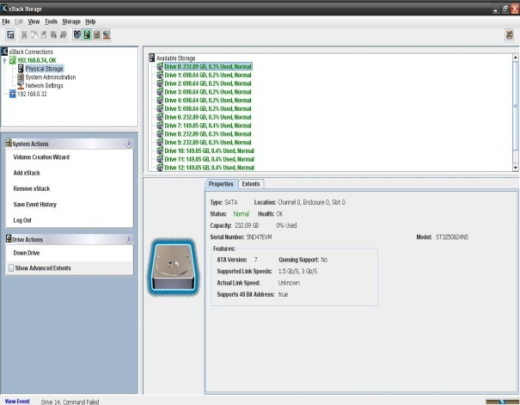
xStack Storage Management Center
The xStack Storage Management Center is an intuitive, Java-based Web application. Capable of managing multiple xStack storages in a single console.
The default IP address to access the application is 192.168.1.1.
The application is divided into four areas, or views:
Network Settings – For viewing and configuring settings for xStack Storage array management and iSCSI data ports.
Physical Storage – For viewing and managing xStack Storage hard disk configuration settings.
System Administration – For performing system administrator tasks such as adding admin user accounts, and selecting a battery policy.
Volume – For viewing, configuring, and managing storage volume configuration settings.

Slide 21
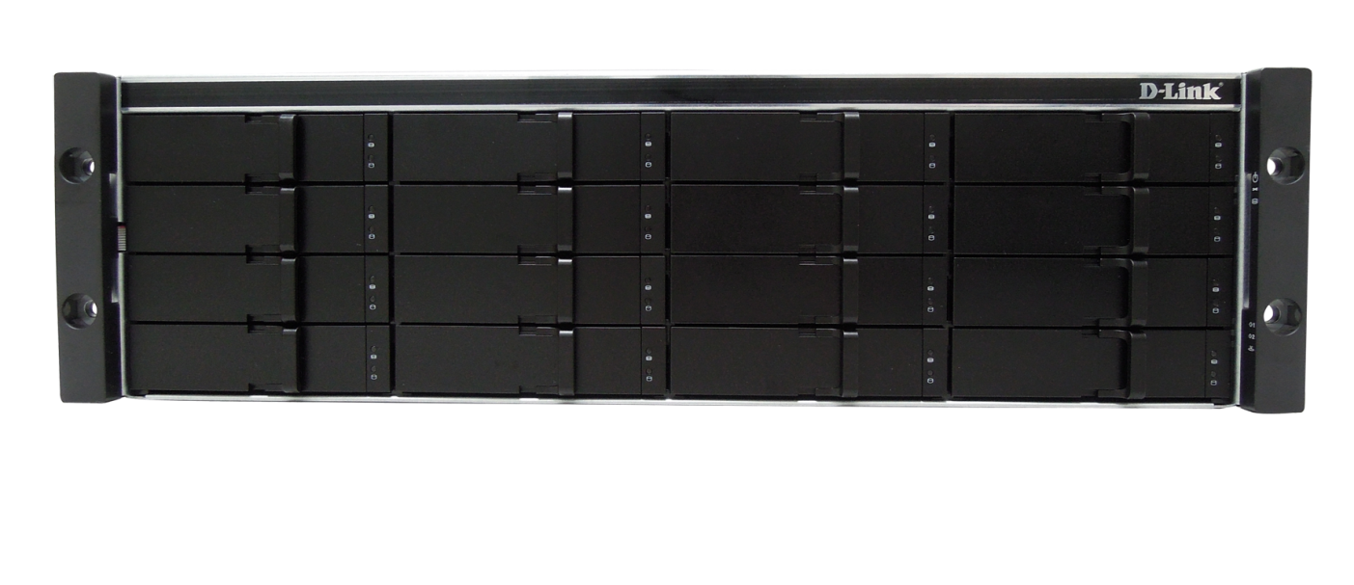
Hardware specification
Front View Industry Standard 3U 19-inch Chassis
DSN-4000 series shares the same 3U-16 bay enclosure, including dual power supplies and cooling FAN module
Model | Description | MSRP
DSN-4100 | 4x GbE host channel
DSN-4200 | 8x GbE host channel
DSN-4000 | Expansion enclosure for DSN-4100/ 4200

Slide 22
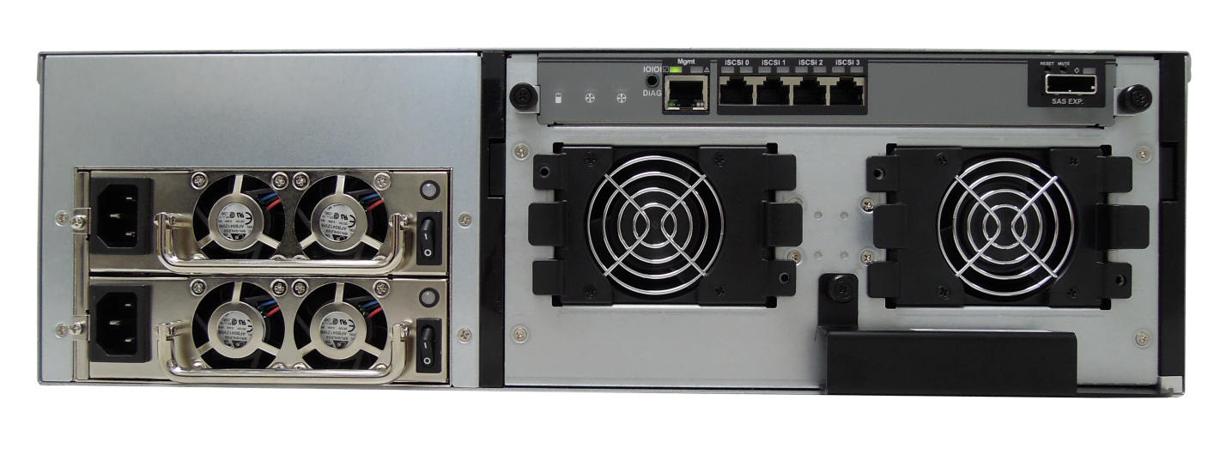
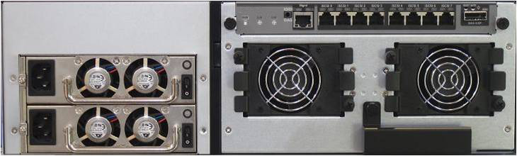
Enclosure
RAID Controller Module
Redundant Power
Supplies
Rear View: DSN-4100
RAID Controller Module
Redundant Power
Supplies
Rear View: DSN-4200

Slide 23
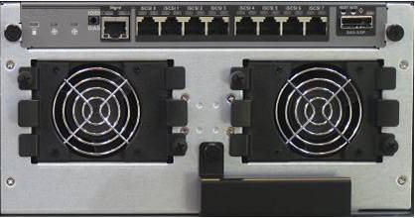
RAID controller module
Management Port
iSCSI Data Ports
(8 x 1GbE shown)
SAS Expansion Port
RS-232 Serial
Diagnostic Port
Hot-Swappable Cooling Fan
Hot-Swappable Cooling Fan
Ejector Lever
Rear View of RAID Controller Module
Example: DSN-4200

Slide 24
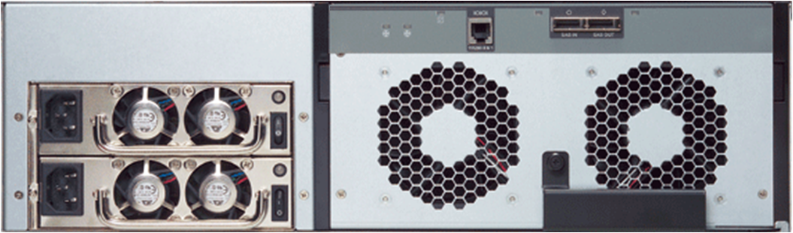
DSN-4000 JBOD
Redundant
AC Power
Supplies
SAS Input Port
Management Port
SAS Output Port
Hot-Swappable Cooling Fan
Rear View: DSN-4000 JBOD
Ejector Lever
DSN-4000 enclosure equips with dual redundant 80 plus power supply.
13% power efficiency improvement against traditional disk array.
Notes:
80 plus: What it means
The efficiency of a computer power supply is its output power divided by its input power. The remaining power is converted into heat. For instance, a 600-watt power supply with 60% efficiency running at full load would draw 1000 W from the mains and would therefore waste 400 W as heat. On the other hand a 600-watt power supply with 80% efficiency running at full load would draw 750 W from the mains and would therefore waste only 150 W as heat.

Slide 25
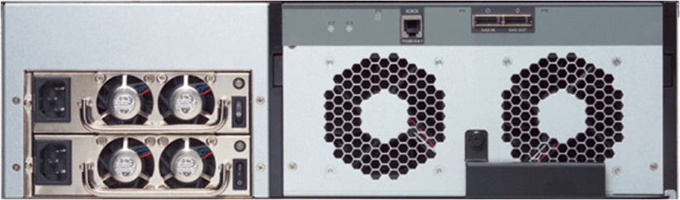
Enclosure Expansion
Every DSN-4100/ or DSN-4200 can connect up to 80 drives via DSN-4000 expansion enclosure (Max. 160TB by SATAII, 240TB by Near line SAS HDD)
DSN-4100 or DSN-4200 (primary array)
Mini-SAS (SFF-8088) cable
DSN-4000 JBOD #1
DSN-4000 JBOD #2
DSN-4000 JBOD #3
DSN-4000 JBOD #4

