Slide 1
DNS-1550-04 Sales Guide
Neo Yin, April 2011

Slide 2
Topics
Market Outlook
D-Link NAS Strategy
DNS-1550-04 introduction
Competition
Back up Slide- Product Specification

Slide 3
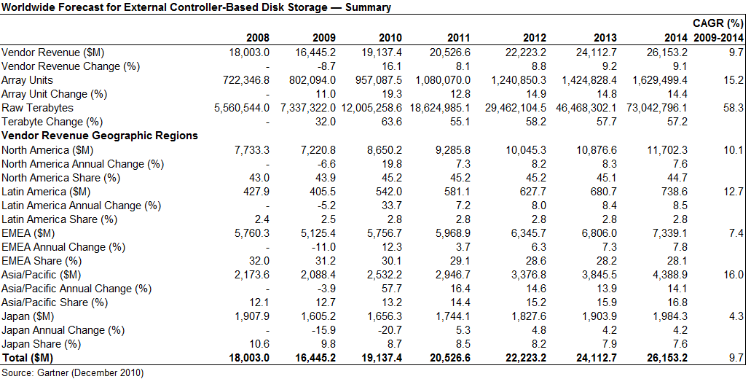
Market Outlook Gartner’s storage market forecast
The latest Gartner quarterly update for the external controller-based (ECB) disk storage market is pointing to a double-digit recovery in 2011. The previous forecast of a 8% compound annual growth rate (CAGR) from 2009 through 2014 has been increased to 9.7%.

Slide 4
Market Outlook Entry level NAS forecast (units)
<$5,000 CAGR 2009 to 2014 is 29.4%
$5,000 to $24,999 CARG 2009 to 2014 is 6.8%
<$ 5,000 sector is the target market for D-Link
Source: Forecast NAS Worldwide, Gartner

Slide 5
Market Outlook Entry level NAS market share
There is no dominant player in the “Less than USD 5,000 NAS” Market: 48% of the market is supplied by “other” brands.
Ideal opportunity for D-Link to become the dominant player
Market share by revenue
Source: Market Share Business NAS, Worldwide, 2009, Gartner

Slide 6
D-Link NAS Strategy
Providing full line of SMB NAS products
Target market is “Low-End NAS” market segment, specially, focus on “Less Than US$ 5,000” market
Tower 4 drives & 5 drives are developed for SOHO market, 1U-rackmount for SMB NAS market
Unified Storage architecture
Unified Storage is NAS embedded iSCSI protocol, unified storage is not only for file sharing but also storage devices for application servers
High Performance
High performance SMB NAS is able to handle heavy business production tasks
Full business NAS feature sets & complete backup solutions
One of important SMB NAS application is backup, complete backup solution incl. local backup to cloud storage backup

Slide 7
Product Overview
D-Links DNS-1550-04 is a 1U-4bay rack mount type unified storage solution providing NAS and iSCSI functionality to enable small and medium businesses to store, share and protect mission-critical data.
Features include:
4-bay SATA Rackmount storage solution
Unified block and file functionality
RAID 0/1/10/5//6, JBOD
Backup options (local/remote NAS backup, scheduled snapshot)
2 GbE ports for load balancing and high availability
5 USB ports (Print Sever, UPS monitoring, USB hard disk)
Predictable Data Migration and S.M.A.R.T.
Advanced iSCSI function; LUN masking, MPIO, etc
IPv6
Cloud backup (Amazon S3) agent
D-Link Green™: Energy-saving design

Slide 8
Product Details
Front-View
Rear View
USB port
Status LEDs
Power button
HDD tray x4
USB port x4
Controller board
Power Supply x2
GbE x2
Swappable Unit

Slide 9
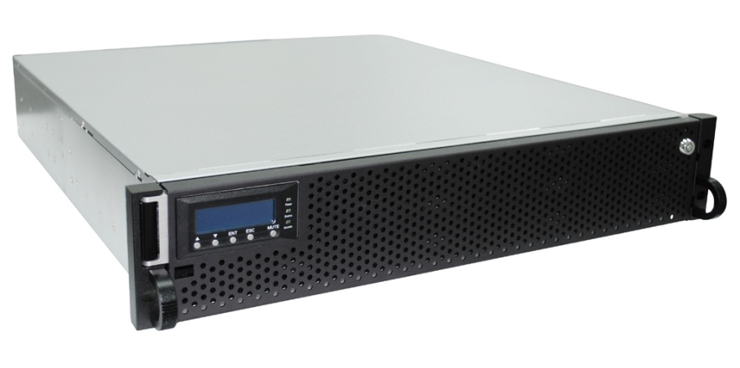
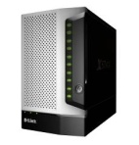
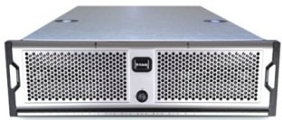
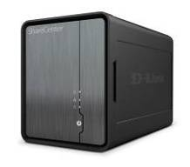
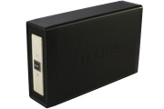
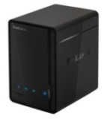
DNS-1550-04 Product Positioning
DSN-6000 series
12 x SAS/SATA drive bays
Redundant controllers
Scalable
NAS & Unified Storage
SMB/
Entry SME
DNS-1550-04
1U 4-bay Rack
DSN-1100
5-Bay Desktop
DSN-3000 Series
Single Controller
SATA Drives
SAN
DNS-1100-04
4-Bay SMB Storage
SOHO
NAS
DNS-1200-05
5-Bay SMB NAS
ShareCenter Shadow DNS-325
DNS-315
SOHO/
Consumer
ShareCenter Solo
DNS-313
ShareCenter Pulse
DNS-320
Capacity and Performance
Notes:
9
9

Slide 10
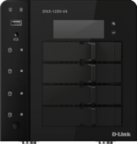
DNS-1550-04 Unified Storage Applications
SMB applications (iSCSI)
MS AD/ SQL
Email server (Exchange)
Remote applications:
WWW Management
FTP
iOS & Android Apps
Multi-Client Backup
- Time Machine
- Acronis Backup Utility
DVR
Remote Backup
Amazon S3 (WWW)
Tower NAS as RSYNC server
Multi-Client File Sharing
- SMB/SAMBA/ CIFS
- WebDAV
Surveillance Storage

Slide 11
DNS-1550-04 Key Selling Points
Unified NAS and IP-SAN solution.
Enterprise class RAID protection
Best-in-class iSCSI performance
Designed for SMB environments that need the simplicity and affordability of Networked Storage
Intuitive GUI design
Hot swappable modular accessories
Enhanced features to enables users to secure their valuable data include:
S.M.A.R.T monitoring of drives to warn users of impending drive failures
Comprehensive backup solution; snapshot, replication, cloud backup, etc.
Includes Acronis Backup software.
USB log retrieval
Green NAS: MAID 2.0& 80 plus power supply

Slide 12
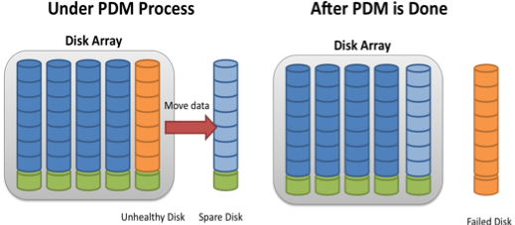
Enterprise Class RAID Protection
RAID 0/1/10/5//6, JBOD
RAID level migration& Recovery
Media Patrol: Scan media surface to make sure data is intact
Predicable Data migration and SMART
What is Predicable Data migration, PDM?
Through the PDM system, hard disk drives incorporate a suite of advanced diagnostics (i.e. S.M.A.R.T) that monitor the internal operations of a drive and provide an early warning for many types of potential problems. When a potential problem is detected, the hard drive can be repaired or replaced before any data is lost or damaged.

Slide 13
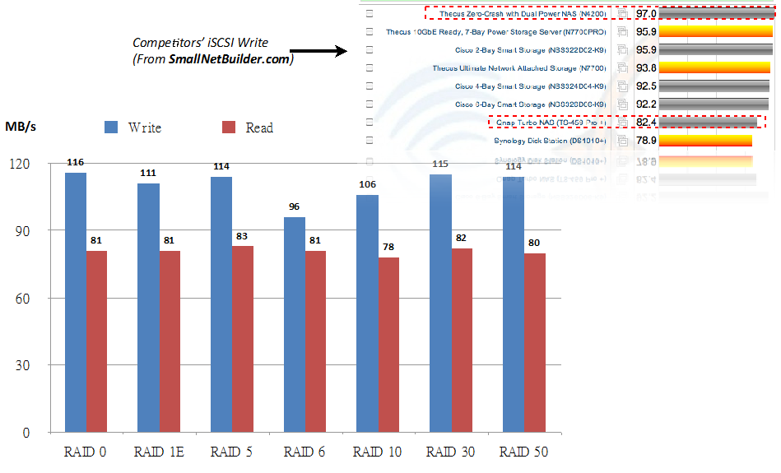
Best –in-Class iSCSI Performance
DNS-1550-04 write performance avg. 108 MB/s, is higher than competitors listed on SmallNetBuilder.com

Slide 14
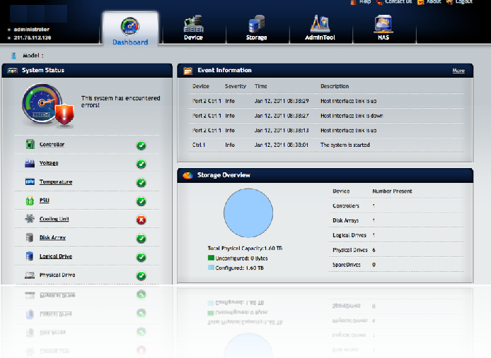
Intuitive Graphic User Interface
> Simplified Management – no special IT skills needed
Dashboard& wizard
Event Log
Capacity Utilization
Health condition of Major component

Slide 15
Hot swappable Modular Design
> Hot swappable modular accessories, Easier for field maintenance
HDD Tray x 4
Control board Unit
Power Supply Unit x2

Slide 16
Comprehensive Backup Solution
Volume Snapshot
Workstations/ Servers backup
Volume Snapshot
Rsync between Storages
Cloud backup to Amazon S3
RSYNC
LAN/ WAN
File Backup
Windows
Internet
Cloud Backup
Mac

Slide 17
Acronis Backup software Bundle
Acronis Backup & Recovery NAS Edition
Support Windows Server x5 License
WHO is Acronis?
#1 Backup software market share in SMB segment– SearchStorage.com
Founded: 2002
US Headquarters: Woburn, MA
Offices: 20 Worldwide
Employees: >650 with >200 in R&D
Ownership: Private

Slide 18
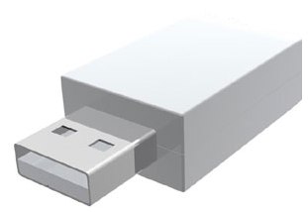
USB log Retrieval
TWO STEPS to retrieve system log:
Plugin the pen drive to NAS
“USB Retrieval” will export the system log (*.html) to pen drive automatically.

Slide 19
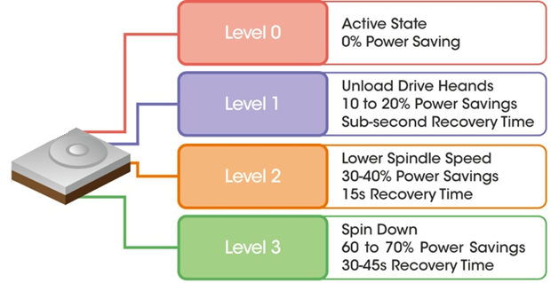
Green NAS: MAID 2.0& 80 plus power supply
MAID 2.0 helps users accomplish effective green storage practices.
MAID stands for Massive Array of Idle Disks, and is a technology used in large disk subsystems where disk drives not in active use at any given time are automatically switched off to save power.
80 PLUS is an initiative to promote energy efficiency in computer power supply units (PSU). It certifies products that have more than 80% energy efficiency at various rated of load.

Slide 20
How to Compete
D-Links DNS-1550-04 solves the storage pain points experienced by SMEs
High performance Unified NAS and SAN storage:
Easy to manage, intuitive GUI
Reduce running costs (management, power and cooling)
Simplify back-up and provide fast restore of valuable data
D-Link Green™ Energy-saving design:
Reduced running costs
Lower Power Consumption

Slide 21
Summary
D-Links DNS-1550-04 is a 1U 4-bay unified storage solution providing unified NAS and iSCSI functionality to enable small and medium businesses to store, share and back-up mission-critical data.
Designed for SMB environments that need the simplicity and affordability of Ethernet storage.
High performance for demanding business applications
Competitively priced
Compete solution from an award winning designer, developer and manufacturer of networking solutions

Slide 22
Backup Slide- Hardware Specification
Item | Specification
CPU | Intel Atom D525 Duel-Core 1.8 GHz
RAM | 2 GB
Flash | 256 MB
# of HDD | 4, support SATA II HDD.
VGA | Yes (for debug only)
USB | Front x 1/Rear x 4
Ethernet Port | Gigabit x 2
Power Supply | 250 W (80 PLUS Certified) x 2 (Redundancy)
Enclosure Dimension | 1U Rack
Chassis | Metal
Button | Power, One-Touch Backup, Reset

Slide 23
Backup Slide- Software Specification
Category | Functionality & Feature
RAID Level | 0, 1, 5, 6, 10,1E
RAID Management | PDM, online RAID level Migration, online Capacity Expansion, Synchronization, DDF
iSCSI | Target/Initiator, CHAP, LUN Mapping/Masking, SPC-3, MPIO
Network | IPV4, IPV6, Load Balance, Fail Over, IEEE 802.3ad, Balance XOR, LLTD
Network File Sharing | SMB/CIFS, AFP, NFS, WebDAV, FTP server,
System Management | Telnet, SSH, LCD Configuration, Setup Wizard, Firmware Upgrade
Backup Solution | NAS remote backup, External Flash backup/restore, Amazon S3, NAS volume Snapshot, Apple Time Machine Support, One-touch backup
PXE Server | Yes
Backup software Bundle | Acronis Backup and Recovery NAS Edition (for Server and workstation)
Disk Management | Wake-on-LAN, Disk Spin Down, MAID 2.0, Media Patrol, HDD S.M.A.R.T
File System | XFS
Security | System Firewall, Volume Encryption, IP Block, Connection Monitor
Application Server | Web Server, SQL, File Management
Power Management | Schedule Power on/off, UPS (USB/Ethernet), Auto Power Recovery
Account Management | Windows ADs, Open LDAP
Language Support | English, German, French, Italian, Spanish, Russian, Japanese, Korean, Traditional Chinese, Simplified Chinese

