Slide 1
Sales Guide
DNR-322L
2-Bay mydlink NVR
Version 1.0 D-Link HQ, Jul. 2011
D-Link Confidential

Slide 2
Before Getting Started – The Model
DNR-322L is a standalone wired Network Video Recorder (NVR) which supports 9 channel network cameras with M-JPEG, MPEG4 or H.264 recording with 2 high-speed 3.5-inch SATA hard disks for long time recording.
Empowered by mydlink technology, DNR-322L can be easily setup for internet access. It supports real-time monitoring and playback from everywhere via IE browser (Either from mydlink website or NVR website).
Record video from network cameras located in local or remote sites into a dedicated HDD storage without turn on PC
The triplex function can keep recording while user live viewing or searching playback at the same time.
With complete video management, display and playback ability makes it as a convenient and stable video recorder.

Slide 3
Table of Content
Product Highlight
Positioning Overview
Target Market
Selling Point
Competition Analysis
Competition Mapping
Sell Against Competition
Uniqueness Highlight
mydlink service
Technology Brief
Product Deployment Guide
Notes:
3

Slide 4
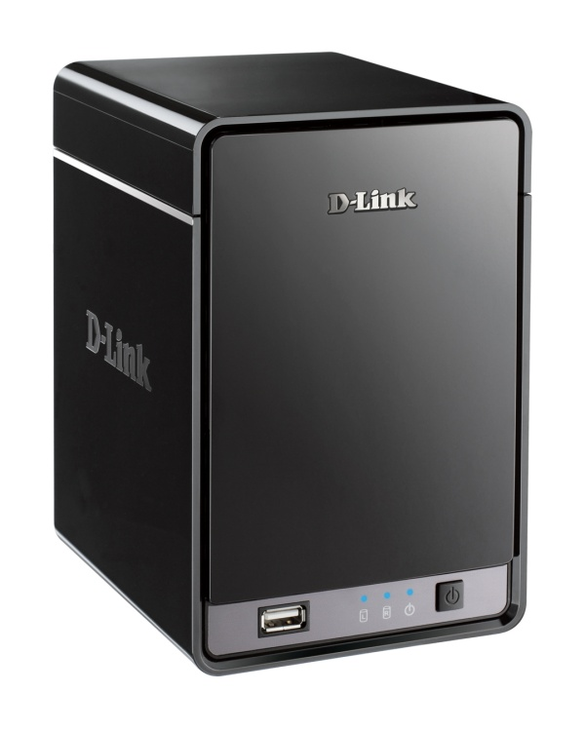
Powerful Network Video Recorder
Remote Live View, Playback
Do you need a video recording solution for IP Camera…
With Plug and Play internet access service…
Simple, secure, and powerful…
DNR-322L is designed for you!
H.264 HD recording
HDD security
mydlink
Easy Interent access
- and more -

Slide 5
Product Highlight
Positioning Overview
Available
In Development
In Plan
DNR-742 4-bay 3.5” SATA 16 channel H.264 / MJPEG Real-time live display VGA @ 480 fps recording Video output Rack mount
16 Ch
(New ID)
DNS-726-4 DNS-722-4
2-bay 3.5” SATA 9 Channels
H.264, MPEG4, MJPEG D1@120fps (CIF @ 240 fps) recording
DNR-326 2-bay 3.5” SATA 9 Channels H.264, MPEG4, MJPEG 720P@270fps recording Gigabit Ethernet Multiple brand camera support Smart Search
9 Ch
mydlink
NVR
DNR-322L 2-bay 3.5” SATA 9 Channels H.264, MPEG4, MJPEG 720P@270fps recording Gigabit Ethernet mydlink enabled
DNR-112 2-bay 3.5” SATA 4 Channel H.264, MPEG4, MJPEG VGA @ 120 fps recording Video output Remote controller
4 Ch
(New ID)
Q1 / 2011
Q2 / 2011
Q3 / 2011
Q4 / 2011 & 2012~
[ Jun. 2011 Update ]

Slide 6
Product Highlight
Positioning Overview
Remote live view and playback from anywhere thru internet
Privacy recording store in your own HDD, not in the cloud
Easy internet setup (mydlink portal)
24/7 video recording
DNR-322L
2-Bay SATA HDD
4TB max.
9 Channel
IP cameras Recording
H.264 HD
Realtime
Event recording
Motion detection
mydlink
Easy internet access

Slide 7
Product Highlight
Target Market
For the one you care
For the place you concern
Baby Care
Home security
Easy access thru mydlink portal
Remote Live View
24/7 hours recording
Record by motion detection
Schedule recording
Remote Playback
2x 3.5” SATA HDD with RAID
Pet monitor
Perimeter security
DNR-322L
Elder Care
Activity monitor

Slide 8
IPv6
Product Highlight
Selling Point
Supports up to 9-channel live view and recording
Supports M-JPEG, MPEG4 or H.264 recording
Simultaneous live view, recording and playback
Supports 1 channel playback
Week days or daily scheduled recording
Audio & video recording in synchronization
Recording Type: Motion detection record, record by schedule, manual record
Continuously recording with automatic overwrite function
Power fail recovery recording
File sharing server support with Samba protocol on second HDD
Embedded two SATA II 3.5” HDD interface
RAID 0/1 and JBOD supported
Supporting features
One 10/100/1000 Mbps auto-MDIX fast Ethernet LAN port
PPPoE, DHCP and Static IP assignment support
Green solution with low power consumption and eliminating the use of a PC
Calendar search and video preview before playback
Export video clips from the playback as evidence
Notes:
Albert’Backup note:
6. Privacy mask (zone) that secure the special area of the view without privacy concern.

Slide 9
Table of Content
Product Highlight
Positioning Overview
Target Market
Selling Point
Competition Analysis
Competition Mapping
Sell Against Competition
Uniqueness Highlight
mydlink service
Technology Brief
Product Deployment Guide
Notes:
9

Slide 10
Table of Content
Product Highlight
Positioning Overview
Target Market
Selling Point
Competition Analysis
Competition Mapping
Sell Against Competition
Uniqueness Highlight
mydlink service
Technology Brief
Product Deployment Guide
Notes:
10

Slide 11
Uniqueness Highlight
mydlink service
Easy Internet access mydlink portal provide a simple login process. Thru email and password, end user don’t need to remember DDNS name or difficult IP address. Simply use browser can access to NVR from anywhere anytime.
Setup Wizard DNR-322L Setup Wizard will help end user go thru hardware, Internet and camera setup process. Just follow few steps, user can format their HDD, search camera, enable recording and connect to mydlink server.
All D-Link camera support DNR-322L supports all of D-Link cameras, not only mydlink one. It provides the flexibility to use all of D-Link cameras, including consumer and business class. The cameras connect to mydlink NVR can easily live view and playback from mydlink portal, no more additional effort of setup.

Slide 12
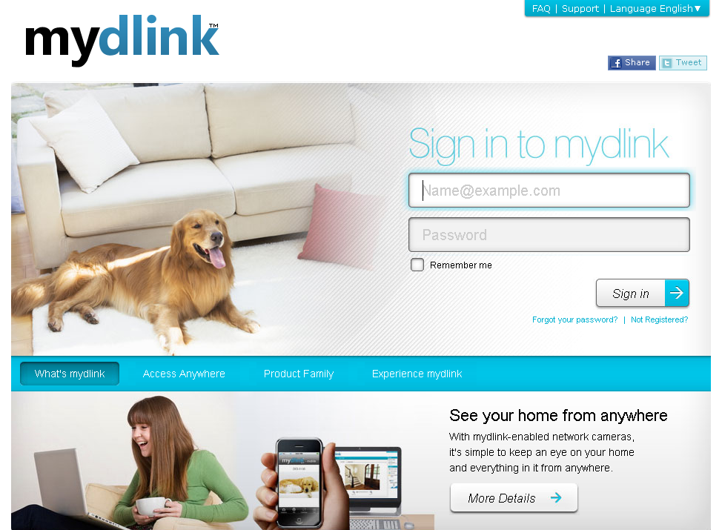
Uniqueness Highlight
mydlink service
mylink is an easy access portal for IP surveillance devices.
Login to mydlink portal only need email account.
Notes:
12

Slide 13
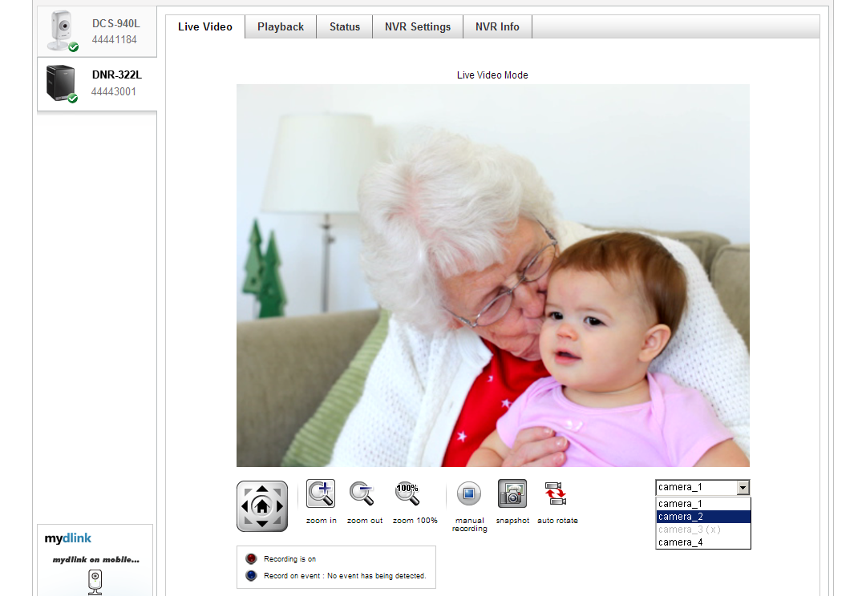
Uniqueness Highlight
mydlink service
mylink NVR supports “Live View”, “Recording”, “Playback”, “Status” and setup functions.
Single channel live view with multiple camera list and recording button.
Notes:
13

Slide 14
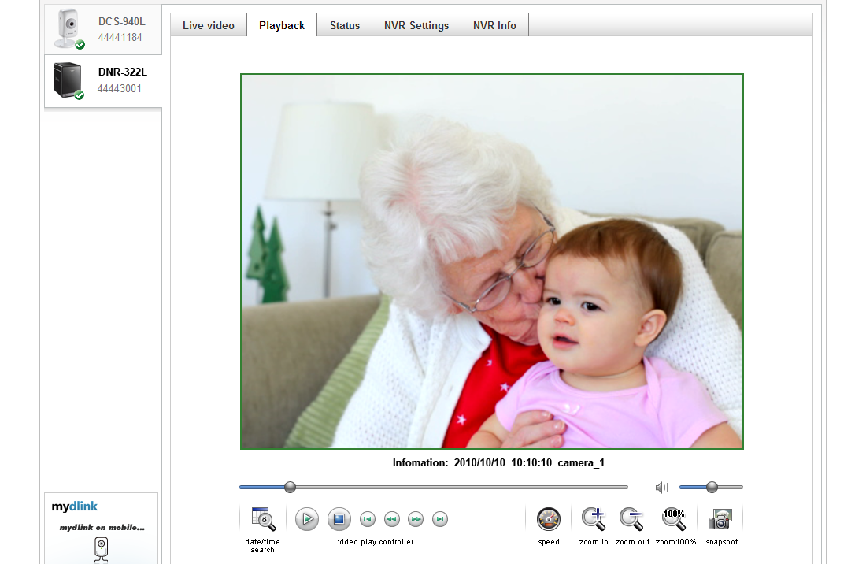
Uniqueness Highlight
mydlink service
Recording is important function of NVR and playback is another, it allows end user to find out what happened.
Single channel playback with audio and speed control.
Notes:
14

Slide 15
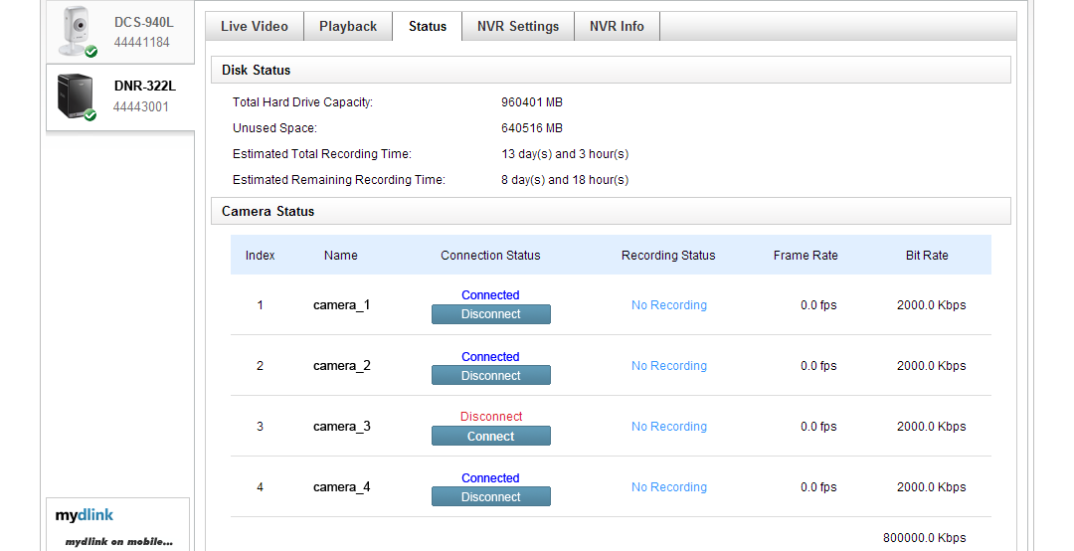
Uniqueness Highlight
mydlink service
HDD, Camera and recording status is displayed in one page.
Easy to understand the system status of NVR.
Notes:
15

Slide 16
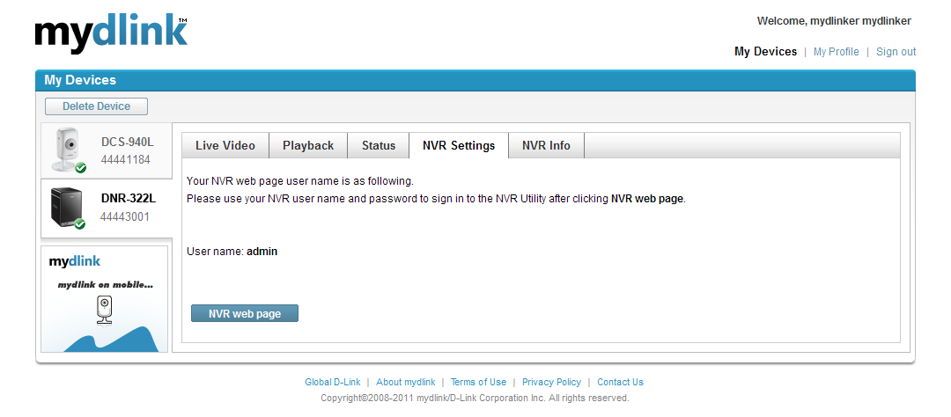
Uniqueness Highlight
mydlink service
NVR Settings allow end user connect to NVR web page to make all of advanced settings.
Notes:
16

Slide 17
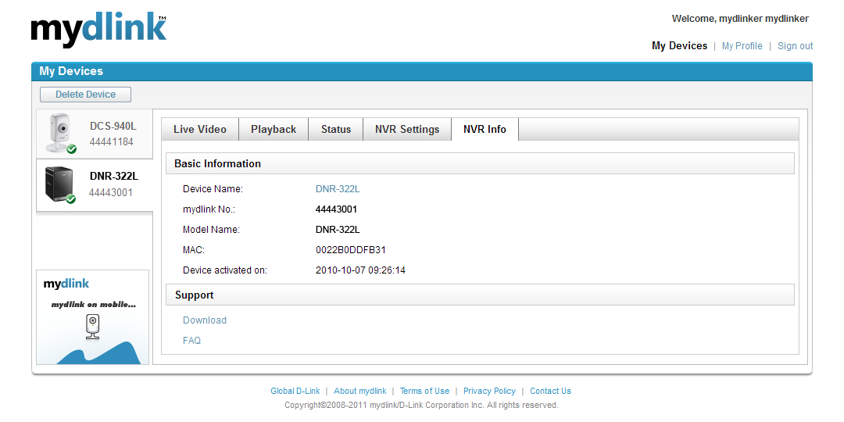
Uniqueness Highlight
mydlink service
NVR basic info and support documents are also available.
Notes:
17

Slide 18
Table of Content
Product Highlight
Positioning Overview
Target Market
Selling Point
Competition Analysis
Competition Mapping
Sell Against Competition
Uniqueness Highlight
mydlink service
Technology Brief
Product Deployment Guide
Notes:
18

Slide 19
Technology Brief
Simply the best
Total solution
Easy to use
Remote camera configuration
Full Function Recording
Various recording schedule
SD Card storage Recording auto overwrite
Remaining recording
Highly Security
Secure data
Auto boot after power recovered
Multiple user privilege control
Powerful Event management
Camera status
Flexible Event management
Event log
Easy Playback
AVI/ASF outputs
Playback speed control
Video enhancement

Slide 20
Technology Brief
Simply the best
Total solution: A standalone SATA RAID network video recorder, compact in size, 24/7 recording without a PC. Multiple network cameras management with friendly GUI. Directly access to view live video or playback recorded data through the internet from anywhere anytime.
Easy to use: Easy to search camera, setup network, view multiple cameras, record, playback and manage the events.
Remote camera configuration: NVR has clear and simple interface to load camera configuration, and setup the camera compression, resolution and frame rate from a single page for all the connected cameras.

Slide 21
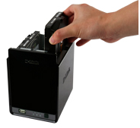
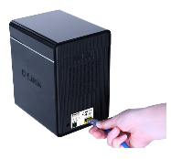
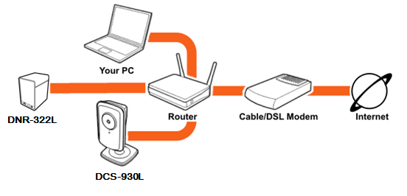
Installation Brief
From HW to Web
Step.1
Step.2
Install the HDD
Connect NVR to network
Connect IP Camera(s) to NVR
Step.3
Connect to Internet
and link to mydlink
mydlink login and live view
21
Notes:
21

Slide 22
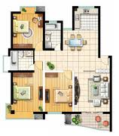
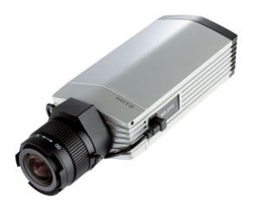
System Configuration
Home surveillance deployment example
Basic Cube
DCS-930L (11n)
DCS-932L (5M IR, 11n)
Advanced cube
DCS-2103 (HD, H.264)
DCS-2130 (HD, H.264,11n)
Outdoor IR Box
DCS-7110 (HD,H.264)
Wireless Router
DIR-300
DIR-815
Internet
Fixed Box
DCS-3715
(Full HD, H.264)
9-ch NVR Appliance
DNR-322L
22
Notes:
22

Slide 23
Technology Brief
Full Function Recording
Various recording schedule: There are many recording options for different applications, the flexible drag and drop interface is very easy to understand and yet very comprehensive. There are “always recording” and “event recording” for daily scheduling.
Recording auto overwrite: NVR has an option to overwrite the oldest data automatically when the HDD space runs out. This allows uninterrupted non-stop security recording.
Remaining recording: There is another useful function to manage recorded data. User is able to decide how many days of the recording should be kept within the HDD capacity limit. For example, if the NVR has the capacity to store 7 days of recording, if the overwrite option is on, the NVR will keep recording the 8th day and delete the 1st day when it cross to next day.

Slide 24
Multiple recording schedule
Manual recording
Schedule recording
Recording schedule is very flexible with two different type: by continuous(Red bar) and by event (Blue bar).
24
Notes:
24

Slide 25
Overwrite recording
Day 4
Day 3
Day 3
Day 3
Day 5
Day 6
Day 2
Day 2
Day 2
Day 1
Day 1
Day 1
Day 4
Day 5
Overwrite when HDD full
Store 3 days
and stop recording
Store 3 days & Overwrite
25
Notes:
25

Slide 26
Technology Brief
Highly Security
Secure data: Support RAID 1 by mirroring two SATA drives, duplicating the data in two separate drives.
Auto boot after power recovered: The NVR will boot up automatically once the power recovered after a power outage.
Multiple user privilege control: Every user can have different privileges to the live view and playback of individual cameras.

Slide 27
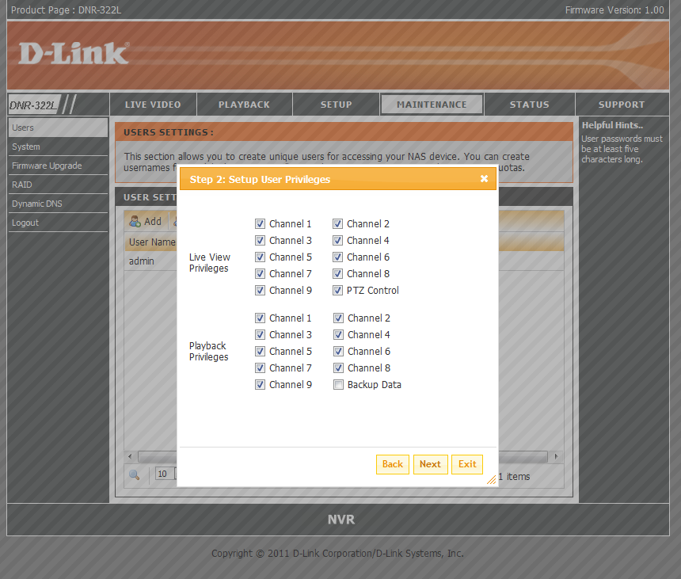
Security
Top
Manager
Security Guard
Normal User
Admin
Administrator is able to grant different privileges for different users.
27
Notes:
27

Slide 28
Technology Brief
Powerful Event management
Camera status: The camera status page will show connection, recording, frame rate and bit rate information of each camera. Meanwhile, the estimated available recording time is also displayed for quick reference.
Flexible Event management: Event setup is another key configuration of the NVR. The NVR can monitor all of the camera triggers from motion detection. The NVR controls email and recording of all the connected cameras. For example, camera 1 detects motion, the NVR can trigger camera 1 and 2 to record at the same time.
Event log: With the simple event log, the log pages are organized by date for easy look up.

Slide 29
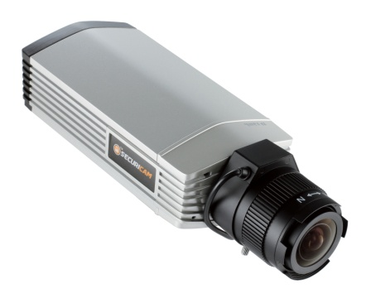
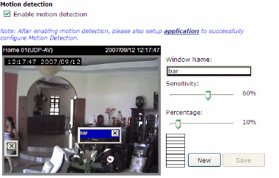
Powerful event alarm
Alarm trigger from motion detection, HDD full
Camera motion detection
HDD full
Day 4
Day 3
Day 2
Day 1
29
Notes:
29

Slide 30
Useful Event action
Recording by event and send E-mail
Recording
with
Specify camera
Send E-mail
30
Notes:
30

Slide 31
Technology Brief
Easy Playback
AVI/ASF outputs: During playback, if user find something important that need to be exported, AVI and ASF files are selectable for the video evidence.
Playback speed control: Up to 16x speed fast forward or fast backward play.
Video enhancement: Users can adjust the recorded video to get enhanced output for brightness, sharpness…etc. This can apply to playback viewing, snapshots or prints.

Slide 32
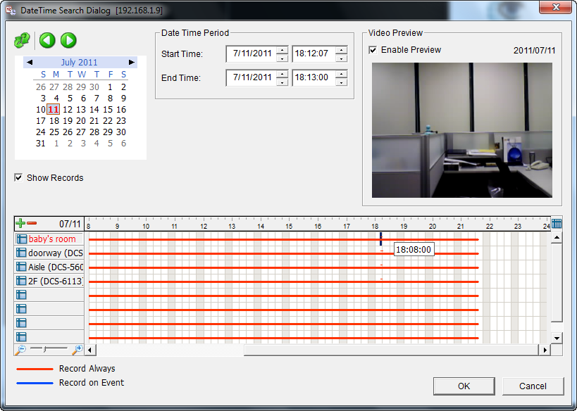
Playback preview
Calendar view
Preview before you decide to playback.
Show recording schedule and actual record in the timeline bar.
32
Notes:
32

Slide 33
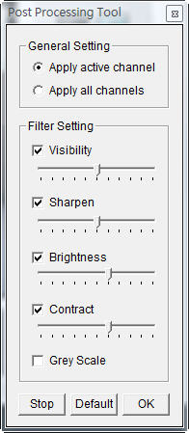
Playback GUI
Full functional operation GUI
Flexible playback control, video adjustment and export video.
33
Notes:
33

Slide 34
Table of Content
Product Highlight
Positioning Overview
Target Market
Selling Point
Competition Analysis
Competition Mapping
Sell Against Competition
Uniqueness Highlight
mydlink service
Technology Brief
Product Deployment Guide
Notes:
34

Slide 35
Product Deployment Guide
Application Example
Internet
Speed Dome
DCS-6815 (18x)
DCS-6817 (30x)
DCS-6818 (36x)
Basic Cube
DCS-930L (11n)
DCS-932L (5M IR, 11n)
Baby Care
Home security
Outdoor IR Box
DCS-7110 (HD,H.264)
Wireless Router
DIR-300
DIR-815
Perimeter security
Pet monitor
Fixed Box
DCS-3715
(Full HD, H.264)
Advanced cube
DCS-2103 (HD, H.264)
DCS-2130 (HD, H.264,11n)
9-ch NVR Appliance
DNR-322L
Activity monitor
Elder Care
Notes:
35

Slide 36
Safe Harbor Statement
The following is intended to outline our general product direction. It is intended for information purposes only, and may not be incorporated into any contract. It is not a commitment to deliver any material, code, or functionality, and should not be relied upon in making purchasing decisions. The development, release, and timing of features or functionality described for D-Link products remains at the sole discretion of D-Link.
Unpublished Work of D-Link Corp. All Rights Reserved.
This work is an unpublished work and contains confidential, proprietary, and trade secret information of D-Link Corp. Access to this work is restricted to D-Link employees who have a need to know to perform tasks within the scope of their assignments. No part of this work may be practiced, performed, copied, distributed, revised, modified, translated, abridged, condensed, expanded, collected, or adapted without the prior written consent of D-Link Corp. Any use or exploitation of this work without authorization could subject the perpetrator to criminal and civil liability.
General Disclaimer
This document is not to be construed as a promise by any participating company to develop, deliver, or market a product. D-Link Corp., makes no representations or warranties with respect to the contents of this document, and specifically disclaims any express or implied warranties of merchantability or fitness for any particular purpose. Further, D-Link Corp., reserves the right to revise this document and to make changes to its content, at any time, without obligation to notify any person or entity of such revisions or changes. All D-Link marks referenced in this presentation are trademarks or registered trademarks of D-Link Corp. in the Taiwan and other countries. All third-party trademarks and images are the property of their respective owners.

