Slide 1
DIR-890L
Wireless AC3200 (TBD)
Sales Guide
Sales Guide V1.00
WRPD
Aug, 2014
D-Link HQ

Slide 2
AGENDA
Product Introduction
Product Position and Target Markets
Selling Points
Competitor Analysis

Slide 3
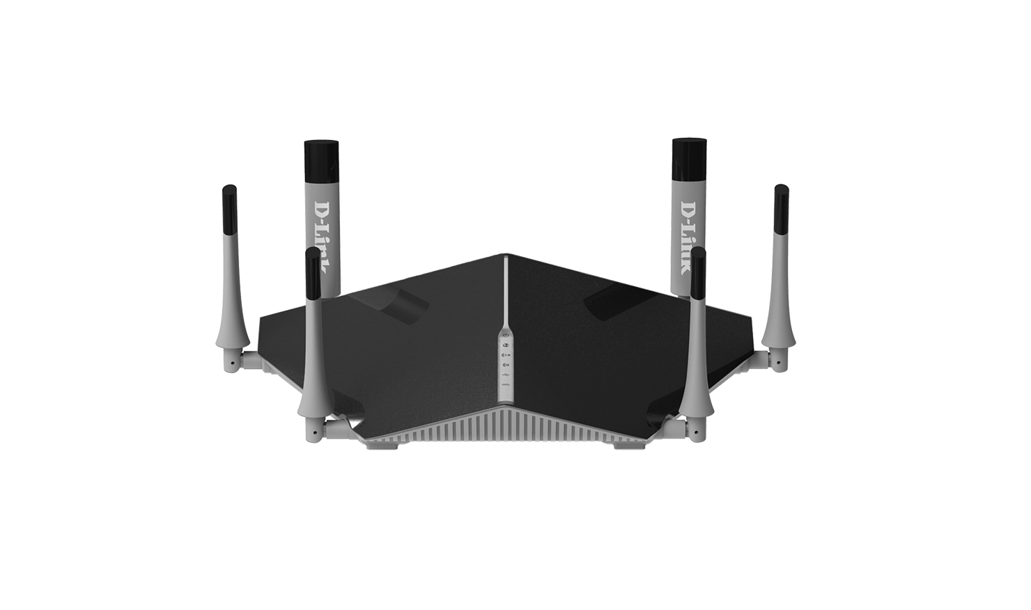
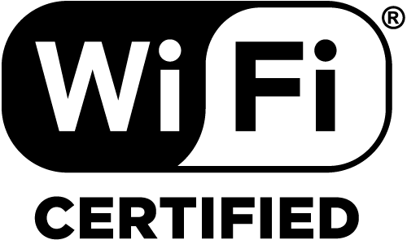
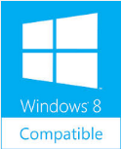
DIR-890L
Easy setup, QRS Mobile app
USB 3.0 + USB 2.0, mydlink SharePort & DLNA for excellent media sharing experience.
Smart Connect: Optimize Wi-Fi Connection & Performance
High Performance: 1 GHz ARM® Cortex™-A9 dual-core CPU
Best coverage: “AC Beamforming” to expand wireless coverage
QuickVPN Server: Securing Remote Access from Anywhere
Six AC streaming: MIMO with concurrent Tri-band, up to 3200Mbps

Slide 4
Product Feature
IEEE 802.11ac and Tri Band– High Transfer Rate
Two 5GHz plus one 2.4GHz radios upto 3200Mbps bandwidth.
Universal Serial Bus 3.0 – SuperSpeed
Latest revision of the USB standard
Operate at 5Gbps speed.
Easy Setup
Brand new Web-Based Setup Wizard
QRS APP support easy installation by iOS and Android devices
Easy Share
mydlink SharePortTM Mobile APP supports file sharing/access by iOS and Android devices
Easy management
mydlinkTM cloud service for web remote management
mydlinkTM Lite APP support remote management by iOS and Android devices

Slide 5
Product Position & Target Markets
Product Position
Ultimate Performance and Reliable Home Networking
Smooth Streaming with Tri-Band Wireless AC
Easy to Set Up and Use
Designed for Optimal Wireless Coverage
SuperSpeed USB for mydlink Content Sharing Right at Your Fingertips
Use mydlink to Monitor Your Network
Target Markets
Digital Video and Audio Home Users
who request extremely fast and reliable wireless streaming
who wants a best performance and fastest media contents sharing

Slide 6
Selling Points

Slide 7
Wireless AC3200
Double performance
Greater network bandwidth
-- Additional 5GHz connectivity provides Dedicated/Double high-speed bandwidth
High-speed Wireless AC
-- Stream HD multimedia across your home without interruption using the fastest wireless connectivity technology available today
Wi-Fi 11n Client 2x2
Browsing Website
Wi-Fi 11g Client 1x1
2.4G Band
Wi-Fi 11n Client 2x2
5G Band 1
Wi-Fi 11ac Client 3X3
Streaming VHD Video
Wi-Fi 11ac Client 3X3
Wi-Fi 11ac Client 3X3
Wi-Fi 11ac Client 2x2
Download Files
Wi-Fi 11ac Client 1x1
3 Concurrent Radio bands
Wi-Fi 11ac Client 2x2
5G Band 4

Slide 8
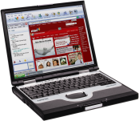
D-Link Smart Connect
D-Link Smart Connect Technology
Easy Wi-Fi Connect: Single Home Network, one SSID and security key for all.
Prevents older legacy devices from affecting optimal performance
SSID: SuperPower
5G band 1
5G band 4

Slide 9
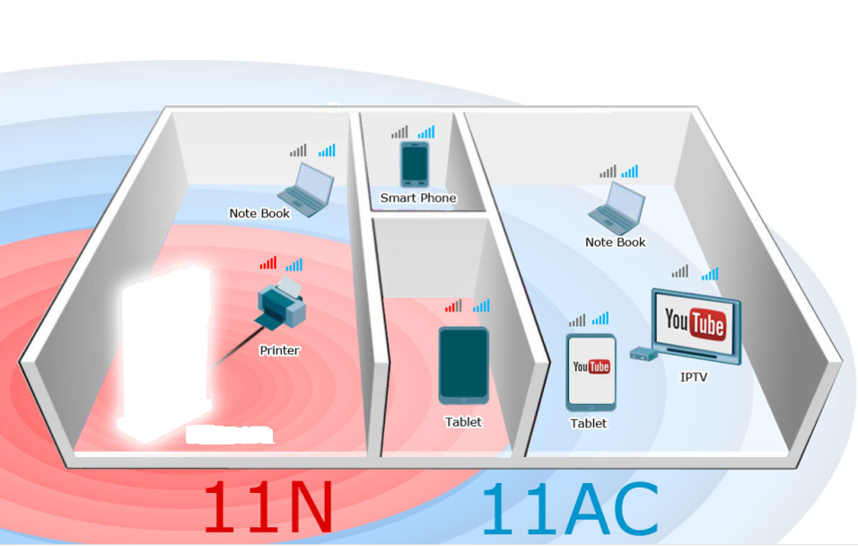
Advanced AC SmartBeam
Supports AC SmartBeam for whole home coverage
Dramatically enhances wireless signal strength and throughput
Advanced legacy enhance
Enhance coverage for 802.11n and legacy b/g device also

Slide 10
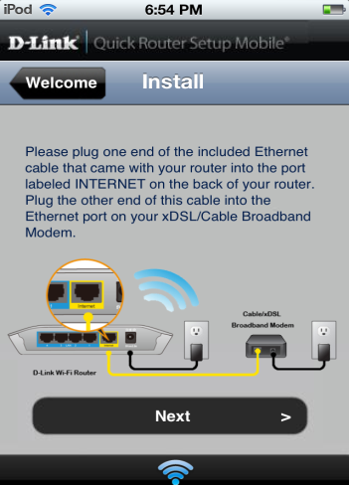
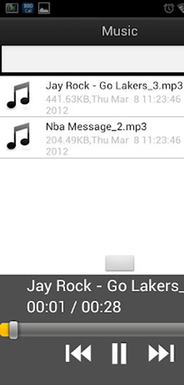
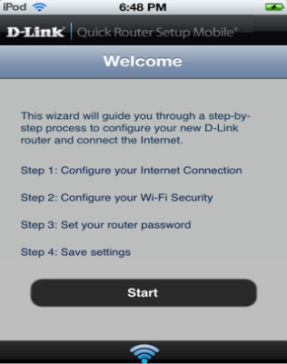
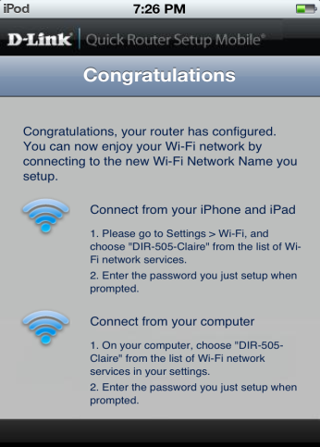
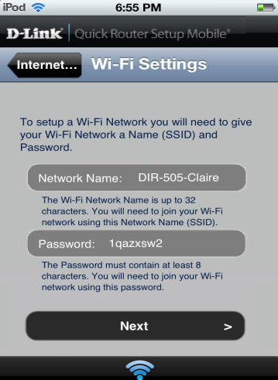
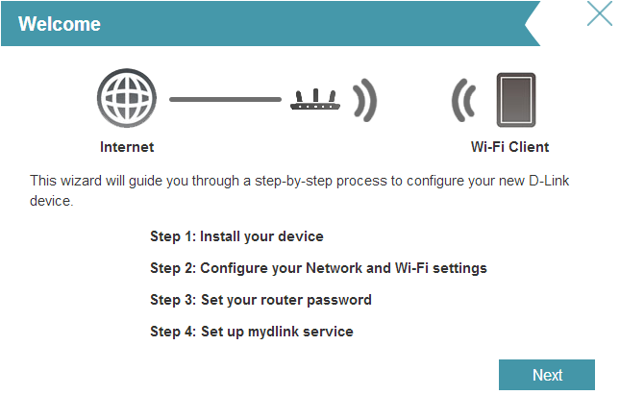
Easy Setup
QRS Mobile
Download from App Store or Google Play to setup
Web-Based Setup Wizard
Easy setup includes mydlink registration through web browser

Slide 11
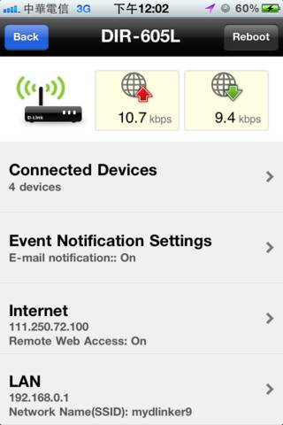
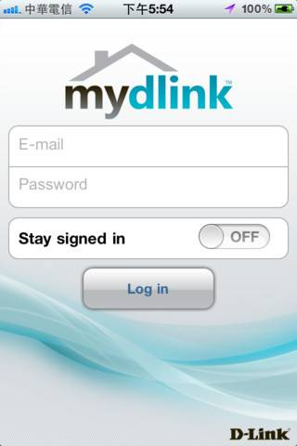
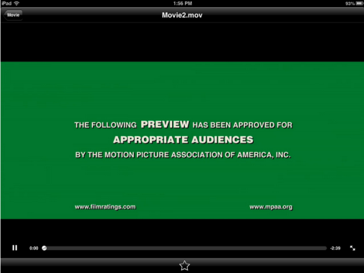
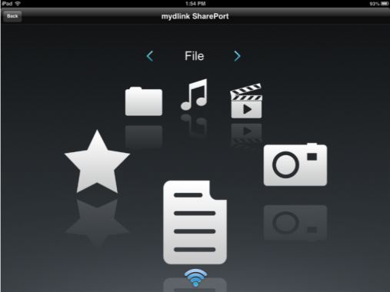
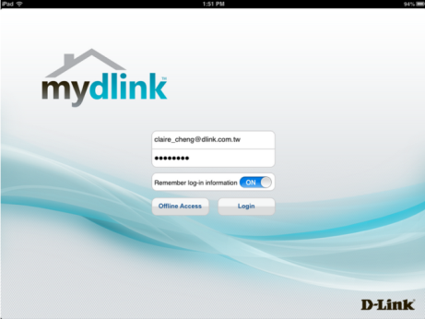
mydlink Cloud Service
D-Link Cloud service offer consumers a better way to access, view, control and share all elements of your router anytime, anywhere.
Cloud management by mydlinkTM Lite
Block intruder while you’re not at home
Get instant intrusion E-mail alert.
Monitor the activity of clients browsing
Cloud Sharing by mydlink SharePortTM
Share your files on USB drive
Get instant music of your own.
View and Upload your photo anywhere.
mydlink Lite APP
mydlink SharePort

Slide 12
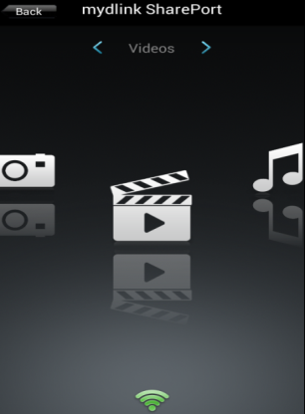
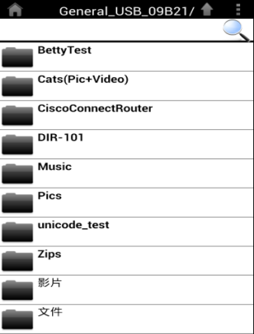
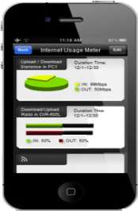
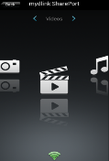
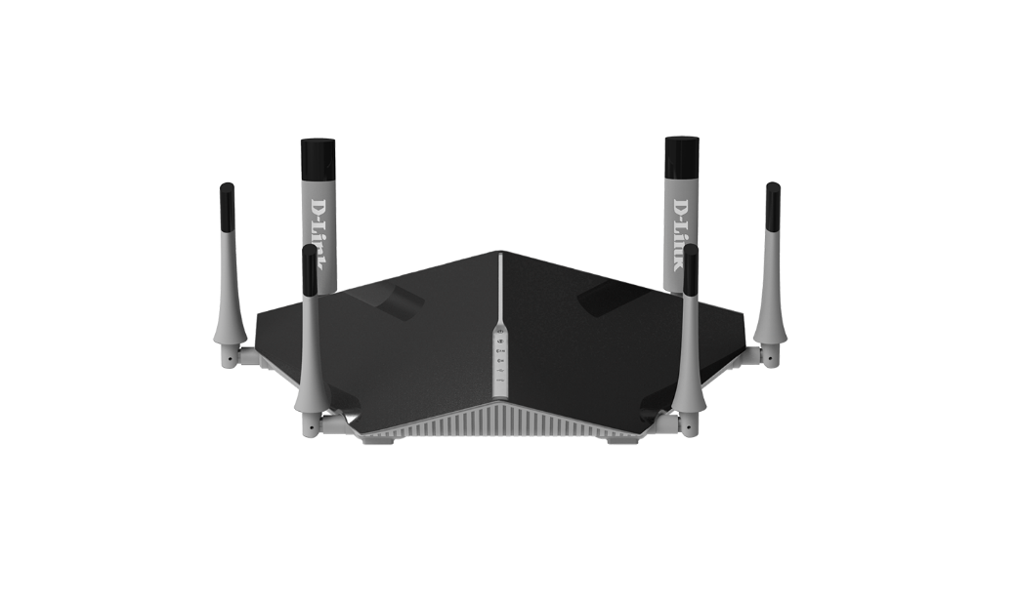
mydlink SharePort™
Easily access USB storage/HD
Sharing your files everywhere
Remote
Local
Internet

Slide 13
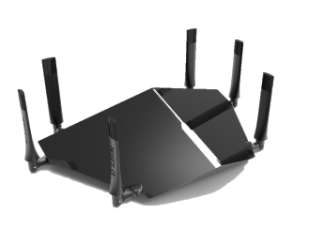
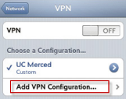
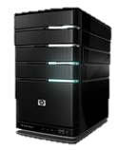
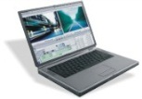
QuickVPN
Easy and secured Remote Access Home network resource from Everywhere!
Secured Internet access by Home network, while travel around global.
Zero Configuration for iOS: Download configuration from management UI and get connected!
VPN Tunnel
Internet
User
Zero Configuration for iOS

Slide 14
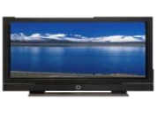
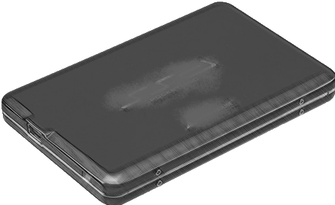
UPnP AV Media Server (DLNA / iTunes)
You can share all the music, movies, photos and videos in USB/NAS to the media platforms in different locations.
ROOM 3
Top Floor
ROOM 4
Top Floor
LCD TV
Digital Frame
ROOM 1
ROOM 2
Bottom Floor
Bottom Floor
DIR-890L
Music Player
USD Drive

Slide 15
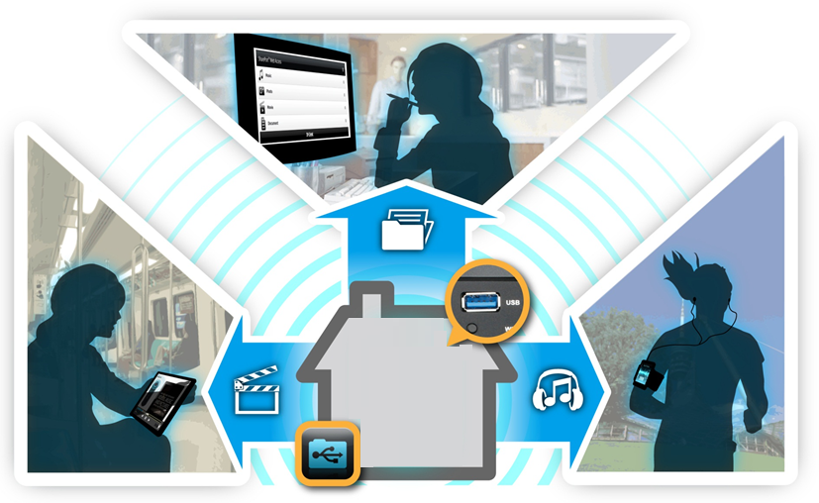
USB 3.0 - SuperSpeed
Music
Photo
Movie
Connect to USB 3.0 storage drive, and access your files with any devices connected to the router instantly
*In some cases, USB 3.0 may interfere with 2.4 GHz Wi-Fi performance.

