Slide 1
DIR-868L
Wireless AC1750 Dual Band Gigabit Cloud Router USB 3.0
Sales Guide
Sales Guide V1.00
WRPD
Jan, 2013
D-Link HQ

Slide 2
AGENDA
Product Introduction
Product Position and Target Markets
Selling Points
Competitor Analysis

Slide 3
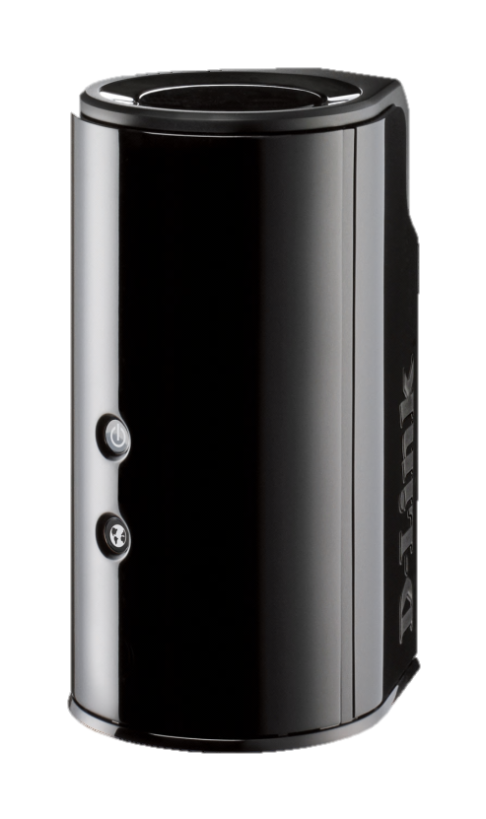
Product Introduction
New Wi-Fi draft IEEE 802.11ac, compatible with IEEE 802.11a/b/g/n
3x3(2.4G)+3x3(5G) MIMO with concurrent dual-band to 1750Mbps
SharePortTM mobile APP support file sharing and access
Media server support DLNA and work with iTunes
Easy setup : QRS Mobile APP and Web-Based Setup Wizard
mydlink Cloud management service
USB 3.0 for SuperSpeed file transfer
*In some cases, USB 3.0 may interfere with 2.4 GHz Wi-Fi performance. A software update will be provided soon.

Slide 4
Product Feature
IEEE 802.11ac – High Transfer Rate
Next-generation Wi-Fi specification for optimal speed and range
The 3x3 5GHz PHY rate can reach to 1300Mbps
Universal Serial Bus 3.0 – SuperSpeed
Latest revision of the USB standard
Operate at 5Gbps speed.
Easy Setup
Web-Based Setup Wizard
QRS APP support easy installation by iOS and Android devices
Easy Share
SharePortTM Plus supports USB printer for PC and Mac
SharePort Web Access supports USB file sharing
SharePortTM Mobile APP supports file sharing/access by iOS and Android devices
Easy management
mydlinkTM cloud service for web remote management
mydlinkTM Lite APP support remote management by iOS and Android devices

Slide 5
Product Position & Target Markets
Product Position
Fast and Reliable Home Networking
Smooth Streaming with Wireless AC
Easy to Set Up and Use
Designed for Optimal Wireless Coverage
SuperSpeed USB Contents Sharing Right at Your Fingertips
Use mydlink to Monitor Your Network
Target Markets
Digital Video and Audio Home Users
who request fast and reliable wireless streaming
who wants a better performance and fast media contents sharing

Slide 6
Selling Points

Slide 7
IEEE 802.11ac Introduction
IEEE 802.11ac is the latest Wi-Fi standard operated in 5GHz. This next (5th) generation technology have best speed, capacity, coverage and battery life than 802.11n.
Expected PHY rate up to 1300Mbps(80MHz, 3 spatial streams and 256 QAM 5/6).
Enhances Wi-Fi for whole-home video distribution, lightly compressed wireless display, high speed synchronization.
802.11ac standard with the Wi-Fi Alliance certification program planned for 2012. (IEEE 802.11ac finalization is anticipated in late 2012, with final 802.11 Working Group approval in late 2013.)

Slide 8
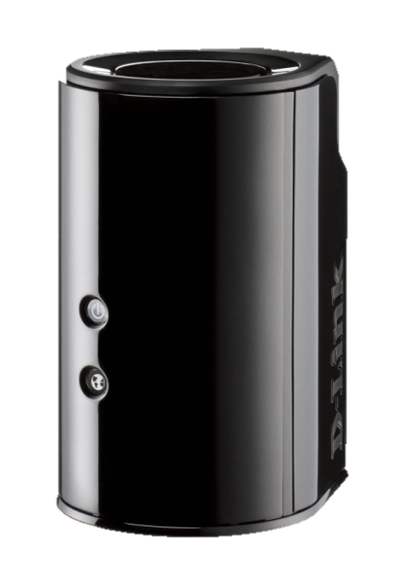
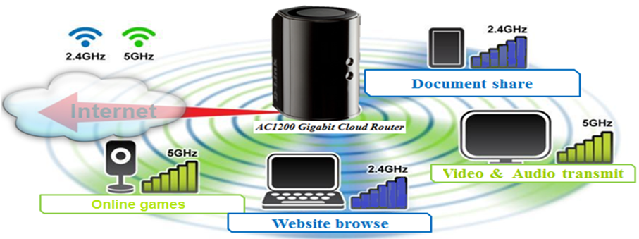
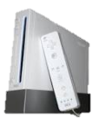
Simultaneous application by 2.4G+5Ghz
Four times wider network bandwidth
-- Using 5G low interference frequency to access real-time HD streaming or paly games
Ultra-speed 5G 11ac
-- More faster throughput than original 5G 11a/n to get stable video quality
DIR-868L

Slide 9
DIR-868L : 11ac (3x3) Actual Throughput
Test result in Shielding Room
＊Internal test data
Mbps

Slide 10
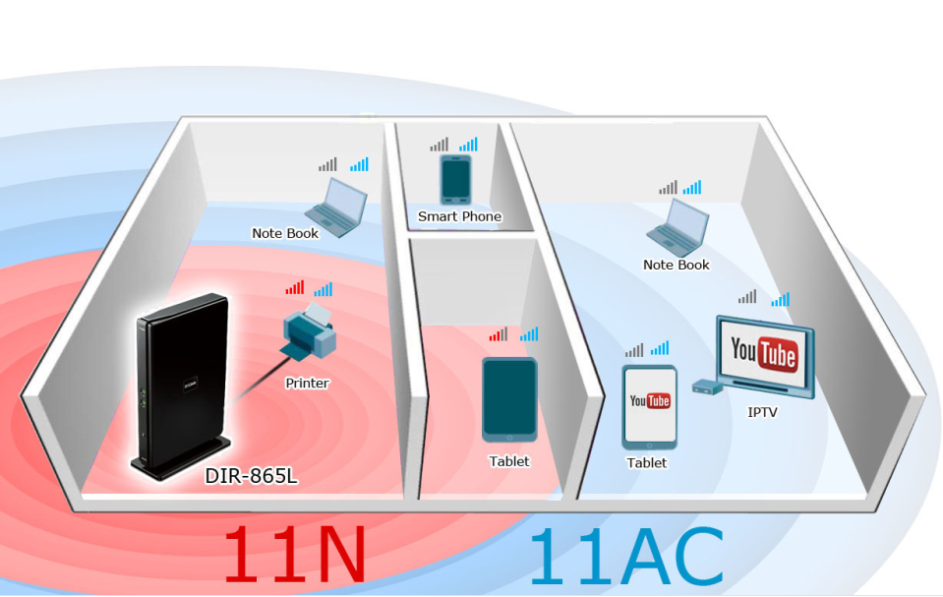
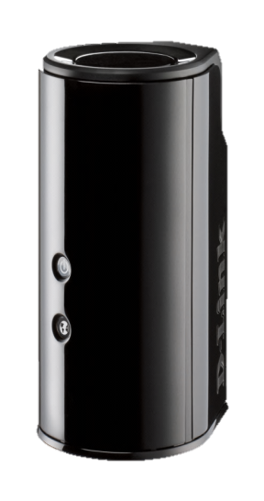
Expanding coverage
For whole Home coverage
Optimal antenna placement --- No dead space
High power amplifier --- Enhance signal to noise ratio on receiver
DIR-868L

Slide 11
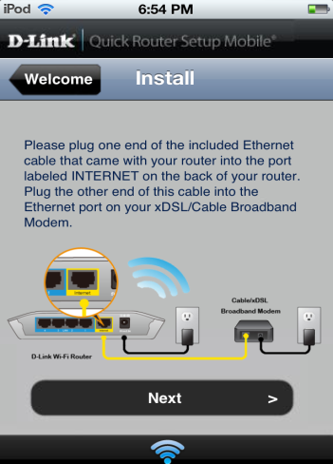
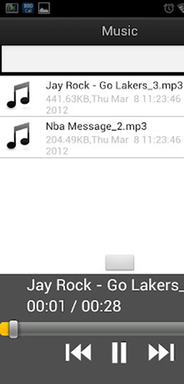
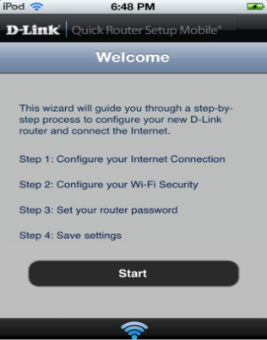
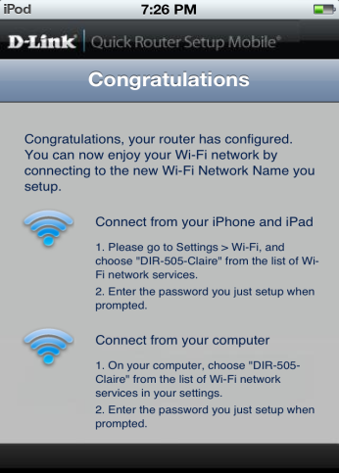
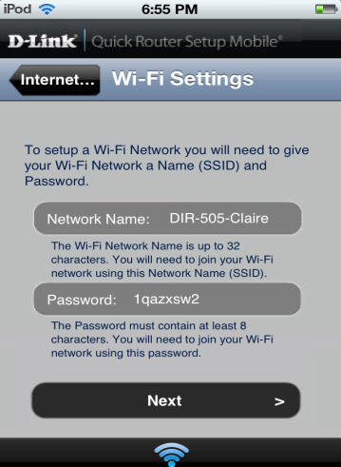
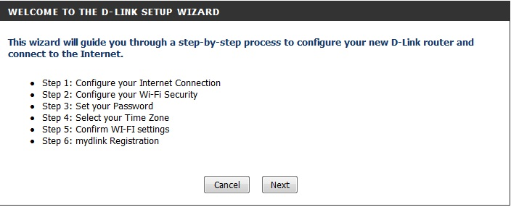
Easy Setup
QRS Mobile
Download from App Store or Google Play to setup
Web-Based Setup Wizard
Easy setup includes mydlink registration through web browser

Slide 12
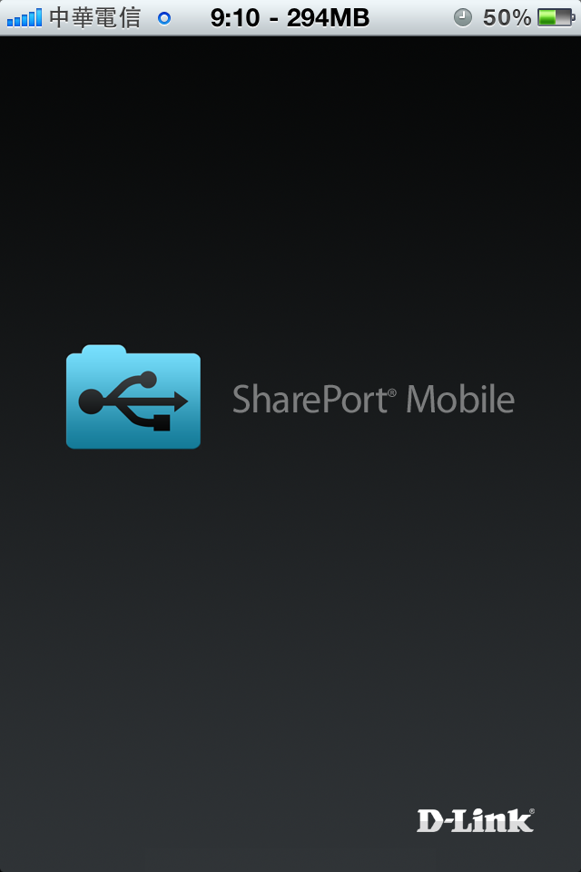
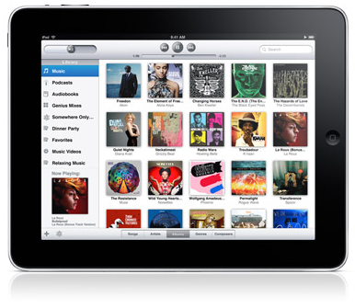
D-Link SharePortTM Mobile
Now you can easily connect to USB storage drive, and share your files with any devices connected to the router.

Slide 13
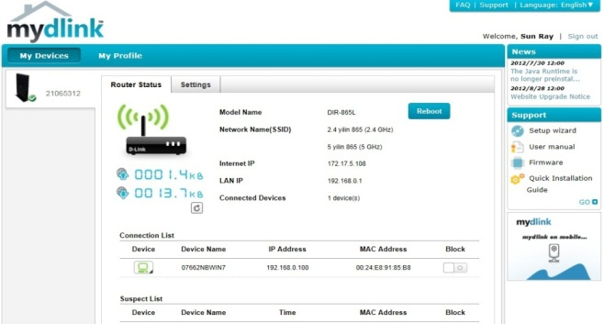
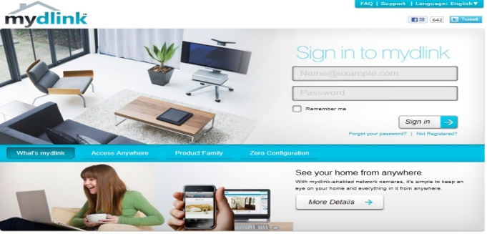
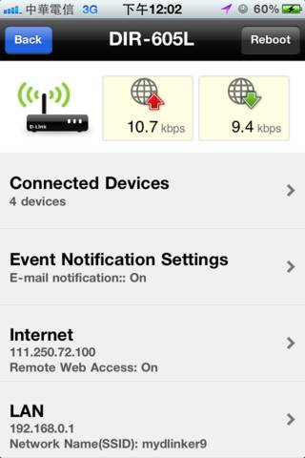
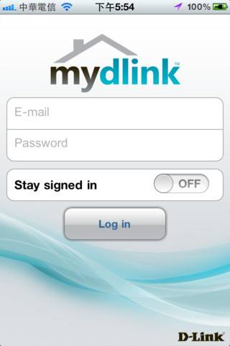
mydlink Management Cloud Service
D-Link Cloud service offer consumers a better way to access, view, and control all elements of your router anytime, anywhere.
Cloud management
Manage router anywhere anytime by mydlinkTM Lite
Block intruder while you’re not at home
Get instant intrusion E-mail alert.
Cloud Monitor
Monitor the activity of clients browsing
Detect network quality(Downlink & Uplink)
mydlink Web portal
mydlink Lite APP

Slide 14
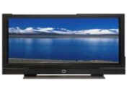
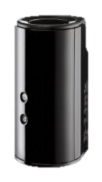
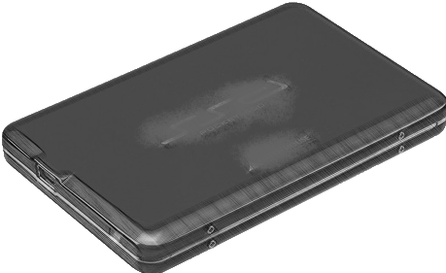
UPnP AV Media Server (DLNA / iTunes)
You can share all the music, movies, photos and videos in USB/NAS to the media platforms in different locations.
ROOM 3
Top Floor
ROOM 4
Top Floor
LCD TV
Digital Frame
ROOM 1
ROOM 2
Bottom Floor
Bottom Floor
DIR-868L
Music Player
USD Drive

Slide 15
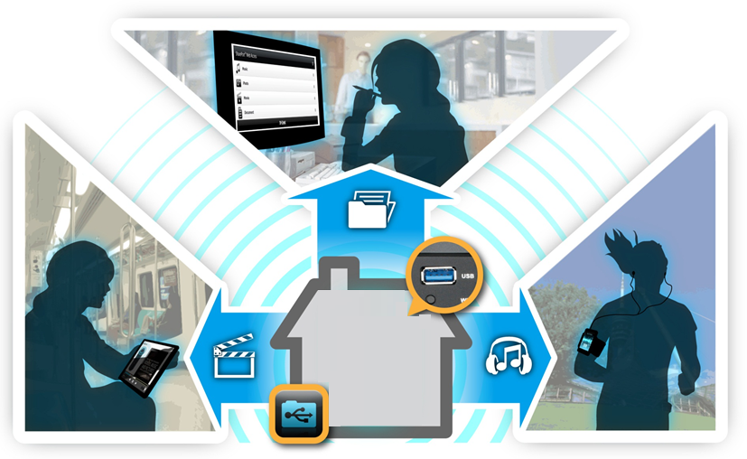
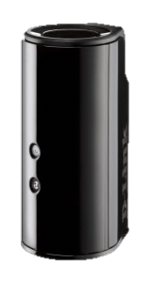
USB 3.0 - SuperSpeed
Music
Photo
Movie
Connect to USB 3.0 storage drive, and access your files with any devices connected to the router instantly
*In some cases, USB 3.0 may interfere with 2.4 GHz Wi-Fi performance. A software update will be provided soon.

Slide 16
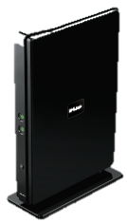
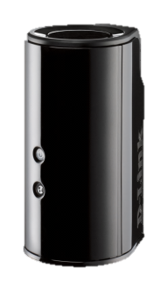
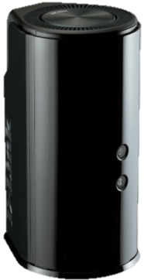
Product Position
High
Level
DIR-865L AC 1750 Dual Band cloud router
DIR-868L wireless gigabit AC 1750
Support 802.11a/b/g/n/draft-ac technology
2.4G(3x3)/5GHz(3x3) up to 1750Mbps
Video streaming, QoS
Support DLNA, iTune service
Shareport mobile/ QRS mobile
mydlink management
USB 2.0
Support 802.11a/b/g/n/draft-ac technology
2.4G(3x3)/5GHz(3x3) up to 1750Mbps
High performance by new fabrication
High amplifier to expand coverage
Support DLNA, iTune service
Shareport mobile/ QRS mobile
mydlink management
USB 3.0
Coverage
NEW
DIR-860L con-current dual-band
Support 802.11a/b/g/n/draft-ac technology
2.4G(2x2)+5G(2x2) up to 1200Mbps
Internal antenna
Shareport™ Plus
Shareport™ Mobile
Support DLNA, iTune service
QRS mobile pro
mydlink cloud service
USB3.0
Wireless Throughput
Middle
Level
High

