Slide 1
DIR-850L Wireless AC1200 Dual Band Gigabit Cloud Router
Sales Guide v1.00
D-LINK HQ –Yilin Chen
Dec 3th, 2012

Slide 2
Agenda
Product Introduction
Product Feature
Selling Point
Competitive Analysis

Slide 3
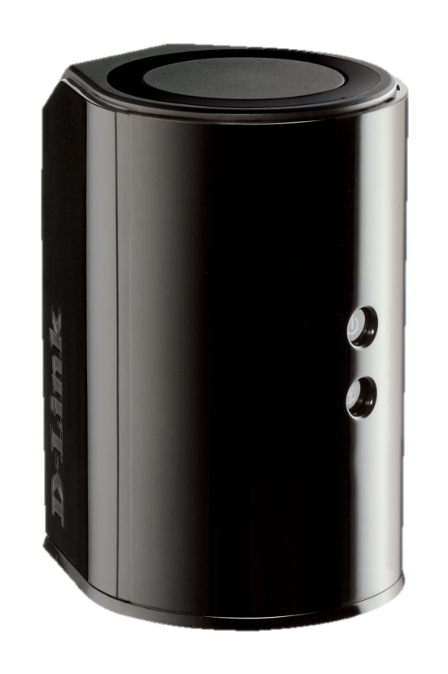
Product Introduction
New Wi-Fi draft IEEE 802.11ac, compatible with IEEE 802.11a/b/g/n
2x2(2.4G)+2x2(5G) MIMO with concurrent dual- band PHY rate up to 1200Mbps
Media server support DLNA and work with iTunes
Easy setup : QRS Mobile APP and Web-Based Setup Wizard
mydlink Cloud management service
ShareportTM mobile APP support file sharing and access
Next - generation Wi-Fi

Slide 4
Product Feature
IEEE 802.11ac High Transfer Rate
Next-generation Wi-Fi specification for optimal speed and range
The 2x2 5GHz PHY rate can reach to 866Mbps
Easy Setup
Web-Based Setup Wizard
QRS APP support easy installation by iOS and Android devices
Easy Share
SharePortTM Plus support USB printer for PC and Mac
SharePort Web file Access support USB file sharing
SharePortTM Mobile APP support file sharing/access by iOS and Android devices
Easy management
mydlink cloud service for remote management
mydlinkTM Lite APP support remote management by iOS and Android devices

Slide 5
Selling Point

Slide 6
IEEE 802.11ac Introduction
IEEE 802.11ac is the latest standard operated in 5GHz. This next (5th) generation technology have best speed, capacity, coverage and battery life than 802.11n.
Expected PHY rate up to 866Mbps(80MHz, 2 spatial streams and 256 QAM 5/6).
Enhances Wi-Fi for whole-home video distribution, lightly compressed wireless display, high speed synchronization.
802.11ac standard with the Wi-Fi Alliance certification program planned for2012. (IEEE 802.11ac finalization is anticipated in late 2012, with final 802.11 Working Group approval in late 2013.)

Slide 7
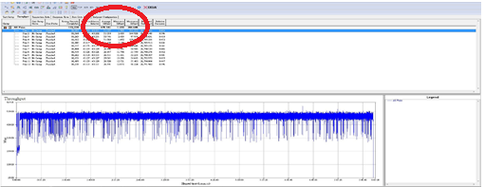
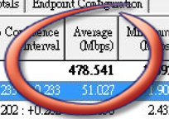
DIR-850L : 11ac Actual Throughput
Test result in Shielding Room
Mbps

Slide 8
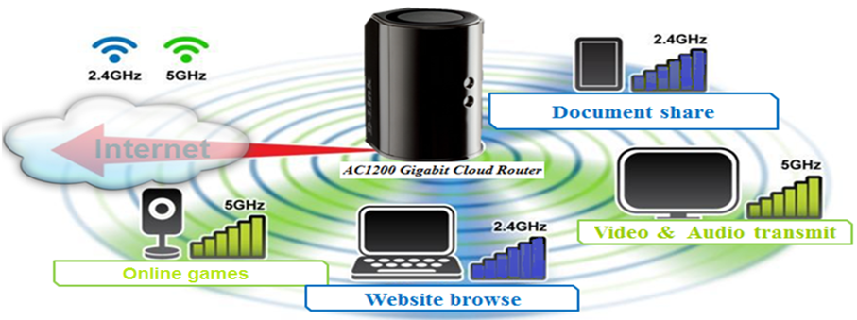
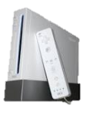
Simultaneous application by 2.4G+5Ghz
Double your network bandwidth
-- Using 5G low interference frequency to access real-time HD streaming or paly games
Ultra-speed 5G 11ac
-- More faster throughput than original 5G 11a/n to get stable video quality

Slide 9
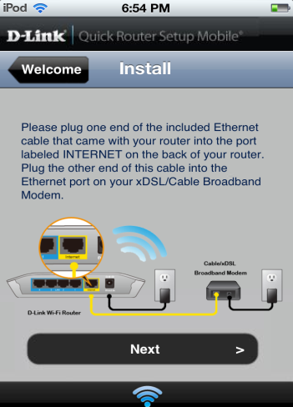
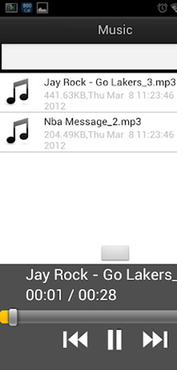
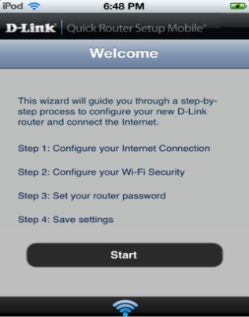
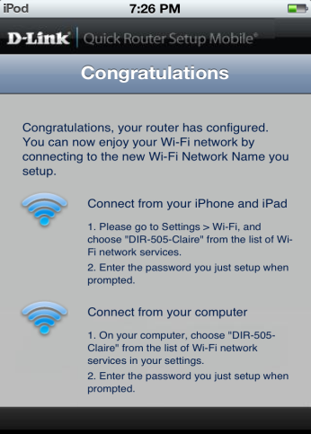
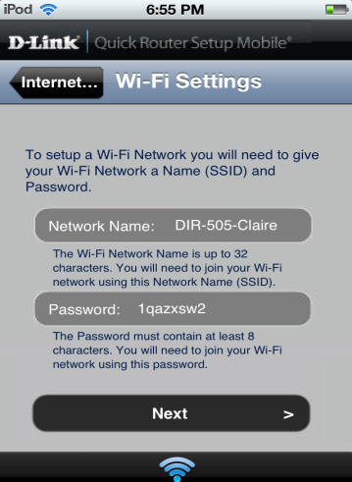
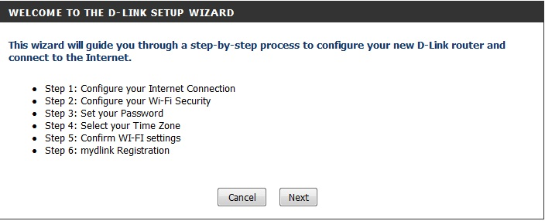
Easy Setup
QRS Mobile
Download from App Store or Google Play to setup
Web-Based Setup Wizard
Easy setup includes mydlink registration through web browser

Slide 10
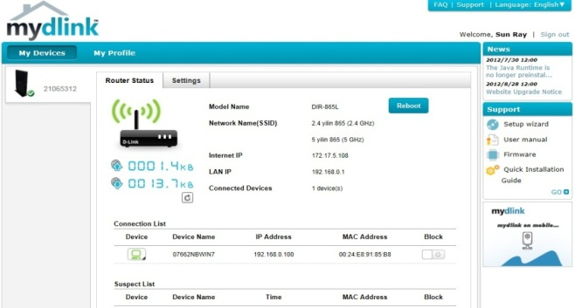
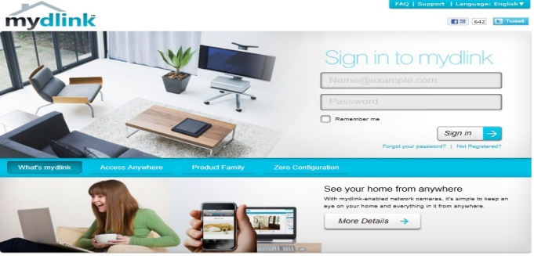
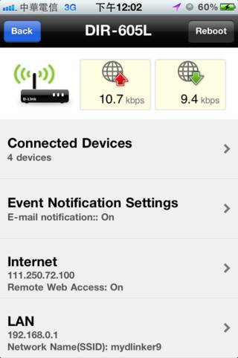
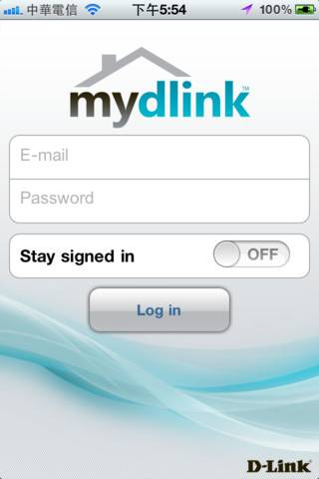
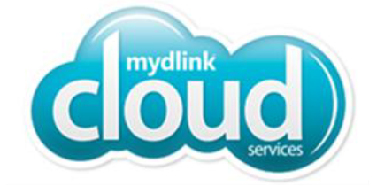
mydlink Management Cloud Service
D-Link Cloud service offer consumers a better way to access, view, and control all elements of your router anytime, anywhere.
Cloud management
Manage router anywhere anytime by mydlinkTM Lite
Block intruder while you’re not at home
Get instant intrusion E-mail alert.
Cloud Monitor
Monitor the activity of clients browsing
Detect network quality(Downlink & Uplink)
mydlink Web portal
mydlink Lite APP

Slide 11
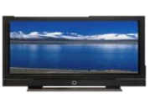
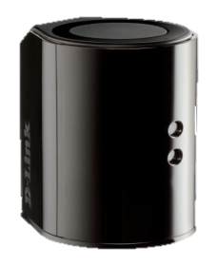
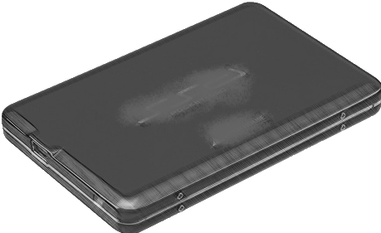
UPnP AV Media Server (DLNA / iTunes)
You can share all the music, movies, photos and videos in USB/NAS to the media platforms in different locations.
ROOM 3
Top Floor
ROOM 4
Top Floor
LCD TV
Digital Frame
ROOM 1
ROOM 2
Bottom Floor
Bottom Floor
DIR-850L
Music Player
USD Drive
Notes:
* DLNA functionality, not get logo yet.

Slide 12
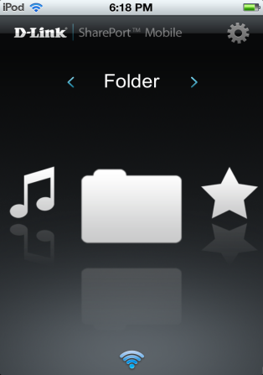
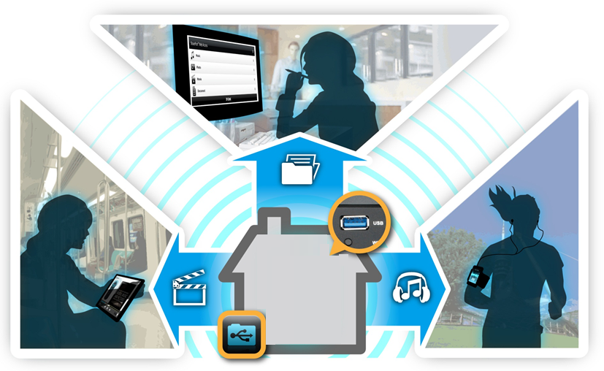
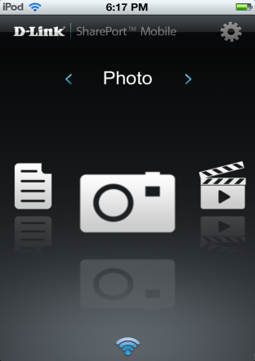
Easy Access & Easy Sharing
Folder
Music
Photo
Movie
My Favor-ite
Easily connect to USB storage drive, and access your files with any devices connected to the router

