Slide 1
DIR-657
HD Media Router 1000
Sales Guide
Wireless & Router Product Div.
Feb 2011
D-Link WRPD

Slide 2

Agenda
The Design
The Market (Product Position and Target Market)
Selling Points
Competitive Advantages
(The Specification and Competitors Comparison Table)

Slide 3
The Design

Slide 4
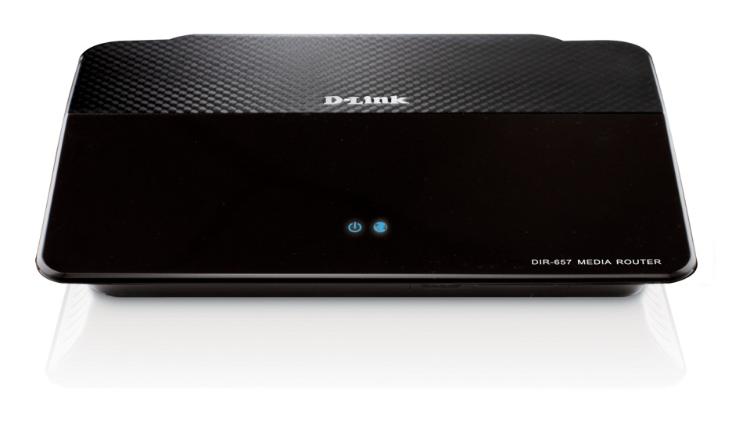
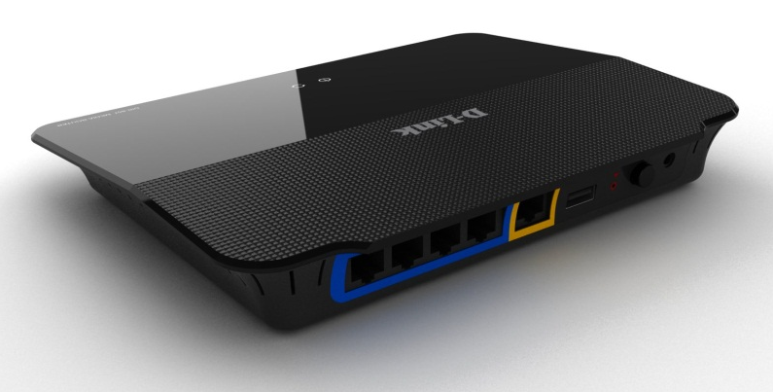
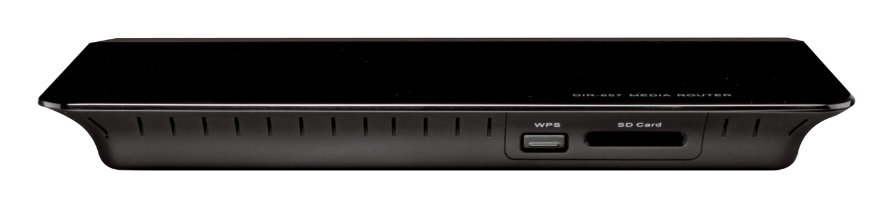
The First Router Designed For Your Homes
DIR-657
HD Media Router 1000

Slide 5
The Market

Slide 6

Product Position & Target Markets
Product Position
  DIR-657 is a guarantee wireless streaming for video quality from a media source to a digital media player or TV within the home network device.
  Deliver file sharing and backup through the network.*
Target Markets
  SOHO Network Users who require easy-to-user wireless network setup, reliable network security.
  Family Home Users who want to a better performance to share media streaming files.
Notes:
Phase Ⅱ support Web File Access Feature.
Web File Access allows you to use a web browser to remotely access files stored on an SD card or USB storage drive plugged into the router.

Slide 7





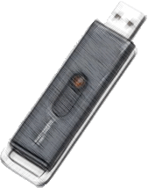

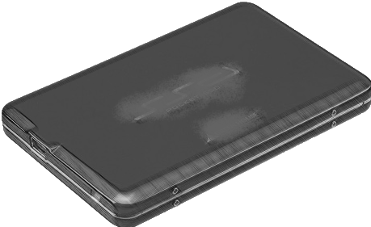

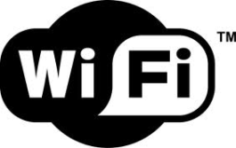

DIR-657 HD Media Router 1000
Best router for online media streaming
Industry leading feature sets optimized for media sharing
DIR-657
UPnP AV Server
Aiming different levels in security protection, easy of use and quality
Dual 300 Mbps
Wi-PnP
Notes:
Wi-PnP: Router will generate wireless configuration (on USB thumb drive) for PC setup

Slide 8
Selling Points

Slide 9






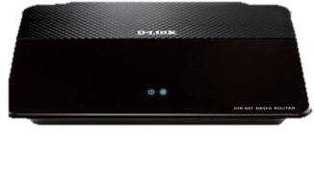

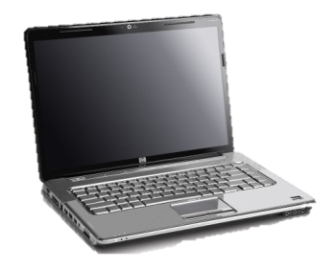
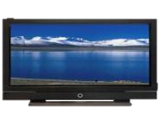


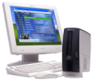
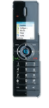

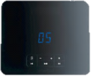

QoS Engine 2 provides optimized for media sharing
QoS Engine 2 manages the bandwidth mismatch and does automatic traffic shaping by allowing higher priority traffic to have preference of the bandwidth.
VOIP
Traffic Type | Adaptive QoS
VOIP | Highest
Online Gaming | High
Video Streaming | High
Web Browsing | Medium
P2P File Sharing | Lowest
WAN DSL Service < 2Mbps
DIR-657
VOIP
Web Browsing
Online Gaming
Video Streaming
P2P File Sharing
VOIP
LAN/WLAN 100 - 1000Mbps

Slide 10
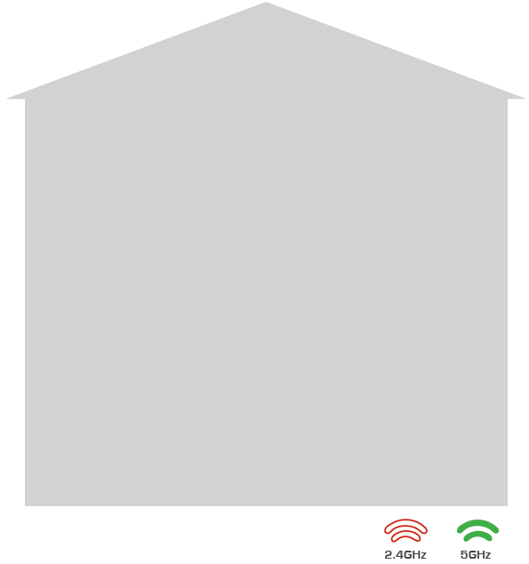



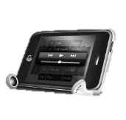


UPnP AV Media Server (DLNA*)
Support in Your House
You can share all the music, movies, photos and videos in SD Card/NAS to the media platforms in different locations.
ROOM 3
ROOM 4
Top Floor
Top Floor
LCD TV
Digital Frame
ROOM 1
ROOM 2
Bottom Floor
Bottom Floor
DIR-657
Music Player
USD Drive
Notes:
* DLNA functionality, not get logo yet.

Slide 11

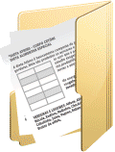



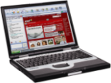

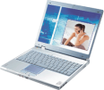
Web File ACCESS*
  Web File Access allows you to use a web browser to remotely access files stored on an SD card or USB storage drive plugged into the router.
Remote
User
Web File Access
DIR-657
Internet
Notes:
* Web File Access feature will support on Phase Ⅱ
* SD card only for read
11

Slide 12
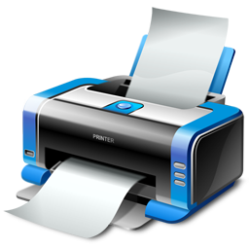


SharePort Plus
  SharePort Plus is an enhancement to SharePort that enables users to share and sync their documents, media files and photos in the USB Disk or SD card slot.
SharePort™
Besides printing, USB Drive /SD card can be file shared!
SharePort™ Plus
DIR-657
DIR-657
Notes:
12

Slide 13

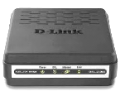

Parental Control provides security shield on your network
Advanced DNS Services
  Auto-correction of common URL typos.
  Blocking phishing websites.
Modem
FamilyShield
  Auto-correction of common URL typos.
  Blocking phishing websites.
  Blocking malware and adult websites.
DIR-657
Parental Control*
  Auto-correction of common URL typos.
  Blocking phishing websites.
  Customizable blocking of botnet and phishing sites.
  Customizable filtering of web content by category.
Notes:
* Needs an OpenDNS account.

Slide 14
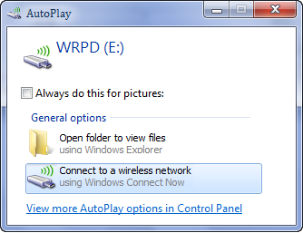

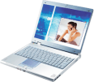
Wi-Pnp
It provides a functionality that router will generate wireless configuration on USB thumb drive for PC setup.
Wi-PnP process steps:
Plug in USB Flash Drive in USB port of router.
Hold the WPS button for 5 seconds.
Wait 10 seconds.
Unplug USB Flash Drive.
Plug USB Flash Drive in Windows Laptop.
Connect to wireless network (using WCN)
or running “WiPnP.exe”.
7. Connected Successfully
DIR-657

Slide 15


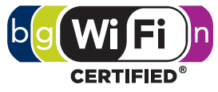
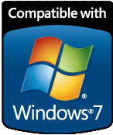

The Specification
Hardware Specifications
  IEEE 802.11n standard Technology, 2x2 single Band
  4 Gigabit Ethernet LAN ports and 1 Gigabit Internet port
  1 USB 2.0 port for MPF Sharing, WCN and Storage devices
  1 SD Card Interface for reader
  WPS (Wi-Fi Protected Setup) PIN and Push Button
Software Features
  File Sharing support
  Intelligent QoS Engine2 support
  UPnP AV Media Server support (DLNA*)
  Parental Control support
  Printer, Scanner, and MFP Sharing support
  Dual Active Firewall support (SPI & NAT)
  IPv6 support
Notes:
* DLNA functionality, not get logo yet.

Slide 16



Rachel Lai / Hans Liu
Wireless & Router Product Division
D-Link Corporation
Tel. +886-2-6600-0123 ext. 5833
Rachel_Lai@dlink.com.tw

