Slide 1
DIR-508L
N300 Portable Router and
Charger
Sales Guide V1.00
Douglas Liu
Jan, 2013

Slide 2
Agenda
Product Introduction
Product Specifications
User Scenario
Selling Points
Competitor Analysis

Slide 3
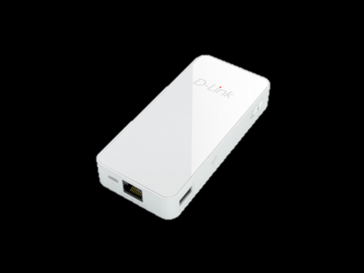
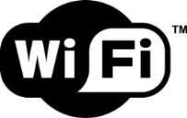
Product Introduction
2-in-1 Functionality - Wi-Fi Router / Hotspot and Power Bank
2.4G (2x2) Fast Wireless speeds up to 300 Mbps
4000 mAh USB Power Bank - Charge most portable devices
Up to 8 hours of continuous operation
mydlink SharePort™ app and SharePort™ Web Access
Embedded Battery allows user to share Internet or multimedia content anytime, anywhere
*IPv6 and DLNA logo available in future

Slide 4
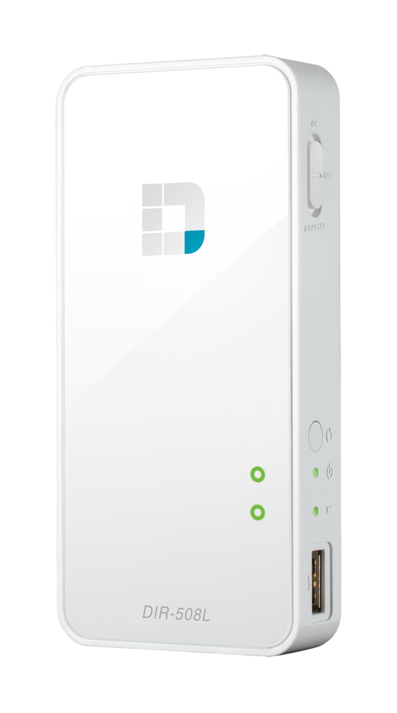
Product Specifications I
Internet Connection Mode
Broadband Router / Mobile Router (3G/4G) / Hotspot Mode
Smart Internet Profile Management allows the DIR-508L to automatically select the Internet connection type
Wireless Performance
2.4 GHz (2x2), Up to 300 Mbps data transmission rate
Flexible Storage
SD
Full SD- SD / SDHC / SDXC
Bus Interface- CLASS6 / CLASS10 / UHS-I
USB
USB 2.0
Type A Receptacle
Fast Ethernet
10/100 Fast Ethernet Internet(WAN) port

Slide 5
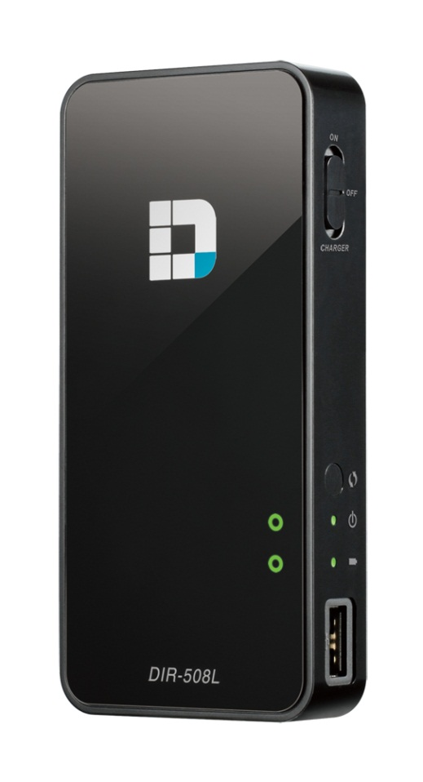
Product Specifications II
Rechargeable mobile battery bank*
High-capacity 4000mAh Li-ion battery
Charge Smart Phones and Tablets
Advanced Applications
mydlink SharePort™ for both iOS and Android devices
Host/Guest Zone administration
DLNA support**
Multiple Operation Modes
On(Router) / Off / Charger
Convenient Power Supply
mini-USB port
Use an adapter or USB port on your PC for convenient recharging
Portable and Easy to Use
Compact unit fits right in your pocket for true portability
*In Charger mode, Max Output 5V, 1A
**DLNA logo available in future
Notes:
DLNA in the future

Slide 6
User Scenarios

Slide 7
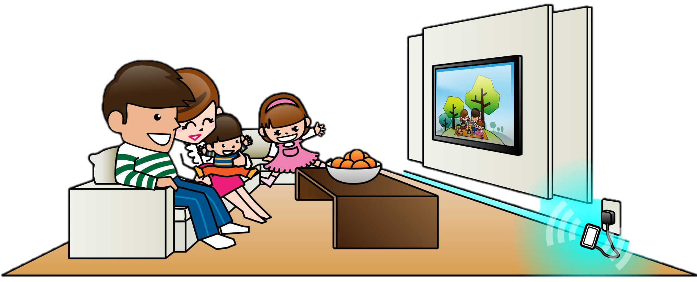
Home
Profile-based Internet Configuration
Detect the Internet type automatically and connect easily with smart internet profile.
Connect to Internet via Home Wireless Router, xDSL/Cable modem without configuration.
Micro-USB charging port
Easily recharge the DIR-508L.
Notes:
No
Scheduled Internet connections
Save money and power when no connection is needed

Slide 8
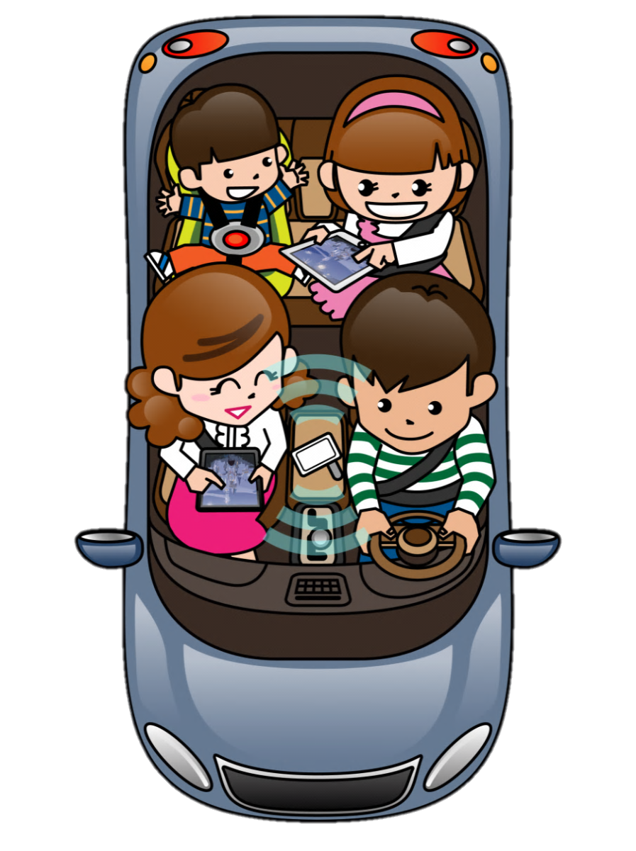
Road Trip
mydlink SharePort™
Share media with friends and family wherever you go.
For both iOS and Android devices
Seamless Mobile Internet
Share a 3G/4G Internet connection*.
*3G/4G adapter is necessary

Slide 9
Out and About
Share your photos instantly!
Share the recent photos in SD card or USB drive with your friends.
No more worrying about battery
Charge your gadgets wherever you are.

Slide 10
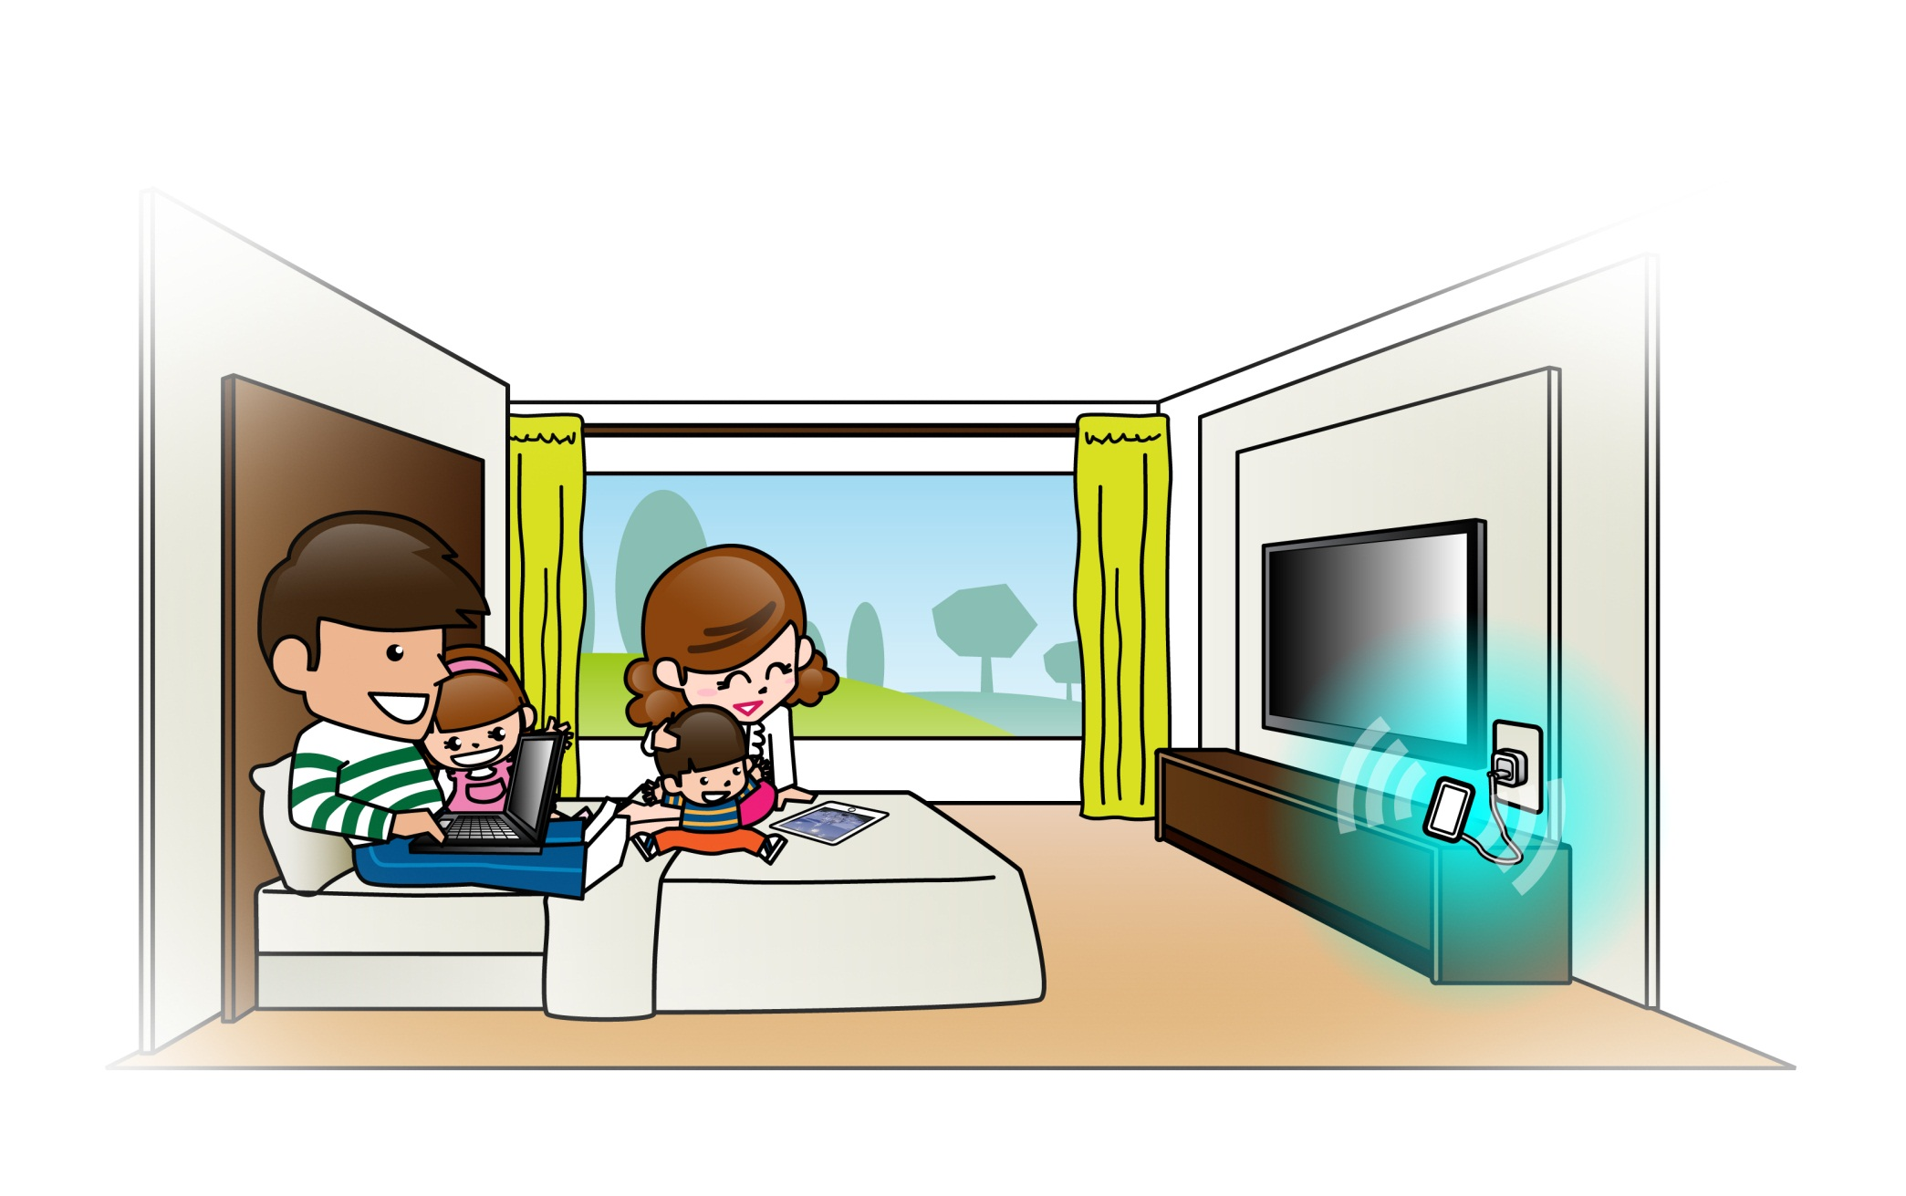
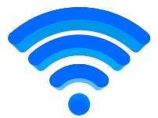
Internet
Hotel
Wi-Fi Hotspot Mode
Share an Internet connection from the hotel room, airport or cafe
Wi-Fi IP: 192.168.0.100

Slide 11
Selling Points

Slide 12
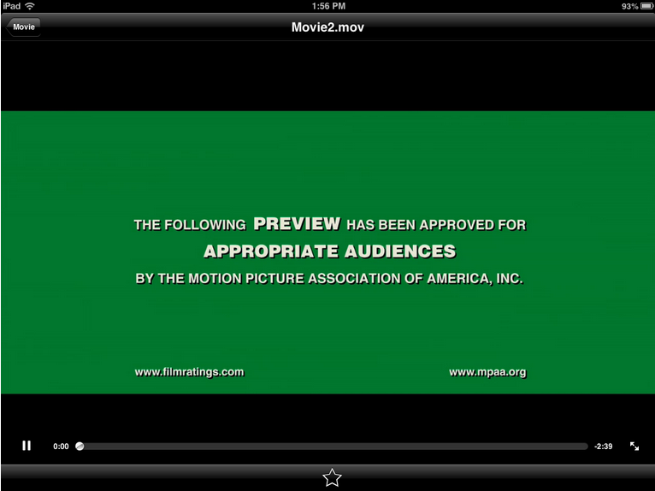
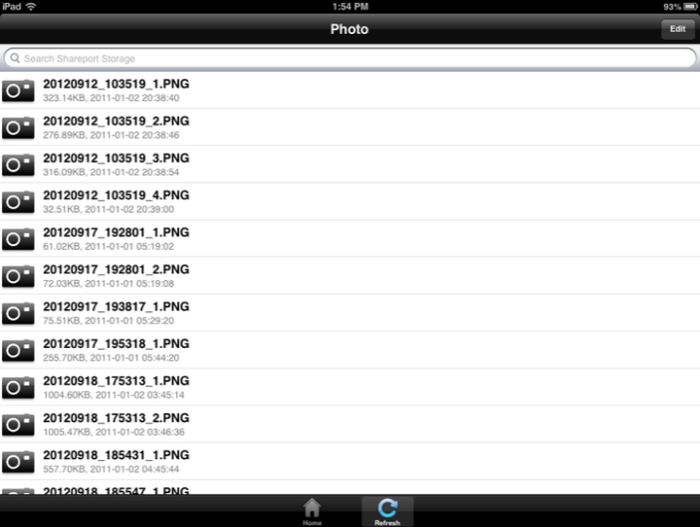
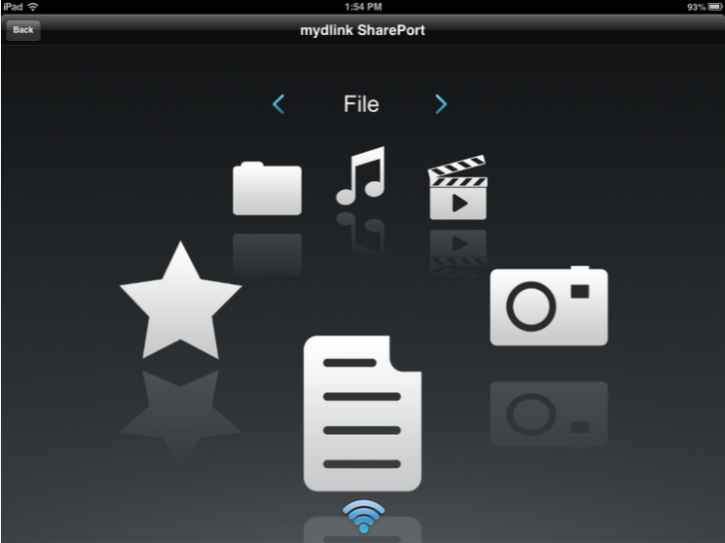
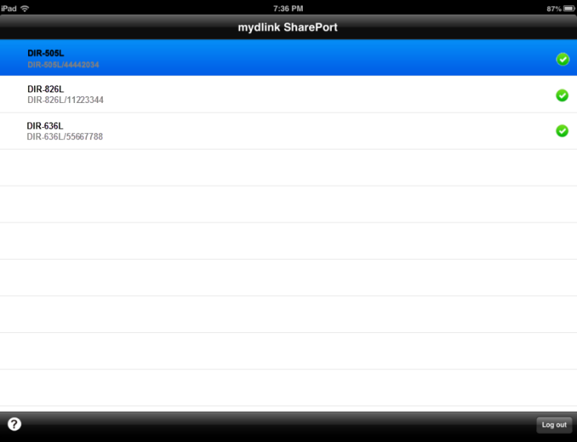
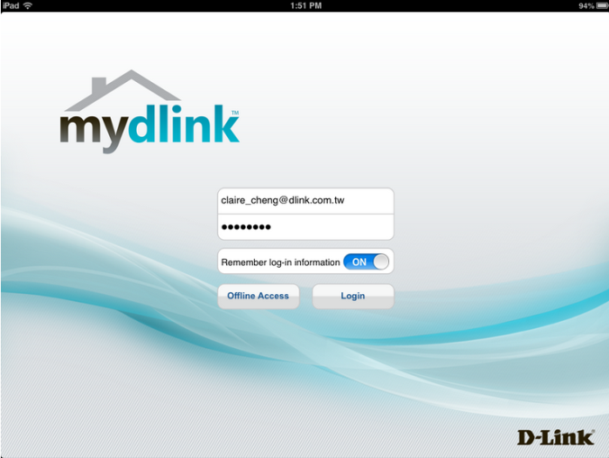
mydlink SharePort™ Mobile App
mydlink SharePort™ app
Remote access with mydlink service wherever you are!
Easy Local access directly.
Supports both iOS and Android devices!

Slide 13
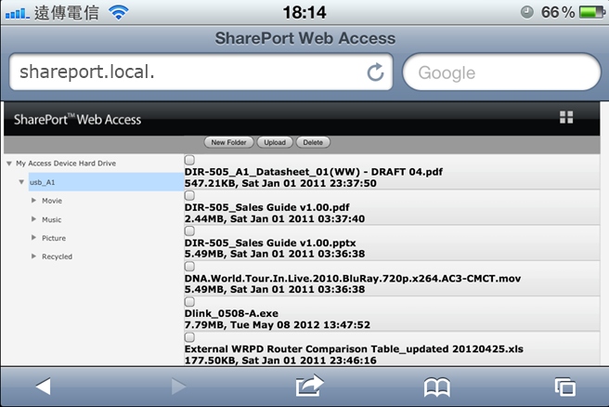
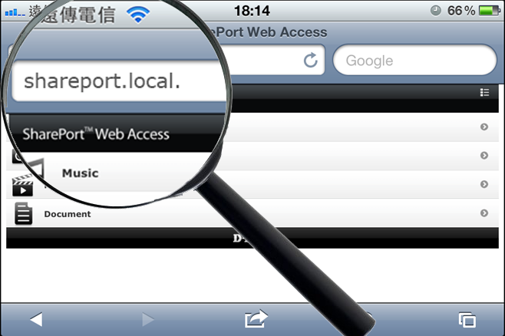
D-Link SharePort™ Web Access UI
TRADITIONAL
FOLDER VIEW
HELPFUL CATEGORY VIEW

Slide 14
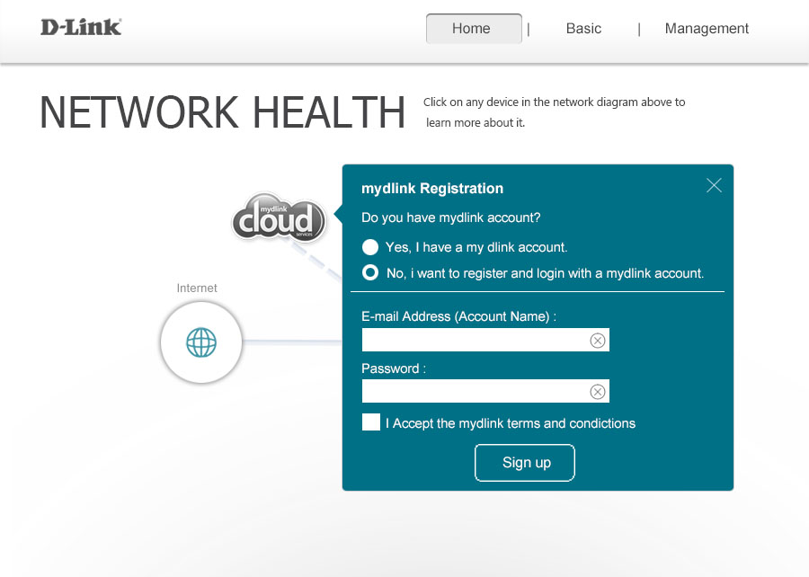
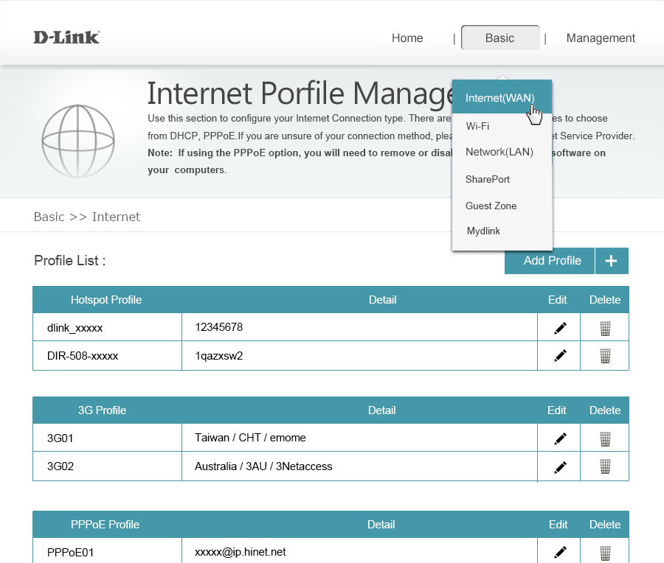
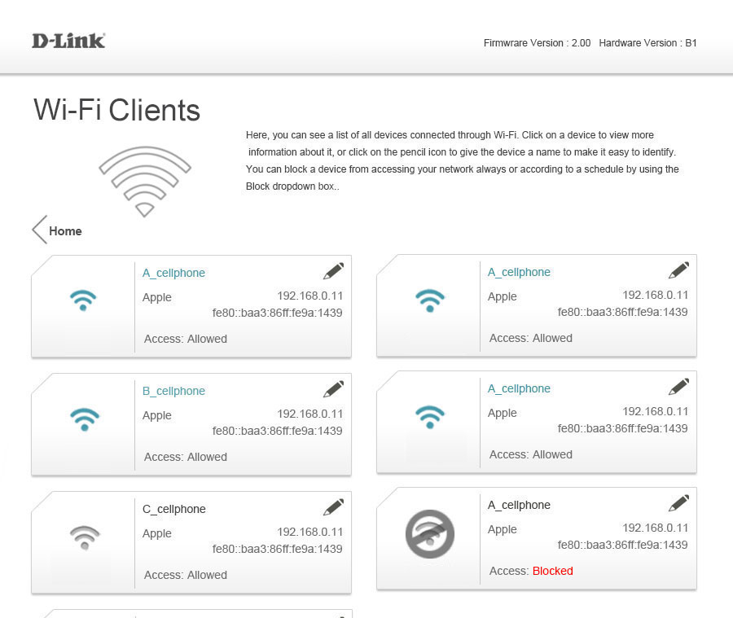
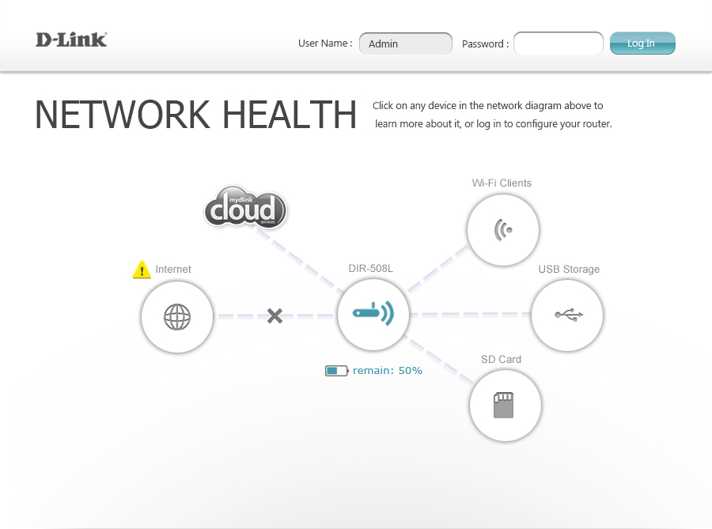
Clear and Simple Web-based User Interface
-Big Screen Devices
Easy-to-understand view of your router’s status!
Easy to set up
Easy to connect
Easy to control

Slide 15
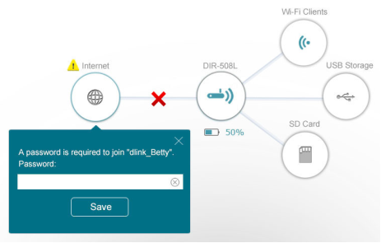
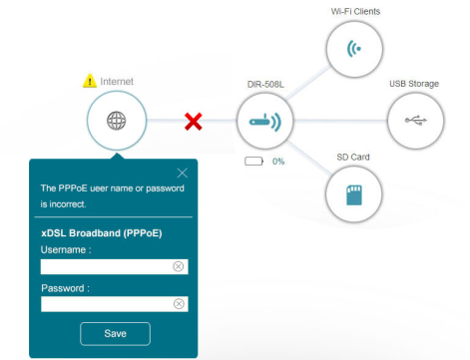
Easy Router Setup Interface
Clearly see what’s missing, and
set it up right away!

Slide 16
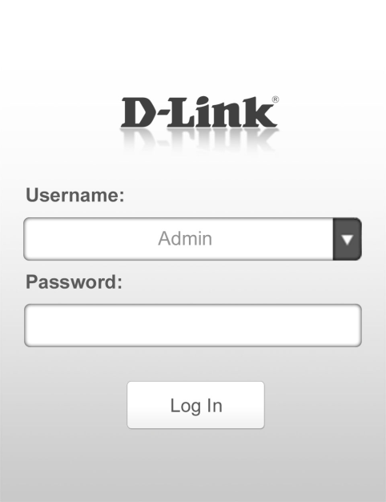
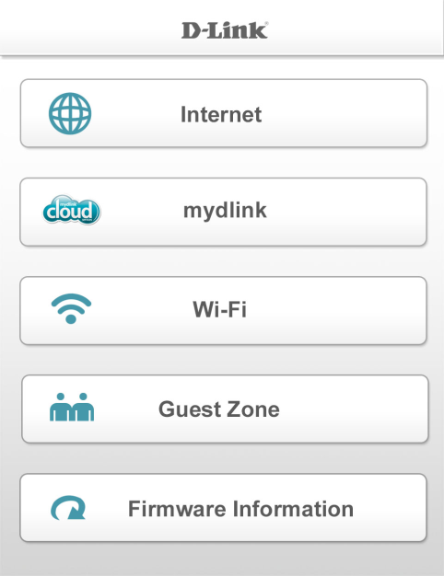
Clear and Simple Web-based User Interface
-Small Screen Devices
Easy-to-understand view of your router’s status!
Easy to set up
Easy to connect
Easy to control

Slide 17
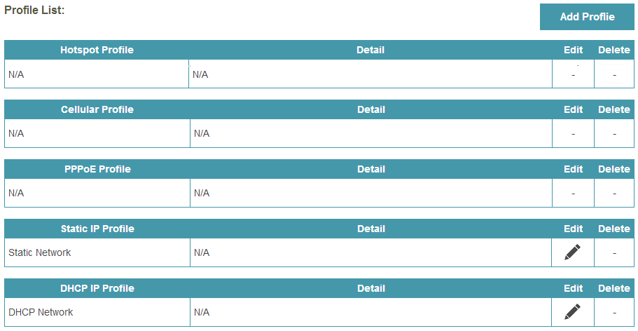
Smart Internet Profile
The Internet Profile Management remembers connection details. Simply connect to the DIR-508L and it will take care of the rest.
Home
Airport
Cafe

Slide 18
Power Bank
4000mAh Portable Power Supply
Built-in 4,000 mAh rechargeable battery, ensuring that even the most demanding users have the power to share a connection and access their files any time.
In Charger mode, it can charge iPad or tablet.
Helpful LED power indicator
Tri-color LED(Green/Orange/Red) shows the current battery level

