Slide 1
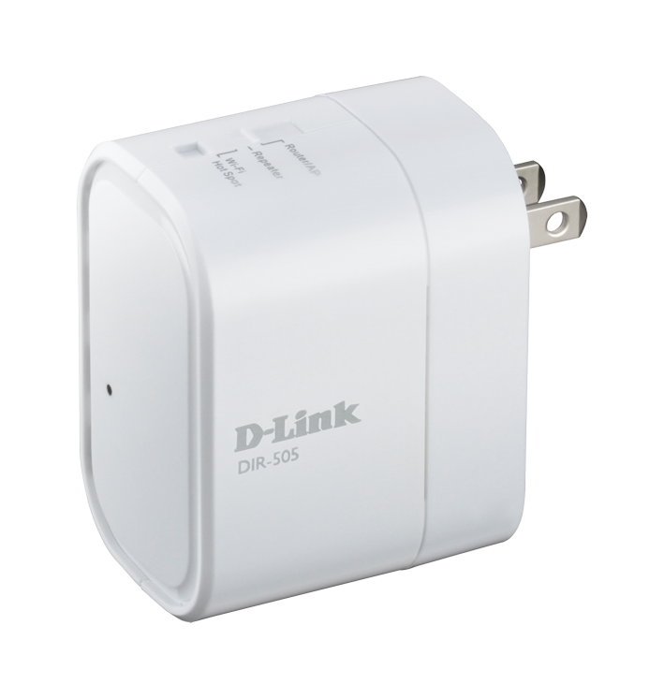
DIR-505 All-in-One Mobile Companion
Global Marketing
April 30, 2012

Slide 2
Index
Market Opportunity
Product Overview
Product Introduction
Product Highlight
Target Audience
Key Selling Points
Key Selling Points Review
Competitive Analysis
Key Selling Points Summary

Slide 3
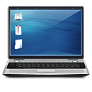
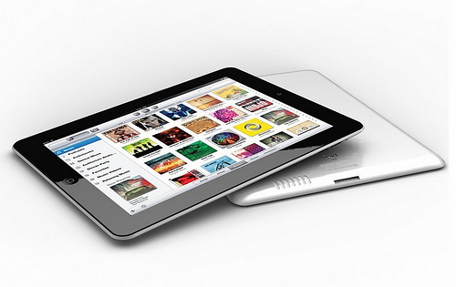
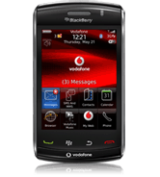
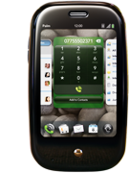
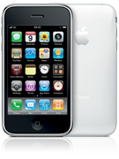
Challenges faced in today’s digital world
What follows the growing demand for mobile phones and cloud services is consumers' desire for constant connectivity.
Increasing numbers of notebooks, netbooks, tablets, and smartphones are booming.
The cost of connecting all these devices to the Internet connection is still high.

Slide 4
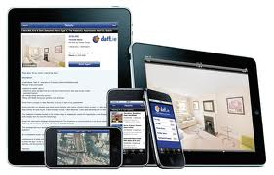
Challenges faced in today’s digital world
Sharing files with mobile devices such as iPhones, iPads, and Android devices can be difficult or troublesome
Sharing files with a large group can also be troublesome, such as sharing a presentation file with audiences.
Traditional routers are not portable enough for travelers and can be messy to set up

Slide 5
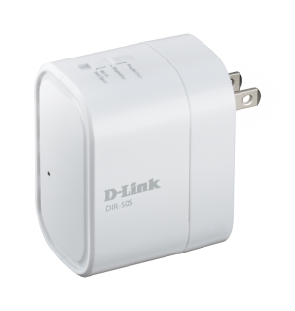
A solution is in sight
The DIR-505 All-in-one Mobile Companion is a compact companion device providing instant Wi-Fi connectivity, convenient file sync, USB sharing, and device charging at home or on-the-go
Share any Internet connection wirelessly
Convenient file sharing
Portable and easy to use
DIR-505
All-in-One Mobile Companion

Slide 6
Index
Market Opportunity
Product Overview
Product Introduction
Product Highlight
Target Audience
Key Selling Points
Key Selling Points Review
Competitive Analysis
Key Selling Points Summary
0

Slide 7
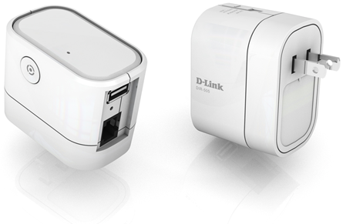
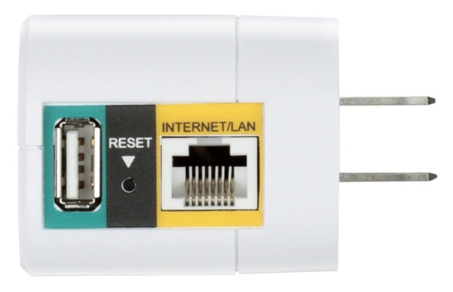
Product Introduction
The DIR-505 All-in-one Mobile Companion is a portable plug-in router that lets you share your Internet connection and your files all from a compact device that fits in your pocket.
Tiny yet versatile, it gives you all the functionality of a router, access point, wireless repeater, and network storage drive in a device that fits in the palm of your hand.

Slide 8
Target Audience
Broad
Male or female
25~55 years old
Traveling smartphone and tablet owners
Owns a lot of contents to view/share.
Has more than two mobile devices, eg. laptop, smart phones, or tablets
Specific
Mobile Professionals
Home Owners

Slide 9
Index
Market Opportunity
Product Overview
Product Introduction
Product Highlight
Target Audience
Key Selling Points
Key Selling Points Review
Competitive Analysis
Key Selling Points Summary
0

Slide 10
Key Selling Points
Multiple Modes for All Your Need
SharePort Mobile: Easy File Sharing
Home and Travel Friendly Design
Easy to Set Up, Easy to Use

Slide 11
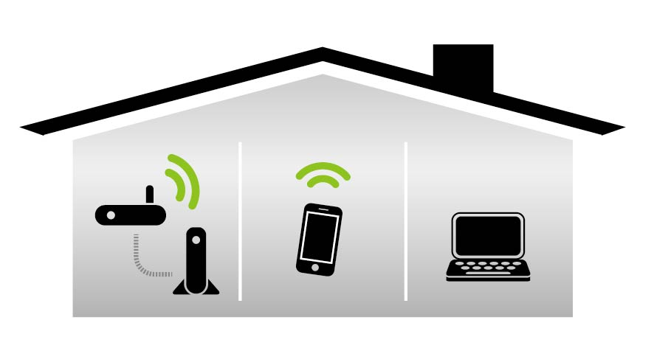
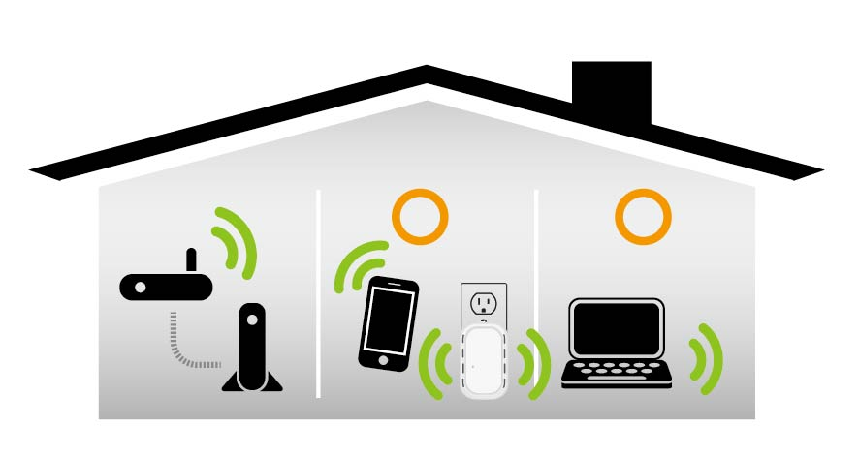
Multiple Modes for All Your Needs
At Home
Share your broadband Internet connection with your home by connecting it to your cable or DSL modem with Router Mode
Extend your existing wireless router’s coverage with Repeater Mode to help provide wireless to rooms with poor signal
Without DIR-505
With DIR-505
Notes:
Need to fix diagram

Slide 12
Multiple Modes for All Your Needs
At the Office
Share your Internet connection with an entire office by using Router Mode.
Set up a private wireless network for you and your colleagues with Access Point Mode
Notes:
Need to fix diagram

Slide 13
Multiple Modes for All Your Needs
When Away
Share a paid WiFi hotspot connection with multiple devices and people, saving money
- Share Internet access with colleagues during a power lunch at a cafe
- Share Internet access for all your travel companions at the airport
- Use both your laptop and smartphone to access the Internet when at a hotel
Provides an extra layer of security when connecting to public hotspots
Airport
Cafe
Hotel
Notes:
Show

Slide 14
SharePort Mobile: Easy File Sharing
Create a shared storage space by connecting a USB storage drive to the DIR-505
Upload and download photos, music, videos, documents, and other files
… through the SharePort Mobile app (iOS, Android)
…through an easy to use web interface
Secure, yet easy to access
Available to any device connected to the DIR-505
Password protected

Slide 15
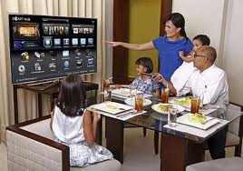
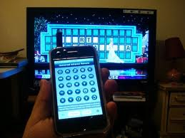
SharePort Mobile: Easy File Sharing
At Home
Stream your digital media library such as photos, music, and videos to other devices for playback. - …to your PC in the study - …to your TV or game console in your living room - …to your mobile device anywhere in your home
You can upload photos and videos from your Camera Roll on your iOS device to your shared storage space, making it easy to share them with your family.

Slide 16
SharePort Mobile: Easy File Sharing
At the Office
Create a shared storage space for your entire office
Share presentation files with an audience quickly and easily
- No need to pass around a USB flash drive with your files on it
View shared documents directly on your iPad or other mobile device.
- Word, Excel, PowerPoint, PDF, etc.

Slide 17
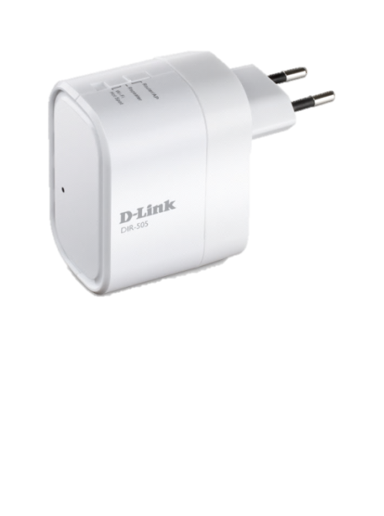
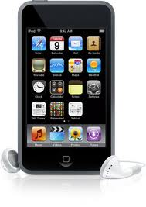
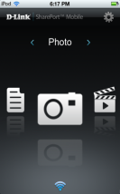
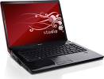
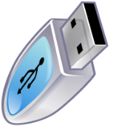
SharePort Mobile: Easy File Sharing
When Away
Back up travel photos and videos taken with your mobile device to your shared storage space
Share your travel photos and videos with your friends
Easy access to your digital media library wherever you are
Stream files directly from the DIR-505 to save storage space on your mobile device
Iphone/ Ipad
PCs & Laptop
TVs & Gaming Counsels & Media Devices

Slide 18
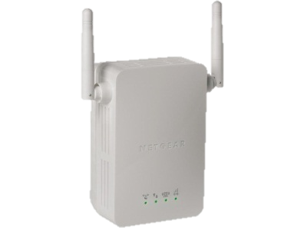
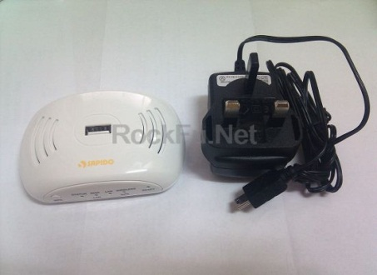
Home and Travel Friendly Design
At Home
Innovative one-piece design does away with unnecessary cables for a clean installation; just plug it in
Pluggable design doesn’t block nearby outlets
Blends into your home’s environment, giving you functionality without getting in the way
Tiny Design
One-Piece
DIR-505
2.68 x 1.65 x 2 in
Competitor
4.41 x 2.91 x 1.77 in
Competitor: With AC Charge
DIR-505

Slide 19
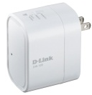
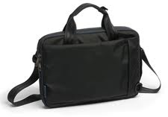
Home and Travel Friendly Design
When Away
Compact design fits in the palm of your hand and fits easily in your pocket or laptop bag
No cables required means no cables to pack
Usable worldwide with support for both 110-120V and 220-240V power outlets
Can be used as a USB charger, allowing you to leave your smartphone chargers at home

Slide 20
Easy to Set Up, Easy to Use
Easy to configure thanks to a built-in Setup Wizard that guides you step by step through the setup process
You can also set up the DIR-505 without a PC by using the friendly QRS Mobile app for iOS devices
Connect your wireless devices automatically at the press of a button with WPS support
After initial configuration, just plug it in anywhere to instantly set up your personal wireless network

Slide 21
30 Second to sell DIR-505
SharePort Mobile: Easy File Sharing
Easy to Set Up, Easy to Use
Multiple Modes for All Your Needs
Home and Travel Friendly Design

