Slide 1
Sales Guide
DCS-6112
DCS-6113
Full HD Fixed Dome Network Camera
Version 1.01
D-Link HQ, June. 2011
D-Link Confidential

Slide 2
Before Getting Started – The Model
DCS-6112 & DCS-6113 are positioned as new generation of business camera that involve many new initiatives:
  First Full HD resolution dome Camera.
  Equipped with Full HD+H.264 spec mix as one of major product range.
  Apply the Advanced web interface.
  One of the key attraction for channel development and project penetration thanks to its popularity and competitive pricing.

Slide 3


Table of Content
Product Highlight
  Positioning Overview
  Target Market
  Selling Point
Competition Analysis
  Competition Mapping
  Sell Against Competition
  Uniqueness Highlight
    Advanced Web Interface
    GPIO Connection
  Technology Brief
Product Deployment Guide
Notes:
3

Slide 4






Product Highlight
Positioning Overview
FullHD
WDR
Sony
Exmor
DCS-6513
1/3” 3 Megapixel CMOS
H.264. MPEG4, MJPEG
1080P @ 30 fps (max.2048X1536 )
WDR, two-way Audio
20Meter IR, IP66/Vandal proof,
Remote focus
HD
WDR
Sony
Exmor
DCS-6511
1/3” 1.3 Megapixel CMOS
H.264. MPEG4, MJPEG
720P @ 30 fps (max.1280x1024 )
WDR, two-way Audio
20Meter IR, IP66/Vandal proof, Remote focus
Outdoor
Full HD
DCS-6510
1/4” VGA CMOS
H.264, MPEG4, MJPEG
640x480 @ 30 fps
two-way Audio, 20Meter IR, IP66/Vandal proof
DCS-6210
1/2.7” CMOS
H.264, MJPEG
720P @ 30 fps (Max. 1080P @ 15fps)
Compact, MicroSD slot
Rugged, IP66
WDR
DCS-6111
¼” VGA WDR CMOS
MPEG4, MJPEG
VGA @ 30 fps
PoE, 3GPP,3-axis, 20Meter IR
Full HD
DCS-6113V
Same with DCS-6113
Vandal proof
DCS-6113
1/2.7” CMOS
H.264, MPEG4, MJPEG
720P @ 30fps
(Max. 1920x1080 @ 15 fps )
two way audio
3-axis, MicroSD slot
10Meter IR
DCS-6114
1/4” CMOS
H.264, MPEG4, MJPEG
720P @ 30fps
3-axis, MicroSD
10Meter IR
Intelligent Video
DCS-6410
1/3” CCD
MPEG4, MJPEG
D1 @ 30 fps
2-way audio, PoE, 3GPP, 15Meter IR
Indoor
Full HD
DCS-6112
1/2.7” CMOS
H.264, MPEG4, MJPEG
720P @ 30fps
(Max. 1920x080 @ 15 fps )
two way audio
3-axis, MicroSD slot
DCS-6110
¼” VGA CMOS
MPEG4, MJPEG
VGA @ 30 fps
PoE, 3-axis
Available
In Development
In Plan
Q1 / 2011
Q2 / 2011
Q3 / 2011
Q4 / 2011 & 2012~
[ Mar. 2011 Update ]
Notes:
4
During play the slide, you can link to the feature highlight page for detail and return to the roadmap page.

Slide 5

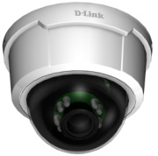
Product Highlight
Positioning Overview
Mainstream HD H.264 fixed dome camera.
Indoor capability with compact design and affordable price.
HD resolution as new industry-standard (aspect ratio: 16:9) provides a significant advantage over competition with future-proof advantage.
DCS-6112
DCS-6113
PoE
802.3af
Day & Night
10M IR, ICR
(DCS-6113 only)
Full HD
1920x1080
Storage
1920x1080
H.264
30fps/720p

Slide 6
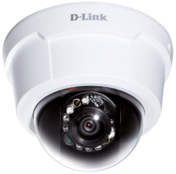






Product Highlight
Target Market
Full HD
H.264
Indoor application
IR Illumination (10M, DCS-6113 only)
PoE
DCS-6112
DCS-6113
Retail
Residential
Commercial
Education
Healthcare
Government
All entrances
Security zone
Public corner
Warehouse
All entrances
Perimeter
Public corner
Private garage
All entrances
Lobby
Security zone
Public corner
Warehouse
Factory plant
All entrances
Public corner
Perimeter
Warehouse
All entrances
Lobby
Security zone
Public corner
Perimeter
Warehouse
All entrances
Lobby
Security zone
Public corner
Perimeter
Warehouse

Slide 7

IPv6
Product Highlight
Selling Point
Triple codec (H.264, MJPEG, MPEG-4) supports all VMS integration.
Full HD 1080P 15 FPS , HD 720P 30fps.
True day & night by IR-cut filter (ICR) with 10M IR coverage. (DCS-6113 only)
SD local storage for event recording.
Tamper Detection that notify when tampering occurred.
ONVIF Compliance.
Advanced camera web interface that eases the installation.
Simultaneous four (4) profiles feed specific stream for each app.
HTTPS streaming allows reliable and secure connection.
IPv6, 802.1x, QoS, CoS equipped for advanced transmission.
Accessible HTML code for live streaming that redirects to web server viewing.
Supporting features
  1/2.7” Megapixel progressive CMOS sensor
  Build-in fixed lens 4mm, F2.0
  10M IR illumination distance (DCS-6113 only)
  Power over Ethernet (PoE)
  2-way audio support
  Digital input/output
  3GPP mobile surveillance
  Support privacy mask function
Notes:
Albert’Backup note:
6. Privacy mask (zone) that secure the special area of the view without privacy concern.

Slide 8
Table of Content
Product Highlight
  Positioning Overview
  Target Market
  Selling Point
Competition Analysis
  Competition Mapping
  Sell Against Competition
  Uniqueness Highlight
    Advanced Web Interface
    GPIO Connection
  Technology Brief
Product Deployment Guide
Notes:
8

Slide 9
Uniqueness Highlight
Advanced Web Interface
  Background
  The Advanced web interface is created to ease the configuration by clear and compact user interface which dramatically increases the usability, friendliness and professional experience as new generation offering.
  Compliance
  DCS-6112/6113 is the third model (SKU) that adopt the Advanced web interface and all upcoming models will also comply as the Advanced one.
  In addition, the web interface for all available models, except DCS-6112/6113 is categorized as standard edition as for following comparison in this material.

Slide 10
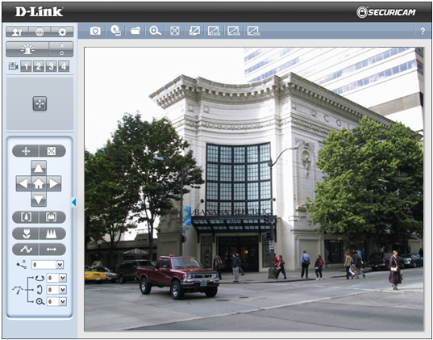
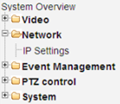

Uniqueness Highlight
Advanced Web Interface
Comparison: Advanced v.s. Standard
Color Tone
Blue and grey
(As D-Link business switch for consistent and professional look & feel)
Black and orange
Button
Function button by icon
(Simple and easy for multi -lingual interface)
Describe functions by word
Layout
Tree view menu
(Intuitive as common tree view interface)
Main function list is in the top and sub-function is in left side
Advanced
Standard
Notes:
10

Slide 11

Uniqueness Highlight
Advanced Web Interface
Key Improvement of Advanced Web Interface
Graphic interface
Intuitive design by mouseover for description of each button.
Tree view menu
Another intuitive design that gives all configuration and setting with ease and clear guidance.
Multi-lingual support
English, French, German, Spanish, Italian
Help hint
A special feature that assist user in every step/ page of configuration by simply click button at upper right of each page to get associated support.
Notes:
11

Slide 12
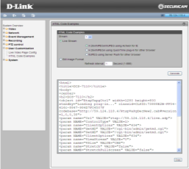
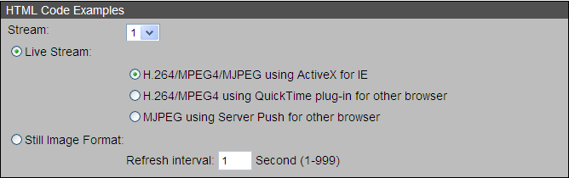
Uniqueness Highlight
Advanced Web Interface
Accessible HTML Code for Live Streaming
    To access the HTML code by selected stream and paste to embed the live streaming to dedicated web page for live video.
  ❶
  ❷
  ❶Choose the configuration
  ❷Get the example code
HTML example code
  ❸Copy the code the your own webpage
<html>
<title>DCS-6112</title>
<body>
<center>
<h2>DCS-6112</h2>
<object id="RtspVapgCtrl" width=1280 height=800 standby="Loading plug-in..." classid=CLSID:73888E2B-FF04-416c-8847-984D7FC4507F codebase="http://59.124.118.4/RtspVaPgDecNew2.cab#version=1,0,0,38">
Notes:
12

Slide 13
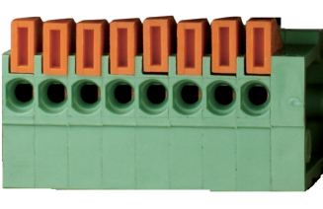
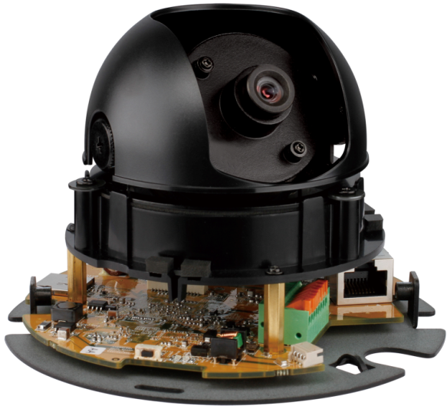
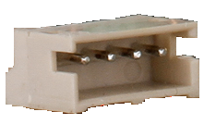
Uniqueness Highlight
GPIO Connection
GPIO, the General Purpose Input/ Output connection which provides unified interface for external connection.
  Useful
  Audio in/out for 2-way audio; DI/DO for external device
  Unified
  Video output for analogue video;
  DC12V input
Notes:
13

Slide 14
Table of Content
Product Highlight
  Positioning Overview
  Target Market
  Selling Point
Competition Analysis
  Competition Mapping
  Sell Against Competition
  Uniqueness Highlight
    Advanced Web Interface
    GPIO Connection
  Technology Brief
Product Deployment Guide
Notes:
14

Slide 15
Technology Brief
Video Management
    HD
    H.264
    IR Illumination
    Privacy Mask
    ePTZ
Network Protocol
    ONVIF
    IPv6
    HTTPS
    LLTD
Event Management
    Tamper Detection

Slide 16
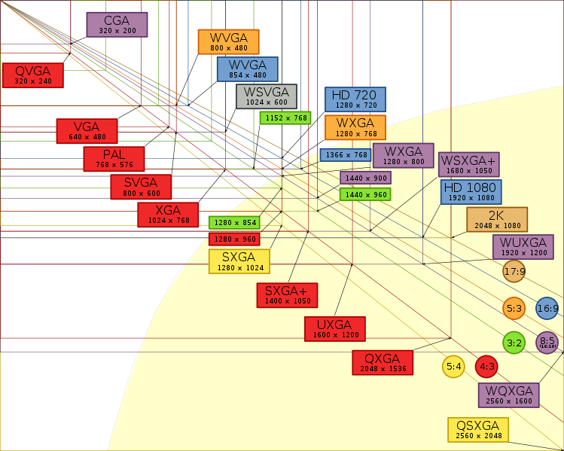
Technology Brief
Video Management
HD Resolution
HD, the High Definition video is commonly been adopted as mainstream video standard from vast video categories, such as digital TV, computer monitor, gaming, filmmaking, and also video surveillance.
Pixel of HD
  1280 x 720 (720p)
  1920 x 1080 (1080i/ 1080p)
Aspect Ratio: 16:9
End-to-end resolution
  Video quality is ensure from camera to monitor as same high quality only by HD.
  Except HD, all other resolution, even higher megapixel ones will end up with letterboxed, pillar-boxed, window-boxed from viewing.
Future-proof standard
  HD is the mainstream which outpace even the non-HD megapixel range.
Source: en.wikipedia.org/wiki/File:Vector_Video_Standards2.svg
Notes:
16

Slide 17
Technology Brief
Video Management
H.264 Advantage
    H.264, aka MPEG-4 Part 10, or MPEG-4 AVC (Advanced Video Coding), becomes the mainstream compression technology since 2010.
    Better video quality than MPEG-4 with far less bit rate (approx. 50% less, 80% less than M-JPEG).
    Thus, less bandwidth and less storage are required, best suit for limited bandwidth and long term storage.
  * M-JPEG and MPEG-4 are widely known as mainstream compression for years, and still the dominant for many video management systems nowadays, but obviously, the trend is embracing H.264 as majority for next move.
Notes:
17

Slide 18

Technology Brief
Video Management
H.264 Quality
  The improved compression performance of H.264 comes at the price of greater computational cost. H.264 is more sophisticated than earlier compression methods and this means that it can take significantly more processing power to compress and decompress H.264 video.
  A video frame compressed at the same bit rate compared as below figures:
MJPEG
(same bit rate 512k)
MPEG4
(same bit rate 512k)
H.264
(same bit rate 512k)
* Picture source: Vcodex White Paper: An overview of H.264
Notes:
18

Slide 19
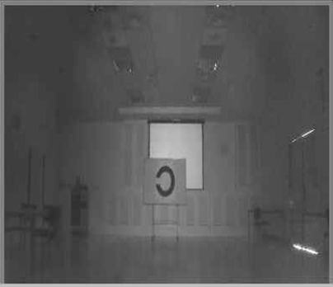
Technology Brief
Video Management
IR Illumination
  DCS-6113 equipped with 8pcs IR LEDs is aimed to create a clearer night vision that extend the night time performance.
  Below is the comparison of on and off that the IR illumination performed.
  Distance to object:10 meter
  Environmental lighting: Indoor
(LED ON, Night mode)
Notes:
19

Slide 20
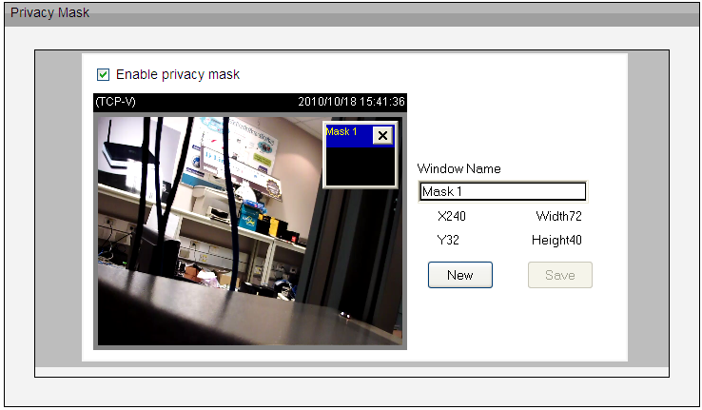


Technology Brief
Video Management
Privacy Mask
  User could easily frame the sensitive zone from the image with black out effect that prohibit all streaming with this privacy mask setting.
  Up to Five (5) areas are supported.
  In associated with Motion Detection, area under privacy mask will be motion-detection-free.
Notes:
20

Slide 21




Technology Brief
Video Management
  ePTZ
  Thanks to digitalization, ePTZ allows user to zoom in to target area or object to see more detail than normal viewing.
  In addition, click and drag to move the closer view to any other area from the original image is easy and simply on your finger tip.
  Especially suit for HD and above.
Full view of video
Pan, tilt and zoom to bottom left by ePTZ
Pan, tilt and zoom to bottom right by ePTZ
Notes:
21

Slide 22

Technology Brief
Network Protocol
ONVIF standard
  ONVIF, the Open Network Video Interface Forum, is an open industry forum for the development of a global standard for the interface of IP-based physical security products.
  How you can benefit from ONVIF
  A global interface standard will make it even easier for end users, integrators, consultants and manufacturers to take advantage of the possibilities offered by network video technology.
Visit ONVIF official website for more detail: www.onvif.org
Notes:
22

Slide 23
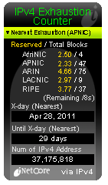
Technology Brief
Network Protocol
IPv6
  IPv6, Internet Protocol version 6, as upcoming generation of internet layer protocol for packet-switched networking which will relief the exhaustion of IP address from current IPv4.
  IPv4 address is going to run out in 2011.
  DCS-6112 and DCS-6113 supports IPv6 to meet coming demand.
IPv4
2³² addresses
IPv6
2¹²⁸ addresses
Source: IPv4 Address Report
Notes:
23

Slide 24
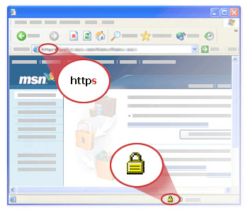
Technology Brief
Network Protocol
HTTPS for network security
  HTTPs, the Hypertext Transfer Protocol over SSL/ TLS (Secure Socket Layer and Transport Layer Security), which is used to provide a secure identification by encrypted connection between web server and client.
  HTTPS is normally used in transaction of payment or access of confidential information with URL begin with “https://” at port 443, instead of HTTP at port 80.
Notes:
24

Slide 25
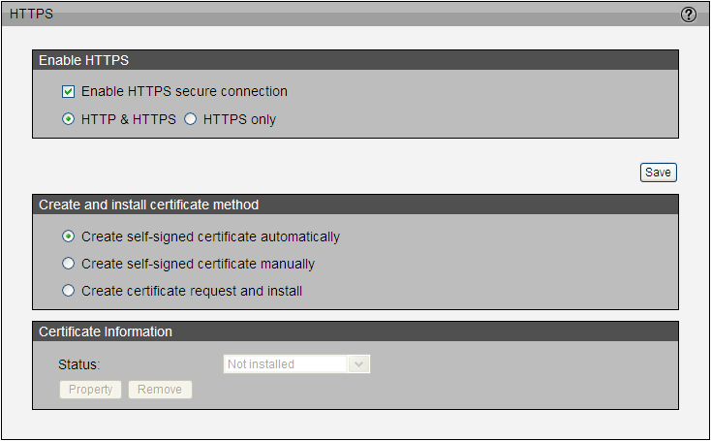
Technology Brief
Network Protocol
HTTPS for network security (cont.)
  The HTTPS can’t be enabled if there is no any certificate on the device.
  Three (3) options to enable the HTTPS:
    Create self-signed certificate automatically,
    Create self-signed certificate manually, and
    Create certificate request and upload the certificate file which is signed by third party already.
Notes:
25

Slide 26
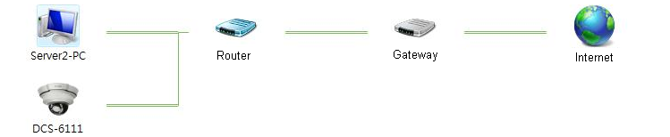

Technology Brief
Network Protocol
LLTD
  LLTD, the Link Layer Topology Discovery, is a proprietary Link Layer protocol for network topology discovery and quality of service diagnostics. It was developed by Microsoft as part of the Windows Rally set of technologies. The LLTD protocol operates over both wired (IEEE 802.3 Ethernet) as well as wireless (IEEE 802.11) networks.
  A future-proof feature that support easy network topology management.
  Supported platform: Windows Vista, Windows 7
  Not supported platform: Windows XP
DCS-7110
Notes:
26

Slide 27
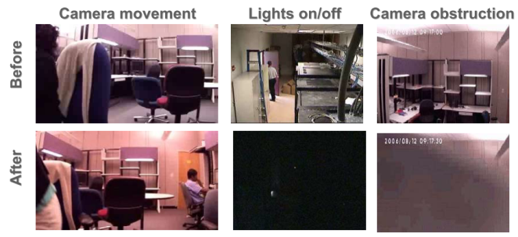

Technology Brief
Event Management
  Tamper Detection
  Tamper Detection can respond to tamper event as trigger to associated event management that provide timely response than ever.
  Detection scope: redirect of camera, defocused, image blocked or spray-printed of the front cover.
  Best suit for location that would be exposed to any tampering, i.e., vehicle, school, sport stadium, prison, banking, luxury house, etc.
Redirect of camera
Defocused
Image blocked
Before
After
Alert
Notes:
27

Slide 28



Technology Brief
SD Card Storage
  Event recording / backup recording
  SD card record supports recording of event trigger from Motion Detection, Tamper Detection and DI.
DI triggered
Tamper detected
Motion detected
Video Clips
Snapshot
Notes:
28

Slide 29
Table of Content
Product Highlight
  Positioning Overview
  Target Market
  Selling Point
Competition Analysis
  Competition Mapping
  Sell Against Competition
  Uniqueness Highlight
    Advanced Web Interface
    GPIO Connection
  Technology Brief
Product Deployment Guide
Notes:
29

Slide 30
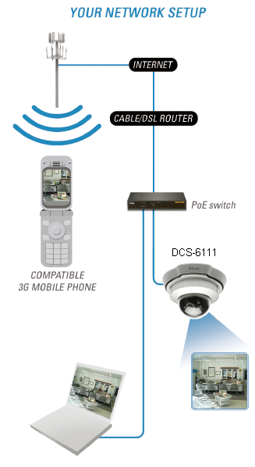



Product Deployment Guide
Application Diagram
PIR sensor
DCS-6112 DCS-6113
DI
DO
Buzzer
Notes:
30

Slide 31
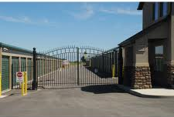


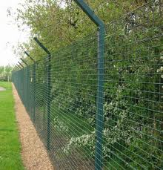
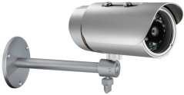





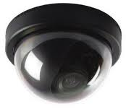

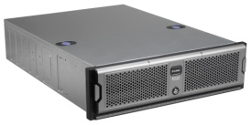


Product Deployment Guide
Application Example
Speed Dome
DCS-6815 (18x)
DCS-6817 (30x)
DCS-6818 (36x)
PoE Switch
DES-1228P
DES-1210-28P
DGS-1210-10P
Outdoor Box
DCS-7410 (30M IR)
DCS-7510 (50M IR)
Entrance gate
Perimeter
Outdoor IR Box
DCS-7110 (HD,H.264)
Indoor Dome
DCS-6112 (2M, H.264)
DCS-6113 (2M, H.264, 10M IR)
Warehouse
VIP Area
Fixed Box
DCS-3710
(1.3M, H.264)
Security Room
Legacy Analog Camera
Video Encoder
DVS-210-1 (MPEG-4)
DVS-310-1 (H.264)
IP SAN Storage
DSN-1100-10
(Tower, 5-Bay, 4GbE)
DSN-2100-10
(2U, 8-Bay, 4GbE)
DSN-3200-10
(3U, 18-Bay, 8GbE)
9-ch NVR Appliance
DNS-722-4 (Basic)
DNS-726-4 (Pro)
VMS Software
DCS-210 (8 ch, upcoming)
DCS-220 (32 ch)
DCS-230 (64 ch)
Legend:
Coax
Ethernet/ PoE
Notes:
31

